Slide 1
Physical Randomness Extractor
Xiaodi Wu (MIT)
x
device
Ext(x,0)
Ext(x,s_{i})
…….
…….
uniform-to-device
Gordon Research Seminar
Decouple
…….
Decouple
…….
Stonehill College, July, 2014
Z₁
Z_{i}
Z_{i+1}
$$\overline{Z}=⨁_{i=1}{Z_{i}}$$
Eve
$$⊗$$
uniform-to-all
Joint work with Kai-Min Chung (Sinica, Taiwan) and Yaoyun Shi (U Michigan)
Plenary talk at QIP 2014, also available at arXiv: 1402.4797v2.

Slide 2
What it is about?
Theoretical Work! However, welcome inputs from experimentalists!
Motivation: practical applications of quantum devices.
Task: Generating Uniform Bits with minimal Assumptions.
(weak source, device-independent, quantum-secure,
noise-resilient, efficiency……)
Physical Implication:
deterministic world v.s. truly random world
“Freedom-of-Choice” loophole in Bell tests:
the strongest known method to mitigate it
Notes:
“theoretical” is overloaded so much. That I should say a Computer Scientist’s view!

Slide 3
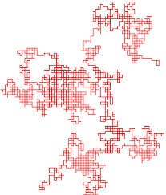
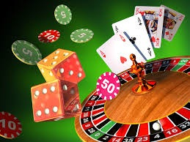
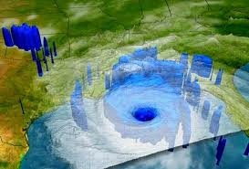
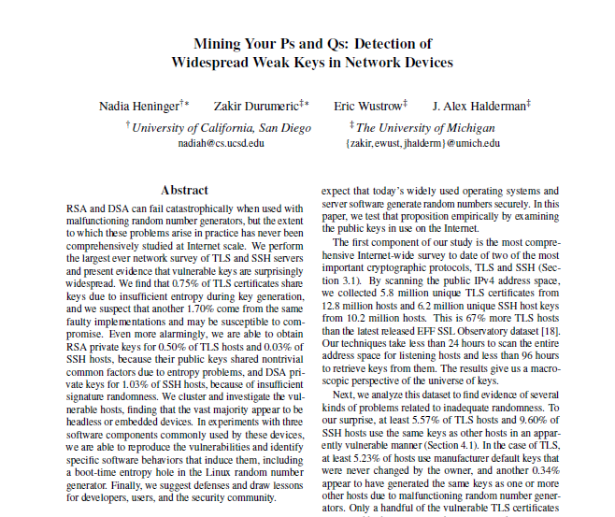
Randomness: THE PROBLEM
Versatile & Precious
Applications: Digital Security, Randomized Algorithms
Gambling, Statistics, Politics, …….
Not always getting it !!!
according to recent CS security studies:
“… that secure random number generation continues to
be an unsolved problem in important areas of practice…”
Resilient to various scenarios: generating randomness with minimal assumptions.
Efficiency, Randomness Quality, Noise-Resiliency, etc..
Notes:
don’t need to emphasize how important randomness is
Evidences from CS show the decades old problem is new!!
Least Assumptions!!!

Slide 4
How can we be sure it’s random?
How could fundamentally unpredictable
events possible?
Notes:
Before we try to tackle our task, we need to ask ourselves this more fundamental question?

Slide 5
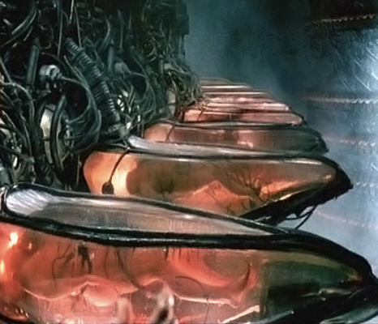
We can’t be sure … without believing first of all its existence
One POSSIBILITY:
a deterministic “matrix” world!

Slide 6
Weak Random Sources: in non-deterministic world
Min-entropy Sources: a random variable
(=) - log (the maximum probability of guessing x sampled from X correctly).
Quantum (=) - log (the maximum probability of guessing x sampled from X correctly w/
the help of quantum side information). e.g. measure & predict
A general measure of the randomness. Capture arbitrarily weak sources.
Capture the amount of uniform bits that can be extracted via classical means.
Non-deterministic World
Non-Zero Min-entropy
Weak Min-entropy Sources
Notes:
Choose to model weak sources as min-entropy sources in non-deterministic world!

Slide 7
Classical Solutions: Extractors
who holds side information
Either Independent short
uniform Seed
Min-entropy Sources
Adversary
deterministic
function
Extractor
Uniform Bits
Or Independent other
min-entropy sources
$$⊗$$
Min-entropy Sources
Adversary
IMPOSSIBLE if no INDEPENDENCE assumption is made!!
However, independence cannot be verified and hard to guarantee!!
GOAL: generate uniform bits with minimal assumptions!!
Notes:
Independence bad, and our goal is to do with minimal assumptions. Not so good for us!

Slide 8
Solutions based on Quantum Mechanics
A Beam Splitter!
Notes:
And those two lines look very suspicious to theoretical people!

Slide 9
CONCERNs : impose many assumptions implicitly
“officially certified” -> a trusted third party. Too strong assumption!
How can “officials” be confident about devices? (Control of devices)
“Classical” Human being probe Quantum devices.
Is current quantum technique reliable?
A more fundamental issue: Randomness from Quantum Mechanics?
YES? If Quantum mechanics explains the inner-working of Nature
NO! If QM is incomplete: e.g. existence of a deterministic alternative
An implicit assumption here: QM completely explains the inner-working
Too strong assumption!
Notes:
Concerns in the perspective of a theorist
Classical in the way we perceive and process information! Sth to discuss later!
You see: it is because I know nothing about implementation that I want to simply dodge the problem
Could the world is non-deterministic and QM is incomplete.
Any protocol makes use of the inner-working of the devices, such as state-preparation and measurements need the last line.
Too strong assumption: stronger than independence.

Slide 10
Device-Independent Cryptography
No Trust of the inner-working due to technical or fundamental issues
GOAL: only make classical operations, still leverage quantum devices
=> Device-Independent Quantum Cryptography !!!
How can “classical” human being leverage quantum power?
Bell-tests for detecting quantum behavior (non-locality)
Force to use the “quantumness” via non-locality!
Successful Examples: (incomplete list)
QKD [BHK05, MRC+06, MPA, VV13, BCK13, RUV13, MS13]
Randomness Expansion [Col06, PAM+10, PM11, FGS11, VV12, MS13, CY13]
Free-randomness Amplification [CR12, GMdlT+12, MP13, BR+13…]
Quantum Bit Commitment & Coin Flipping [SCA+11]
Quantum Computation Delegation [RUV13, MacK13]
Notes:
don’t trust inner-workings either tech limit or more fundamental issues
Only trust classical input/outputs, still make use of quantum devices
DI Explanation: given a device (no matter what technique one uses), just observe the classical input/output, one can be sure whether this quantum device functions well.
How is this possible: Bell test +yes we can
List of references: not only we know it is possible, but also we have a lot of successful examples.

Slide 11
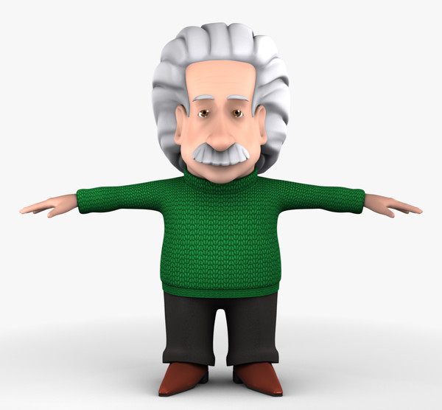
Physical Randomness Extractor
Adversary (manufacturer):
Prepares devices
No communication
Devices: spatially separated
User: classical & deterministic
Comm. Restriction among devices
Random sources
quality varies
Accept/Reject options
Acc: output uniform bits
Rej: catch cheating devices
Adversary
Devices
Devices
deterministic
& classical
random sources
almost perfect randomness
Notes:
Randomness related DI-Model, which we formulate as physical randomness extractors
Imagine Adversary, or manufacturers (Einstein, for EPR, and for non-locality) who build the machine.

Slide 12
Adversary
Devices
[Col06, PAM+10, PM11, FGS11, VV12, MS13, CY13]
deterministic
& classical
SV source:
x₁,x₂,…,x_{n},…,each bit x_{i} has a bounded bias conditioned on previous bits
Highly random: linear min-entropy
Randomness
Expansion
short uniform bits independent
long uniform outputs
0.5- ε≤ Prob[X_{i}=0|X₁,…,X_{i-1}]≤0.5+ε
[CR12, GMdlT+12, MP13, BR+13…]
Santha-Vazirani sources w/ cond. independence
a single uniform bit
Randomness
Amplification
Notes:
A short summary of known results in the view of this work!

Slide 13
Main Result:
Features:
statistical dist
Noise Resilient
Adversary
Small Quantum Memory
entanglement
on the fly
Devices
Efficiency for constant errors
Immune to publicize the source
adversary can even know the
source after delivering devices
deterministic
& classical
Min-entropy sources
Uniform Outputs
Assumptions:
Min-entropy Sources (non-deterministic world)
small finite amount
infinitely
long
Quantum Mechanics (that could be incomplete)
No Communication (that could be enforced)
Notes:
Main Result is a framework start from min-entropy. Assumption: Features
One instantiation: constant error + full feature

Slide 14
Deterministic World v.s. Truly Random World [CR]
Does non-deterministic world imply truly random world?
the world allows uniformly random events
A Possible Dichotomy Theorem:
deterministic
operation
Weak "uncertainty"
(e.g., guess probability < 1)
Min-entropy Source
Full "uncertainty“
(uniformly random)
against environment
no extra randomness
Our Physical Randomness Extractor is such a deterministic operation!
Thus, either the world is deterministic
or we can faithfully create uniformly random events
at least in principle, await verification by experiments
Notes:
Transition: what is the implication of our main results
non-deterministic world, by definition, only imply a little bit uncertainty.

Slide 15
Comparisons to existing DI results
Computer Science:
Randomness Expansion: replace uniform seeds by min-entropy sources
while still output infinitely long bits and enjoy other features
Randomness Amplification: relax SV-sources to min-entropy sources
and output infinitely many bits rather than one bit (expanding)
Physics:
[CR,GMdlT,..] model the weak sources in non-deterministic world as
SV-sources w/ cond. indep, which we relax to min-entropy sources.
almost optimal dichotomy theory
Notes:
One-> many non-trivial
Optimal in the sense that non-deterministic world → min-entropy sources.

Slide 16
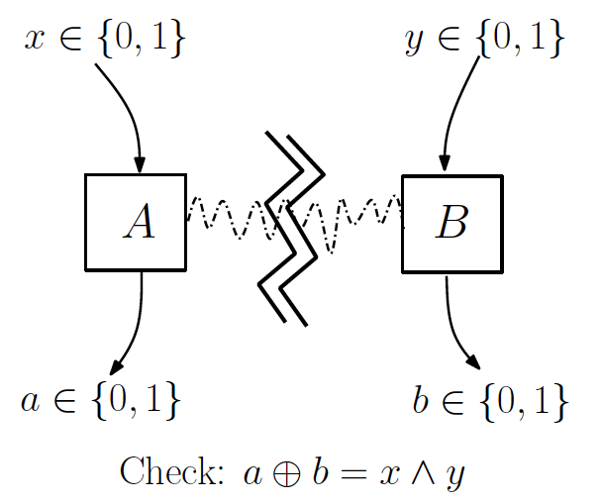
Difficulty with Weak Sources
Bell Violations ( Quantum/Classical Separation in nonlocal games)
are usually established under a fixed input distribution: uniform dist.
s.t. the separation is specific and sensitive to the input distribution
Hardness: random sources → so many distributions
CHSH Game
Inputs
Uniform: Q/C Separation!
SV sources: Q/C Separation
w/ restrictive bias ε [CR]
why ? full support + brute force analysis
Min-entropy sources:
NO Separation w/ support 3 or less
e.g., {00, 01, 10}
Fairly random w/ large min-entropy!
Notes:
Bell Violation/ Nonlocal Games (Quantum / Classical Separation) specific and sensitive to the input distribution
Usually it is the uniform distribution
For SV source, huge effort spent on brute force analyzing, and full support
General method, less brute force, more intuition

Slide 17
Our Solutions: a bird’s-eye view
min-entropy sources
Classical pre-processing:
transfer input to uniform “locally”
impose correlations among blocks
some
…….
where
…….
random
Decouple the correlations:
use existing DI protocols to decouple
Decouple
…….
Decouple
…….
Decouple
By establishing a new property
input seeds uniform to device only
arbitrarily correlated otherwise
e.g., Adv can know the inputs
Z₁
Z_{i}
Z_{N}
Z= XOR all X_{i} s
Useful Property
w/ many applications !!
Classical Post-Processing: XOR picks the right one
Notes:
Want a more intuitive and more general approach!
1) New property. In QKD model!!!, no need to pre-share any uniform bits as an application!!!
Improve the seed quality, but only locally. Somewhere randomness
Decouple the dependence. RE. Need a new property about RE protocols. That is uniform-to-device, uniform-to-all.

Slide 18
Instantiations & Limits
Good Instantiation (as mentioned earlier) when the error is constant!
e.g., error ~ 0.2, then # of boxes ~ 20
Our protocol can achieve optimal errors,
however, at the price of large # of boxes!!
Is there a fundamental limit?
No idea so far: seems to be a hard problem!
Partial Progress:
For a large class of protocols w/ full features of our PRE, ours is almost optimal!
Or w/ basic features of our PRE, still impossible to match parameters of RE!
Remark: the class of protocols include all known protocol designs!!
Notes:
Define Error!
Good and bad instantiations. Impossibility results!

Slide 19
“Freedom-of-Choice” Loophole & Resolution [CR]
Bell-tests: experimental setting needs to be chosen “freely at random”
e.g., x,y sampled uniformly & independently from the testing system !!
Our protocol can generate the choices of experimental settings
and prove they are “freely uniform” in the non-deterministic world!
Notes:
In an abstract way, here is the problem!
Describe it and mention there is a solution!

Slide 20
Conclusions
Random Number Generator with minimal assumptions
(device-independent, noise-resilient, efficient w/ large err)
Dichotomy theorem & Freedom-of-Choice loophole
Open Questions
Improve the # of devices’ dependence on err and N.
due to impossibility results: require totally new protocols.
Trade-off between assumptions and practical efficiency!
Inputs from Experimental Perspectives Appreciated !!
Notes:
About trade-off assumptions: add some stronger but not too strong assumption, then we could have a provably better quantum RNG than any solution ever known.

Slide 21
Thank You!!
Q & A

