Slide 1
Chapter 2
Deterministic Representation and Acting
Dana S. Nau
University of Maryland
with contributions from
Mark “mak” Roberts

Slide 2
Motivation Outline
How to model a complex environment?
  Generally need simplifying assumptions
Classical planning
    Finite, static world, just one actor
    No concurrent actions, no explicit time
    Determinism, no uncertainty, no exogeneous events
    Full observability
    Unit-cost actions
  Sequence of states and actions ⟨s₀, a₁, s₁, a₂, s₂, …⟩
Avoids many complications
Most real-world environments don’t satisfy the assumptions
  ⇒ Errors in prediction
OK if they’re infrequent and don’t have severe consequences
2.2. State-Transition Systems
2.3. State-Variable Representation
2.6. Acting
2.4. Classical Representation
2.5. Computational Complexity
Chapter 2 of Haslum et al. (2019)*
  Classical fragment of PDDL
  Planning domains and problems
  untyped, typed
______________
* Haslum, Lipovetzky, Magazzini, & Muise.
An Introduction to the Planning Domain
Definition Language. Morgan Claypool, 2019.

Slide 3
Section 2.1. State-Transition Systems
State-transition system or classical planning domain:
Σ = (S,A,γ,cost) or (S,A,γ)
  S - finite set of states
  A - finite set of actions
  γ: S×A → S
    prediction (or state-transition) function
    partial function: γ(s,a) is not necessarily defined for every (s,a)
      a is applicable in s iff γ(s,a) is defined
      Domain(a) = {s ∈ S | a is applicable in s}
      Range(a) = {γ(s,a) | s ∈ Domain(a)}
  cost: S×A → ℝ⁺ or cost: A → ℝ⁺
    optional; default is cost(a) ≡ 1
    money, time, something else
plan:
  a sequence of actions π = ⟨a₁, …, a_{n}⟩
π is applicable in s₀ if the actions are applicable in the order given
      γ(s₀, a₁) = s₁
      γ(s₁, a₂) = s₂
      …
      γ(s_{n–1}, a_{n}) = s_{n}
  In this case define γ(s₀, π) = s_{n}
Classical planning problem:
  P = (Σ, s₀, S_{g})
  planning domain, initial state, set of goal states
Solution for P:
  a plan π such that that γ(s₀,π) ∈ S_{g}

Slide 4
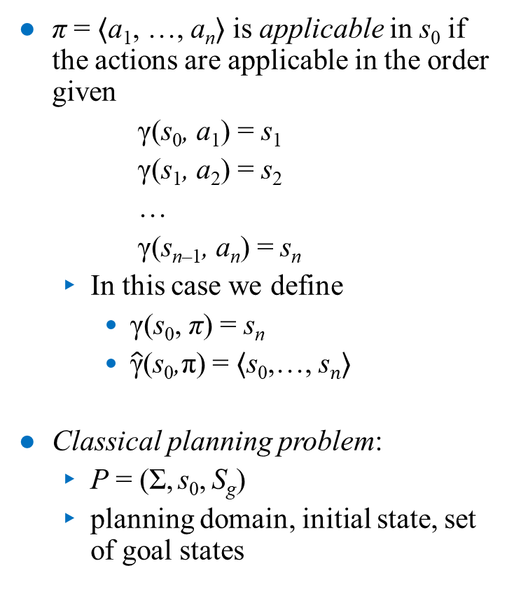
Planning Problems
π = ⟨a₁, …, a_{n}⟩ is applicable in s₀ if the actions are applicable in the order given
      γ(s₀, a₁) = s₁
      γ(s₁, a₂) = s₂
      …
      γ(s_{n–1}, a_{n}) = s_{n}
  In this case we define
    γ(s₀, π) = s_{n}
    $\hat{\text{γ}}$(s₀,π) = ⟨s₀,…, s_{𝑛}⟩
Classical planning problem:
  P = (Σ, s₀, S_{g})
  planning domain, initial state, set of goal states
Solution for P: a plan π such that that γ(s₀,π) ∈ S_{g}
  Minimal solution: no subsequence is also a solution
  Shortest solution: no solution has fewer actions
  Optimal solution: no solution has lower cost
Example: Suppose P has three solutions
    π₁ = ⟨a₁⟩
    π₂ = ⟨a₂, a₃, a₄, a₅⟩
    π₃ = ⟨a₂, a₃, a₁⟩
  Then π₁ is both shortest and optimal
Poll: Which solutions are minimal?
A. π₁ B. π₂ C. π₃

Slide 5
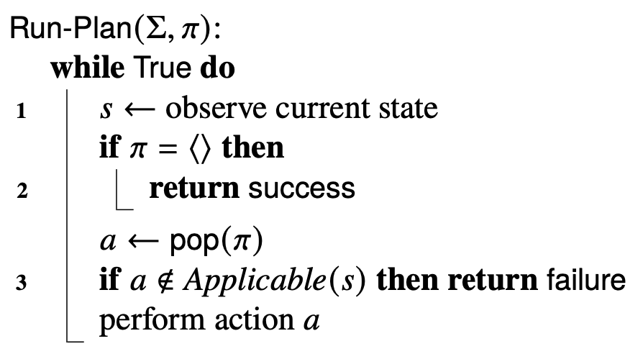
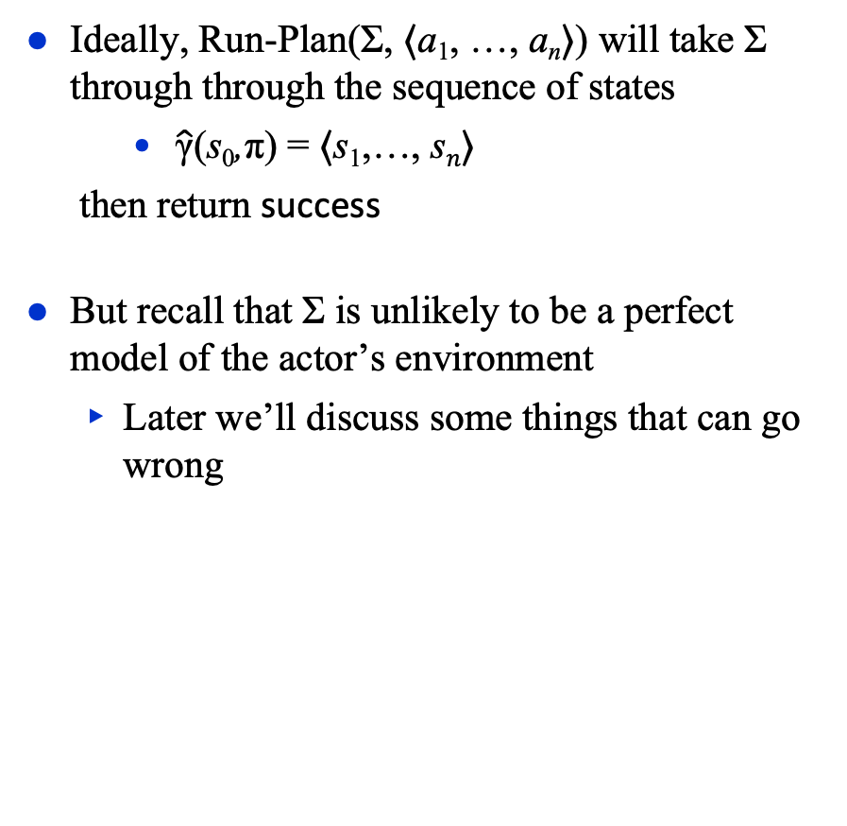
Acting with a Plan
A simple procedure for running a plan
To test whether π has achieved a desired goal S_{g}
  add S_{g} as a third argument
  before line 2, insert this:
        if s ∉ S_{g} then return failure
Ideally, Run-Plan(Σ, ⟨a₁, …, a_{n}⟩) will take Σ through through the sequence of states
    $\hat{\text{γ}}$(s₀,π) = ⟨s₁,…, s_{𝑛}⟩
  then return success
But recall that Σ is unlikely to be a perfect model of the actor’s environment
  Later we’ll discuss some things that can go wrong

Slide 6
Section 2.2. Representation
We write Run-Plan(Σ, π)
  But what Run-Plan really needs is data structures that represent Σ and π
If S and A are small enough
  Give each state and action a name
  For each s and a, store γ(s,a) in a lookup table
In larger domains, don’t represent all states explicitly
  Language for describing properties of states
  Language for describing how each action changes those properties
  Start with initial state, use actions to
  produce other states
…
a₁
s₁ = γ(s₀,a₁)
s₀
a₁′
…
s₁′ = γ(s₀,a₁′)

Slide 7
Kinds of Representations
Domain-specific representation:
  tailor-made for a specific environment
State: arbitrary data structure
Action: (head, preconditions, effects, cost)
  head: name and parameter list
    Get actions by instantiating the parameters
  preconditions:
    Computational tests to predict whether an action can be performed
    Should be necessary/sufficient for the action to run without error
  effects:
    Procedures that modify the current state
  cost: procedure that returns a number
    Can be omitted, default is cost ≡ 1
Advantage: can use whatever works best for that particular domain
Disadvantage: for each new domain, need new representation, new algorithms
Alternative: domain-independent representation
  A “standard format” that can be used for many different planning domains
  Limited representational capability, but easy to compute
  Domain-independent algorithms that work for anything in this format
  We’ll use a state-variable representation …

Slide 8
Example
Drilling holes in a metal workpiece
  A state
    geometric model of the workpiece
      annotated with dimensions, tolerances, etc.
    capabilities and status of
    drilling machine and drill bit
  Several actions
    clamp the workpiece onto the drilling machine
    load a drill bit into the machine
    drill a hole
Name: drill-hole
Arguments:
  ID codes for the machine and drill bit
  annotated geometric model of the workpiece
  description of the hole to be drilled
Preconditions
  Capabilities: can the machine and drill bit produce the desired hole?
  Current state: Is the drill bit installed? Is the workpiece clamped onto the table? Etc.
Effects
  annotated geometric model of modified workpiece
Cost
  estimate of time or monetary cost

Slide 9
Discussion
Advantage of domain-specific representation:
  use whatever works best for that particular domain
Disadvantage:
  for each new domain, need new representation and deliberation algorithms
Alternative: domain-independent representation
  Try to create a “standard format” that can be used for many different planning domains
  Deliberation algorithms that work for anything in this format
State-variable representation
  Simple formats for describing states and actions
  Limited representational capability
    But easy to compute, easy to reason about
  Domain-independent search algorithms and heuristic functions that can be used in all state-variable planning problems

Slide 10
State-Variable Representation
Objects = {names of objects in the environment}
Organized into an typed ontology
  sets of object types
Objects = Robots ∪ Containers ∪ Locs ∪ {nil}
  Robots = {r1}
  Containers = {c1, c2}
  Locs = {d1, d2, d3}
Objects only needs to include objects that matter at the current level of abstraction
Can omit lots of details
  physical characteristics of robots, containers, loading docks, roads, …
d3
r1
c1
c2
d1
d2

Slide 11
Rigid Properties
Terminology from first-order logic:
atom ≡ atomic formula ≡ positive literal
≡ predicate symbol with list of arguments
  e.g., adjacent(x,d2), where x is unbound
negative literal ≡ negated atom ≡ atom with negation sign in front of it
  e.g., ¬ adjacent(x,d2)
an atom that contains no variable symbols is ground (or fully instantiated)
  e.g., adjacent(d1,d2)
an atom that contains no constant symbols is lifted
  e.g., adjacent(x,y)
an atom that contains both is partially instantiated
  e.g., adjacent(x,d2)
ground instance of any expression: replace every variable with a value in its range
  e.g., adjacent(d1,d2) is a ground instance of both adjacent(x,d2) and adjacent(x,y)
Objects have two kinds of properties
  rigid and varying
Rigid: stays the same in every state
  Can be described as a mathematical relation
    adjacent = {(d1,d2), (d2,d1), (d1,d3), (d3,d1)}
  Or equivalently, a set of ground atoms
      adjacent(d1,d2), adjacent(d2,d1),
      adjacent(d1,d3), adjacent(d3,d1)
  I’ll use the two notations interchangeably
d3
r1
c1
c2
d1
d2

Slide 12
Varying Properties
Varying property (or fluent):
    a property that may differ in different states
Represent it using a state variable
  a term that we can assign a value to
    e.g., loc(r1)
Let X = {all state variables in the environment}
  e.g., X = {loc(r1), loc(c1), loc(c2), cargo(r1)}
Each state variable x ∈ X has a range
= {all values that can be assigned to x}
    Range(loc(r1)) = Locs
    Range(loc(c1)) = Range(loc(c2)) = Robots ∪ Locs
    Range(cargo(r1)) = Containers ∪ {nil}
To abbreviate the “range” notation often I’ll just say things like
  loc(r1) ∈ Locs
  loc(c1), loc(c2) ∈ Robots ∪ Locs
d3
r1
c1
c2
d1
d2
Instead of “domain”, to avoid confusion with planning domains

Slide 13
States as Functions
Represent each state s as a function that assigns values to state variables
  For each state variable x, s(x) is one x’s possible values
  s₁(loc(r1)) = d1, s₁(cargo(r1)) = nil,
  s₁(loc(c1)) = d1, s₁(loc(c2)) = d2
Mathematically, a function is a set of ordered pairs
    s₁ = {(loc(r1), d1), (cargo(r1), nil), (loc(c1), d1) , (loc(c2), d2)}
Equivalently, write it as a set of ground positive literals (or ground atoms):
  s₁ = {loc(r1)=d1, cargo(r1)=nil, loc(c1)=d1, loc(c2)=d2}
  Here, we’re using ‘=’ as a predicate symbol
d3
r1
c1
c2
d1
d2

Slide 14
Action Schemas
Action schema (or template): parameterized set of actions
  α = (head, pre, eff, cost)
  head: name, parameters
  pre: precondition literals
  eff: effect literals
  cost: a number (optional, default is 1)
e.g.,
  head = take(r,l,c)
  pre = {cargo(r)=nil, loc(r)=l, loc(c)=l}
  eff = {cargo(r)=c, loc(c)=r}
Each parameter has a range of possible values:
  Range(r) = Robots = {r1}
  Range(l) = Locs = {d1,d2,d3}
  Range(l) = Range(m) = Locs = {d1,d2,d3}
  Range(c) = Containers = {c1,c2}
d3
r1
c1
c2
d1
d2
We’ll usually write it more like pseudocode:
move(r,l,m)
pre: loc(r)=l, adjacent(l,m)
eff: loc(r) ← m
take(r,l,c)
pre: cargo(r)=nil, loc(r)=l, loc(c)=l
eff: cargo(r) ← c, loc(c) ← r
put(r,l,c)
pre: loc(r)=l, loc(c)=r
eff: cargo(r) ← nil, loc(c) ← l
r ∈ Robots = {r1}
l,m ∈ Locs = {d1,d2,d3}
c ∈ Containers = {c1,c2}
the target
of the
assignment

Slide 15
Actions
A = set of action schemas
  move(r,l,m)
  pre: loc(r)=l, adjacent(l, m)
  eff: loc(r) ← m
  take(r,l,c)
  pre: cargo(r)=nil, loc(r)=l, loc(c)=l
  eff: cargo(r) ← c, loc(c) ← r
  put(r,l,c)
  pre: loc(r)=l, loc(c)=r
  eff: cargo(r) ← nil, loc(c) ← l
  r ∈ Robots = {r1}
  l,m ∈ Locs = {d1,d2,d3}
  c ∈ Containers = {c1,c2}
Action: ground instance of an α ∈ A
  replace each parameter with something in its range
A = {all actions we can get from A}
= {all ground instances of members of A}
  move(r1,d1,d2)
  pre: loc(r1)=d1, adjacent(d1,d2)
  eff: loc(r1) ← d2
d3
r1
c1
c2
d1
d2

Slide 16
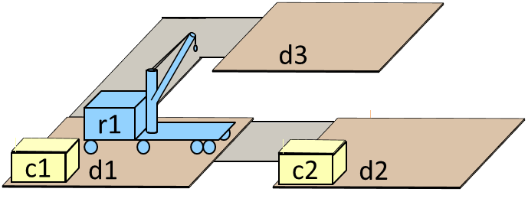
Actions
A = set of action schemas
  move(r,l,m)
  pre: loc(r)=l, adjacent(l, m)
  eff: loc(r) ← m
  take(r,l,c)
  pre: cargo(r)=nil, loc(r)=l, loc(c)=l
  eff: cargo(r) ← c, loc(c) ← r
  put(r,l,c)
  pre: loc(r)=l, loc(c)=r
  eff: cargo(r) ← nil, loc(c) ← l
  r ∈ Robots = {r1}
  l,m ∈ Locs = {d1,d2,d3}
  c ∈ Containers = {c1,c2}
Action: ground instance a of an action schema α ∈ A such that no state variable is a target of more than one effect eff(a)
A = {all actions we can derive from A}
= {all ground instances of members of A}
  move(r1,d1,d2)
  pre: loc(r1)=d1, adjacent(d1,d2)
  eff: loc(r1) ← d2
We’ll normally refer to an action by writing its head
  move(r1,d1,d2)
Answers:
A. 1 F. 6
B. 2 G. 7
C. 3 H. 8
D. 4 I. 9
E. 5 J. other
Poll. Let:
A = {the action schemas on this page}
A = {all ground instances of members of A}
How many move actions in A?

Slide 17
Applicability
Poll: How many move actions are applicable in s₁?
A. 1 F. 6
B. 2 G. 7
C. 3 H. 8
D. 4 I. 9
E. 5 J. other
a is applicable in s if
  for every positive literal l ∈ pre(a),
  l ∈ s or l is in one of the rigid relations
  for every negative literal ¬l ∈ pre(a),
  l ∉ s and l isn’t in any of the rigid relations
Rigid relation
  adjacent = {(d1,d2), (d2,d1), (d1,d3), (d3,d1)}
State
  s₁ = {loc(r1)=d1, cargo(r1)=nil, loc(c1)=d1, loc(c2)=d2}
Action schema
  move(r,l,m)
  pre: loc(r)=l, adjacent(l, m)
  eff: loc(r) ← m
  r ∈ Robots = {r1}
  l,m ∈ Locs = {d1,d2,d3}
Applicable:
  move(r1,d1,d2)
  pre: loc(r1)=d1, adjacent(d1,d2)
  eff: loc(r1) ← d2
Not applicable:
  move(r1,d2,d1)
  pre: loc(r1)=d2, adjacent(d2,d1)
  eff: loc(r1) ← d1
d3
r1
c1
c2
d1
d2

Slide 18
Applying an Action
If a is applicable in s:
  γ(s,a) = {x = w | eff(a) contains x←w}
  ∪ {x = w | x isn’t a target in eff(a)}
s₂ = {loc(r1)=d2, cargo(r1)=nil, loc(c1)=d1, loc(c2)=d2}
a = take(r1,c2,d2)
pre: cargo(r1)=nil, loc(r1)=d2, loc(c2)=d2
eff: cargo(r1) ← c2, loc(c2) ← r1
γ(s₂, take(r1,c2,d2)) =
  {loc(r1)=d2, loc(c1)=d1, cargo(r1)=c2, loc(c2)=r1}
  ⌊__________________________⌋ ⌊____________________________⌋
  from s₂ from eff(a)
d3
r1
c1
c2
d1
d2
d3
r1
c2
c1
d1
d2

Slide 19
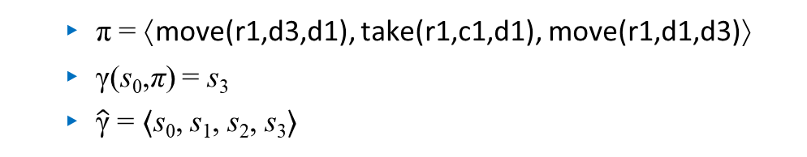
Applying a Plan
A plan π is applicable in a state s if we can apply the actions in the order that they appear in π
This produces a sequence of states
γ(s,π) = the last state in the sequence
  π = ⟨move(r1,d3,d1), take(r1,c1,d1), move(r1,d1,d3)⟩
  γ(s₀,π) = s₃
  $\hat{\text{γ}}$ = ⟨s₀, s₁, s₂, s₃⟩
s₀ = {loc(r1)=d3,
cargo(r1)=nil,
loc(c1)=d1,
loc(c2)=d2}
s₁ = {loc(r1)=d1,
cargo(r1)=nil,
loc(c1)=d1,
loc(c2)=d2}
s₂ = {loc(r1)=d1,
cargo(r1)=c1,
loc(c1)=r1,
loc(c2)=d2}
s₃ = {loc(r1)=d3,
cargo(r1)=c1,
loc(c1)=r1,
loc(c2)=d2}

Slide 20
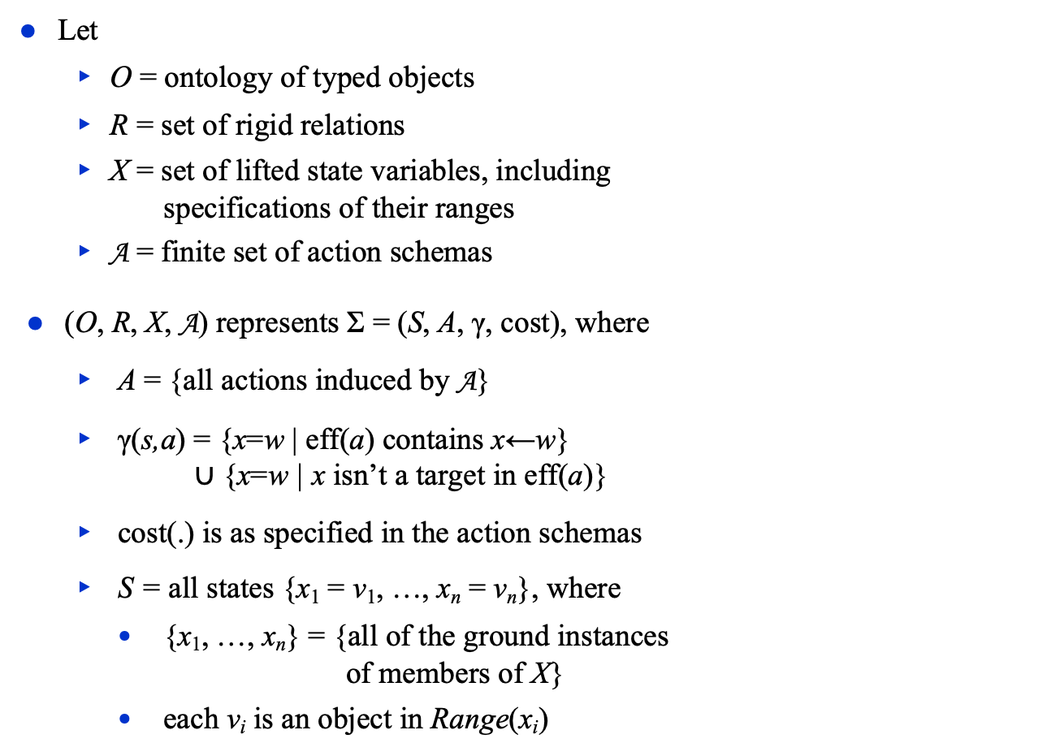
State-Variable Planning Domain
Objects = Robots ∪ Containers
∪ Locs ∪ {nil}
Robots = {r1}
Containers = {c1, c2}
Locs = {d1, d2, d3}
adjacent = {(d1,d2), (d2,d1),
(d1,d3), (d3,d1)}
loc(c) ∈ Locs ∪ Robots,
loc(r) ∈ Locs,
cargo(r) ∈ Containers ∪ {nil}
where c ∈ Containers, r ∈ Robots
move(r,l,m)
pre: loc(r)=l, adjacent(l, m)
eff: loc(r) ← m
take(r,c,l)
pre: cargo(r)=nil,
loc(r)=l, loc(c)=l
eff: cargo(r) ← c, loc(c) ← r
put(r,c,l)
pre: loc(r)=l, loc(c)=r
eff: cargo(r) ← nil, loc(c) ← l
O:
R:
X:
A:
Let
  O = ontology of typed objects
  R = set of rigid relations
  $\text{X}$ = set of lifted state variables, including
  specifications of their ranges
  A = finite set of action schemas
(O, R, X, A) represents Σ = (S, A, γ, cost), where
  A = {all actions induced by A}
  γ(s,a) = {x=w | eff(a) contains x←w}
  ∪ {x=w | x isn’t a target in eff(a)}
  cost(.) is as specified in the action schemas
  S = all states {x₁ = v₁, …, x_{n} = v_{n}}, where
    {x₁, …, x_{n}} = {all of the ground instances
    of members of X}
    each v_{i} is an object in Range(x_{i})
s₀ = {loc(r1)=d2,
cargo(r1)=c1,
loc(c1)=r1,
loc(c2)=d2}
d3
r1
c1
c2
d1
d2

Slide 21
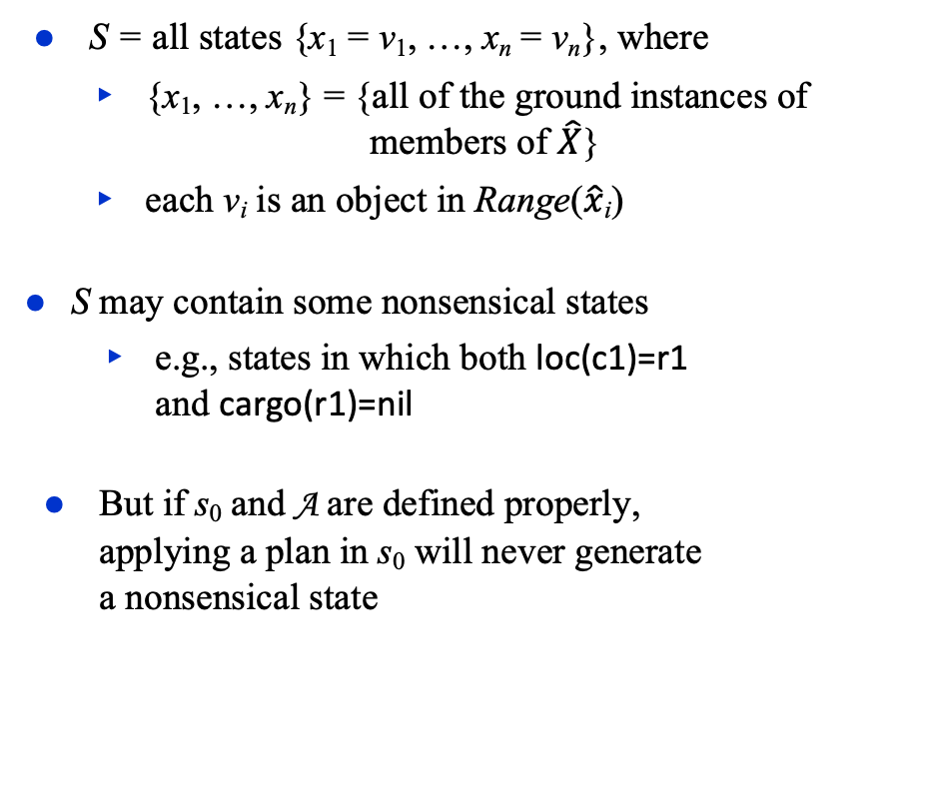
State-Variable Planning Domain
Objects = Robots ∪ Containers
∪ Locs ∪ {nil}
Robots = {r1}
Containers = {c1, c2}
Locs = {d1, d2, d3}
adjacent = {(d1,d2), (d2,d1),
(d1,d3), (d3,d1)}
loc(c) ∈ Locs ∪ Robots,
loc(r) ∈ Locs,
cargo(r) ∈ Containers ∪ {nil}
where c ∈ Containers, r ∈ Robots
move(r,l,m)
pre: loc(r)=l, adjacent(l, m)
eff: loc(r) ← m
take(r,c,l)
pre: cargo(r)=nil,
loc(r)=l, loc(c)=l
eff: cargo(r) ← c, loc(c) ← r
put(r,c,l)
pre: loc(r)=l, loc(c)=r
eff: cargo(r) ← nil, loc(c) ← l
O:
R:
X:
A:
S = all states {x₁ = v₁, …, x_{n} = v_{n}}, where
  {x₁, …, x_{n}} = {all of the ground instances of
  members of $\hat{X}$}
  each v_{i} is an object in Range($\hat{x}$_{i})
S may contain some nonsensical states
  e.g., states in which both loc(c1)=r1
  and cargo(r1)=nil
But if s₀ and A are defined properly,
applying a plan in s₀ will never generate
a nonsensical state
s₀ = {loc(r1)=d2,
cargo(r1)=c1,
loc(c1)=r1,
loc(c2)=d2}
d3
r1
c1
c2
d1
d2

Slide 22
State-Variable Planning Problem
Objects = Robots ∪ Containers
∪ Locs ∪ {nil}
Robots = {r1}
Containers = {c1, c2}
Locs = {d1, d2, d3}
adjacent = {(d1,d2), (d2,d1),
(d1,d3), (d3,d1)}
loc(c) ∈ Locs ∪ Robots,
loc(r) ∈ Locs,
cargo(r) ∈ Containers ∪ {nil}
where c ∈ Containers, r ∈ Robots
move(r,l,m)
pre: loc(r)=l, adjacent(l, m)
eff: loc(r) ← m
take(r,c,l)
pre: cargo(r)=nil,
loc(r)=l, loc(c)=l
eff: cargo(r) ← c, loc(c) ← r
put(r,c,l)
pre: loc(r)=l, loc(c)=r
eff: cargo(r) ← nil, loc(c) ← l
O:
R:
X:
A:
P = (Σ, s₀, g), where
  Σ = is a state-variable planning domain
  s₀ ∈ S is the initial state
  g is a set of ground literals called the goal
S_{g} = {all states in S that satisfy g}
  = {s ∈ S | s ∪ R contains every positive literal
  in g, and none of the negative literals in g}
π is a solution for P if γ(s₀,π) satisfies g
g = {loc(c1)=d1}
c1
d1
s₀ = {loc(r1)=d2,
cargo(r1)=c1,
loc(c1)=r1,
loc(c2)=d2}
Poll: How many solutions
of length 3?
A. 1 B. 2 C. 3
D. 4 E. 5 F. 6
G. 7 H. 8 I. 9
J. other
d3
r1
c1
c2
d1
d2
⟨move(r1,d2,d1), put(r1,c1,d1)⟩
is a solution of length 2

Slide 23
Section 2.3. Acting
For classical planning problems we assumed
    Finite, static world, just one actor
    No concurrent actions, no explicit time
    Determinism, no uncertainty, no exogeneous events
    Full observability
    Unit-cost actions
  Sequence of states and actions ⟨s₀, a₁, s₁, a₂, s₂, …⟩
Most real-world environments don’t satisfy the assumptions because of errors in prediction
This can usually be fine if
  errors occur infrequently, and
  they don’t have severe consequences
What to do if an error does occur?
Notes:
Changed slightly

Slide 24

Service Robot
π = ⟨a₁,a₂,a₃,a₄,a₅⟩
  a₁ = go(r1,room3,hall)
  a₂ = navigate(r1,hall,room1)
  a₃ = take(r1,o7,room1)
  a₄ = navigate(r1,room1,room2)
  a₅ = put(r1,o7,room2)⟩
room3
a₁
a₂
a₃
a₄
a₅
room2
o7
room1
go(r,l,m)
pre: adjacent(l,m), loc(r)=l
eff: loc(r) ← m
navigate(r,l,m)
pre: ¬adjacent(l, m), loc(r)=l
eff: loc(r) ← m
take(r,o,l)
pre: loc(r)=l, loc(o)=l,
cargo(r)=nil
eff: loc(o) ← r, cargo(r) ← o
ignores how to get from l to m, e.g., opening the door
ignores how do navigation, localization
ignores how to grasp o, lift it, put it down

Slide 25
Service Robot
π = ⟨a₁,a₂,a₃,a₄,a₅⟩
  a₁ = go(r1,room3,hall)
  a₂ = navigate(r1,hall,room1)
  a₃ = take(r1,o7,room1)
  a₄ = navigate(r1,room1,room2)
  a₅ = put(r1,o7,room2)⟩
Some things that can go wrong:
  Execution failures
    robot gripper slips on doorknob
    door is locked or broken
  Sensor errors
    navigation error causes robot to go to wrong room
  Incorrect or partial information
    where is o7 ?
  Events that make actions inapplicable
    someone puts object o6 onto r1
  Events that make actions unnecessary
    someone puts object o7 onto r1
How to detect and recover?
room3
room2
o7
room1
go(r,l,m)
pre: adjacent(l,m), loc(r)=l
eff: loc(r) ← m
navigate(r,l,m)
pre: ¬adjacent(l, m), loc(r)=l
eff: loc(r) ← m
take(r,o,l)
pre: loc(r)=l, loc(o)=l,
cargo(r)=nil
eff: loc(o) ← r, cargo(r) ← o

Slide 26
Acting with Lookahead
Call Lookahead, obtain π, perform 1st action, call Lookahead again …
Useful when unpredictable things are likely to happen
  Replans immediately
Also useful with receding horizon search (e.g., as in chess programs):
  Lookahead looks a limited distance ahead
Potential problem:
  Lookahead needs to return quickly
  Otherwise, may pause repeatedly while waiting for Lookahead to return
  What if ξ changes during the wait?
Run-Lookahead(Σ, g)
  s ← abstraction of observed state ξ
  while s ⊭ g do
    π ← Lookahead(Σ, s, g)
    if π = failure then return failure
    a ← pop-first-action(π); perform(a)
    s ← abstraction of observed state ξ
the planner

Slide 27
Acting with Lookahead
Run-Lazy-Lookahead(Σ, g)
  π ← ⟨ ⟩
  while True do
    s ← abstraction of observed state ξ
    if s ⊨ g then return success
    if π = ⟨ ⟩ or Simulate(Σ, s, g, π) = failure then
      π ← Lookahead(Σ, s, g)
      if π = failure then return failure
    a ← pop-first-action(π)
    perform(a)
Call Lookahead, execute the plan as far as possible,
don’t call Lookahead again unless necessary
Simulate tests whether the plan will execute correctly
  Could do lower-level refinement, physics-based simulation
  Could just test whether γ(s,π) ⊨ g
  Or just test whether s = γ(s′, a), where s′ is the previous state
Potential problems
  Simulate needs to return quickly
    otherwise, may pause repeatedly, ξ may change
  May might miss opportunities to replace π with a better plan
Poll: Assuming no action failures during acting, which approach does more work, in terms of planning: Run-Lazy-Lookahead or Run-Lookahead?
A. Run-Lazy-Lookahead C. Equal amounts
B. Run-Lookahead D. Unsure

Slide 28
Acting with Plan Repair
We may want to repair π rather than get a new plan
  e.g., if we’ve already made commitments or resource allocations
Modify Run-Lazy-Lookahead
Run-Lazy-Lookahead(Σ, g)
  π ← ⟨ ⟩
  while True do
    s ← abstraction of observed state ξ
    if s ⊨ g then return success
    if π = ⟨ ⟩ or Simulate(Σ, s, g, π) = failure then
      π ← Lookahead-Repair(Σ, s, g,π)
      if π = failure then return failure
    a ← pop-first-action(π)
    perform(a)

Slide 29
How to do Lookahead
Some possibilities (can also combine these)
Full planning (if the planner can solve the planning problem quickly enough)
Receding horizon
  Modify Lookahead to search just part of the way to g
  E.g., cut off search when one of the following
  exceeds a maximum threshold:
    plan length, plan cost, computation time
Sampling
  Modify Lookahead to do a Monte Carlo rollout
    Depth-first search with random node selection and no backtracking
  Call Lookahead several times, choose the plan that looks best
  Best-known example of this: the UCT algorithm (see Chapter 9)
Subgoaling
  Tell Lookahead to plan for some subgoal g₁, rather than g itself (see next page)
  Once the actor has achieved g₁, tell Lookahead to plan for the next subgoal g₂
  And so forth until the actor reaches g

Slide 30

Subgoaling Example
Killzone 2
  “First-person shooter” game, ≈ 2009
  widely acclaimed at the time
Special-purpose AI planner
  Plans enemy actions at the squad level
    Subproblems; plans are maybe 4–6 actions long
  Different planning algorithm from
  what we’ve discussed so far
      HTN planning (see Part II)
    Quickly generates a plan for a subgoal
    Replans several times per second as the world changes
Why it worked:
  Don’t want to get the best possible plan
  Need actions that appear believable and consistent to human users
  Need them very quickly

Slide 31
Classical Representation
Motivation
  The field of AI planning started out as automated theorem proving
  It still uses a lot of that notation
Classical representation is equivalent to state-variable representation
  No distinction between rigid and varying properties
  Both represented as logical predicates
  Both are in the current state
    adjacent(l,m) - location l is adjacent to m
    loc(r) = l ⟶ loc(r,l) - robot r is at location l
    loc(c) = r ⟶ loc(c,r) - container c is on robot r
    cargo(r) = c ⟶ loaded(r) - there’s a container on r
d3
r1
c1
d1
d2
State s = a set of ground atoms
  Atom a is true in s iff a ∈ s
s₀ = {adjacent(d1,d2), adjacent(d2,d1),
adjacent(d1,d3), adjacent(d3,d1),
loc(c1,d1), loc(r1,d2)}
Poll: Should s₀ also contain
¬ loaded(r1) ?
A: yes B: no
C: unsure
why not loaded(r,c)?

Slide 32
Classical planning operators
action schemas
  move(r,l,m)
  pre: loc(r)=l, adjacent(l, m)
  eff: loc(r) ← m
  take(r,c,l)
  pre: cargo(r)=nil, loc(r)=l, loc(c)=l
  eff: cargo(r) ← c, loc(c) ← r
  put(r,c,l)
  pre: loc(r)=l, loc(c)=r
  eff: cargo(r) ← nil, loc(c) ← l
  Range(r) = Robots = {r1}
  Range(l) = Range(m) = Locs = {d1,d2,d3}
  Range(c) = Containers = {c1,c2}
Classical planning operators
  move(r,l,m)
  pre: loc(r,l), adjacent(l, m)
  eff: ¬loc(r,l), loc(r,m)
  take(r,c,l)
  pre: ¬loaded(r), loc(r,l), loc(c,l)
  eff: loaded(r), ¬loc(c,l), loc(c,r)
  put(r,c,l)
  pre: loc(r,l), loc(c,r)
  eff: ¬loaded(r), loc(c,l), ¬loc(c,r)
Poll: Does move really need to include ¬loc(r,l) ?
A: yes B: no
C: unsure
d3
r1
c1
d1
d2

Slide 33
Classical Actions
Let
  pre –(a) = {a’s negated preconditions}
  pre⁺(a) = {a’s non-negated preconditions}
a is applicable in state s iff
  s ∩ pre –(a) = ∅ and pre⁺(a) ⊆ s
If a is applicable in s then
  γ(s,a) = (s ∖ eff –(a)) ∪ eff ⁺(a)
Planning operator:
  o: move(r,l,m)
  pre: loc(r,l), adjacent(l,m)
  eff: ¬loc(r,l), loc(r,m)
Action:
  a₁: move(r1,d2,d1)
  pre: loc(r1,d2), adjacent(d2,d1)
  eff: ¬loc(r1,d2), loc(r1,d1)
meaning?
s₀ = {adjacent(d1,d2),
adjacent(d2,d1),
adjacent(d1,d3),
adjacent(d3,d1),
loc(c1,d1),
loc(r1,d2)}
γ(s₀, a₁) = {adjacent(d1,d2),
adjacent(d2,d1),
adjacent(d1,d3),
adjacent(d3,d1),
loc(c1,d1),
loc(r1,d1)}
d3
d3
r1
r1
c1
c1
d1
d2
d1
d2

Slide 34
Discussion
x(b₁,…,b_{n–1})=b_{n} ⇒ P_{x}(b₁,…,b_{n–1},b_{n})
State-variable
rep.
Classical
rep.
x_{P}(b₁,…,b_{k})=1 ⇐ P(b₁,…,b_{k})
Equivalent expressive power
  Each can be converted to the other in linear time and space
Classical representation
  More natural for logicians
  Don’t require single-valued functions
State variables
  More natural for engineers and computer programmers
  When changing a value, don’t have to explicitly delete the old one
Historically, classical representation has been more widely used
  That’s starting to change
Poll: Could we instead use x_{P}(b₁,…,b_{k–1})=b_{k} ?
A: yes B: no
C: unsure

Slide 35
PDDL
Language for defining planning domains and problems
Original version of PDDL ≈ 1996
  Just classical planning
Multiple revisions and extensions
  Different subsets accommodate different kinds of planning
We’ll discuss the classical-planning subset
  Chapter 2 of the PDDL book

Slide 36
Example domain
Initial state:
(define (domain example-domain-1)
(requirements :negative-preconditions)
(:action move
:parameters (?r ?l ?m)
:precondition (and (loc ?r ?l)
(adjacent ?l ?m))
:effect (and (not (loc ?r ?l))
(loc ?r ?m)))
(:action take
:parameters (?r ?l ?c)
:precondition (and (loc ?r ?l)
(loc ?c ?l)
(not (loaded ?r)))
:effect (and (not (loc ?c ?l))
(loc ?c ?r)
(loaded ?r)))
(:action put
:parameters (?r ?l ?c)
:precondition (and (loc ?r ?l)
(loc ?c ?r))
:effect (and (loc ?c ?l)
(not (loc ?c ?r))
(not (loaded ?r)))))
These are untyped parameters.
d3
r1
c1
d1
d2
Goal:
r1
c1
(define (problem example-problem-1)
(:domain example-domain-1))
(:init
(adjacent d1 d2)
(adjacent d2 d1)
(adjacent d1 d3)
(adjacent d3 d1)
(loc c1 d1)
(loc r1 d2)
(:goal (loc c1 r1)))

Slide 37
Example problem
Classical representation:
(define (problem example-problem-1)
(:domain example-domain-1))
(:init
(adjacent d1 d2)
(adjacent d2 d1)
(adjacent d1 d3)
(adjacent d3 d1)
(loc c1 d1)
(loc r1 d2)
(:goal (loc c1 r1)))
d3
r1
c1
d1
d2
s₀ = {adjacent(d1,d2), adjacent(d2,d1),
adjacent(d1,d3), adjacent(d3,d1),
loc(c1,d1), loc(r1,d2)}
r1
c1
g = {loc(c1,r1)}

Slide 38
Typed domain
(:action move
:parameters (?r - robot
?l ?m - location)
:precondition (and (loc ?r ?l)
(adjacent ?l ?m))
:effect (and (not (loc ?r ?l))
(loc ?r ?m)))
(:action take
:parameters (?r - robot
?l - location
?c - container)
:precondition (and (loc ?r ?l)
(loc ?c ?l)
(not (loaded ?r)))
:effect (and (not (loc ?r ?l))
(loc ?r ?m)))
(:action put
:parameters (?r - robot
?l - location
?c - container)
:precondition (and (loc ?r ?l)
(loc ?c ?r))
:effect (and (loc ?c ?l)
(not (loc ?c ?r))
(not (loaded ?r)))))
State-variable representation:
  Objects = Movable_objects ∪ Locs
  Movable_objects = Robots ∪ Containers
  Robots = {r1}
  Containers = {c1}
  Locs = {d1, d2, d3}
  r ∈ Robots, l,m ∈ Locs, c ∈ Containers
d3
r1
c1
d1
d2
(define (domain example-domain-2)
(:requirements
:negative-preconditions
:typing)
(:types
location movable-obj - object
robot container - movable-obj)
(:predicates
(loc ?r - movable-obj
?l - location)
(loaded ?r - robot)
(adjacent ?l ?m - location))
Locations, Movable_objects ⊆ Objects
Robots, Containers ⊆ Movable_objects
r ∈ Robots,
l ∈ Locs,
c ∈ Containers
r ∈ Movable_objects
l ∈ Locs
r ∈ Robots

Slide 39
Typed problem
State-variable representation:
  Objects = Movable_objects ∪ Locs
  Movable_objects = Robots ∪ Containers
  Robots = {r1}
  Containers = {c1}
  Locs = {d1, d2, d3}
  r ∈ Robots,
  l,m ∈ Locs,
  c ∈ Containers
(define (problem example-problem-2)
(:domain example-domain-2))
(:objects
r1 - robot
c1 - container
d1 d2 d3 - location)
(:init
(adjacent d1 d2)
(adjacent d2 d1)
(adjacent d1 d3)
(adjacent d3 d1)
(loc c1 d1)
(loc r1 d2)
(:goal (loc c1 r1)))
d3
r1
c1
d1
d2
s₀ = {adjacent(d1,d2), adjacent(d2,d1),
adjacent(d1,d3), adjacent(d3,d1),
loc(c1,d1), loc(r1,d2)}
g = {loc(c1,r1)}
r1
c1

Slide 40
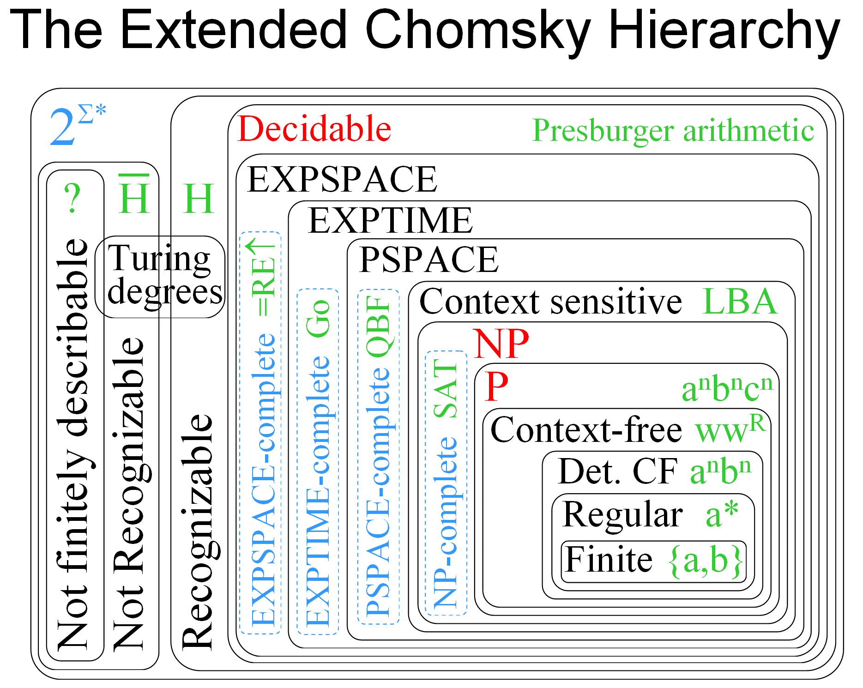
Computational Complexity Refresher
Computational complexity results are normally given for decision problems
  each decision problem is an infinite set of questions with yes/no answers
  Two decision problems in which P may be any classical planning problem:
  PLAN EXISTENCE: does P have a solution?
  PLAN LENGTH: does P have a solution of length ≤ 𝑘?
Prof. Gabriel Robins, UVA
https://www.cs.virginia.edu/~robins/cs6160/
Lectures 19-21 cover the key concepts

Slide 41
Section 2.5. Computational Complexity
Suppose P is given in state-variable representation (rather than enumerating S and A explicitly):
  PLAN EXISTENCE is EXPSPACE-complete
  PLAN LENGTH is NEXPTIME-complete
If we restrict P to be in a fixed planning domain Σ that is known in advance :
  Both problems are in PSPACE
  PSPACE-complete for some planning domains
These are worst-case results, average case is often much lower (e.g., polynomial)
Poll. What is the complexity of PLAN EXISTENCE if P is given by enumerating S and A explicitly?
A. PSPACE-complete B. NP-complete
C. Polynomial D. something else
As a reminder: P ⊆ NP ⊆ PSPACE ⊆ EXPTIME ⊆ NEXPTIME ⊆ EXPSPACE
Need a refresher on complexity? See:
UVA CS 4102 PSPACE and beyond (Bloomfield, 2011)
MIT OpenCourseWare 6.006 Computational Complexity Lecture
MIT OpenCourseWare 6.045 Course, specifically lectures 12, 15, & 16
UVA CS 6160 (Robins, 2022)

Slide 42
Summary
Section 2.2. State-transition systems
  Classical planning assumptions
  States, actions, transition function
  Plans, planning problems, solutions
  Run-Plan
Section 2.3. State-Variable Representation
  Objects, rigid properties
  Varying properties, state variables, states
  Action schemas, actions, applicability, γ
  Plans, problems, solutions
Section 2.4. Classical Representation
Section 2.5. Computational Complexity
Section 2.6. Acting
  Things that can go wrong while acting
  Run-Lookahead, Run-Lazy-Lookahead
  Plan repair
  Interacting with an online planner
    subgoaling, limited horizon, sampling
Chapter 2 of Haslum et al. (2019)
  Classical fragment of PDDL
  Planning domains, planning problems
  untyped, typed
Notes:
Updated section numbers

