Slide 1
Cryptography
Lecture 27

Slide 2
Final exam logistics
Official exam time: May 13, 8-10am
Exam will be available on Gradescope from noon on May 12 until noon on May 13
  Once you take the exam, no communication with other students until noon on May 13
Exam itself is 120 minutes
  Plus 5 minutes to print, 15 minutes to scan
  Will be enforced by Gradescope
Students with ADS accommodations should email me to make arrangements

Slide 3
Final exam logistics
Exam will cover material through Thursday, May 5
  Covers entire semester, focus on material since midterm
Exam is open-book/open-notes
  No communication with anyone during the exam
  No Internet/WiFi/cellular access during the exam
    If something is unclear, explain your understanding of the question
Suggestions
  Use one sheet of paper per question so you can work on parts of different problems
  Skim entire exam before starting
  Intended to be easy -- be concise rather than exhaustive
  Maximize points if you are running out of time

Slide 4
Final review

Slide 5
Topics we covered
Defining security
  E.g., for private-key encryption: perfect secrecy, EAV-security, CPA-security, CCA-security
Security definitions will be tested
  You should be able to write pseudocode and give analysis showing that some scheme is insecure because it does not satisfy a given definition
Assumptions
  Primitives (PRGs/stream ciphers, PRPs/block ciphers, hash functions) and instantiations (AES, SHA-256, …)
  Number-theoretic assumptions
Proofs

Slide 6
Topics we covered, I
Private-key encryption
Message authentication codes
Hash functions and applications
Constructions of:
  Stream ciphers (LFSRs)
  Block ciphers (SPNs, Feistel networks)
  Hash functions (Davies-Meyer, Merkle-Damgard)
Generic attacks on hash functions, block ciphers, etc.

Slide 7
Topics we covered, II
Number theory/group theory
RSA assumption, dlog assumption, DH assumptions
Diffie-Hellman key exchange
Public-key encryption
Digital signatures

Slide 8
Goals
Understand real-world crypto
  Almost everything we have covered in class is used in practice, or is the basis for something used in practice
  Know when to use different schemes
  Understand the formal guarantees that different schemes provide
To make sure you understand a scheme, ask yourself if you could implement it

Slide 9
Public-key infrastructure (PKI)

Slide 10
Public-key distribution
Alice, pk*
pk
X
Alice, pk
Alice, pk*
Alice, pk
pk, sk

Slide 11
Public-key distribution
pk
Alice, pk
Alice, pk
X
Alice, pk*
pk, sk

Slide 12
Use signatures for secure key distribution!
Assume a trusted party with a public key known to everyone
  Certificate authority (CA) acting as “root of trust”
  Public key pk_{CA}
  Private key sk_{CA}

Slide 13
Use signatures for secure key distribution!
Alice asks the CA to sign the binding (Alice, pk)
  cert_{CA→Alice} = Sign_{skCA}(Alice, pk)
(CA must verify Alice’s identity, and obtain her public key, out of band)

Slide 14
Use signatures for secure key distribution!
Bob obtains Alice, pk, and the certificate cert_{CA→Alice} …
  … checks that Vrfy_{pkCA}((Alice, pk), cert_{CA→Alice}) = 1
Bob is then assured that pk is Alice’s public key
  As long as the CA is trustworthy…
    Honest, and properly verifies Alice’s identity
  …and the CA’s private key has not been compromised

Slide 15
Certificate chains
Can also have chains of certificates
E.g., Bob holds pk_{CA}
Alice has pk and cert_{CA’→Alice}
Alice also sends pk_{CA’} and cert_{CA→CA’} to Bob
Bob does:
  Uses pk_{CA} and cert_{CA→CA’} to verify that pk_{CA’} is the public key of CA’
  Uses pk_{CA’} and cert_{CA’→Alice} to verify that pk is the public key of Alice

Slide 16
Chicken-and-egg problem?
How does Bob get pk_{CA} in the first place?
Several possibilities…

Slide 17
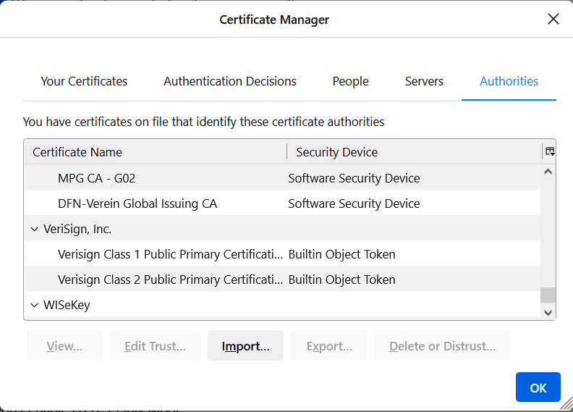
“Roots of trust”
Bob only needs to securely obtain a small number of CA’s public keys
  Need to ensure secure distribution only for these few, initial public keys
E.g., distribute as part of an operating system, or web browser
  Firefox:
  Tools->Options->Privacy & Security->View Certificates->Authorities

Slide 18
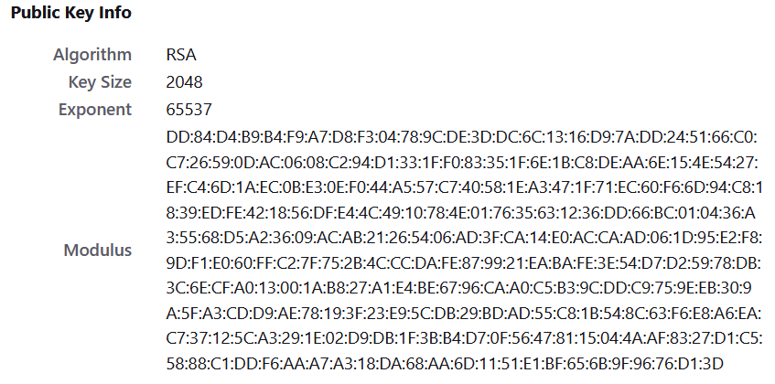

Slide 19
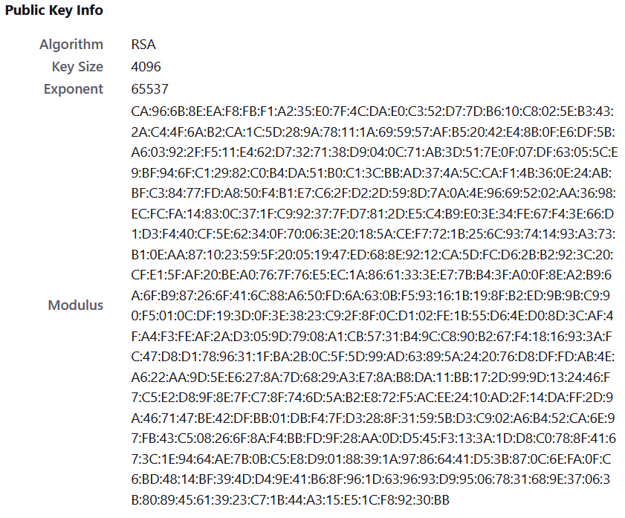

Slide 20
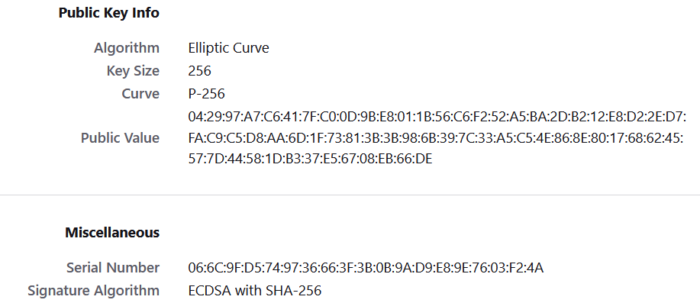

Slide 21
“Web of trust”
Obtain public keys in person
  “Key-signing parties”
Obtain “certificates” on your public key from people who know you
If A knows pk_{B}, and B issued a certificate for C, then C can send that certificate to A
  What trust assumptions are being made here?

Slide 22
Public repository
Store certificates in a central repository
  E.g., OpenPGP keyserver
To find Alice’s public key
  Get all public keys for “Alice,” along with certificates on those keys
  Look for a certificate signed by someone you trust whose public key you already have

Slide 23
PKI in practice…
Does not work quite as well as in theory…
  Proliferation of root CAs
    Compromises of CAs
  Revocation can be difficult
  Users/browsers may not verify certificates properly

Slide 24
SSL/TLS
How can you securely send your credit card number to Amazon?
SSL/TLS
  Secure Socket Layer (Netscape, mid-’90s)
  Transport Layer Security
    TLS 1.0 (1999)
    TLS 1.2 (2008)
    TLS 1.3 (2018)
  Used by every web browser for https connections

Slide 25
TLS 1.3
Goals
  Understand (at a high level) a real-world crypto protocol
  Pull together everything learned in this course
Not goals
  Understanding low-level details/implementation
  Defining or proving security

Slide 26
TLS 1.3
Two phases
  Handshake protocol
    Establish shared keys between two entities
    Server-to-client authentication only
  Record-layer protocol
    Use shared keys for secure communication
Note: high-level details only
  Actual implementation is (even) more complex

Slide 27

Handshake protocol
https://bank.com, g^{x}, N_{C}
pk_{CA}
g^{y}, N_{S}
sk, pk, cert_{CA→Bank}
mk = (g^{x})^{y}
k_{C}, k’_{C}, k_{S}, k’_{S} = Derive(mk)
c ← Enc_{k’S}(Sign_{sk}(trans), pk, cert)
mk = (g^{y})^{x}
k_{C}, k’_{C}, k_{S}, k’_{S} = Derive(mk)
(σ, pk, cert) = Dec_{k’S}(c)
Verify!
Mac_{k’C}(trans’)
Verify!

Slide 28
Record-layer protocol
Parties now share session keys k_{C}, k_{S}
Client uses k_{C} for authenticated encryption of all messages it sends
Server uses k_{S} for authenticated encryption of all messages it sends
  Prevents reflection attacks
Sequence numbers used to prevent replay attacks

