Slide 1
V
eriWeb
Automatically Testing Dynamic Web Sites
Michael Benedikt Juliana Freire Patrice Godefroid
Presented by
Krist Wongsuphasawat

Slide 2
Outline
Motivation
Previous Works
What is VeriWeb?
VeriWeb Architecture
Exploring Algorithm
Automatically Filling Form
Conclusion

Slide 3
1.1 Motivation
Web pages became
very complex.
154 Links
7 Forms
>161 Actions?

Slide 4
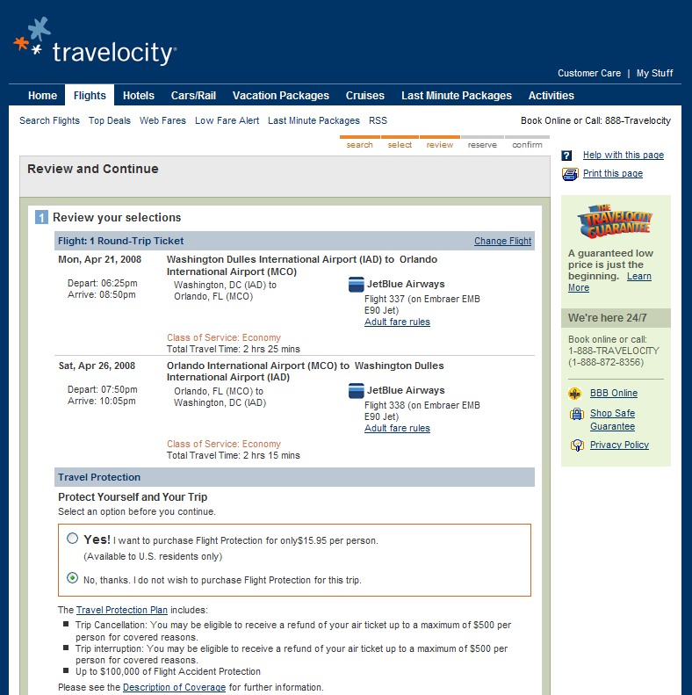
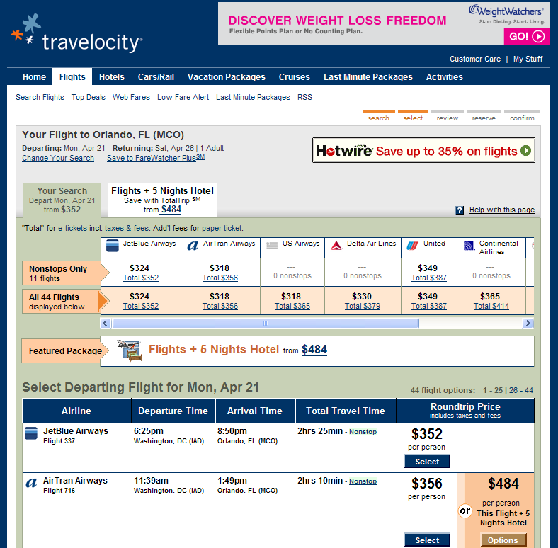
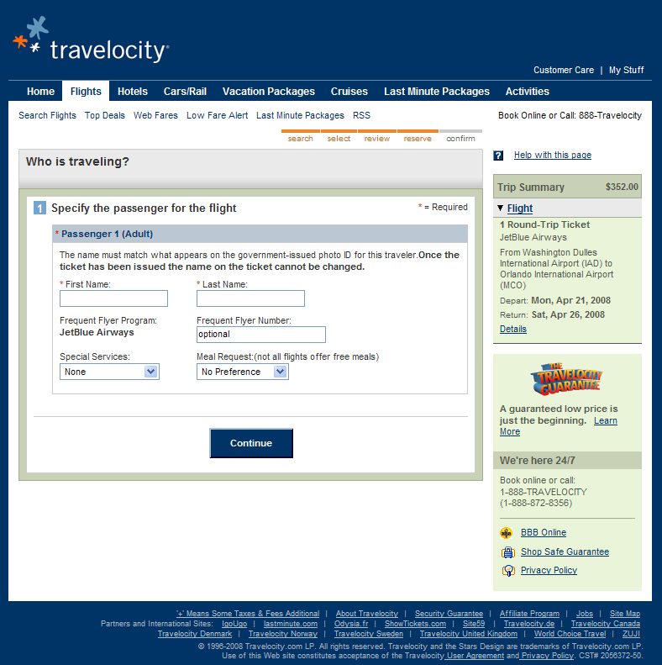
1.1 Motivation
Web navigation became very complex.
….
Select Destination
Review
….
Select Flight
Reserve
….

Slide 5
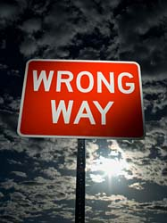
1.1 Motivation
Many things can go wrong.
Interaction between HTML pages
Application on pages
Java Applet, JavaScript, etc.
Application on server side
Dynamic pages, Database Interfaces, CGI
Wide variety of server and browsers
Rapidly Changing Technology

Slide 6
1.2 Challenges
Web sites are complex applications.
Web sites are updated often.
Hard to keep test suite updated
Web sites are highly intertwined with the environment
e.g. browser, OS, etc.
Impossible to test stand-alone
Users are inexperienced
Unexpected behavior

Slide 8
2. Previous Works
Crawlers
check links and pages for common errors
e.g. LinkCheck, SiteInspector, Weblint, Webtrends
broken links, unreachable pages, HTML errors, etc.
Go through links
Capture-replay tools
explore particular scenario in a dynamic web site
e.g. MacroBot, Silktest, etester, etc.
Record interactions that can be played back unattended.
Must manually create interactions.

Slide 9
3.1 What is VeriWeb?
Exercises multiple scenarios in a web application that
are automatically discovered
VeriWeb = Crawlers + Capture-replay tools
+ more
exploits scenarios that
include dynamic portions of sites
Unlike a capture-replay tool,
no recording is needed
exhaustively searches the site for errors
Unlike a crawler, it can go through forms

Slide 10
3.2 VeriWeb Features
Functional testing
both static and dynamic elements of Web site
Regression testing
Standard correctness checks
e.g., broken links, malformed URLs
Realistic testing
Tests are run through a Web browser and closely mimic users’ actions

Slide 11
4. VeriWeb Architecture
cache
Error Handling
Execution
Smart Traces
web
Web Navigator
Web Proxy
page
action
page
Smart Profiles
Choice Finder
Error Handler
possible
actions
selected
action
error notification
VeriSoft
Searching

Slide 12
4.1 Searching
cache
Smart Traces
web
Web Navigator
Web Proxy
page
action
page
Smart Profiles
Choice Finder
Error Handler
possible
actions
selected
action
error notification
VeriSoft
Searching

Slide 13
4.1 Searching
Exercise all possible execution paths a user might follow
in a web site
2 tasks
Action Discovery – ChoiceFinder
Exploration Control - VeriSoft

Slide 14
4.1.1 ChoiceFinder
Find the set of possible actions from that page
Analyze HTML to find links, forms, buttons, etc.
2 challenges
How to fill in forms?
How to prune the search spaces?

Slide 15
4.1.2 Verisoft
Explore the state spaces
Guarantee complete coverage of the state space up to some depth
When error is detected, a scenario leading to error state is saved.
Saved scenarios can be replayed.

Slide 16
4.2 Execution
cache
Execution
Smart Traces
web
Web Navigator
Web Proxy
page
action
page
Smart Profiles
Choice Finder
Error Handler
possible
actions
selected
action
error notification
VeriSoft

Slide 17
4.2.1 Web Navigator
Mimics what a user would do while interacting with
Browser
Execute actions for selected choice
Link: follow link
Form: fill and submit form
etc.

Slide 18
4.3 Error Handling
cache
Error Handling
Smart Traces
web
Web Navigator
Web Proxy
page
action
page
Smart Profiles
Choice Finder
Error Handler
possible
actions
selected
action
error notification
VeriSoft

Slide 19
4.3.1 Type of Errors
2 Types of errors
Navigation Errors
e.g. Failure in retrieving a page
Detected by Web Navigator
Page Errors
Your constraints
Detected by Error Handler
Various checking modules can be invoked from ErrorHandler

Slide 20
4.3.2 Error Logging
3 Different levels
VeriSoft
error traces
scenario (i.e. state-space path from the starting page)
Web Navigator
smart traces (smart bookmarks)
richer representation of scenario
can be replayed by WebVCR
robust, can be replayed even web page structural changes
Web Proxy
cached pages
all visited pages or just pages in scenarios that lead to errors
offline error detection

Slide 21
4. VeriWeb Architecture
cache
Error Handling
Execution
Smart Traces
web
Web Navigator
Web Proxy
page
action
page
Smart Profiles
Choice Finder
Error Handler
possible
actions
selected
action
error notification
VeriSoft
Searching

Slide 22
5.1 Exploration Algorithm
ExploreSite(startingURL,constraints)
….. currentPage = Navigator.load(startingURL);
….. while (true) {
….. ….. error = ErrorHandler(currentPage,constraints);
….. ….. if (error.status==true)
….. ….. ….. VeriSoft.assert(currentPage,error);
….. ….. if (this page has been seen before)
….. ….. ….. VeriSoft.abort(currentPage,``cycle'');
….. ….. else {
….. ….. ….. choices = ChoiceFinder(currentPage);
….. ….. ….. selectedChoice = VeriSoft.toss(choices);
….. ….. ….. currentPage = Navigator.execute(selectedChoice,choices);
….. ….. ….. if (currentPage.error != null)
….. ….. ….. ….. VeriSoft.assert(currentPage,error);
….. ….. }
…..}
}
*One run for one Path
}
Page Error
}
Navigation Error

Slide 23
5.1 Exploration Algorithm
Set Start Page
Stop if this page has been seen before
Check for page error
Do until depth reach
Find choices
Current page
Select choice
Execute choice
Check for navigation error

Slide 24
5.2 Controlling the search
Filtering
ignore “unimportant” actions
e.g. links to PDF , Word documents, external sites, mailto links, etc.
Cycle detection
State vs. stateless: page that look identical may represent different states.
e.g., the initial page of Amazon with and without cookies
Configurable cycle-detection

Slide 25
6. Automatically filling forms
How to fill this form automatically?
Tester needs to provide some information!

Slide 26
6.1 Smart Profiles
Information used to fill in forms
Data model level
Not form-by-form approach
e.g. car sale site
Specify a dataset that describe
Customer profiles
Car models or properties
As light-weight as possible
independent of the structure of the Web site
reusable as structure of Web site changes

Slide 27
6.1 Smart Profiles
XML Schema
<!DOCTYPE smartprofile [
<!ELEMENT smartprofile (signature* |
profile*)>
<!ELEMENT signature (name, field+)>
<!ELEMENT field (name,synonym)>
<!ATTLIST field key CDATA>
<!ELEMENT profile (name, signature,
fieldvalue+)>
<!ELEMENT fieldvalue (name,regexp)>
<!ELEMENT regexp (#PCDATA) >
<!ELEMENT name (#PCDATA)>
<!ELEMENT synonym (#PCDATA)>
]>

Slide 28
6.1 Smart Profiles
Signature
Profile#1
Profile#2
Profile#3
Like class and object

Slide 29
6.1 Smart Profiles
Signature
<signature>
<name> CarType </name>
<field key=true>
<name> Make </name>
<synonym> *carmake* </synonym>
</field>
<field key=false>
<name> Model </name>
</field>
<field key=false>
<name> Year </name>
</field>
<field key=false>
<name> Interior </name>
</field>
<field key=false>
<name> Type </name>
</fiield>
</signature>
Profile
<profile>
<name> Rolls </name>
<signature> CarType </signature>
<fieldvalue>
<name> Make </name>
<regexp> Rolls-Royce </regexp>
</fieldvalue>
<fieldvalue>
<name> Model </name>
<regexp> *Corniche* </regexp>
</fieldvalue>
<fieldvalue>
<name> Year </name>
<regexp> 2002 </regexp>
</fieldvalue>
<fieldvalue>
<name> Type</name>
<regexp> Convertible* </regexp>
</fieldvalue>
</profile>

Slide 30
6.2 Filling out forms
Form Analysis
Generate field name for every field
Output = Form schema
Form Matching
Match form schema to smart profiles
Output = Candidate profiles
Form Completion
Match value in candidate profile with field

Slide 31
6.3 More
Creating profiles is an iterative process
System prompts tester for missing information
Unknown field

Slide 32
7. Conclusion
As web sites became more complex and change rapidly, we
need some automatic and robust way to test them
Contributions of this paper are
Infrastructure to automate testing of dynamic Web sites
Search algorithms for automatically exploring all the paths a user might follow in a Web application
SmartProfiles as a high-level specification of test data to populate forms
Automatically filling forms strategy.

Slide 33
References
VeriWeb: Automatically testing dynamic web sites
by Michael Benedikt, Juliana Freire, Patrice Godefroid
In: Proceedings of the 11th international world wide web conference (WWW2002)
http://citeseerx.ist.psu.edu/viewdoc/summary?doi=10.1.1.4.5474
VeriWeb: Presentation Slides
by Juliana Freire
www.cs.utah.edu/~juliana/pub/veriweb-www2002-talk.pdf

