Slide 1
CMSC 818G
Information Technology

Slide 2
Summary
Information Technology (IT) is broadly understood as any technology or expertise used to transmit, process, or store information. Perspectives on IT range from traditional views of digital systems (e.g., computers, networks, and software) to broader interpretations, including human skills (e.g., writing legibly) and non-digital tools (e.g., books and eyeglasses).
IT as Digital Systems & Networks – Many associate IT with computers, networks, and support services, such as IT help desks and troubleshooting connectivity issues.
IT as Information Processing – IT is seen as any system that interacts with, processes, or stores information, which includes AI, cloud computing, cybersecurity, and data centers.
IT as a Broad Concept – Some believe that nearly all technology is IT, as most innovations adjust or transmit information in some way, whether through digital means or mechanical systems (e.g., water heaters improving temperature perception).
Encoding & Decoding Information – The process of translating meaning into a format that can be understood and transmitted (e.g., human communication, written text, digital messages) is considered a fundamental aspect of IT.
IT’s Role in Society – IT is seen as a tool that enhances daily life by improving accessibility, automating tasks, and making information more usable (e.g., smartwatches tracking health, AI assisting with communication).
While some define IT strictly in terms of digital information processing, others argue that almost all technology involves IT because it enables the transmission and transformation of information.

Slide 3
Information Technology
Technology that deals with information
What is Information
What is Technology
What does “deals with” mean?

Slide 4
What is information???

Slide 5

Information
Shannon:
The word ‘information’ has been given different meanings by various writers in the general
field of information theory. It is likely that at least a number of these will prove sufficiently
useful in certain applications to deserve further study and permanent recognition.
It is hardly to be expected that a single concept of information would satisfactorily
account for the numerous possible applications of this general field,
1) technical problems concerning the quantification of information and dealt with by Shannon’s theory;
2) semantic problems relating to meaning and truth; and
3) what he called ‘influential’ problems concerning the impact and effectiveness of information on human behavior, which he thought had to play an equally important role.
Floridi, Luciano. Information: A Very Short Introduction (Very Short Introductions) (p. 2). OUP Oxford. Kindle Edition.

Slide 6
Definition of Information
General Definition of Information (GDI) – Data + meaning
Data Based Definition
  GDI σ is an instance of information, understood as semantic content,
  if and only if:
    GDI.l) a consists of n data, for n ≥ 1;
    GDI.2) the data are well formed;
    GDI.3) the well-formed data are meaningful.
Data must comply with the meanings (semantics) of the chosen system, code or language.
Floridi, Luciano. Information: A Very Short Introduction (Very Short Introductions) (p. 2). OUP Oxford. Kindle Edition.

Slide 7
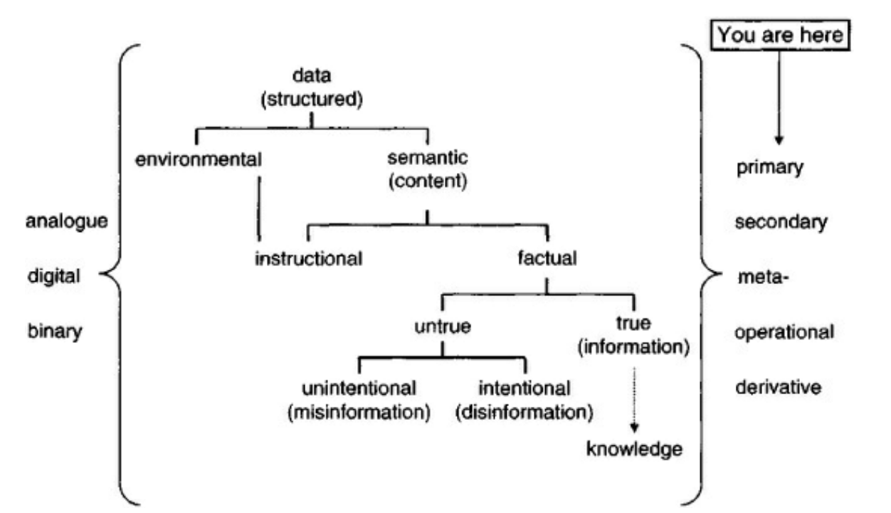
Types of data/information
Primary Data
Secondary Data
Meta Data
Operational Data
Derivative Data
Environmental Data/information
Information as Semantic Content
  Instructional
  Factual

Slide 8
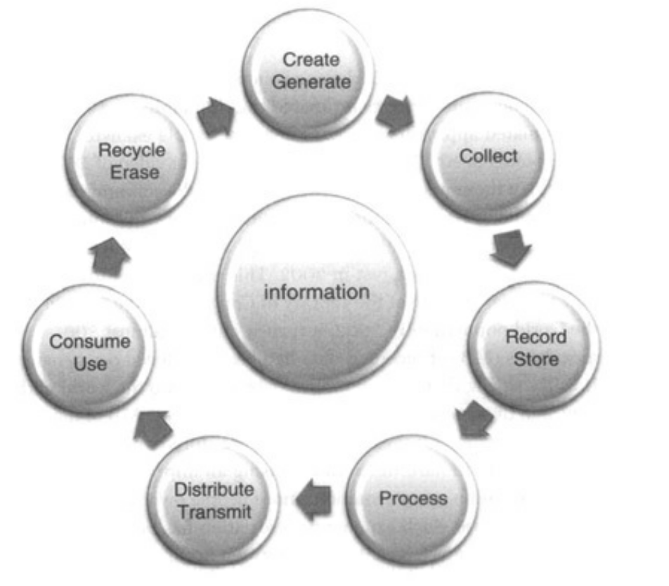
Information Cycle

Slide 9
Shannon – Information theory
Mathematical theory of communication
  The mathematical theory of communication deals with the carriers of information, symbols and signals, not with information itself. That is, information is the measure of your freedom of choice when you select a message. - Weaver
Entropy
  You should call it entropy for two reasons: first, the function is already in use in thermodynamics under the same name; second, and more importantly, most people don’t know what entropy really is, and if you use the word entropy in an argument you will win every time. – von Neumann
Entropy is a measure of
  The average amount of information per symbol produced by the informer, or
  The corresponding average amount of data deficit (Shannon’s uncertainty) that the informee has before the inspection of the output of the informer, or
  The corresponding informational potentiality of the same source, that is its informational entropy
Floridi, Luciano. Information: A Very Short Introduction (Very Short Introductions) (p. 45). OUP Oxford. Kindle Edition.

Slide 10
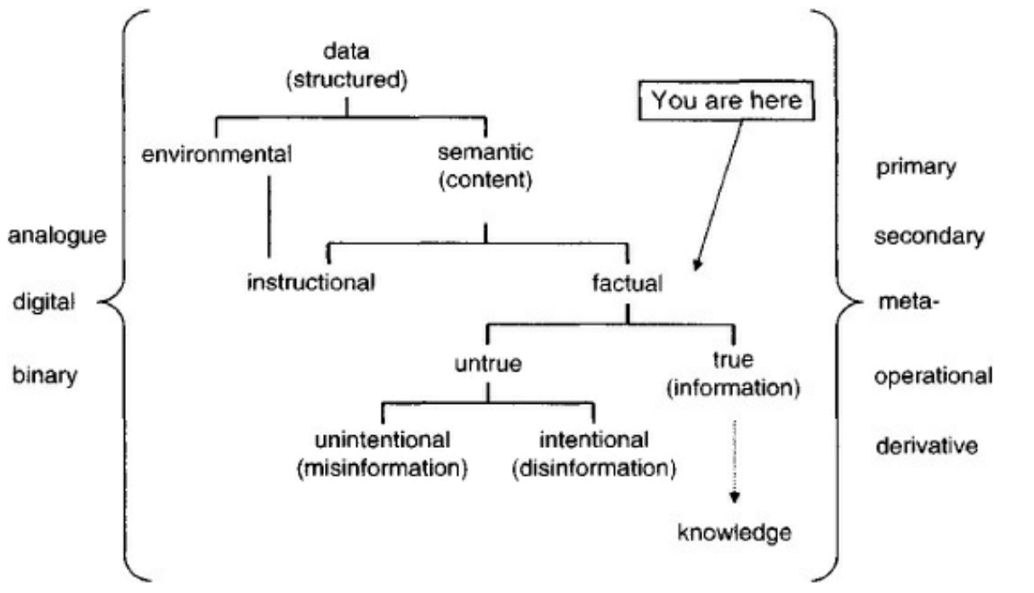
Semantic Information

Slide 11
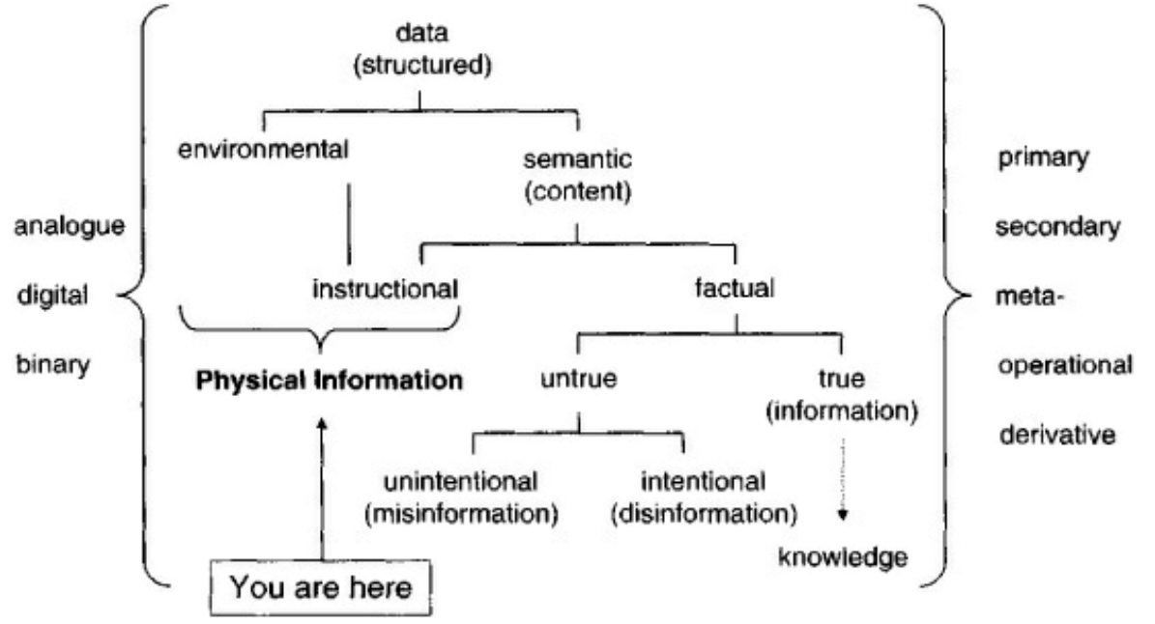
Physical Information

Slide 12
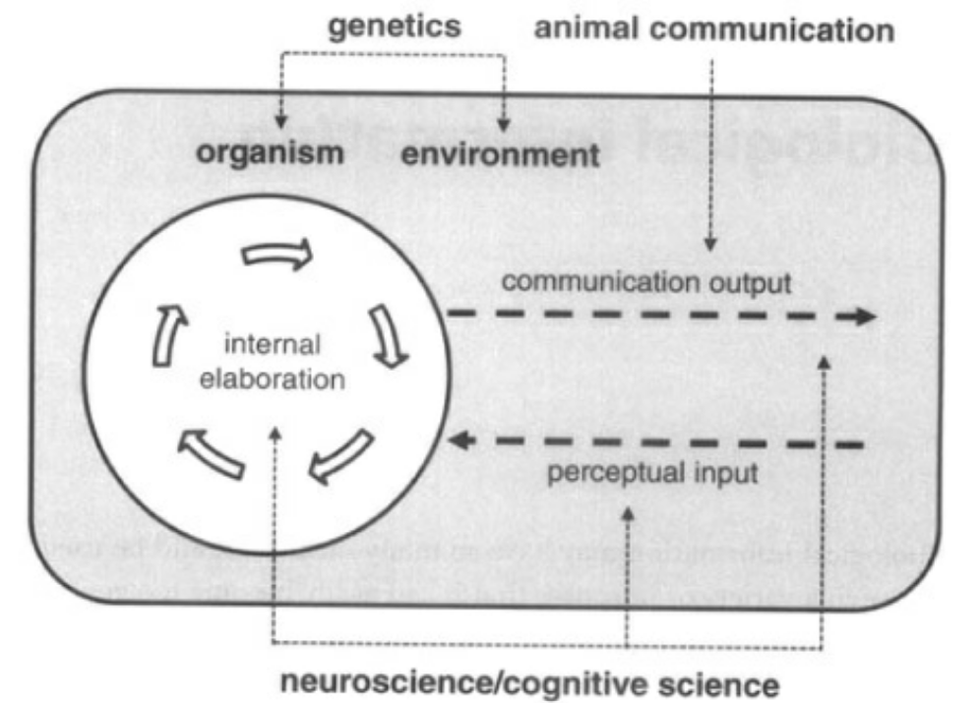
Biological Information
Biological
Genetic
DNA and genetic code
Neural Information

Slide 13
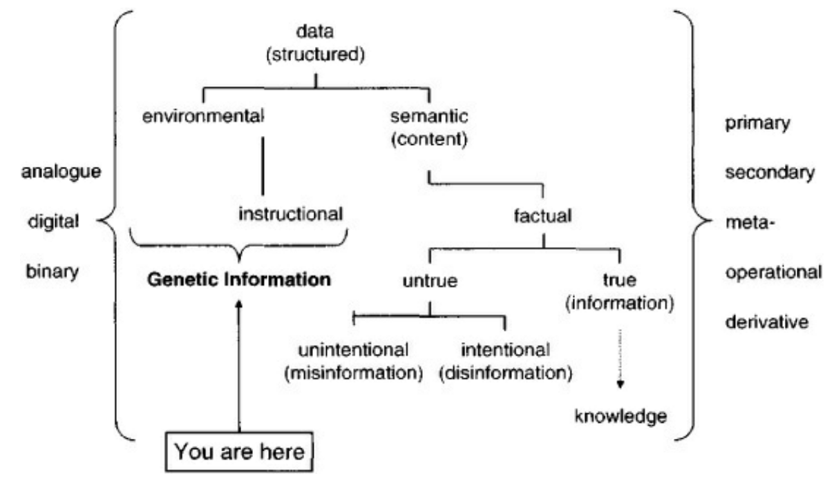
Genetic Information

Slide 14
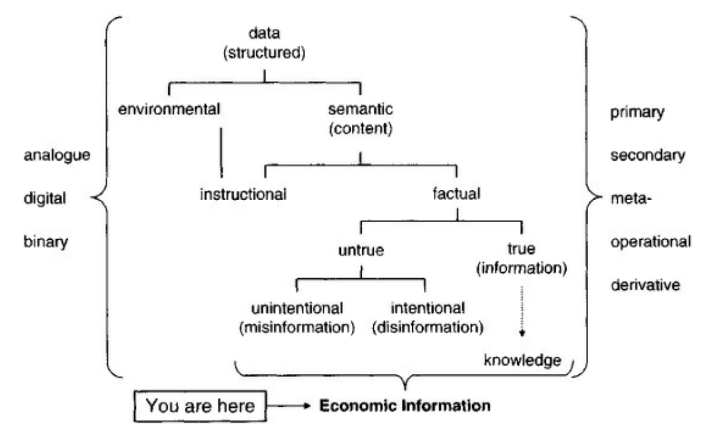
Economic Information

Slide 15
Information vs Concepts
C = A + B
Newton’s First Laws of Motion
  An object at rest stays at rest and an object in motion stays in motion with the same speed and in the same direction unless acted upon by an unbalanced force.

Slide 16
Information vs Representations
Representations are benign by themselves
Created in the physical world to capture an aspect of information
Extracting the information from a representation requires the knowledge of the mapping used
Information has a context which is rarely captured in representations
The ultimate consumer of information is a sentient being

Slide 17
Basic Notions
Physical World
MIND
Representation
Information
Concept

Slide 18
Information and Representations
Sentient entities deal with it
With meaning => Concept
In the physical world we only deal with representations
For
Communication
Storage
Manipulation
Use

Slide 19
Sentient Being
Large collection of Concepts
Large collection of interrelationships among individual conceptual items
  Collection of all of it – Perceived Reality - knowledge
Acquiring
  Through Senses => Information
  Assimilation using prior conceptual framework
Processing
  Accessing
  Exploring known relationships
  Deducing new ones
  Initiating actions
Actions
  Decision – What action to take and when
  Actuation – initiating the action
  Execution – using physical parts of the body

Slide 20
Meaning
Derived in context
Context reflects ALL the interrelationships this information item has with all concepts
Deriving meaning is required to assimilate and integrate any information with prior knowledge – collection of concepts
If a relationship can not be established with a new information item, then it may be kept as an isolated item/concept

Slide 21
Context
All interrelationships
Any question you ask is exploring another relationship
Relationships are information items also
  Standard graph theoretic models may not work
Models
  Collection of interrelationships
  Used in all decision making
    Which may lead to actuation of actions

Slide 22
Models
Each sentient being has a very large number of such models
Some models may be static
Others may be refined
An expert is one who understand more interrelationships in a field – has better models

Slide 23
Agents
Capable of handling information/representations
Capable of actions
Two types
  Sentient (SA)
  Constructed (CA)
Actions
  SA
    Using the mind and the body
  CA
    Exploiting the physical properties of the constructed system components
    As designed by some SA using concepts and mapping them to the CA

Slide 24
Interaction among Sentient Agents
Primarily through exchange of information
Some interaction may be through physical means also

Slide 25

Exchange of information
Only through representations

Slide 26
Information Communication
Sentient Agent
Sentient Agent
Information
Information
Perceived
Reality
Perceived
Reality
Representation
Representation

Slide 27
Representations
All “Information” in physical world is the representations which are relevant for sentient beings
Representations are created as arrangements of energy or matter
  Ink spread on paper
  Chalk on a board
  Bits in a memory cell
  Sound waves
  Pictures
  …
Many representations of any information item

Slide 28
Use of Representations
Storage
  Keep the arrangement of matter or energy in a container
  Very few interrelationships are retained
Movement
  Transfer the representation directly or indirectly – so that at the receiving end a corresponding representation can be created
Manipulation
  Transform them through physical operations
    Addition, multiplication, …
    Photoshop
    …

Slide 29
Manipulation of Representations
Physical operations on representations which may be meaningful
2 + 3 = 5
010
Adder
101
011

Slide 30
Meaningful Manipulations
Sentient Agent
Information
Information
Operation
Perceived
Reality
Perceived
Reality
Representation
Representation
Operation

Slide 31
Information Manipulation in CAs
Computers are constructed agents
All representations in computers are in the form of bits
There is no meaning of bits or collection of bits that is available in or to the computer – only to the designer
Computer Operations
  Arithmetic and Logic operations and comparisons => bits
  Move bits individually or in groups
  Control the movement of bits using some bit(s) as triggers
Complex manipulations are done as a sequence of simple ones
The sequence is defined by a program which is also represented as bits which are used to “guide” the movement of bits during the execution

Slide 32
Communications between CAs
At least two agents are involved
Move representations from a sender to a receiver
May transform one or more times in the process
  Compression
  Encryption
  …
Protocol
  Each side has an implicit or explicit model of the other side
    “When I send this, I expect to receive this”
Communication Transit Times
  As communication requires movement of some representation, fastest it can travel is at the speed of light.
  Non-Zero Latencies

Slide 33
Physical Reality
Energy in various forms
Laws of interactions (Nature) – as interpreted by science
  Depend on the form
    Elementary Particles
    Atoms
    Molecules
    Objects
    Collection of objects

Slide 34
Physical Entities
Concept
Energy or Matter
Conceptual version of it??
Can not deal with information
  Only representations – other CAs
  Have a variety of information about them – not aware
Have attributes
  Size, color, shape, weight …
Aggregation
  Compose larger entities from a collection of smaller entities
Aggregate may have complex interdependent structures and properties
Physical

Slide 35
Physical Entities
Natural Systems
  Weather, Air, Sea, Sun
Man-made or Constructed Systems
  May have many interacting components
    Exploiting the knowledge of interactions – Physics
  Unknowns – Nature, Sentient entities
All man-made systems exist in natural environment
  Interact

Slide 36
Constructed System
A system designed by humans – not due to the nature alone
Has
  resources
  permissible actions
  State
  Environment
  Energy sources
  Location
  Range of operation

Slide 37
Purpose/Goal/Intent
Constructed systems – for a goal/purpose
Involve several resources and actual or permissible actions
Machines – incapable of defining their purpose
Intent – purpose or goal before the actions are taken to achieve it

Slide 38
Constructed Systems
Purpose
  To “help” mankind
  To carry out hard tasks
    Mechanical – Industrial revolution
    Informational – Handlining LARGE quantities in reasonable times
Designed by exploiting the known interrelationships
  Automobile
  Computer
  …
Once implemented – can change only within the bounds permitted by the design
  Bounds may be explicit or implicit
Complexity of a system can lead to unexpected behaviors – malfunction, bugs, …

Slide 39
Intention Detection
Can we detect the intention from observing a sequence of actions/states before the final goal of the intent is achieved?

Slide 40
Accuracy
Mathematics and Mathematical Models are precise
  Conceptual models
Our knowledge of all physical systems is imprecise
  Operate with in designed tolerances
  Imprecision is controlled by design
    (Most of the time)

Slide 41
Time
Physics of Time
  Linear
  Unidirectional
  Local
  …
Event
  Change that occurs instantaneously
Time may be used to order events
Synchronization
  Concurrency vs simultaneity

Slide 42
Changes in Time
Information
  Static
    E.g., name
    About past events
      Representation and interpretation may change
  Dynamic
    Changes with time
      As a system evolves

Slide 43
Implications of Information Movement
Moving information from location x to location y takes time t_{xy}
At y we can only get information from x which is at least t_{xy} old

Slide 44
Information Uncertainty Principle-1
The perceived reality at any location CAN NOT be the same as the actual reality at any remote location of the global reality
  Due to the transmission and processing delays
It is not sufficient to receive the information
  It must be interpreted and processed to integrate it with the current perceived reality
Perceived reality at a location may be consistent with global/remote reality but can not be the same
We can never have a complete model of another entity:
  model abstracts knowledge

Slide 45
Information Uncertainty Principle - 2
Due to finite precision of measurement and representations we can never have complete and precise knowledge of any quantifiable information
We deal with this uncertainty all the time !!!

Slide 46
Value of Information
Implicit understanding of the value
Is entity/agent specific
Use in selecting – deciding among options for processing and taking action
Value of information changes with time
  Different for each agent
  Depends on his perceived reality
  Can not assign a fixed ordinal scale to the value

Slide 47
Value of Information
Value may be captured by uncertainty models
Example – queue length at a router
  The knowledge of the queue length at time t may be precise
  The knowledge at a later time given the value at t will have a variance which will increase with time
  When we want to know the value of queue length from some other location, the information movement delay increases the variance

Slide 48
Designing a System
Constructed System
Any complex system has many decision points
  Decisions must be based on the available information
    Provisions must be made for that information to be available
Right Information at the Right place, and at the Right Time

Slide 49
Autonomous Systems
Built using a sequence of steps
  Once triggered, all are executed in a defined sequence
Trigger
  Based on External Input
    Pressing a button
    Receiving a message
  Internal
    Completion of some step or sequence
    Detection of a condition (provisions must be made for monitoring the condition)

Slide 50
Man-Machine Interaction (HCI)
Ultimate User of all IT is some Sentient Being
Information must be presented in the form and format that is
  Interpretable
    Visual
    Textual
    …
Interface must accept inputs/commands which are easy for the user
User always operates in a context

Slide 51
Context
Defined in very general terms earlier
  Any interrelationship
Any entity plus its context defines its model (Concept)
We may be able to extract the full context
  But use only “relevant context”
Relevant context
  Relevant with respect to what?
    Current situation
Situation
  Current state of entities of interest

Slide 52
Situation
Collection of the state of relevant interacting entities
Example
  Car Accident
    Cars
    Drivers
    Location
    ….

Slide 53
Basic Nature of Information
Always related to many other pieces of information
  Its context
Its meaning, usefulness, and use depends on the context
The value of a piece of information depends on the situation and the context
  In isolation a piece of information may have very little value
There is a model (collection of relationships) or a template for every generic piece of information
A piece of information may have “Name” which may be used in place of the detailed description with full context.
Car
Make and Model
Color
VIN
Purchase Date
Owner
Insurance
….
Tag No

Slide 54
Template
4AB1575 - MD
Toyota Prius
Red
30904958509
01/15/2012
Agrawala
GEICO
….
A graph for the generic piece of information
Instantiated with specifics
Some specifics may also have templates which can be expanded as needed
Model
Car Tag No
Make and Model
Color
VIN
Purchase Date
Owner
Insurance
….
Tag No

Slide 55
Template
Example - person
Health
Height/weight
Insurance
Primary Doctor
Allergies
Medications
History
….
Lab Tests
Person/Name
Age
Home -Address
Phone
Profession
Religion
….
Health
Ethenicity
email

Slide 56
Access
Physical movement of represented information (RI) or some related signals so that RI can be recreated
Define access paths – physical
Paths are physical and must be in place BEFORE any access can be made
Can not build physical paths based on content – No physical content addressable memories.
Hash/Index – Mapping of content to an address/path

Slide 57
Represented information –Symbols
Symbols do not carry meaning
May attach a symbol to represent meaning
That symbol also requires its meaning
  Searle- Penrose
Process of attaching one symbol to another
  Relationship is externally defined
Can I have a fully self describing data structure from which “information” can be derived without any additional, out of band information/communication

Slide 58
Represented information and Interrelationships
Very few captured/retained
Interrelationship is also information

Slide 59
Action
Manipulation of physical or information entities
Require
  Energy
  Time
  Resources
  Trigger
  Space (??)

Slide 60
Most actions exploit physical interaction among objects following laws of nature (physics).
We control them by controlling the environment and trigger conditions.
Once environment is set and trigger is initiated
  Action ➔ result of natural interactions following laws of physics
At lowest level all actions are atomic in that once started they continue and complete following laws of nature.
Maintenance required:
  In the design we did not take into account some interaction aspects which continue to happen.
  Wear and tear

Slide 61
Sequence of Actions
Complex objectives may require a sequence of actions.
May set up the environment so that one action triggers the next – using represented information indicating that the first action is complete and triggering the second one.
The first action in the sequence still requires external trigger.
When the sequence can not be predefined, a trigger may have to be generated dynamically reflecting the current situation/state. A sentient entity may be involved in defining the trigger/next action at every step

Slide 62
Sequence of Triggers
May be decided after the action reflecting the state after the action is observed
Program- A Sequence of Triggers
  Limited modification of execution sequence based on anticipated states
  Can not modify if unanticipated actions/states occur (due to aspects not considered in the model)
    Environment
    Natural Laws – inadequate knowledge
    Noise
Control
Eliminate trigger

Slide 63
Complex scenarios
May require a number of concurrent actions
  Coordinated actions
  Coordinated triggers
  Collection of Triggers may be viewed as the “Plan”.

Slide 64
Levels of abstraction
At physical level there are no abstractions. All actions take place with full involvement of the lowest levels of details
Abstraction -May treat a collection of actions as a single action at a higher level
Refinement – May elaborate the subactions of an action
  Sub-actions may or may not require external triggers – may be triggered by previous actions.

Slide 65
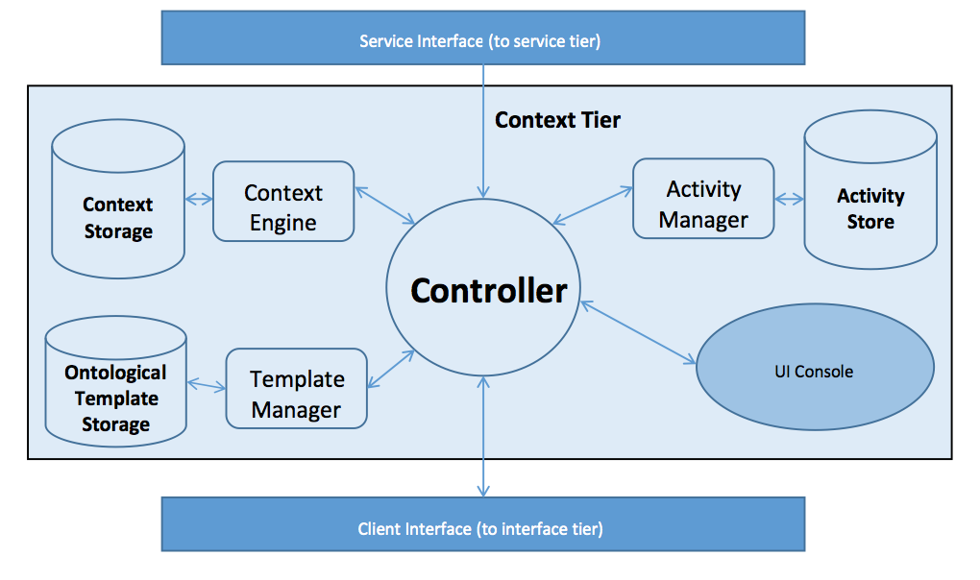
Rover Architecture

Slide 66
Rover Architecture
Controller
  Handles inter-module communication
  Answers External calls/API
Context Engine
  Fetches Context and provides relevant context
  Executes Dynamic Ontological Models
  Applies filters as needed to build models
Context Store
  Graph DB storing context models as they expand and are enriched
  Neo4j DB
Template Manager
  Fetches Ontological Models from Template Store

Slide 67
Rover Architecture
Template Store
  Ontological Store
  Holds models for entities, events, relationships and activities
Activity Manager
  Monitors activities as they are executed
    Evaluates goal states
  Monitors context in order to instantiate activities
Service Tier
  Access to external services
Client Interface
  Web Service / REST API
UI Console (forthcoming)
  Displays Situation Graph

Slide 68
Context Storage and Representation
Graph Database (Neo4j)
  Native Graph storage and processing
  Nodes and Relationships to store data
  A Graph –[:records_data]->Node-[:has]->Properties
Nodes are vertices
  Can be labeled/indexed
Relationships
  Can query relationships just as you would nodes
Both nodes and relationships are enriched through attributes
  key : value stores assign attributes in a NoSQL fashion

Slide 69
Example of situation graph expansion and contraction
Accident specifically Road Accident
Start with basic entities an relationships as model dictates
Dynamic Ontological Model expands and contracts situation graph as information becomes present or changes
  Information can be cached
  Models can be expanded
  Activities (as triggered) are instantiated
  Add additional entities as needed
Constant enrichment of relevant context

Slide 70
Relevant Context
Context that is relevant to the situation
Relevancy is determined by the situation itself
  Based on expert knowledge (static)
  Semantic Relatedness (real time)
If a person sustains an injury, certainly his medical information is relevant
If he obtained the injury because of an accident, automobile information is relevant too

Slide 71
Relevant Context - Demo
In the event of a `Road Accident’, relevant context for Car is - driver, passenger, model, owner
In the event of a `Accident induced personal injury’, relevant context for Person involved is - personal information, automobile information, medical records

Slide 72
Accident can be categorized as :
Road Accident
  Cars
  Persons
Chemical Accident
  Building
  Persons
Accident
Sub class
Sub class
Road Accident
Chemical Accident

Slide 73
Road Accident - Event
Road
Accident
Cars
Time
Persons
Location
Roads
Entities:
Roads affected
Cars
Persons
Attributes:
Location
Time
Involving
Impacting
Driven By
Involving

Slide 74
Person - Entity
Personal
Professional Credentials
Home
Owns
Person
Medical Records
Has
Automobile
Owns
Friends
Friend of
Name
SSN
Address
Blood Results
Contains
Blood Type
Weight
Height
Diploma?
Master’s Degree?
Job Title
Contains
Allergies

Slide 75
Car - Entity
Car
Person
Owned By
Driver
Driven By
Wanted by Police
Passenger
Passenger In
State
Purchase Details
Purchase Date
Purchase Price
Make
Model
Year
Color
VIN
Damaged?
Drivable?
Has Fuel?

Slide 76
Transport injured - Activity
Locate ambulance(s)
Select and Call
Get stretcher
Get injured
Transport to Location
Determine Location to Transport

Slide 77
Towing - Activity
Locate Towing Service
Place order
Hookup Car
Remove from Scene

Slide 78
Situation Graph – Accident Creation
Road Accident
Car 1
Car2
Persons
Location
Roads affected

Slide 79
Situation Graph
Road Accident
Driver 1
Car 1
Car 2
Location
Roads affected
Driver2
Basic Template Is now instantiated
  Basic entity list is added as model expand
Select relevant information about these entities for the situation

Slide 80
Car (Template)
Car
Owner
Owned By
Driver
Driven By
Criminal status
Passenger
Passenger In
State
Purchase Details
Purchase Date
Purchase Price
Make – Model
Tag#
Year
Color
VIN
Damaged?
Drivable?
Has Fuel?

Slide 81
Car – Relevant Information
Car
Owner
Owned By
Driver
Driven By
Criminal status
Passenger
Passenger In
State
Purchase Details
Purchase Date
Purchase Price
Make
Model
Year
Color
VIN
Damaged?
Drivable?
Has Fuel?

Slide 82
Person (Template)
Friends
Friend of
Personal
Professional Credentials
Home
Owns
Person
Medical Records
Has
Automobile
Owns
Name
SSN
Address
Blood Results
Contains
Blood Type
Weight
Height
Diploma?
Master’s Degree?
Job Title
Contains
Allergies

Slide 83
Person – Relevant Context
Friends
Friend of
Personal
Professional Credentials
Home
Owns
Person
Medical Records
Has
Automobile
Owns
Name
SSN
Address
Blood Results
Contains
Blood Type
Weight
Height
Diploma?
Master’s Degree?
Job Title
Contains
Allergies

Slide 84
Situation Graph – After Initial Template
Name
Address
Personal
Road Accident
Driver 1
Car 1
Location
Roads affected
Driver2
Car 2
Person 3
Driver Of
Owns
Stolen?
State
Person 4
Responds Tp
Stolen?
State
Driver Of,
Owns
Name
Address
Personal

Slide 85
Situation Graph – As info comes in
Name
Address
Personal
Road Accident
Driver 1
Car 1
Location
Roads affected
Driver2
Car 2
Person 3
Driver Of
Owns
Stolen?
State
Person 4
Responds Tp
Stolen?
State
Driveable? - Yes
Driver Of,
Owns
John Doe
123 Fake St
Personal
Honda Acord
MD Tags 123ABC

Slide 86
Situation Graph – Dynamic Ontology Performs Automatic Query
Name
Address
Personal
Road Accident
Driver 1
Car 1
Location
Roads affected
Driver2
Car 2
Person 3
Driver Of
Owns
Stolen?
State
Person 4
Responds Tp
Stolen?
Yes
State
Driveable? - Yes
Driver Of,
Owns
John Doe
123 Fake St
Personal
Honda Acord
MD Tags 123ABC

Slide 87
Situation Graph – Context Triggers Activity
Name
Address
Personal
Road Accident
Driver 1
Car 1
Location
Roads affected
Driver2
Car 2
Person 3
Make Arrest
Locate Towing Service
Place order
Hookup Car
Remove from Scene
Driver Of
Owns
Person 4
Responds Tp
Stolen?
Yes
State
Driveable? - Yes
Driver Of,
Owns
John Doe
123 Fake St
Personal
Honda Acord
MD Tags 123ABC

Slide 88
Situation Graph – More Information
Jane Doe
234 Elm St.
Injured!
Name
Address
Personal
Personal
Road Accident
Driver 1
Car 1
Location
Roads affected
Driver2
Car 2
Person 3
Driver Of
Owns
Stolen
No
State
Person 4
Responds Tp
Stolen?
State
Driveable? - Yes
Driver Of,
Owns
John Doe
123 Fake St
Personal
Honda Acord
MD Tags 123ABC

Slide 89
Situation Graph – Context Caches Information by Expanding Situation Graph
Jane Doe
234 Elm St.
Injured!
Name
Address
Personal
Personal
Medical Records
Road Accident
Driver 1
Car 1
Location
Roads affected
Driver2
Car 2
Person 3
Driver Of
Owns
Person 4
Responds Tp
Driver Of,
Owns
John Doe
123 Fake St
Personal

Slide 90
Situation Graph – Context Triggers Activity
Jane Doe
234 Elm St.
Injured!
Name
Address
Personal
Personal
Medical Records
Road Accident
Driver 1
Car 1
Location
Roads affected
Driver2
Car 2
Person 3
Driver Of
Locate ambulance(s)
Select and Call
Get stretcher
Get injured
Transport to Location
Determine Location to Transport
Owns
Person 4
Responds Tp
Assists With
Person 5
Driver Of,
Owns
John Doe
123 Fake St
Personal

Slide 91
Merging Situation Graphs
When two situation graphs have a common node the graphs may be merged
Merged situation graph may be given a new identity with the identity of the two situations merged kept in the log.

