Slide 1

Computer Networks
CMSC 417 : Spring 2025
Topic: VPN, IPV6, Transport layer
(Textbook chapter 3 & 5)
Nirupam Roy
Tu-Th 2:00-3:15pm
CSI 2117
March 12th, 2025

Slide 2
Virtual Networks and Tunnels

Slide 3
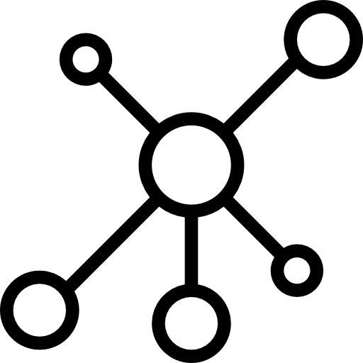


Untrusted/Shared network
Gateway A
Gateway B
IP Header
Data
Trusted network (Site A)
Trusted network (Site B)

Slide 4
Untrusted/Shared network
Gateway A
Gateway B
Virtual Tunnel
IP Header
Data
Trusted network (Site A)
Trusted network (Site B)

Slide 5
New IP Header Source: Gateway-A Dest: Gateway-B
Encapsulation
IP Header
Data
Untrusted/Shared network
Gateway A
Gateway B
Virtual Tunnel
IP Header
Data
Trusted network (Site A)
Trusted network (Site B)

Slide 6
New IP Header Source: Gateway-A Dest: Gateway-B
Decapsulation
New IP Header Source: Gateway-A Dest: Gateway-B
IP Header
Data
IP Header
Data
Untrusted/Shared network
Gateway A
Gateway B
Virtual Tunnel
IP Header
Data
Trusted network (Site A)
Trusted network (Site B)

Slide 7
Untrusted/Shared network
Gateway A
Gateway B
Virtual Tunnel
IP Header
Data
IP Header
Data
Trusted network (Site A)
Trusted network (Site B)

Slide 8

New IP Header Source: Gateway-A Dest: Gateway-A
New IP Header Source: Gateway-A Dest: Gateway-A
Encryption/Decryption
IP Header
Data
IP Header
Data
Untrusted/Shared network
Gateway A
Gateway B
Virtual Tunnel
IP Header
Data
Trusted network (Site A)
Trusted network (Site B)

Slide 9
Untrusted/Shared network
Gateway A
Gateway B
Virtual Tunnel
Virtual Private Network
(VPN)
Trusted network (Site A)
Trusted network (Site B)

Slide 10
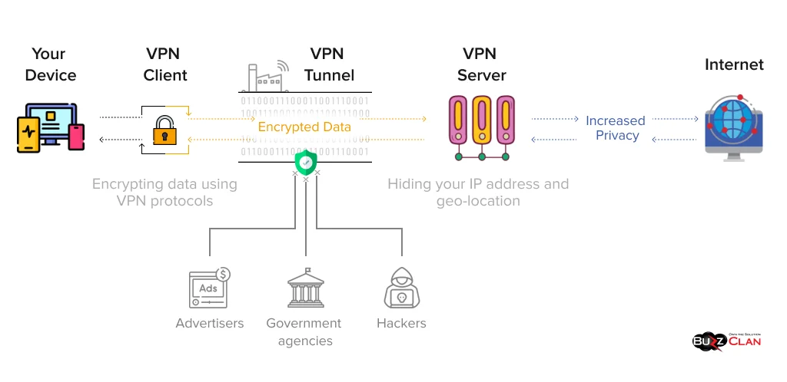
Picture: https://buzzclan.com/cyber-security/how-does-a-vpn-work/

Slide 11
Why do we need virtual networks or tunnels?
1. Security
2. Special capabilities between routers (e.g., multicast)
3. Supporting heterogeneity

Slide 12
Why do we need virtual networks or tunnels?
1. Security
2. Special capabilities between routers (e.g., multicast)
3. Supporting heterogeneity
Disadvantages:
1. Increases packet length
a) Wastage of bandwidth
b) More processing
c) Fragmentation
2. Increases management cost

Slide 13
IPv6
1) Address and packet format
2) Unicast, Multicast, Anycast addressing
3) IPV4 and IPV6 coexistence

Slide 14
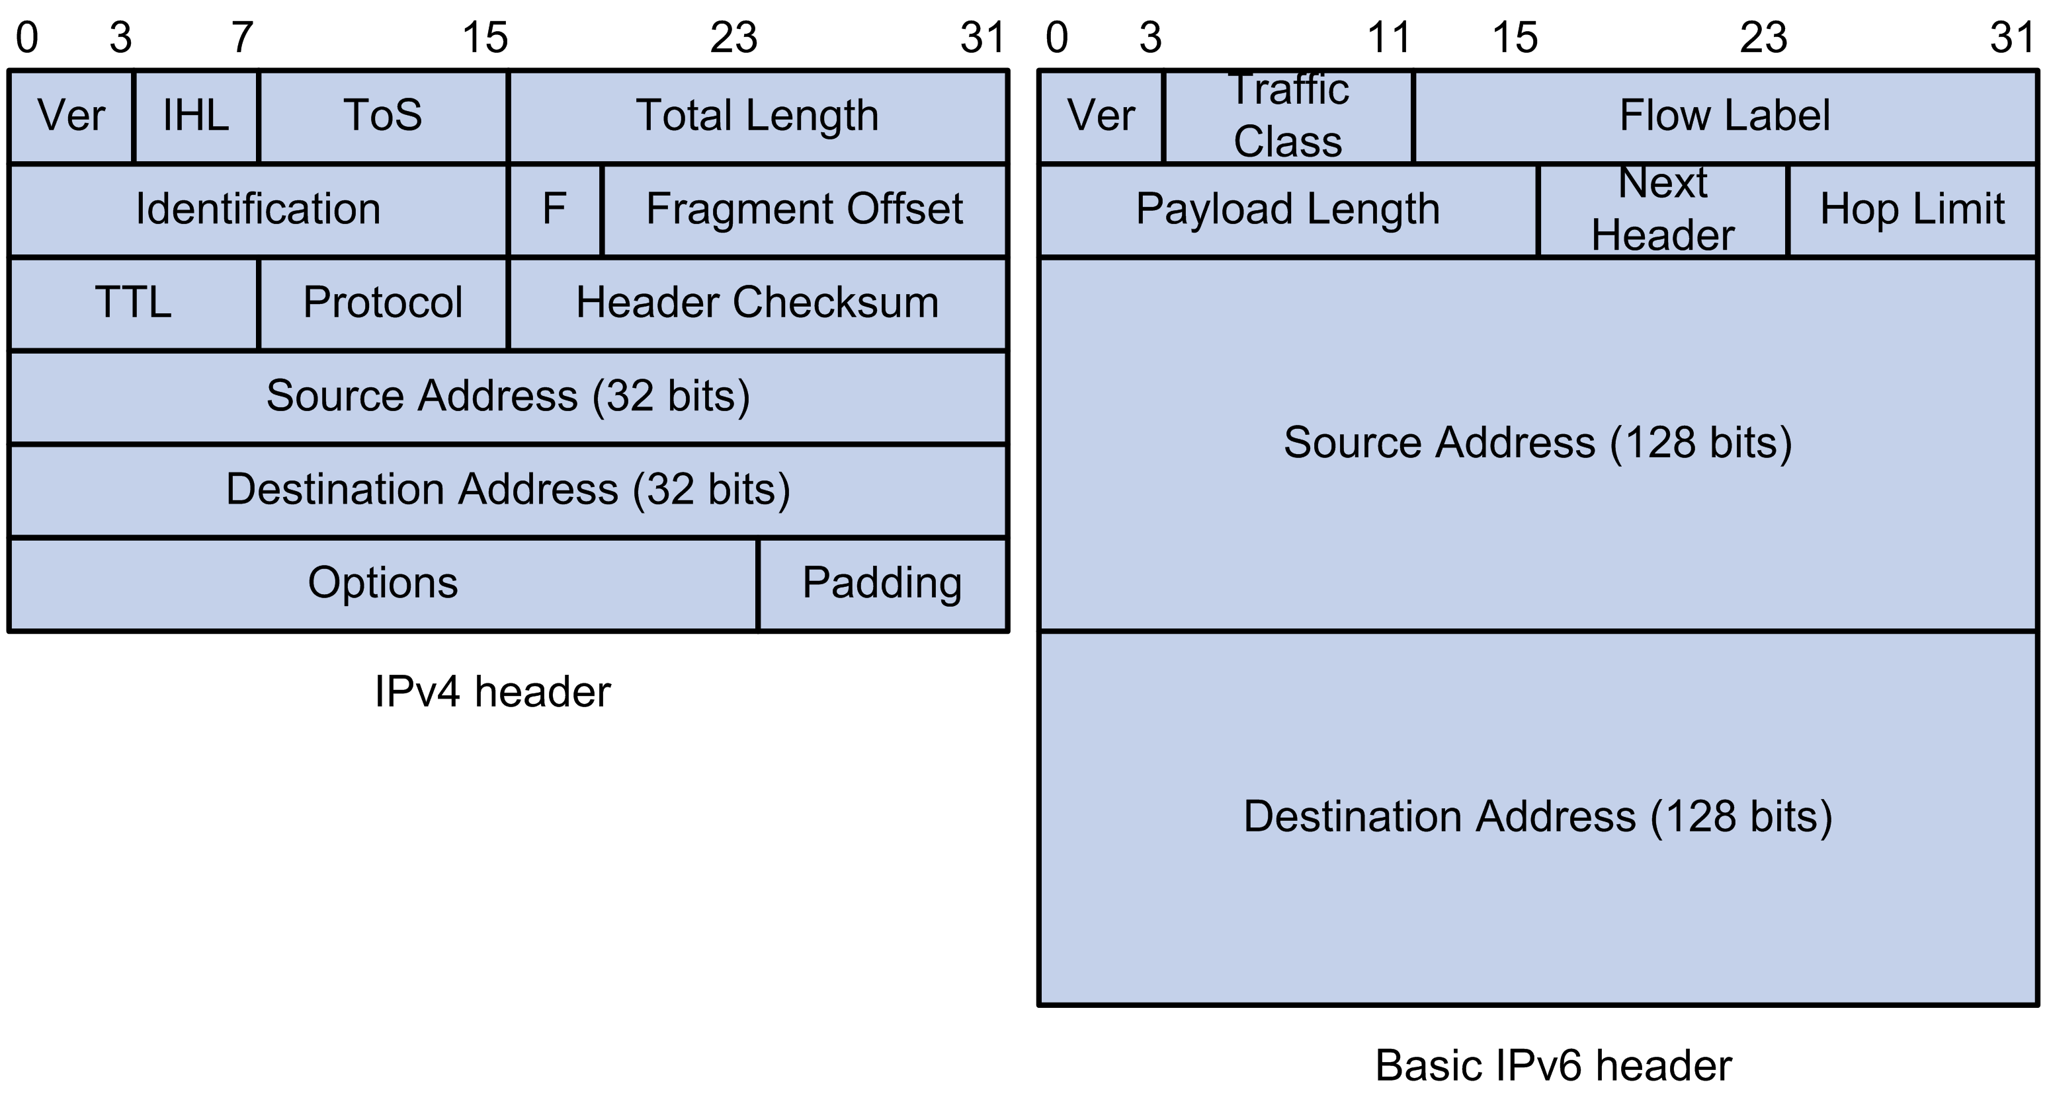
IPv6: Address and packet format
Pic courtesy: https://techhub.hpe.com

Slide 15
IPv6: Address and packet format
Q 1. Why is there no header checksum?
Q 2. Why is there no fragmenting related option?
Q 3. Is 128-bit IP address big enough?
Pic courtesy: https://techhub.hpe.com
Notes:
IPv6 provides for a maximum of 3.4×10^38 (340 trillion trillion trillion) unique IP addresses, or about 47 octillion unique addresses for every person on the planet.
For comparison: One light-year is about 6 trillion miles (9 trillion km)
Q1: Does not provide much quality of service when the delivery policy itself is unreliable,
Q2: Pushing the responsibility to the edge. With increasing traffic fragmentation is computation costly.

Slide 16
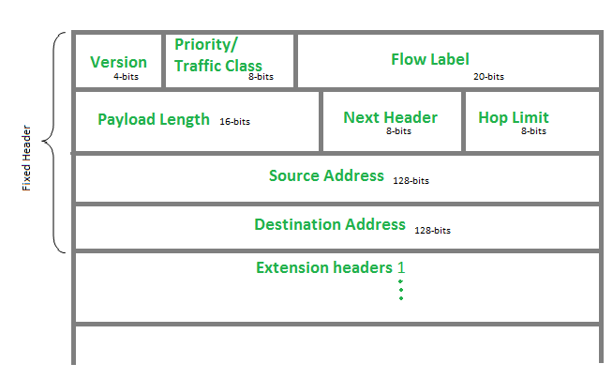
Notes:
Fragmentations are possible in IPV6, but only at source. And in that case an extension header will be defined.

Slide 17
IPv6: Address and packet format
Q 1. Why is there no header checksum?
Q 2. Why is there no fragmenting related option?
Q 3. Is 128-bit IP address big enough?
Pic courtesy: https://techhub.hpe.com
Notes:
IPv6 provides for a maximum of 3.4×10^38 (340 trillion trillion trillion) unique IP addresses, or about 47 octillion unique addresses for every person on the planet.
For comparison: One light-year is about 6 trillion miles (9 trillion km)
Q1: Does not provide much quality of service when the delivery policy itself is unreliable,
Q2: Pushing the responsibility to the edge. With increasing traffic fragmentation is computation costly.

Slide 18
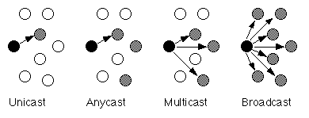
Unicast, Multicast, Anycast, Broadcast

Slide 19
Unicast, Multicast, Anycast, Broadcast
IPv4
IPv4
IPv4

Slide 20
Unicast, Multicast, Anycast, Broadcast
IPv4
IPv4
IPv4
IPv6
IPv6
IPv6

Slide 21
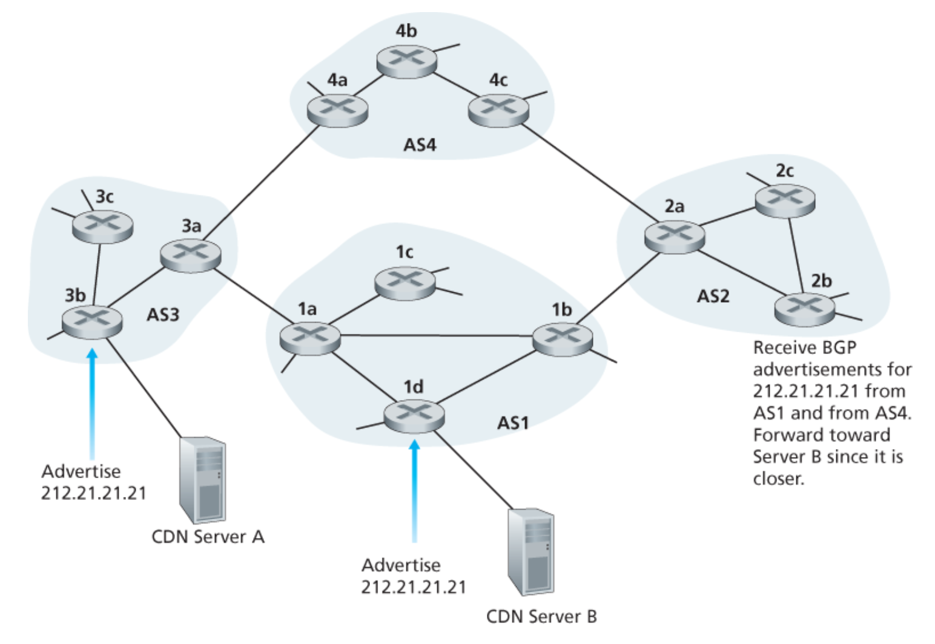
Unicast, Multicast, Anycast, Broadcast
IP: Anycast example

Slide 22
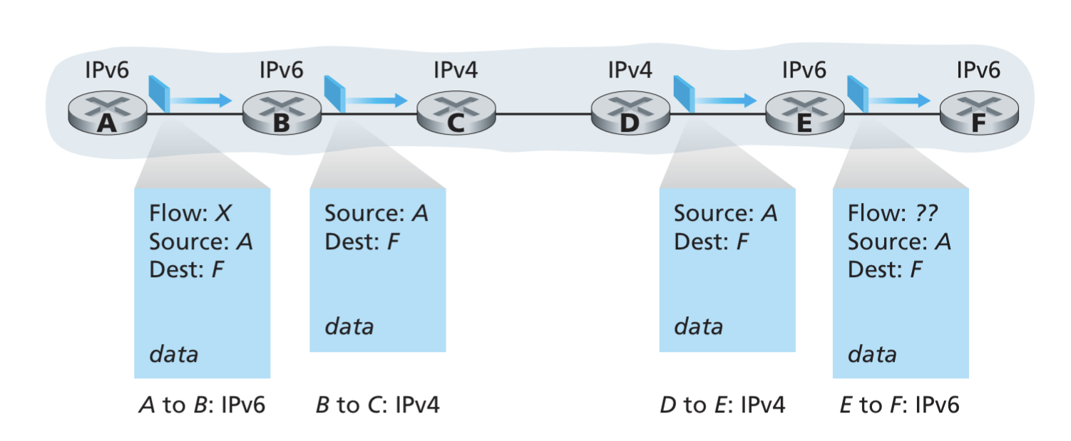
IPv4 and IPv6 Co-existence

Slide 23
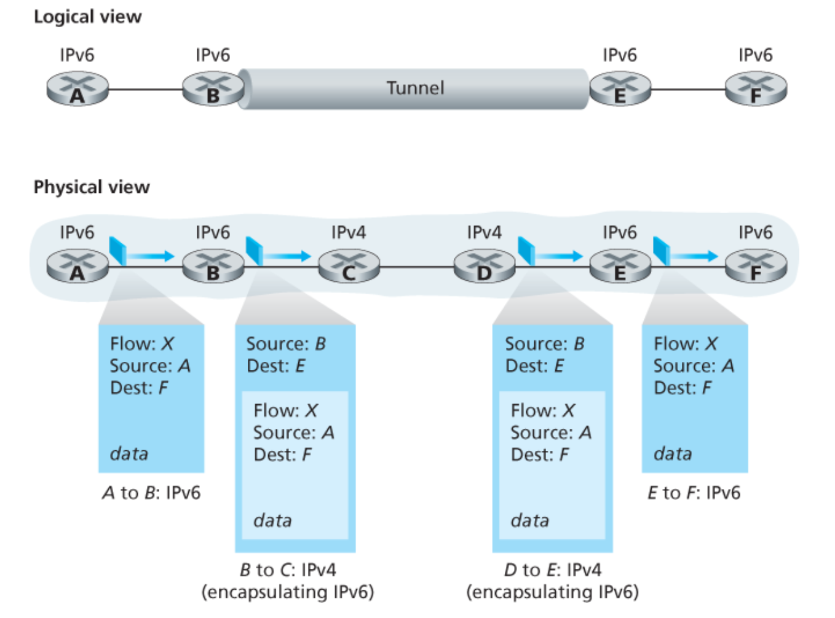
IPv4 and IPv6 Co-existence

Slide 24
Computer Networks
CMSC 417 : Spring 2025
Topic:
Transport Layer Protocols (UDP, TCP)
(Textbook chapter 5)
Nirupam Roy
Tu-Th 2:00-3:15pm
CSI 2117
March 12th, 2025

Slide 25
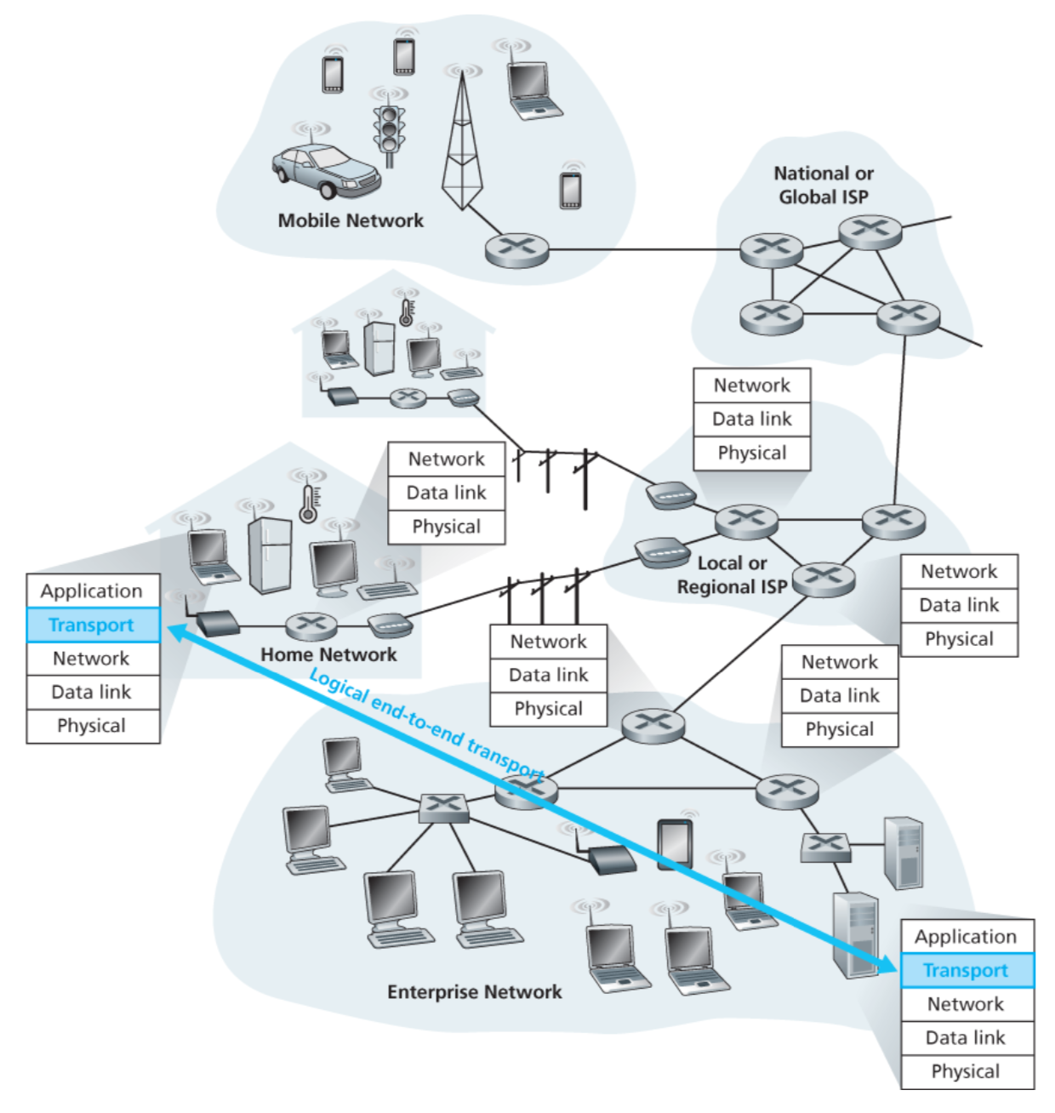

Slide 26
Transport layer: From the lens of two perspectives
(1) Abstraction of clients. (machines/networks/processes)
(2) Abstraction of services.

Slide 27
(1) Abstraction of clients

Slide 28
Network layer abstraction
128.2.0.0/16
200.30.0.0/16
16.20.0.0/20
Network 1
Network 3
Network 2

Slide 29
Network layer abstraction
128.2.0.0/16
200.30.0.0/16
16.20.0.0/20
Network 1
Network 3
Network 2

Slide 30
Network layer abstraction
Network layer services
128.2.0.0/16
200.30.0.0/16
16.20.0.0/20
Network 1
Network 3
Network 2

Slide 31
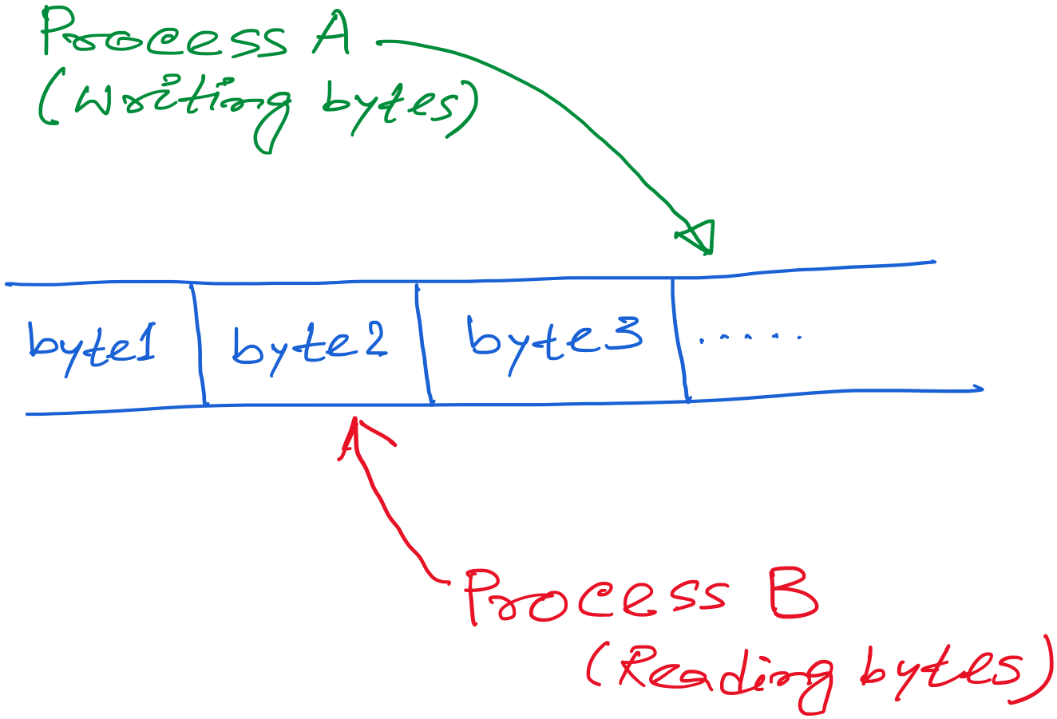
Transport layer abstraction

Slide 32
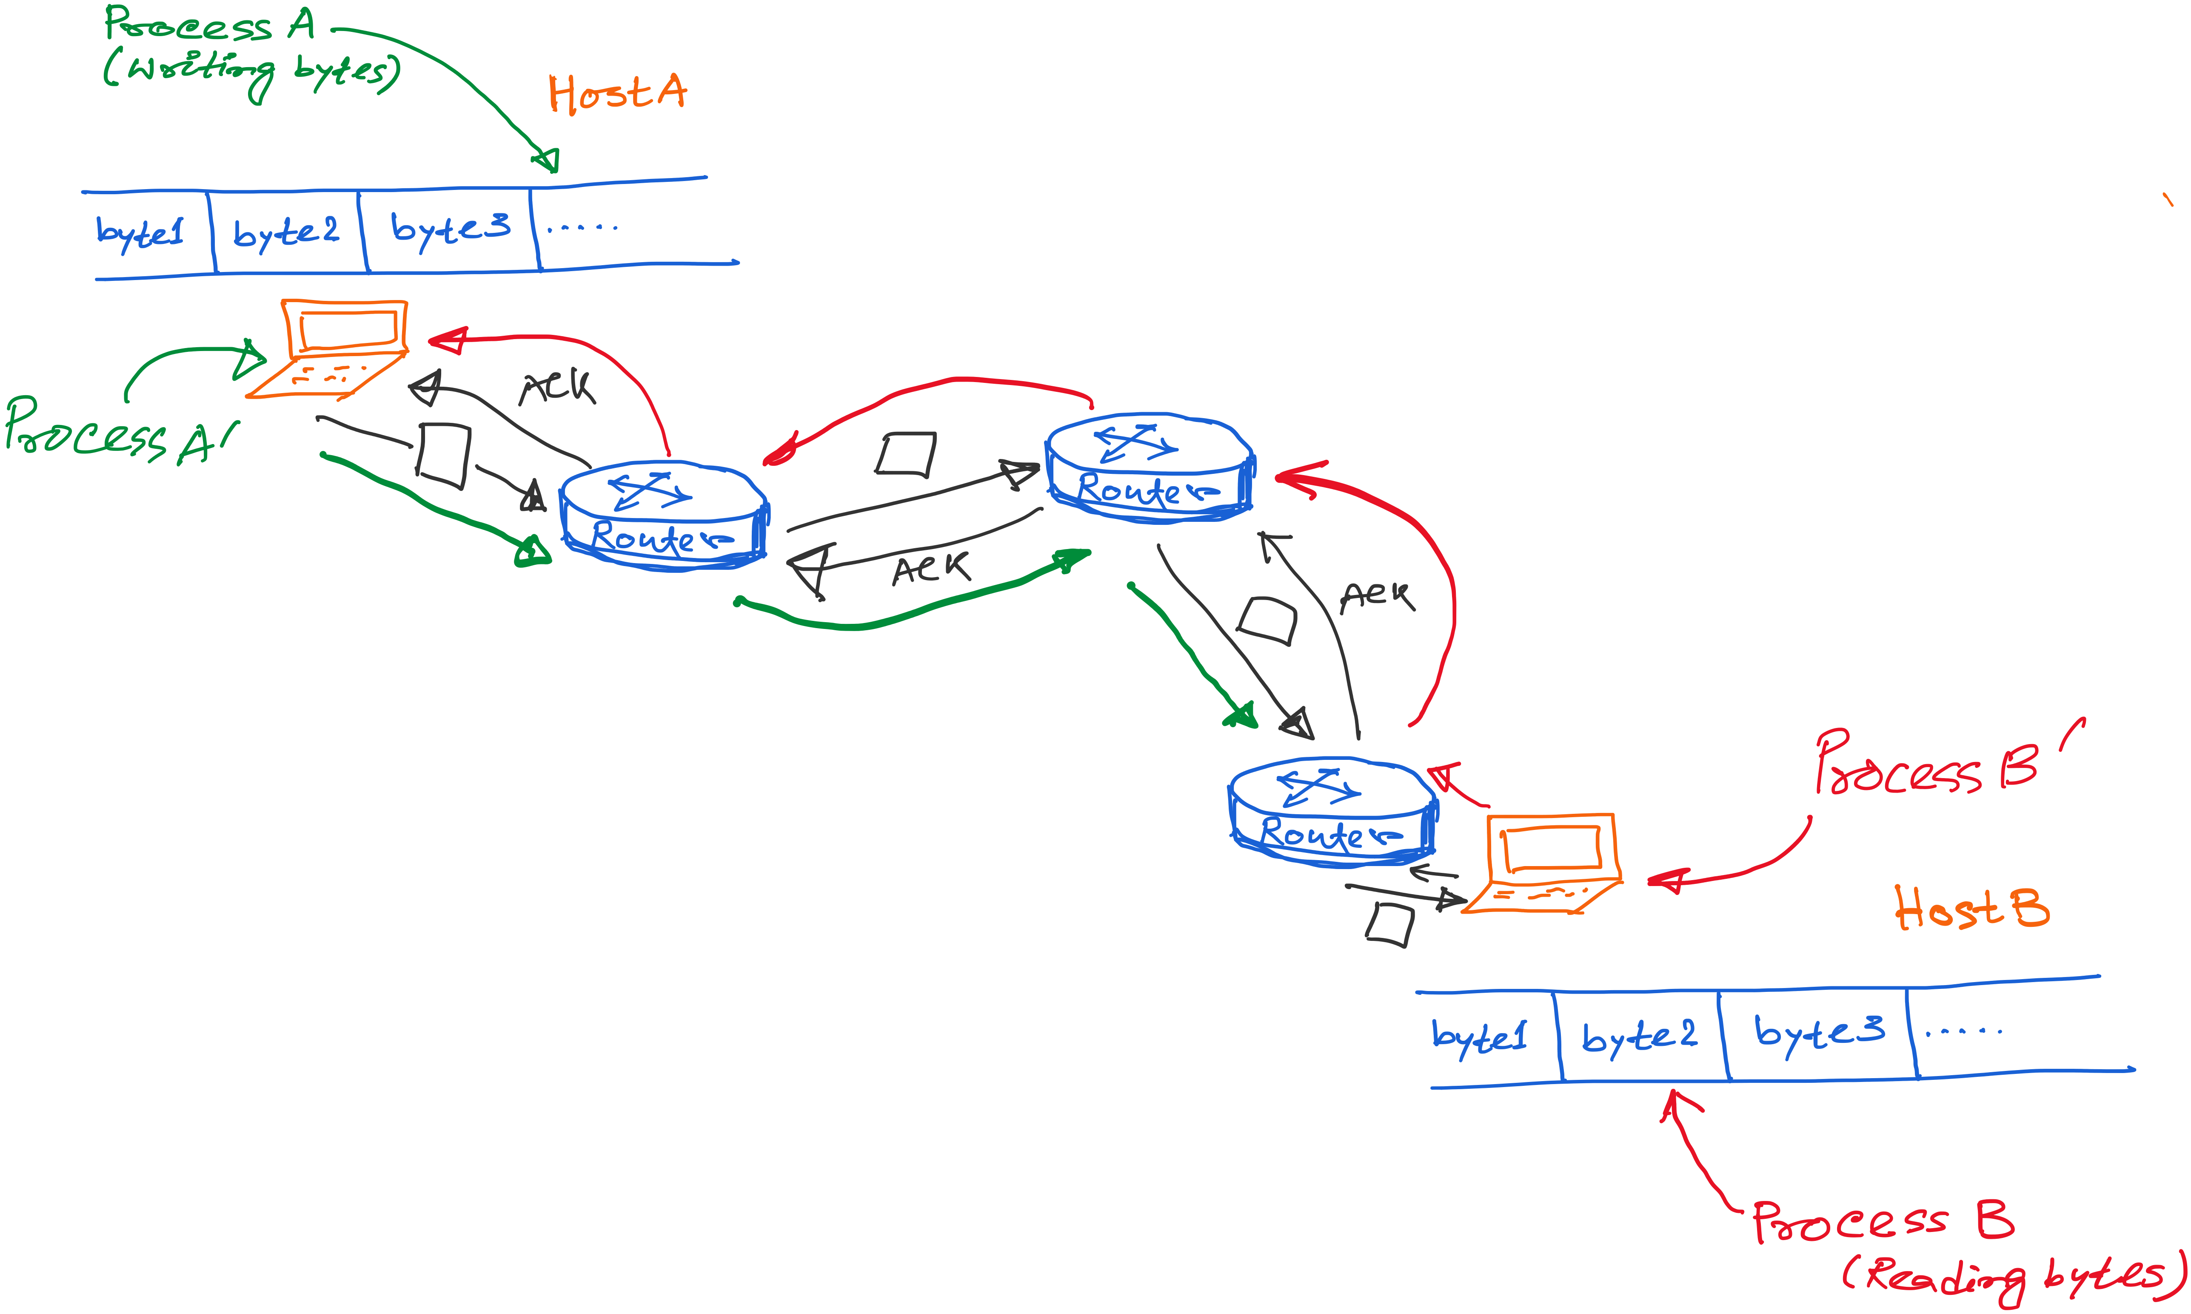
Transport layer abstraction
Transport layer services

Slide 33
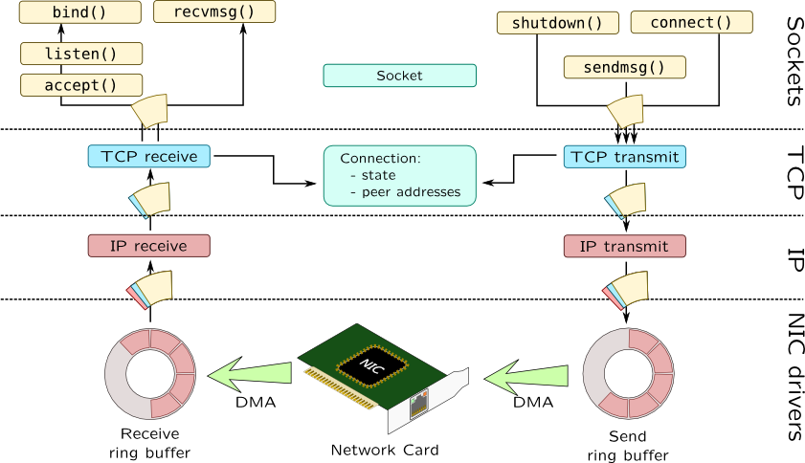

Slide 34
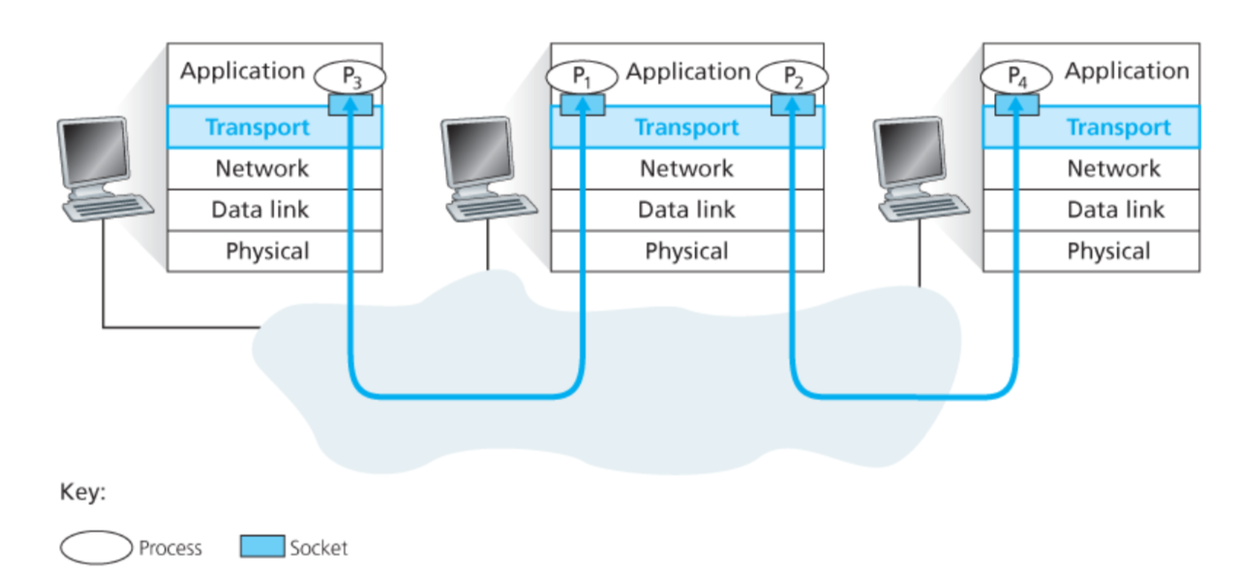
Connection between processes

Slide 35
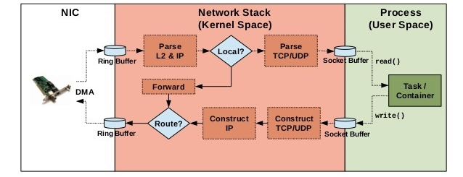
Implementation of networking algorithms

Slide 36
Transport Protocols
Logical communication between processes
  Sender divides a message into segments
  Receiver reassembles segments into message
Transport services
  (De)multiplexing packets
  Detecting corrupted data
  Optionally: reliable delivery, flow control, …

Slide 37
Two Basic Transport Features
Demultiplexing: port numbers
Error detection: checksums
Server host 128.2.194.242
Service request for
128.2.194.242:80
(i.e., the Web server)
Client host
Web server
(port 80)
Client
OS
Echo server
(port 7)
IP
payload
detect corruption

Slide 38
Multiplexing/demultiplexing
Demultiplexing at rcv host:
Multiplexing at send host:
delivering received segments
to correct socket
Data headers helps flows
from multiple sockets to use
common the network channel,
Info in header later helps
Demultiplexing.
= socket
= process
application
application
application
P4
P3
P1
P2
P1
transport
transport
transport
network
network
network
link
link
link
physical
physical
physical
host 1
host 2
host 3

Slide 39
How demultiplexing works
1) host receives IP datagrams
  each datagram has source IP address, destination IP address
  each datagram carries 1 transport-layer segment
  each segment has source, destination port number
2) host uses IP addresses & port numbers to direct segment to appropriate socket
32 bits
source port #
dest port #
other header fields
application
data
(message)
TCP/UDP segment format

Slide 40
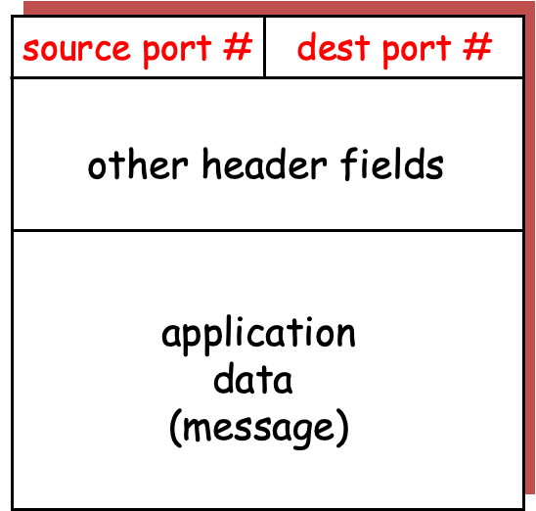
application
application
P3
P1
P2
P1
transport
transport
network
network
link
link
physical
physical
host 1
host 2

Slide 41
application
application
P3
P1
P2
P1
transport
transport
network
network
link
link
physical
physical
host 1
host 2

Slide 42
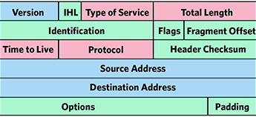
application
application
P3
P1
P2
P1
transport
transport
network
network
link
link
physical
physical
host 1
host 2

Slide 43
application
application
P3
P1
P2
P1
transport
transport
network
network
link
link
physical
physical
host 1
host 2

Slide 44
application
application
P3
P1
P2
P1
transport
transport
network
network
link
link
physical
physical
host 1
host 2

Slide 45
Connection-less mux/demux:
- User Datagram Protocol (UDP)
Connection-oriented mux/demux:
- Transmission Control Protocol (TCP)

Slide 46
Connectionless demultiplexing
When host receives UDP segment:
  checks destination port number in segment
  directs UDP segment to socket with that port number
IP datagrams with different source IP addresses and/or source port numbers directed to same socket
Create sockets with port numbers:
DatagramSocket mySocket1 = new DatagramSocket(99111);
DatagramSocket mySocket2 = new DatagramSocket(99222);
UDP socket identified by two-tuple:
(dest IP address, dest port number)

Slide 47
Connectionless demux (cont)
DatagramSocket serverSocket = new DatagramSocket(6428);
P2
P1
P3
P1
SP: 6428
SP: 6428
DP: 9157
DP: 5775
SP: 9157
SP: 5775
client
IP: A
DP: 6428
server
IP: C
DP: 6428
Client
IP:B
SP provides “return address”

Slide 48
Connection-oriented demux
TCP socket identified by 4-tuple:
  source IP address
  source port number
  dest IP address
  dest port number
recv host uses all four values to direct segment to appropriate socket
Server host may support many simultaneous TCP sockets:
  each socket identified by its own 4-tuple
Web servers have different sockets for each connecting client
  non-persistent HTTP will have different socket for each request

Slide 49
Connection-oriented demux (cont)
= socket
= process
P1
P4
P5
P6
P2
P1
P3
SP: 5775
DP: 80
S-IP: B
D-IP:C
SP: 9157
SP: 9157
client
IP: A
DP: 80
server
IP: C
DP: 80
Client
IP:B
S-IP: A
S-IP: B
D-IP:C
D-IP:C

Slide 50
Connection-oriented demux: Threaded Web Server
= socket
= process
P1
P4
P2
P1
P3
SP: 5775
DP: 80
S-IP: B
D-IP:C
SP: 9157
SP: 9157
client
IP: A
DP: 80
server
IP: C
DP: 80
Client
IP:B
S-IP: A
S-IP: B
D-IP:C
D-IP:C

Slide 51
(2) Abstraction of services

Slide 52
IP Protocol Stack: Key Abstractions
Application
Applications
Transport
Streams of data
Messages
Network
Best-effort global packet delivery
Best-effort local packet delivery
Link
Transport layer is where we “pay the piper”
  Provide applications with good abstractions
  Without support or feedback from the network

Slide 53
End-to-end Protocols
(UDP, TCP)

Slide 54
End-to-end Protocols
Common properties that a transport protocol can be expected to provide
  Guarantees message delivery
  Delivers messages in the same order they were sent
  Delivers at most one copy of each message
  Supports arbitrarily large messages
  Supports synchronization between the sender and the receiver
  Allows the receiver to apply flow control to the sender
  Supports multiple application processes (Mux/DeMux)

Slide 55
End-to-end Protocols
Typical limitations of the network on which transport protocol will operate
  Drop messages/Packet loss
  Reorder messages/Out of order delivery
  Deliver duplicate copies of a given message
  Limit messages to some finite size
  Deliver messages after an arbitrarily long delay

Slide 56
End-to-end Protocols
Challenge for Transport Protocols
  Develop algorithms that turn the less-than-desirable properties of the underlying network into the high level of service required by application programs

Slide 58
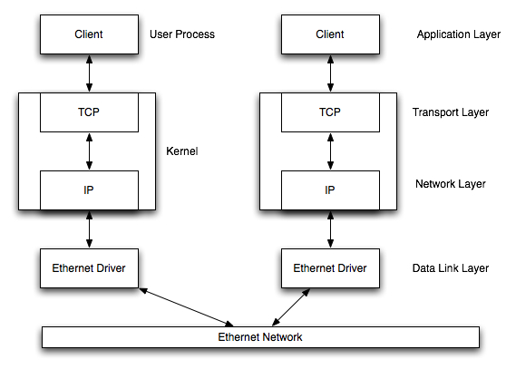

Slide 59
User Datagram Protocol (UDP)

Slide 60
UDP: User Datagram Protocol [RFC 768]
Bare minimum Internet transport protocol
“best effort” service, UDP segments may be:
  lost
  delivered out of order to app
connectionless:
  no handshaking between UDP sender, receiver
  each UDP segment handled independently of others

Slide 61
User Datagram Protocol (UDP)
Datagram messaging service
  Demultiplexing: port numbers
  Detecting corruption: checksum
Lightweight communication between processes
  Send and receive messages
  Avoid overhead of any ordered, reliable delivery
SRC port
DST port
length
checksum
DATA

Slide 62
UDP: more
often used for streaming multimedia apps
  loss tolerant
  rate sensitive
other UDP uses
  DNS
  SNMP
reliable transfer over UDP: add reliability at application layer
  application-specific error recovery!
32 bits
Length, in
bytes of UDP
segment,
including
header
source port #
dest port #
length
checksum
Application
data
(message)
UDP segment format

Slide 63
UDP checksum
Goal: detect “errors” (e.g., flipped bits) in transmitted segment
Sender:
treat segment contents as sequence of 16-bit integers
checksum: addition (1’s complement sum) of segment contents
sender puts checksum value into UDP checksum field
Receiver:
compute checksum of received segment
check if computed checksum equals checksum field value:
  NO - error detected
  YES - no error detected.
Is UDP service == IP service ??

Slide 64
Recall encapsulation

Slide 65
Advantages of UDP
Fine-grain control
  UDP sends as soon as the application writes
No connection set-up delay
  UDP sends without establishing a connection
No connection state
  No buffers, parameters, sequence #s, etc.
Small header overhead
  UDP header is only eight-bytes long

Slide 66
Popular Applications That Use UDP
Multimedia streaming
  Retransmitting packets is not always worthwhile
  E.g., phone calls, video conferencing, gaming, IPTV
Simple query-response protocols
  Overhead of connection establishment is overkill
  E.g., Domain Name System (DNS), DHCP, etc.
“Address for www.cnn.com?”
“12.3.4.15”

Slide 67
How to introduce reliability in transport?

Slide 68
What are the expectations from a reliable packet delivery system?
Guaranteed delivery
Ordered delivery
At-most one copy of the message
(any or all of the above)

Slide 69
What are the features of the underlying ‘best effort’ network?
Packet loss
Out of order delivery
Multiple copies
Delay variations
A non-zero probability of packet delivery

Slide 70
Transmission Control Protocol (TCP)

Slide 71
TCP “Segments”
Host A
Byte 0
Byte 1
Byte 2
Byte 3
Byte 80
Segment sent when:
Segment full (Max Segment Size),
Not full, but times out, or
“Pushed” by application.
TCP Data
TCP Data
Host B
Byte 0
Byte 1
Byte 2
Byte 3
Byte 80

Slide 72
Sequence Number
Host A
ISN (initial sequence number)
Byte 81
Sequence number =
ISN+ # of the 1st byte the segment
TCP Data
TCP Data
Host B

Slide 73
Sequence Number
Host A
ISN (initial sequence number)
Byte 81
Sequence number =
ISN+ # of the 1st byte the segment
TCP Data
TCP Data
Host B
How are acknowledgements identified?

Slide 74
TCP Header

Slide 75
Acknowledgement Number
Host A
ISN (initial sequence number)
Byte 81
Sequence number =
ISN+ # of the 1st byte the segment
TCP Data
TCP Data
Host B

Slide 76
Starting and Ending a Connection:
TCP Handshakes
(Three-Way Handshake)

Slide 77
Establishing a TCP Connection
A
B
SYN
SYN ACK
Each host tells its ISN to the other host.
ACK
Data
Data
Three-way handshake to establish connection
  Host A sends a SYN (open) to the host B
  Host B returns a SYN acknowledgment (SYN ACK)
  Host A sends an ACK to acknowledge the SYN ACK

Slide 78
TCP Header
32 bits
Source port
Destination port
Sequence number
Flags:
SYN
FIN
RST
PSH
URG
ACK
Acknowledgment
HdrLen
0
Flags
Advertised window
Checksum
Urgent pointer
Options (variable)
Data

Slide 79
TCP Header

Slide 82
Step 1: A’s Initial SYN Packet
A’s port
B’s port
A’s Initial Sequence Number
Flags:
SYN
FIN
RST
PSH
URG
ACK
Acknowledgment
20
Flags
Advertised window
0
Checksum
Urgent pointer
Options (variable)
A tells B it wants to open a connection…

Slide 85
Step 2: B’s SYN-ACK Packet
B’s port
A’s port
B’s Initial Sequence Number
Flags:
SYN
FIN
RST
PSH
URG
ACK
A’s ISN plus 1
20
Flags
Advertised window
0
Checksum
Urgent pointer
Options (variable)
B tells A it accepts, and is ready to hear the next byte…
… upon receiving this packet, A can start sending data

Slide 88
Step 3: A’s ACK of the SYN-ACK
A’s port
B’s port
Sequence number
Flags:
SYN
FIN
RST
PSH
URG
ACK
B’s ISN plus 1
20
Flags
Advertised window
0
Checksum
Urgent pointer
Options (variable)
A tells B it is okay to start sending
… upon receiving this packet, B can start sending data

Slide 90
What is really happening?
Exchange of ISNs
(a) Alice --> Bob SYNchronize with my Initial Sequence Number of X
(b) Alice <-- Bob I received your syn, I ACKnowledge that I am ready for [X+1]
(c) Alice <-- Bob SYNchronize with my Initial Sequence Number of Y
(d) Alice --> Bob I received your syn, I ACKnowledge that I am ready for [Y+1]
Piggybacking information
(a) Alice --> Bob : SYN
(b) Alice <-- Bob : SYN+ACK
(c) Alice --> Bob : ACK
Can data piggyback on 3-way handshake packets?

Slide 91
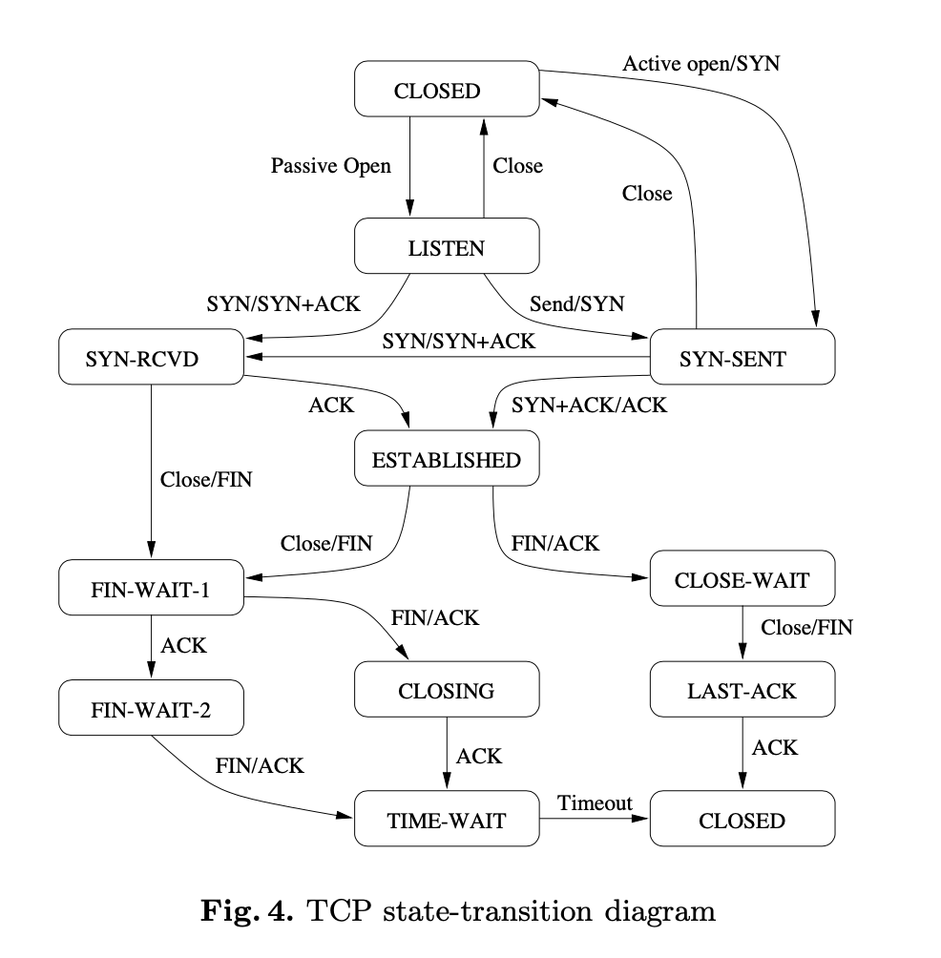
[Ref] Efficient Reachability Analysis of Hierarchical Reactive Machines

Slide 92
What if the SYN Packet Gets Lost?
Suppose the SYN packet gets lost
  Packet is lost inside the network, or
  Server rejects the packet (e.g., listen queue is full)
Eventually, no SYN-ACK arrives
  Sender sets a timer and wait for the SYN-ACK
  … and retransmits the SYN if needed
How should the TCP sender set the timer?
  Sender has no idea how far away the receiver is
  Some TCPs use a default of 3 or 6 seconds

Slide 93
SYN Loss and Web Downloads
User clicks on a hypertext link
  Browser creates a socket and does a “connect”
  The “connect” triggers the OS to transmit a SYN
If the SYN is lost…
  The 3-6 seconds of delay is very long
  The impatient user may click “reload”
User triggers an “abort” of the “connect”
  Browser “connects” on a new socket
  Essentially, forces a fast send of a new SYN!

Slide 94
Tearing Down the Connection
B
ACK
SYN
SYN ACK
Data
ACK
FIN
ACK
FIN
ACK
A
time
Closing (each end of) the connection
  Finish (FIN) to close and receive remaining bytes
  And other host sends a FIN ACK to acknowledge

Slide 95
Tearing Down the Connection
B
ACK
SYN
SYN ACK
Data
ACK
FIN
ACK
FIN
ACK
A
time
Closing (each end of) the connection
  Finish (FIN) to close and receive remaining bytes
  And other host sends a FIN ACK to acknowledge
  Reset (RST) to close and not receive remaining bytes

Slide 96
Sending/Receiving the FIN Packet
Sending a FIN: close()
  Process is done sending data via the socket
  Process invokes “close()” to close the socket
  Once TCP has sent all the outstanding bytes…
  … then TCP sends a FIN
Receiving a FIN: EOF
  Process is reading data from the socket
  Eventually, the attempt to read returns an EOF

