Slide 1
Computer Networks
CMSC 417 : Spring 2025
Topic: DHCP, NAT, ARP, ICMP
(Textbook chapter 3)
Nirupam Roy
Tu-Th 2:00-3:15pm
CSI 2117
March 10th, 2025

Slide 2
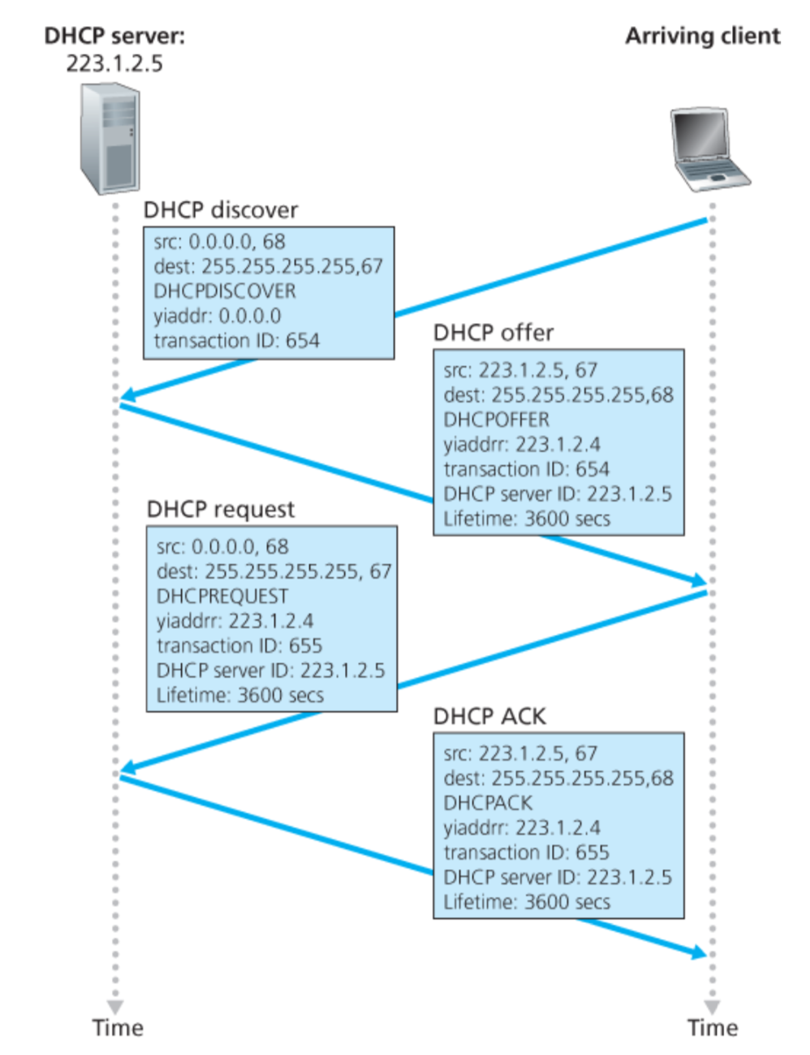
<Discover>
Broadcast: is there a DHCP server out there?
<Offer>
Broadcast: I’m a DHCP server! Here’s an IP address you can use
<Request> Broadcast: OK. I’ll take that IP address! Can I ?
<Ack>
Broadcast: OK. You’ve got that IP address!
Discussion Point 1: The transaction ID (xid). RFC 2131
Discussion Point 2: Broadcast address. (Limited/Directed broadcast)
Notes:
RFC 2131, Page [39]: The DHCP client broadcasts DHCPDISCOVER, DHCPREQUEST and DHCPINFORM messages, unless the client knows the address of a DHCP server. The client unicasts DHCPRELEASE messages to the server.
DHCP is not intended for use in configuring routers.

Slide 3
Broadcast addresses: Limited and Directed broadcast
Broadcast traffic is sent to all stations on a LAN.
There are two types of IPv4 broadcast addresses:
Limited broadcast: The limited broadcast address is
255.255.255.255. It is “limited” because it is never forwarded across a router.
(b) Directed broadcast: The directed (also called net-directed) broadcast address of the 192.0.2.0/24 network is 192.0.2.255 (the host portion of the address is all “1”s in binary, or 255). It is called “directed” broadcast, because traffic to these addresses may be sent from remote networks (it may be “directed”).

Slide 4
DHCP: more than IP addresses
DHCP can return more than just allocated IP address on subnet:
address of first-hop router for client
name and IP address of DNS sever
network mask (indicating network versus host portion of address)

Slide 5
Dynamic Host Configuration Protocol (DHCP)
DHCP server is responsible for providing configuration information to hosts
DHCP server maintains a pool of available addresses
There is at least one DHCP server for an administrative domain (a server or a relay agent per subnet)

Slide 6
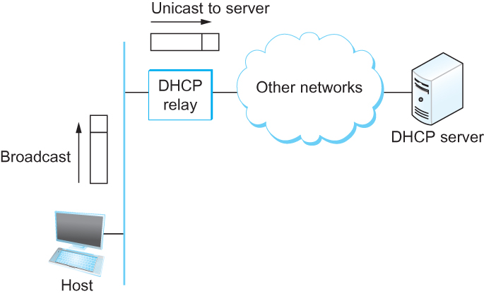
DHCP relay
Newly booted or attached host sends DHCPDISCOVER message to a special IP address (255.255.255.255)
DHCP relay agent unicasts the message to DHCP server and waits for the response

Slide 7
Check your IP addresses
ifconfig (linux/mac) / ipconfig (windows)

Slide 8
Check your IP addresses
(ifconfig/ipconfig)

Slide 9
Private Address Space & NAT

Slide 10
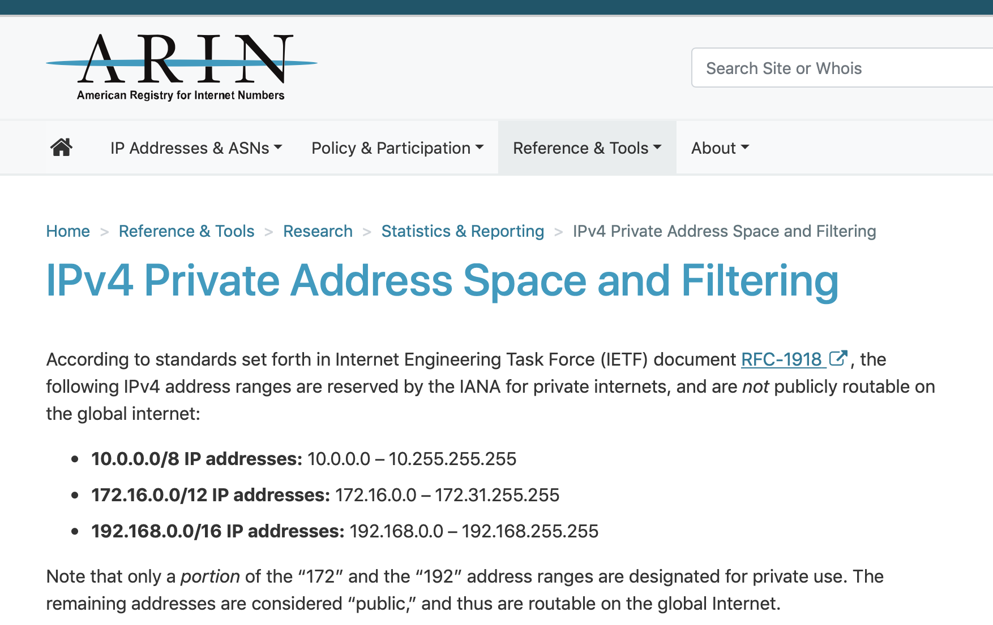

Slide 11
NAT: network address translation
rest of
Internet
local network
(e.g., home network)
10.0.0.0/24
10.0.0.1
10.0.0.4
10.0.0.2
138.76.29.7
10.0.0.3
all datagrams leaving local
network have same single source NAT IP address: 138.76.29.7,different source port numbers
datagrams with source or
destination in this network
have 10.0.0.0/24 address for
source, destination (as usual)

Slide 12
What is a Port number?
Computer 1
Computer 2
211
716
456
Process - 1
Process - 1
1001
263
2039
Process - 2
Process - 2
IP addr-1
IP addr-2
Process - n
Process - n
16-bit integers
called ‘port numbers’
Notes:
An internet port number can be as large as 65,535. This is because port numbers are 16-bit integers, meaning they can represent values from 0 to 65,535.
Key points about port numbers:
Range:
0 - 65,535
Well-known ports:
Ports from 0 to 1023 are considered "well-known" and are assigned to commonly used services like HTTP (port 80).
Registered ports:
Ports from 1024 to 49151 are registered ports that can be used by applications to identify specific services.
Dynamic ports:
Ports from 49152 to 65,535 are considered "dynamic" or "ephemeral" and are used for temporary connections by applications.

Slide 13
NAT: network address translation
NAT translation table
WAN side addr LAN side addr
2: NAT router
changes datagram
source addr from
10.0.0.1, 3345 to
138.76.29.7, 5001,
updates table
1: host 10.0.0.1
sends datagram to
128.119.40.186, 80
138.76.29.7, 5001 10.0.0.1, 3345
…… ……
S: 10.0.0.1, 3345
D: 128.119.40.186, 80
10.0.0.1
1
2
S: 138.76.29.7, 5001
D: 128.119.40.186, 80
10.0.0.4
10.0.0.2
138.76.29.7
S: 128.119.40.186, 80
D: 10.0.0.1, 3345
4
S: 128.119.40.186, 80
D: 138.76.29.7, 5001
3
10.0.0.3
4: NAT router
changes datagram
dest addr from
138.76.29.7, 5001 to 10.0.0.1, 3345
3: reply arrives
dest. address:
138.76.29.7, 5001

Slide 14
NAT: network address translation
motivation: local network uses just one IP address as far as outside world is concerned:
range of addresses not needed from ISP: just one IP address for all devices
can change addresses of devices in local network without notifying outside world
can change ISP without changing addresses of devices in local network
devices inside local net not explicitly addressable, visible by outside world (a security plus)

Slide 15
NAT: network address translation
implementation: NAT router must:
outgoing datagrams: replace (source IP address, port #) of every outgoing datagram to (NAT IP address, new port #)
. . . remote clients/servers will respond using (NAT IP address, new port #) as destination addr
remember (in NAT translation table) every (source IP address, port #) to (NAT IP address, new port #) translation pair
incoming datagrams: replace (NAT IP address, new port #) in dest fields of every incoming datagram with corresponding (source IP address, port #) stored in NAT table

Slide 16
NAT: network address translation
implementation: NAT router must:
outgoing datagrams: replace (source IP address, port #) of every outgoing datagram to (NAT IP address, new port #)
. . . remote clients/servers will respond using (NAT IP address, new port #) as destination addr
remember (in NAT translation table) every (source IP address, port #) to (NAT IP address, new port #) translation pair
incoming datagrams: replace (NAT IP address, new port #) in dest fields of every incoming datagram with corresponding (source IP address, port #) stored in NAT table

Slide 17
NAT: network address translation
16-bit port-number field:
Over 60,000 simultaneous connections with a single LAN-side address!
NAT challenges:
violates end-to-end argument
NAT possibility must be taken into account by app designers, e.g., P2P applications
NAT traversal: what if client wants to connect to server behind NAT?

Slide 18
Network-specific address (IP address) vs LAN-specific address (HW address)

Slide 19
Two perspectives of addresses:
(1)Network-to-network & (2)machine-to-machine
Destination
Router
Source

Slide 20
application
transport
network
link
physical
Router
Source

Slide 21
network
link
physical
application
transport
network
link
physical
Router
Source

Slide 22
network
link
physical
Router
Hierarchical address for addressing networks
(IP address)

Slide 23
network
link
physical
application
transport
network
link
physical
Router
Source

Slide 24
Flat address for addressing machines at the link-layer
(MAC address)
network
link
physical
application
transport
network
link
physical
Router
Source

Slide 25
Address Resolution Protocol (ARP)

Slide 26
MAC addresses and ARP
32-bit IP address:
network-layer address for interface
used for layer 3 (network layer) forwarding
MAC (or LAN or physical or Ethernet) address:
function: used “locally” to get frame from one interface to another physically-connected interface (same network, in IP-addressing sense)
48 bit MAC address (for most LANs) burned in NIC ROM, also sometimes software settable
e.g.: 1A-2F-BB-76-09-AD
hexadecimal (base 16) notation
(each “numeral” represents 4 bits)

Slide 27
MAC addresses and ARP
each adapter on LAN has unique LAN addr. or MAC addr.
1A-2F-BB-76-09-AD
LAN
(wired or
wireless)
adapter
71-65-F7-2B-08-53
58-23-D7-FA-20-B0
0C-C4-11-6F-E3-98

Slide 28
MAC addresses (more)
MAC address allocation administered by IEEE
manufacturer buys portion of MAC address space (to assure uniqueness)
analogy:
MAC address: like Social Security Number
IP address: like postal address
MAC flat address ➜ portability
can move LAN card from one LAN to another
IP hierarchical address not portable
address depends on IP subnet to which node is attached

Slide 29
ARP: address resolution protocol
Question: how to determine
interface’s MAC address, knowing its IP address?
ARP table: each IP node (host, router) on LAN has table
IP/MAC address mappings for some LAN nodes:
< IP address; MAC address; TTL>
TTL (Time To Live): time after which address mapping will be forgotten (typically 20 min)
137.196.7.78
1A-2F-BB-76-09-AD
137.196.7.23
137.196.7.14
LAN
71-65-F7-2B-08-53
58-23-D7-FA-20-B0
0C-C4-11-6F-E3-98
137.196.7.88

Slide 30
ARP protocol: same LAN
A wants to send datagram to B
B’s MAC address not in A’s ARP table.
A broadcasts ARP query packet, containing B's IP address
destination MAC address = FF-FF-FF-FF-FF-FF
all nodes on LAN receive ARP query
B receives ARP packet, replies to A with its (B's) MAC address
frame sent to A’s MAC address (unicast)
A caches (saves) IP-to-MAC address pair in its ARP table until information becomes old (times out)
soft state: information that times out (goes away) unless refreshed
ARP is “plug-and-play”:
nodes create their ARP tables without intervention from net administrator

Slide 31
Address Translation Protocol (ARP)
Map IP addresses into physical addresses
destination host
next hop router
Techniques
encode physical address in host part of IP address
table-based
ARP (Address Resolution Protocol)
table of IP to physical address bindings
broadcast request if IP address not in table
target machine responds with its physical address
table entries are discarded if not refreshed
Query message include the physical address of the sending host. Why?

Slide 32
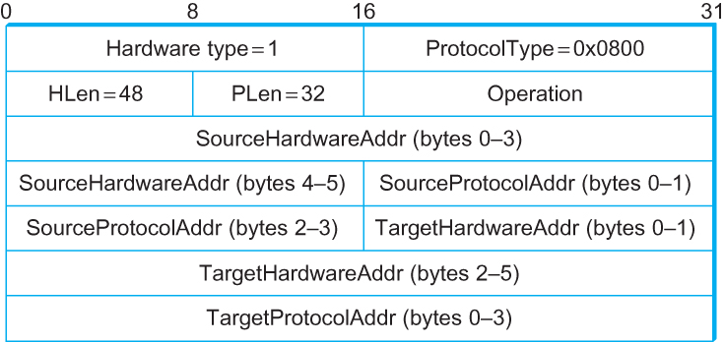
ARP Packet Format
HardwareType: type of physical network (e.g., Ethernet)
ProtocolType: type of higher layer protocol (e.g., IP)
HLEN & PLEN: length of physical and protocol addresses
Operation: request or response
Source/Target Physical/Protocol addresses

Slide 33
Internet Control Message Protocol (ICMP)

Slide 34
Internet Control Message Protocol (ICMP)
Defines a collection of error messages that are sent back to the source host.
E.g., ICMP messages are sent whenever a router or host is unable to process an IP datagram successfully
Destination host unreachable due to link /node failure
Reassembly process failed
TTL had reached 0 (so datagrams don't cycle forever)
IP header checksum failed
ICMP-Redirect
From router to a source host
With a better route information

Slide 35
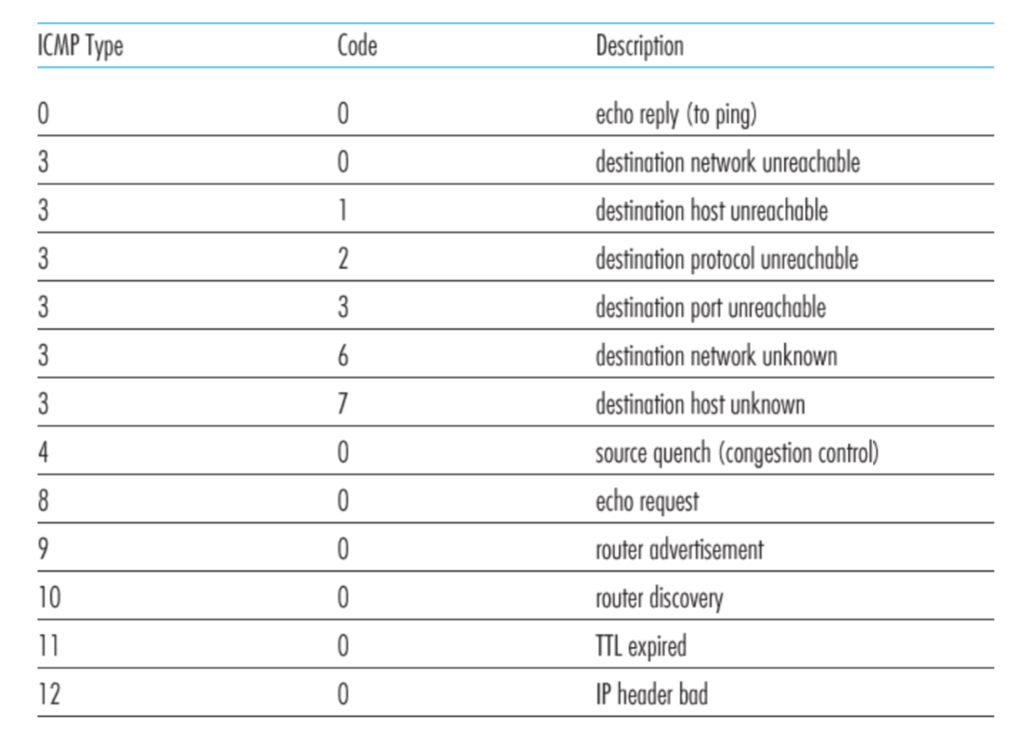
ICMP message types

Slide 36
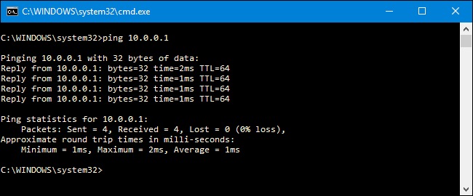
Ping example

Slide 37
Traceroute : An unintuitive application using ICMP

Slide 38
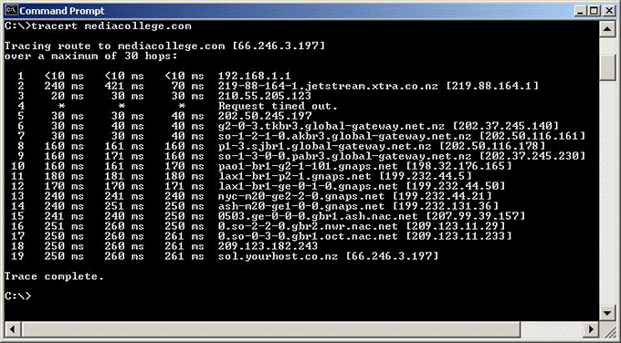
Traceroute example

Slide 39
Traceroute : An unintuitive application

Slide 40
Virtual Networks and Tunnels

Slide 41
Untrusted/Shared network
Gateway A
Gateway B
IP Header
Data
Trusted network (Site A)
Trusted network (Site B)

Slide 42
Untrusted/Shared network
Gateway A
Gateway B
Virtual Tunnel
IP Header
Data
Trusted network (Site A)
Trusted network (Site B)

Slide 43
New IP Header Source: Gateway-A Dest: Gateway-B
Encapsulation
IP Header
Data
Untrusted/Shared network
Gateway A
Gateway B
Virtual Tunnel
IP Header
Data
Trusted network (Site A)
Trusted network (Site B)

Slide 44
New IP Header Source: Gateway-A Dest: Gateway-B
Decapsulation
New IP Header Source: Gateway-A Dest: Gateway-B
IP Header
Data
IP Header
Data
Untrusted/Shared network
Gateway A
Gateway B
Virtual Tunnel
IP Header
Data
Trusted network (Site A)
Trusted network (Site B)

Slide 45
Untrusted/Shared network
Gateway A
Gateway B
Virtual Tunnel
IP Header
Data
IP Header
Data
Trusted network (Site A)
Trusted network (Site B)

Slide 46
New IP Header Source: Gateway-A Dest: Gateway-A
New IP Header Source: Gateway-A Dest: Gateway-A
Encryption/Decryption
IP Header
Data
IP Header
Data
Untrusted/Shared network
Gateway A
Gateway B
Virtual Tunnel
IP Header
Data
Trusted network (Site A)
Trusted network (Site B)

Slide 47
Untrusted/Shared network
Gateway A
Gateway B
Virtual Tunnel
Virtual Private Network
(VPN)
Trusted network (Site A)
Trusted network (Site B)

Slide 48
Why do we need virtual networks or tunnels?
1. Security
2. Special capabilities between routers (e.g., multicast)
3. Supporting heterogeneity

Slide 49
Why do we need virtual networks or tunnels?
1. Security
2. Special capabilities between routers (e.g., multicast)
3. Supporting heterogeneity
Disadvantages:
1. Increases packet length
a) Wastage of bandwidth
b) More processing
c) Fragmentation
2. Increases management cost

Slide 50
IPv6
1) Address and packet format
2) Unicast, Multicast, Anycast addressing
3) IPV4 and IPV6 coexistence

Slide 51
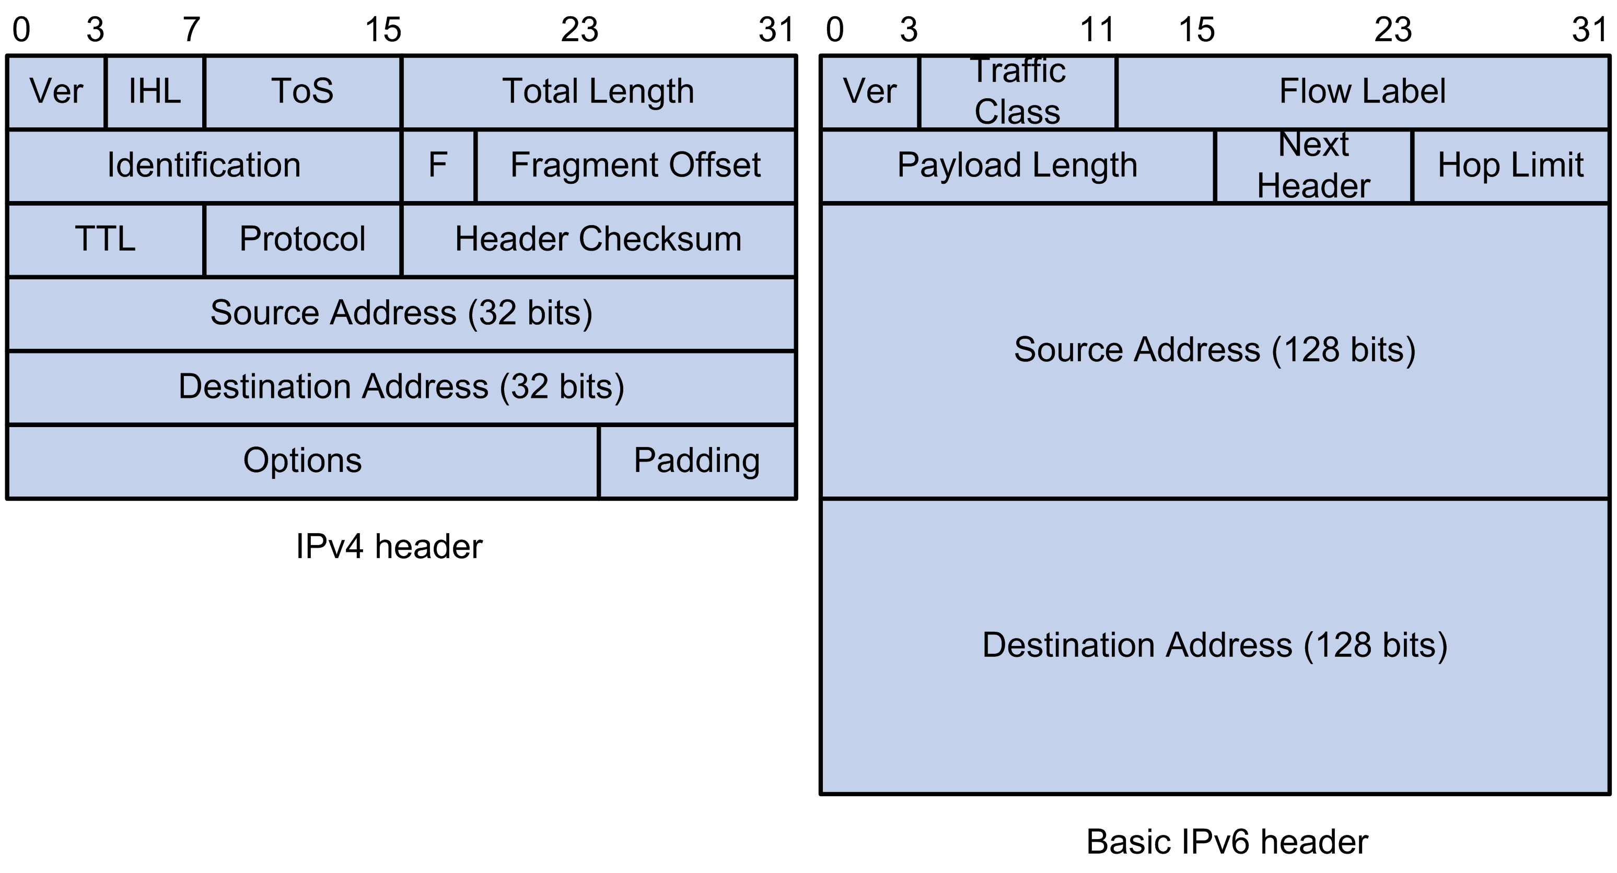
IPv6: Address and packet format
Pic courtesy: https://techhub.hpe.com

Slide 52
IPv6: Address and packet format
Q 1. Why is there no header checksum?
Q 2. Why is there no fragmenting related option?
Q 3. Is 128-bit IP address big enough?
Pic courtesy: https://techhub.hpe.com
Notes:
IPv6 provides for a maximum of 3.4×10^38 (340 trillion trillion trillion) unique IP addresses, or about 47 octillion unique addresses for every person on the planet.
For comparison: One light-year is about 6 trillion miles (9 trillion km)

Slide 53
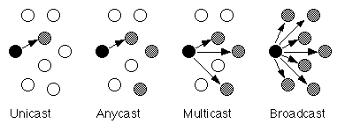
Unicast, Multicast, Anycast, Broadcast

Slide 54
Unicast, Multicast, Anycast, Broadcast
IPv4
IPv4
IPv4

Slide 55
Unicast, Multicast, Anycast, Broadcast
IPv4
IPv4
IPv4
IPv6
IPv6
IPv6

Slide 56
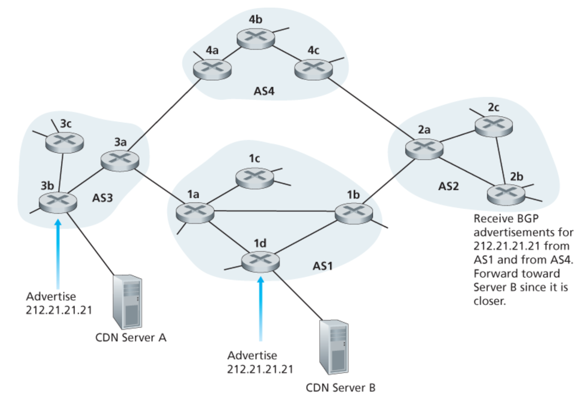
Unicast, Multicast, Anycast, Broadcast
IP: Anycast example

Slide 57
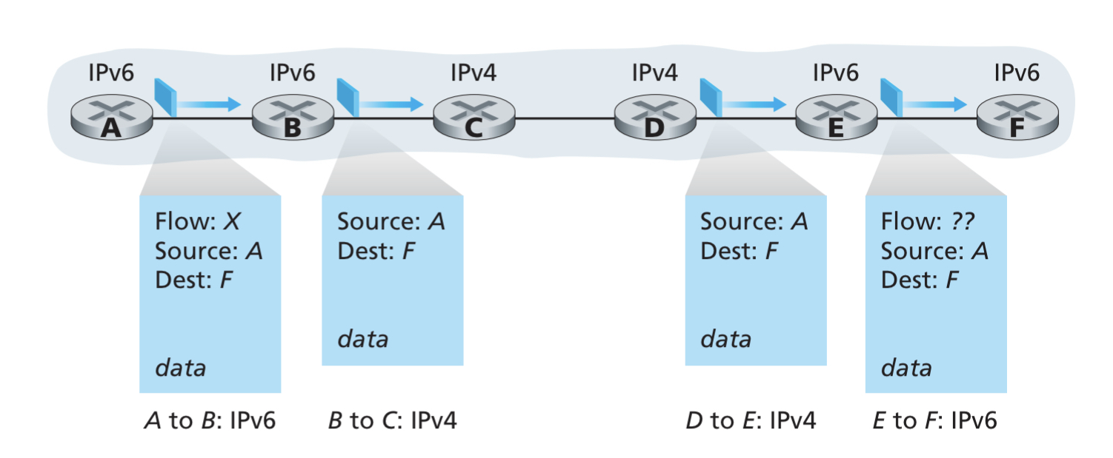
IPv4 and IPv6 Co-existence

Slide 58
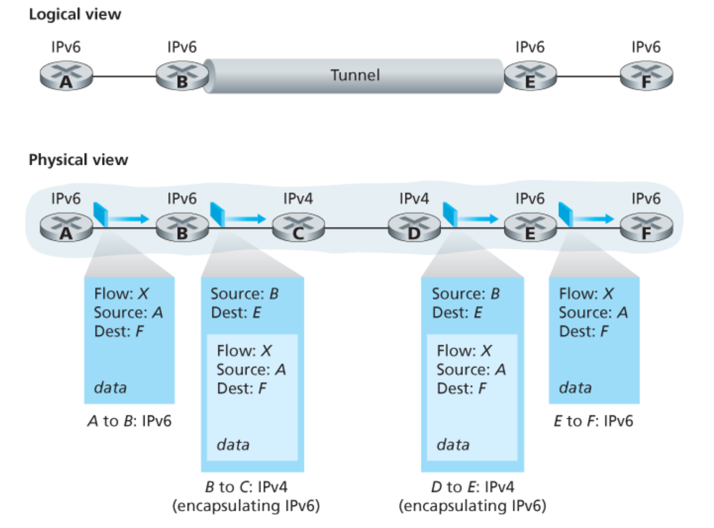
IPv4 and IPv6 Co-existence

Slide 59
Computer Networks
CMSC 417 : Spring 2023
Topic:
Transport Layer Protocols (UDP, TCP)
(Textbook chapter 5)
Nirupam Roy
Tu-Th 2:00-3:15pm
CSI 2117
March 5th, 2024

Slide 60
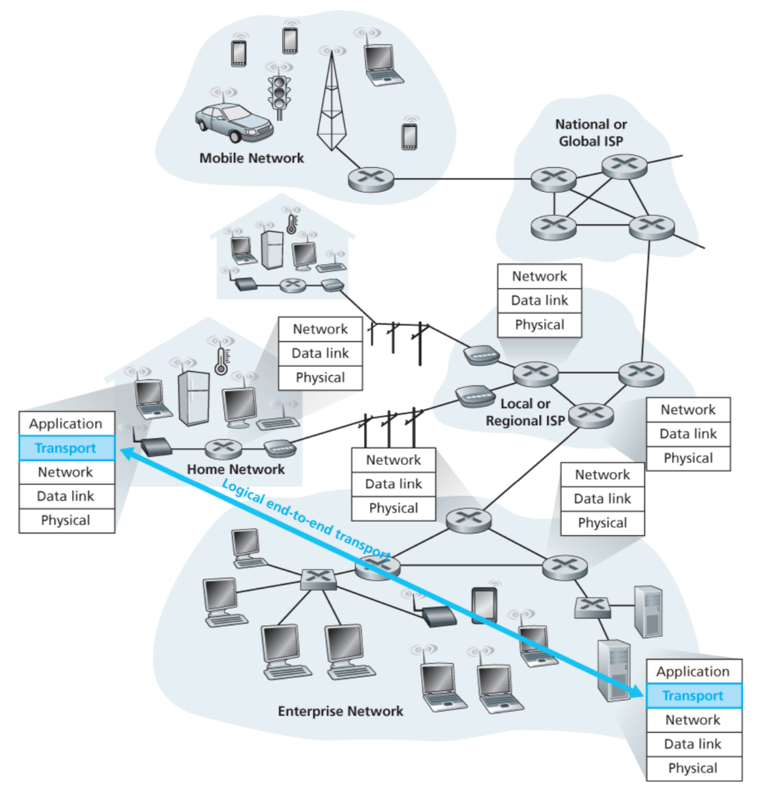

Slide 61
Transport layer: From the lens of two perspectives
(1) Abstraction of clients. (machines/networks/processes)
(2) Abstraction of services.

Slide 62
(1) Abstraction of clients

Slide 63
Network layer abstraction
128.2.0.0/16
200.30.0.0/16
16.20.0.0/20
Network 1
Network 3
Network 2

Slide 64
Network layer abstraction
128.2.0.0/16
200.30.0.0/16
16.20.0.0/20
Network 1
Network 3
Network 2

Slide 65
Network layer abstraction
Network layer services
128.2.0.0/16
200.30.0.0/16
16.20.0.0/20
Network 1
Network 3
Network 2

Slide 66
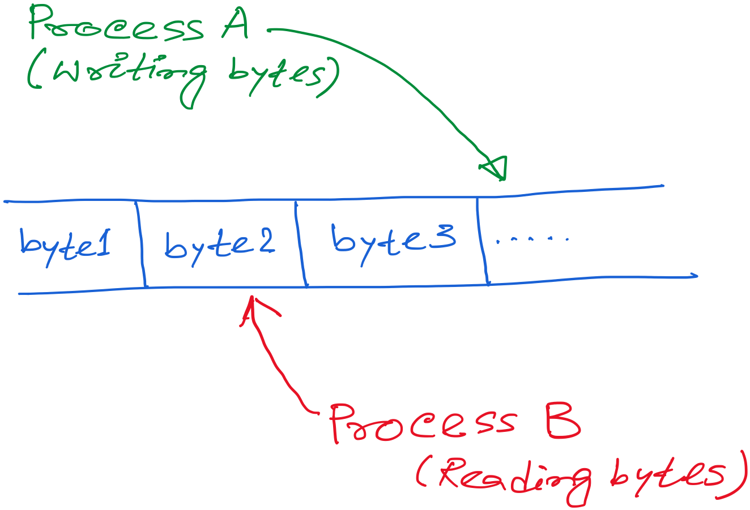
Transport layer abstraction

Slide 67
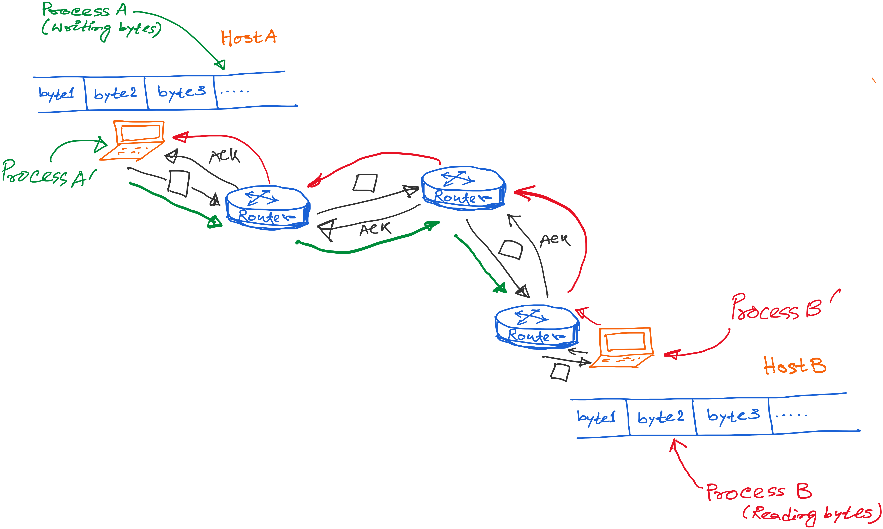
Transport layer abstraction
Transport layer services

Slide 68
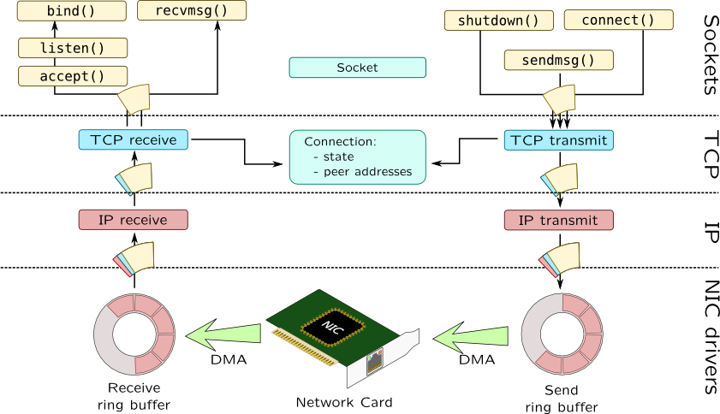

Slide 69
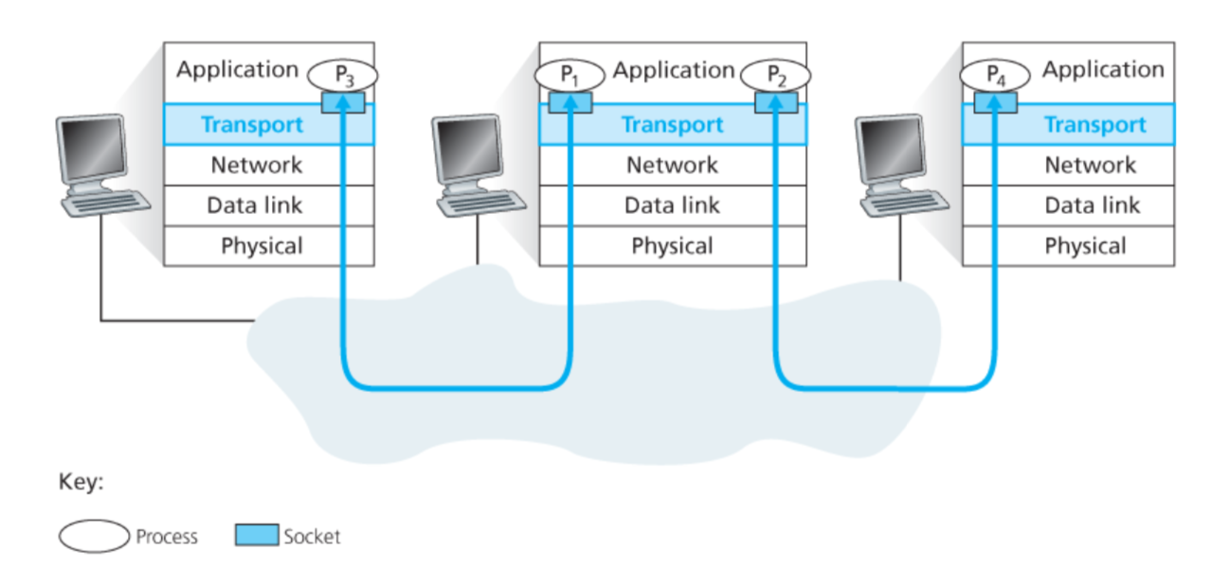
Connection between processes

Slide 70
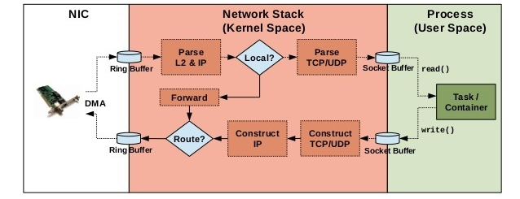
Implementation of networking algorithms

Slide 71
Transport Protocols
Logical communication between processes
Sender divides a message into segments
Receiver reassembles segments into message
Transport services
(De)multiplexing packets
Detecting corrupted data
Optionally: reliable delivery, flow control, …

Slide 72
Two Basic Transport Features
Demultiplexing: port numbers
Error detection: checksums
Server host 128.2.194.242
Service request for
128.2.194.242:80
(i.e., the Web server)
Client host
Web server
(port 80)
Client
OS
Echo server
(port 7)
IP
payload
detect corruption

Slide 73
Multiplexing/demultiplexing
Demultiplexing at rcv host:
Multiplexing at send host:
delivering received segments
to correct socket
Data headers helps flows
from multiple sockets to use
common the network channel,
Info in header later helps
Demultiplexing.
= socket
= process
application
application
application
P4
P3
P1
P2
P1
transport
transport
transport
network
network
network
link
link
link
physical
physical
physical
host 1
host 2
host 3

Slide 74
How demultiplexing works
1) host receives IP datagrams
each datagram has source IP address, destination IP address
each datagram carries 1 transport-layer segment
each segment has source, destination port number
2) host uses IP addresses & port numbers to direct segment to appropriate socket
32 bits
source port #
dest port #
other header fields
application
data
(message)
TCP/UDP segment format

Slide 75
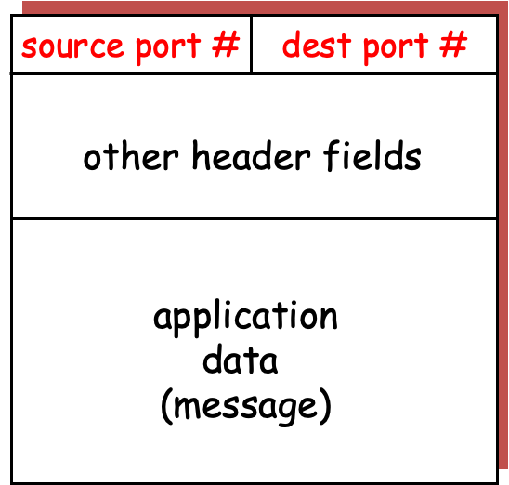
application
application
P3
P1
P2
P1
transport
transport
network
network
link
link
physical
physical
host 1
host 2

Slide 76
application
application
P3
P1
P2
P1
transport
transport
network
network
link
link
physical
physical
host 1
host 2

Slide 77
application
application
P3
P1
P2
P1
transport
transport
network
network
link
link
physical
physical
host 1
host 2

Slide 78
application
application
P3
P1
P2
P1
transport
transport
network
network
link
link
physical
physical
host 1
host 2

Slide 79
application
application
P3
P1
P2
P1
transport
transport
network
network
link
link
physical
physical
host 1
host 2

