Slide 1
Information Dynamics
Ashok Agrawala
2024

Slide 2
Basic Notions
Physical World
MIND
Representation
Information
Concept

Slide 3
What is information???

Slide 4
Information
Shannon:
The word ‘information’ has been given different meanings by various writers in the general
field of information theory. It is likely that at least a number of these will prove sufficiently
useful in certain applications to deserve further study and permanent recognition.
It is hardly to be expected that a single concept of information would satisfactorily
account for the numerous possible applications of this general field,
1) technical problems concerning the quantification of information and dealt with by Shannon’s theory;
2) semantic problems relating to meaning and truth; and
3) what he called ‘influential’ problems concerning the impact and effectiveness of information on human behavior, which he thought had to play an equally important role.
Floridi, Luciano. Information: A Very Short Introduction (Very Short Introductions) (p. 2). OUP Oxford. Kindle Edition.

Slide 5
Definition of Information
General Definition of Information (GDI) – Data + meaning
Data Based Definition
GDI σ is an instance of information, understood as semantic content,
if and only if:
GDI.l) a consists of n data, for n ≥ 1;
GDI.2) the data are well formed;
GDI.3) the well-formed data are meaningful.
Data must comply with the meanings (semantics) of the chosen system, code or language.
Floridi, Luciano. Information: A Very Short Introduction (Very Short Introductions) (p. 2). OUP Oxford. Kindle Edition.

Slide 6
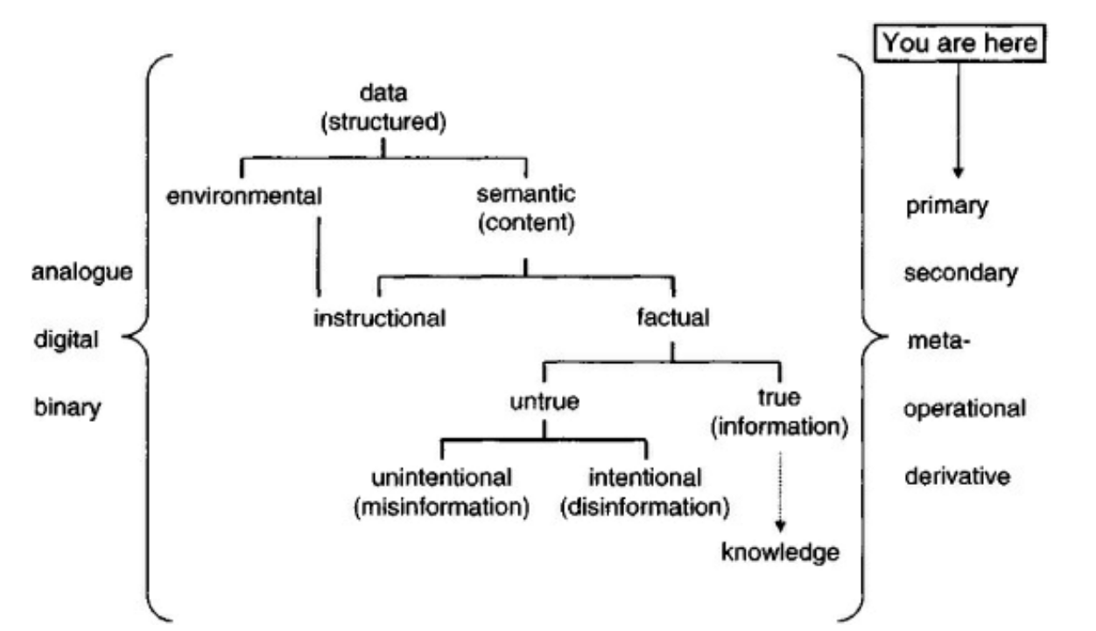
Types of data/information
Primary Data
Secondary Data
Meta Data
Operational Data
Derivative Data
Environmental Data/information
Information as Semantic Content
Instructional
Factual

Slide 7
Information Cycle

Slide 8
Shannon – Information theory
Mathematical theory of communication
The mathematical theory of communication deals with the carriers of information, symbols and signals, not with information itself. That is, information is the measure of your freedom of choice when you select a message. - Weaver
Entropy
You should call it entropy for two reasons: first, the function is already in use in thermodynamics under the same name; second, and more importantly, most people don’t know what entropy really is, and if you use the word entropy in an argument you will win every time. – von Neumann
Entropy is a measure of
The average amount of information per symbol produced by the informer, or
The corresponding average amount of data deficit (Shannon’s uncertainty) that the informee has before the inspection of the output of the informer, or
The corresponding informational potentiality of the same source, that is its informational entropy
Floridi, Luciano. Information: A Very Short Introduction (Very Short Introductions) (p. 45). OUP Oxford. Kindle Edition.

Slide 9
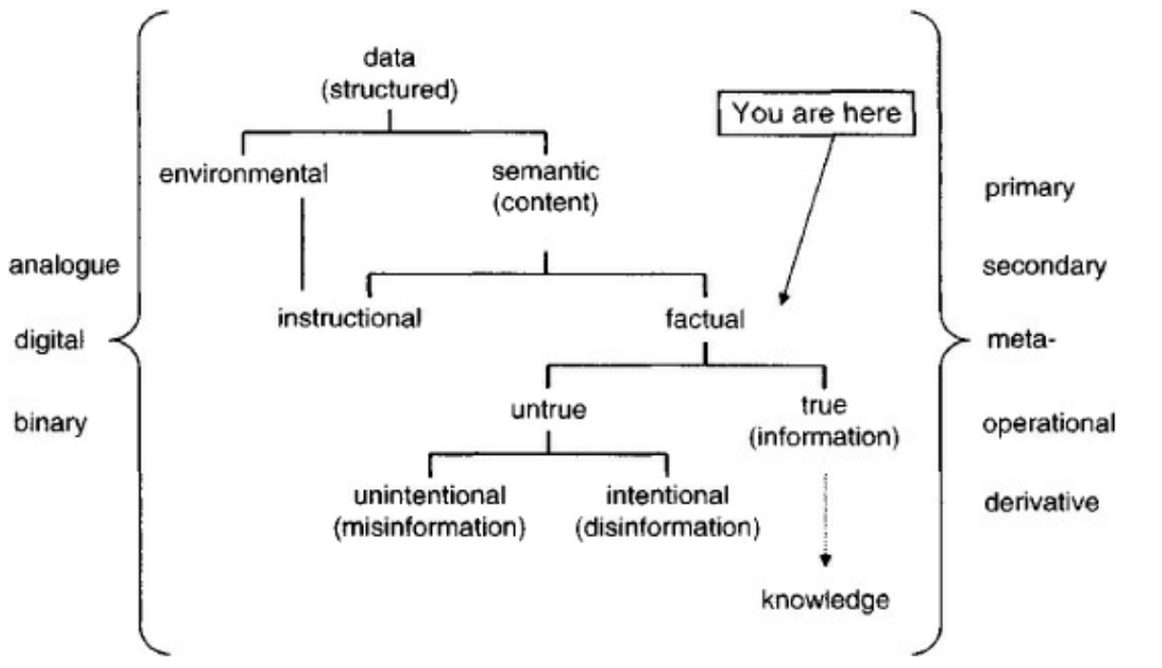
Semantic Information

Slide 10
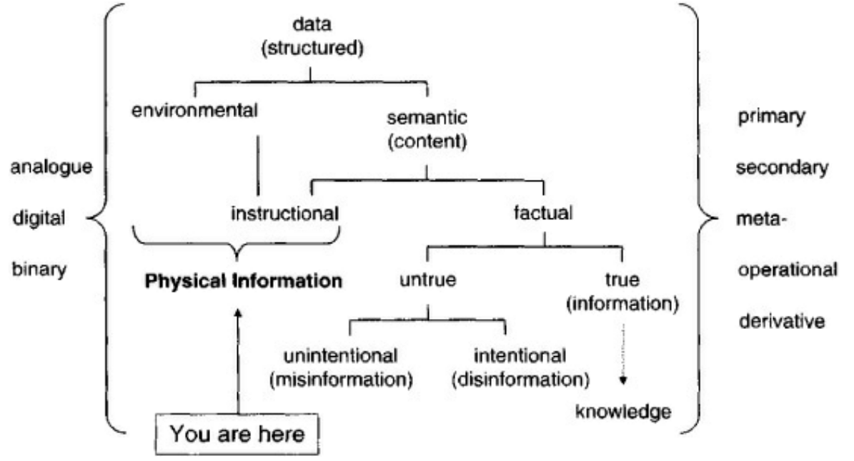
Physical Information

Slide 11
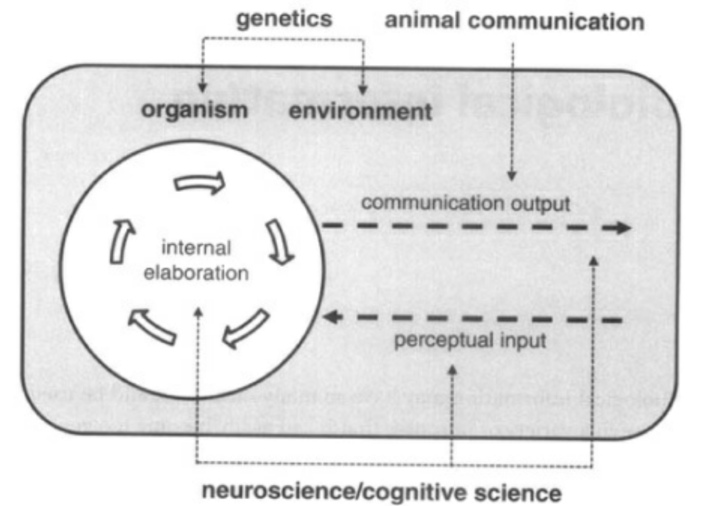
Biological Information
Biological
Genetic
DNA and genetic code
Neural Information

Slide 12
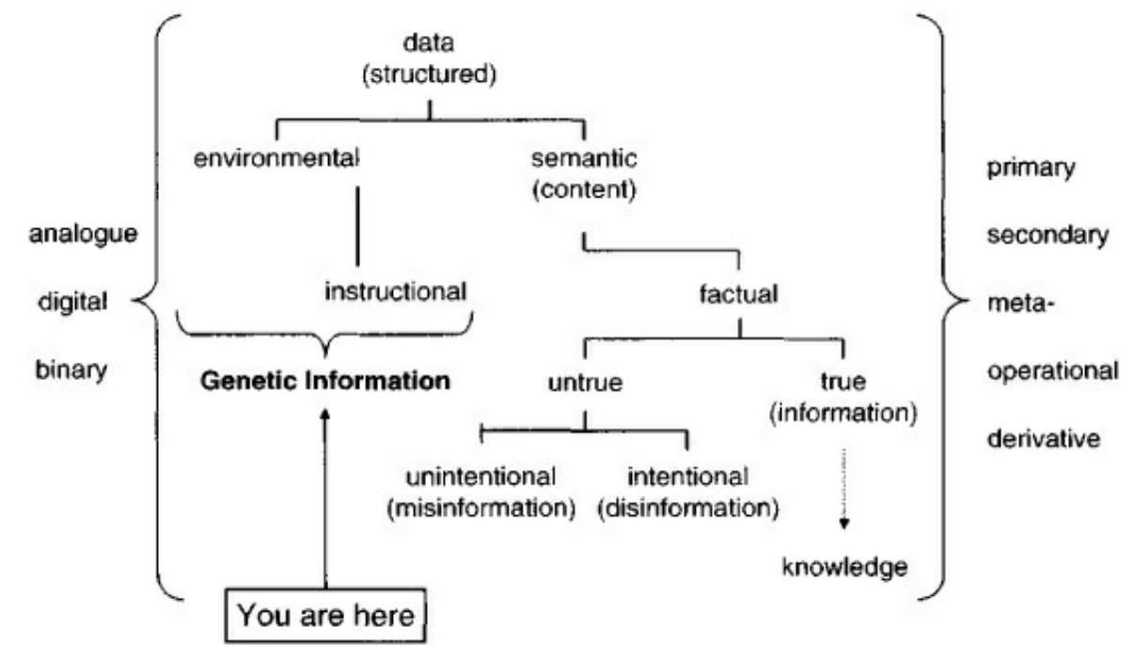
Genetic Information

Slide 13
Economic Information

Slide 14
Information vs Concepts
C = A + B
Newton’s First Laws of Motion
An object at rest stays at rest and an object in motion stays in motion with the same speed and in the same direction unless acted upon by an unbalanced force.

Slide 15
Information vs Representations
Representations are benign by themselves
Created in the physical world to capture an aspect of information
Extracting the information from a representation requires the knowledge of the mapping used
Information has a context which is rarely captured in representations
The ultimate consumer of information is a sentient being

Slide 16
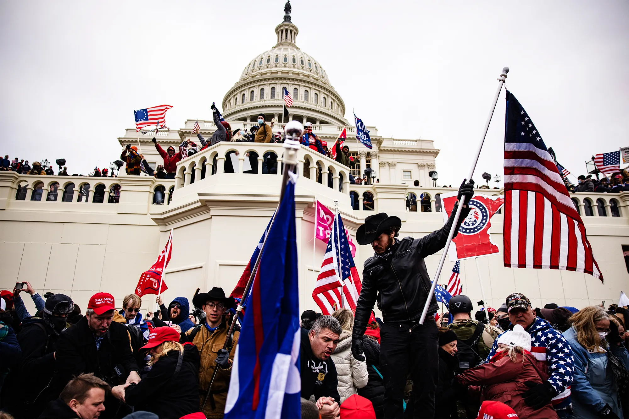
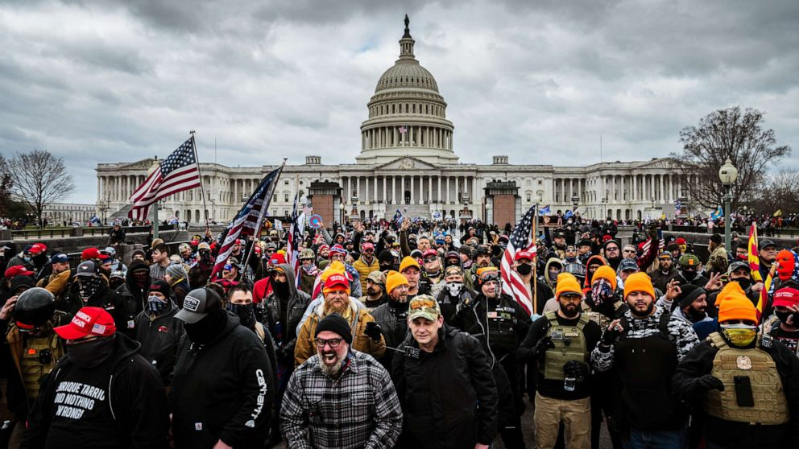
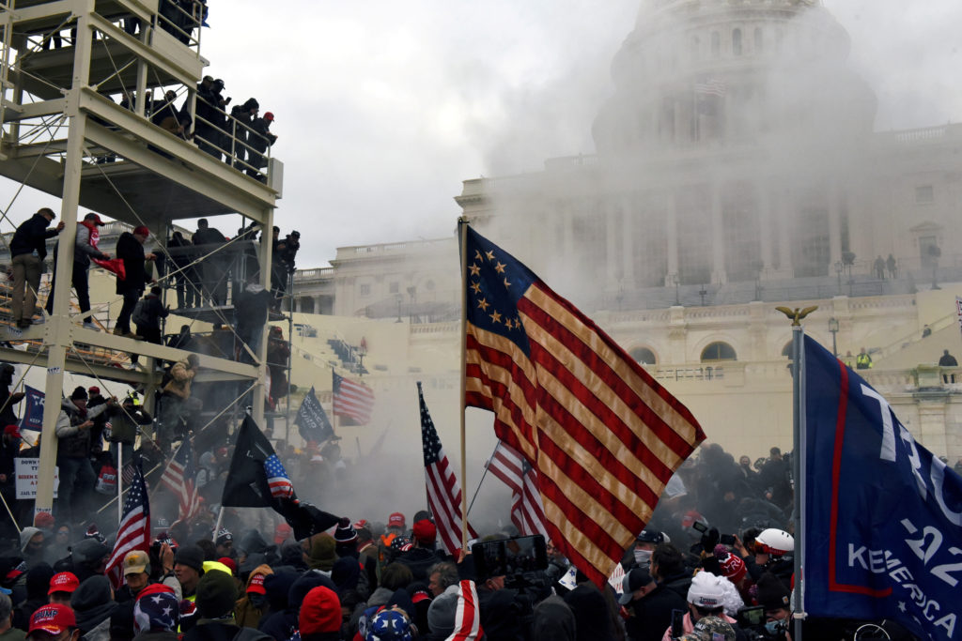

Slide 17
Information and Representations
Sentient entities deal with it
With meaning => Concept
In the physical world we only deal with representations
For
Communication
Storage
Manipulation
Use

Slide 18
Sentient Being
Large collection of Concepts
Large collection of interrelationships among individual conceptual items
Collection of all of it – Perceived Reality - knowledge
Acquiring
Through Senses => Information
Assimilation using prior conceptual framework
Processing
Accessing
Exploring known relationships
Deducing new ones
Initiating actions
Actions
Decision – What action to take and when
Actuation – initiating the action
Execution – using physical parts of the body

Slide 19
Meaning
Derived in context
Context reflects ALL the interrelationships this information item has with all concepts
Deriving meaning is required to assimilate and integrate any information with prior knowledge – collection of concepts
If a relationship can not be established with a new information item, then it may be kept as an isolated item/concept

Slide 20
Context
All interrelationships
Any question you ask is exploring another relationship
Relationships are information items also
Standard graph theoretic models may not work
Models
Collection of interrelationships
Used in all decision making
Which may lead to actuation of actions

Slide 21
Models
Each sentient being has a very large number of such models
Some models may be static
Others may be refined
An expert is one who understand more interrelationships in a field – has better models

Slide 22
Question?
Is information
Discrete, or
Continuous
???

Slide 23
Perceived Reality/Knowledge
The conceptual framework
Collection of all concepts, models, and interrelationships
Model of
External world
Individuals
Self
Activities
….

Slide 24
Agents
Capable of handling information/representations
Capable of actions
Two types
Sentient (SA)
Constructed (CA)
Actions
SA
Using the mind and the body
CA
Exploiting the physical properties of the constructed system components
As designed by some SA using concepts and mapping them to the CA

Slide 25
Interaction among Sentient Agents
Primarily through exchange of information
Some interaction may be through physical means also

Slide 26
Exchange of information
Only through representations

Slide 27
Information Communication
Sentient Agent
Sentient Agent
Information
Information
Perceived
Reality
Perceived
Reality
Representation
Representation

Slide 28
Representations
All “Information” in physical world is the representations which are relevant for sentient beings
Representations are created as arrangements of energy or matter
Ink spread on paper
Chalk on a board
Bits in a memory cell
Sound waves
Pictures
…
Many representations of any information item

Slide 29
Use of Representations
Storage
Keep the arrangement of matter or energy in a container
Very few interrelationships are retained
Movement
Transfer the representation directly or indirectly – so that at the receiving end a corresponding representation can be created
Manipulation
Transform them through physical operations
Addition, multiplication, …
Photoshop
…

Slide 30
Manipulation of Representations
Physical operations on representations which may be meaningful
2 + 3 = 5
010
Adder
101
011

Slide 31
Meaningful Manipulations
Sentient Agent
Information
Information
Operation
Perceived
Reality
Perceived
Reality
Representation
Representation
Operation

Slide 32
Information Manipulation in CAs
Computers are constructed agents
All representations in computers are in the form of bits
There is no meaning of bits or collection of bits that is available in or to the computer – only to the designer
Computer Operations
Arithmetic and Logic operations and comparisons => bits
Move bits individually or in groups
Control the movement of bits using some bit(s) as triggers
Complex manipulations are done as a sequence of simple ones
The sequence is defined by a program which is also represented as bits which are used to “guide” the movement of bits during the execution

Slide 33
Communications between CAs
At least two agents are involved
Move representations from a sender to a receiver
May transform one or more times in the process
Compression
Encryption
…
Protocol
Each side has an implicit or explicit model of the other side
“When I send this, I expect to receive this”
Communication Transit Times
As communication requires movement of some representation, fastest it can travel is at the speed of light.
Non-Zero Latencies

Slide 34
Physical Reality
Energy in various forms
Laws of interactions (Nature) – as interpreted by science
Depend on the form
Elementary Particles
Atoms
Molecules
Objects
Collection of objects

Slide 35
Physical Entities
Energy or Matter
Can not deal with information
Only representations – other CAs
Have a variety of information about them – not aware
Have attributes
Size, color, shape, weight …
Aggregation
Compose larger entities from a collection of smaller entities
Aggregate may have complex interdependent structures and properties

Slide 36
Physical Entities
Natural Systems
Weather, Air, Sea, Sun
Man-made or Constructed Systems
May have many interacting components
Exploiting the knowledge of interactions – Physics
Unknowns – Nature, Sentient entities
All man-made systems exist in natural environment
Interact

Slide 37
Constructed System
A system designed by humans – not due to the nature alone
Has
resources
permissible actions
State
Environment
Energy sources
Location
Range of operation

Slide 38
Purpose/Goal/Intent
Constructed systems – for a goal/purpose
Involve several resources and actual or permissible actions
Machines – incapable of defining their purpose
Intent – purpose or goal before the actions are taken to achieve it

Slide 39
Constructed Systems
Purpose
To “help” mankind
To carry out hard tasks
Mechanical – Industrial revolution
Informational – Handlining LARGE quantities in reasonable times
Designed by exploiting the known interrelationships
Automobile
Computer
…
Once implemented – can change only within the bounds permitted by the design
Bounds may be explicit or implicit
Complexity of a system can lead to unexpected behaviors – malfunction, bugs, …

Slide 40
Intention Detection
Can we detect the intention from observing a sequence of actions/states before the final goal of the intent is achieved?

Slide 41
Accuracy
Mathematics and Mathematical Models are precise
Our knowledge of all physical systems is imprecise
Operate with in designed tolerances
Imprecision is controlled by design
(Most of the time)

Slide 42
Time
Physics of Time
Linear
Unidirectional
Local
…
Event
Change that occurs instantaneously
Time may be used to order events
Synchronization
Concurrency vs simultaneity

Slide 43
Changes in Time
Information
Static
E.g., name
About past events
Representation and interpretation may change
Dynamic
Changes with time
As a system evolves

Slide 44
Implications of Information Movement
Moving information from location x to location y takes time t_{xy}
At y we can only get information from x which is at least t_{xy} old

Slide 45
Information Uncertainty Principle-1
The perceived reality at any location CAN NOT be the same as the actual reality at any remote location of the global reality
Due to the transmission and processing delays
It is not sufficient to receive the information
It must be interpreted and processed to integrate it with the current perceived reality
Perceived reality at a location may be consistent with global/remote reality but can not be the same
We can never have a complete model of another entity:
model abstracts knowledge

Slide 46
Information Uncertainty Principle - 2
Due to finite precision of measurement and representations we can never have complete and precise knowledge of any quantifiable information
We deal with this uncertainty all the time !!!

Slide 47
Value of Information
Implicit understanding of the value
Is entity/agent specific
Use in selecting – deciding among options for processing and taking action
Value of information changes with time
Different for each agent
Depends on his perceived reality
Can not assign a fixed ordinal scale to the value

Slide 48
Value of Information
Value may be captured by uncertainty models
Example – queue length at a router
The knowledge of the queue length at time t may be precise
The knowledge at a later time given the value at t will have a variance which will increase with time
When we want to know the value of queue length from some other location, the information movement delay increases the variance

Slide 49
Designing a System
Constructed System
Any complex system has many decision points
Decisions must be based on the available information
Provisions must be made for that information to be available
Right Information at the Right place, and at the Right Time

Slide 50
Autonomous Systems
Build using a sequence of steps
Once triggered, all are executed in a defined sequence
Trigger
Based on External Input
Pressing a button
Receiving a message
Internal
Completion of some step or sequence
Detection of a condition (provisions must be made for monitoring the condition)

Slide 51
Man-Machine Interaction (HCI)
Ultimate User of all IT is some Sentient Being
Information must be presented in the form and format that is
Interpretable
Visual
Textual
…
Interface must accept inputs/commands which are easy for the user
User always operates in a context

Slide 52
Context
Defined in very general terms earlier
Any interrelationship
Any entity plus its context defines its model
We may be able to extract the full context
But use only “relevant context”
Relevant context
Relevant with respect to what?
Current situation
Situation
Current state of entities of interest

Slide 53
Situation
Collection of the state of relevant interacting entities
Example
Car Accident
Cars
Drivers
Location
….

Slide 54
Basic Nature of Information
Always related to many other pieces of information
Its context
Its meaning, usefulness, and use depends on the context
The value of a piece of information depends on the situation and the context
In isolation a piece of information may have very little value
There is a model (collection of relationships) or a template for every generic piece of information
A piece of information may have “Name” which may be used in place of the detailed description with full context.
Car
Make and Model
Color
VIN
Purchase Date
Owner
Insurance
….
Tag No

Slide 55
Template
4AB1575 - MD
Toyota Prius
Red
30904958509
01/15/2012
Agrawala
GEICO
….
A graph for the generic piece of information
Instantiated with specifics
Some specifics may also have templates which can be expanded as needed
Model
Car Tag No
Make and Model
Color
VIN
Purchase Date
Owner
Insurance
….
Tag No

Slide 56
Template
Example - person
Health
Height/weight
Insurance
Primary Doctor
Allergies
Medications
History
….
Lab Tests
Person/Name
Age
Home -Address
Phone
Profession
Religion
….
Health
Ethenicity
email

Slide 57
Access
Physical movement of represented information (RI) or some related signals so that RI can be recreated
Define access paths – physical
Paths are physical and must be in place BEFORE any access can be made
Can not build physical paths based on content – No physical content addressable memories.
Hash/Index – Mapping of content to an address/path

Slide 58
Represented information –Symbols
Symbols do not carry meaning
May attach a symbol to represent meaning
That symbol also requires its meaning
Searle- Penrose
Process of attaching one symbol to another
Relationship is externally defined
Can I have a fully self describing data structure from which “information” can be derived without any additional, out of band information/communication

Slide 59
Represented information and Interrelationships
Very few captured/retained
Interrelationship is also information

Slide 60
Action
Manipulation of physical or information entities
Require
Energy
Time
Resources
Trigger
Space (??)

Slide 61
Most actions exploit physical interaction among objects following laws of nature (physics).
We control them by controlling the environment and trigger conditions.
Once environment is set and trigger is initiated
Action ➔ result of natural interactions following laws of physics
At lowest level all actions are atomic in that once started they continue and complete following laws of nature.
Maintenance required:
In the design we did not take into account some interaction aspects which continue to happen.
Wear and tear

Slide 62
Sequence of Actions
Complex objectives may require a sequence of actions.
May set up the environment so that one action triggers the next – using represented information indicating that the first action is complete and triggering the second one.
The first action in the sequence still requires external trigger.
When the sequence can not be predefined, a trigger may have to be generated dynamically reflecting the current situation/state. A sentient entity may be involved in defining the trigger/next action at every step

Slide 63
Sequence of Triggers
May be decided after the action reflecting the state after the action is observed
Program- A Sequence of Triggers
Limited modification of execution sequence based on anticipated states
Can not modify if unanticipated actions/states occur (due to aspects not considered in the model)
Environment
Natural Laws – inadequate knowledge
Noise
Control
Eliminate trigger

Slide 64
Complex scenarios
May require a number of concurrent actions
Coordinated actions
Coordinated triggers
Collection of Triggers may be viewed as the “Plan”.

Slide 65
Levels of abstraction
At physical level there are no abstractions. All actions take place with full involvement of the lowest levels of details
Abstraction -May treat a collection of actions as a single action at a higher level
Refinement – May elaborate the subactions of an action
Sub-actions may or may not require external triggers – may be triggered by previous actions.

Slide 66
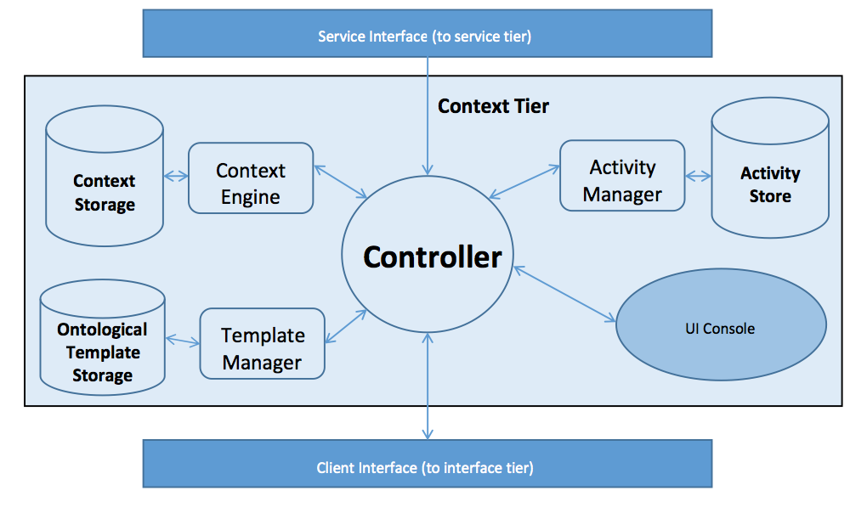
Rover Architecture

Slide 67
Rover Architecture
Controller
Handles inter-module communication
Answers External calls/API
Context Engine
Fetches Context and provides relevant context
Executes Dynamic Ontological Models
Applies filters as needed to build models
Context Store
Graph DB storing context models as they expand and are enriched
Neo4j DB
Template Manager
Fetches Ontological Models from Template Store

Slide 68
Rover Architecture
Template Store
Ontological Store
Holds models for entities, events, relationships and activities
Activity Manager
Monitors activities as they are executed
Evaluates goal states
Monitors context in order to instantiate activities
Service Tier
Access to external services
Client Interface
Web Service / REST API
UI Console (forthcoming)
Displays Situation Graph

Slide 69
Context Storage and Representation
Graph Database (Neo4j)
Native Graph storage and processing
Nodes and Relationships to store data
A Graph –[:records_data]->Node-[:has]->Properties
Nodes are vertices
Can be labeled/indexed
Relationships
Can query relationships just as you would nodes
Both nodes and relationships are enriched through attributes
key : value stores assign attributes in a NoSQL fashion

Slide 70
Example of situation graph expansion and contraction
Accident specifically Road Accident
Start with basic entities an relationships as model dictates
Dynamic Ontological Model expands and contracts situation graph as information becomes present or changes
Information can be cached
Models can be expanded
Activities (as triggered) are instantiated
Add additional entities as needed
Constant enrichment of relevant context

Slide 71
Relevant Context
Context that is relevant to the situation
Relevancy is determined by the situation itself
Based on expert knowledge (static)
Semantic Relatedness (real time)
If a person sustains an injury, certainly his medical information is relevant
If he obtained the injury because of an accident, automobile information is relevant too

Slide 72
Relevant Context - Demo
In the event of a `Road Accident’, relevant context for Car is - driver, passenger, model, owner
In the event of a `Accident induced personal injury’, relevant context for Person involved is - personal information, automobile information, medical records

Slide 73
Accident can be categorized as :
Road Accident
Cars
Persons
Chemical Accident
Building
Persons
Accident
Sub class
Sub class
Road Accident
Chemical Accident

Slide 74
Road Accident - Event
Road
Accident
Cars
Time
Persons
Location
Roads
Entities:
Roads affected
Cars
Persons
Attributes:
Location
Time
Involving
Impacting
Driven By
Involving

Slide 75
Person - Entity
Personal
Professional Credentials
Home
Owns
Person
Medical Records
Has
Automobile
Owns
Friends
Friend of
Name
SSN
Address
Blood Results
Contains
Blood Type
Weight
Height
Diploma?
Master’s Degree?
Job Title
Contains
Allergies

Slide 76
Car - Entity
Car
Person
Owned By
Driver
Driven By
Wanted by Police
Passenger
Passenger In
State
Purchase Details
Purchase Date
Purchase Price
Make
Model
Year
Color
VIN
Damaged?
Drivable?
Has Fuel?

Slide 77
Transport injured - Activity
Locate ambulance(s)
Select and Call
Get stretcher
Get injured
Transport to Location
Determine Location to Transport

Slide 78
Towing - Activity
Locate Towing Service
Place order
Hookup Car
Remove from Scene

Slide 79
Situation Graph – Accident Creation
Road Accident
Car 1
Car2
Persons
Location
Roads affected

Slide 80
Situation Graph
Road Accident
Driver 1
Car 1
Car 2
Location
Roads affected
Driver2
Basic Template Is now instantiated
Basic entity list is added as model expand
Select relevant information about these entities for the situation

Slide 81
Car (Template)
Car
Owner
Owned By
Driver
Driven By
Criminal status
Passenger
Passenger In
State
Purchase Details
Purchase Date
Purchase Price
Make – Model
Tag#
Year
Color
VIN
Damaged?
Drivable?
Has Fuel?

Slide 82
Car – Relevant Information
Car
Owner
Owned By
Driver
Driven By
Criminal status
Passenger
Passenger In
State
Purchase Details
Purchase Date
Purchase Price
Make
Model
Year
Color
VIN
Damaged?
Drivable?
Has Fuel?

Slide 83
Person (Template)
Friends
Friend of
Personal
Professional Credentials
Home
Owns
Person
Medical Records
Has
Automobile
Owns
Name
SSN
Address
Blood Results
Contains
Blood Type
Weight
Height
Diploma?
Master’s Degree?
Job Title
Contains
Allergies

Slide 84
Person – Relevant Context
Friends
Friend of
Personal
Professional Credentials
Home
Owns
Person
Medical Records
Has
Automobile
Owns
Name
SSN
Address
Blood Results
Contains
Blood Type
Weight
Height
Diploma?
Master’s Degree?
Job Title
Contains
Allergies

Slide 85
Situation Graph – After Initial Template
Name
Address
Personal
Road Accident
Driver 1
Car 1
Location
Roads affected
Driver2
Car 2
Person 3
Driver Of
Owns
Stolen?
State
Person 4
Responds Tp
Stolen?
State
Driver Of,
Owns
Name
Address
Personal

Slide 86
Situation Graph – As info comes in
Name
Address
Personal
Road Accident
Driver 1
Car 1
Location
Roads affected
Driver2
Car 2
Person 3
Driver Of
Owns
Stolen?
State
Person 4
Responds Tp
Stolen?
State
Driveable? - Yes
Driver Of,
Owns
John Doe
123 Fake St
Personal
Honda Acord
MD Tags 123ABC

Slide 87
Situation Graph – Dynamic Ontology Performs Automatic Query
Name
Address
Personal
Road Accident
Driver 1
Car 1
Location
Roads affected
Driver2
Car 2
Person 3
Driver Of
Owns
Stolen?
State
Person 4
Responds Tp
Stolen?
Yes
State
Driveable? - Yes
Driver Of,
Owns
John Doe
123 Fake St
Personal
Honda Acord
MD Tags 123ABC

Slide 88
Situation Graph – Context Triggers Activity
Name
Address
Personal
Road Accident
Driver 1
Car 1
Location
Roads affected
Driver2
Car 2
Person 3
Make Arrest
Locate Towing Service
Place order
Hookup Car
Remove from Scene
Driver Of
Owns
Person 4
Responds Tp
Stolen?
Yes
State
Driveable? - Yes
Driver Of,
Owns
John Doe
123 Fake St
Personal
Honda Acord
MD Tags 123ABC

Slide 89
Situation Graph – More Information
Jane Doe
234 Elm St.
Injured!
Name
Address
Personal
Personal
Road Accident
Driver 1
Car 1
Location
Roads affected
Driver2
Car 2
Person 3
Driver Of
Owns
Stolen
No
State
Person 4
Responds Tp
Stolen?
State
Driveable? - Yes
Driver Of,
Owns
John Doe
123 Fake St
Personal
Honda Acord
MD Tags 123ABC

Slide 90
Situation Graph – Context Caches Information by Expanding Situation Graph
Jane Doe
234 Elm St.
Injured!
Name
Address
Personal
Personal
Medical Records
Road Accident
Driver 1
Car 1
Location
Roads affected
Driver2
Car 2
Person 3
Driver Of
Owns
Person 4
Responds Tp
Driver Of,
Owns
John Doe
123 Fake St
Personal

Slide 91
Situation Graph – Context Triggers Activity
Jane Doe
234 Elm St.
Injured!
Name
Address
Personal
Personal
Medical Records
Road Accident
Driver 1
Car 1
Location
Roads affected
Driver2
Car 2
Person 3
Driver Of
Locate ambulance(s)
Select and Call
Get stretcher
Get injured
Transport to Location
Determine Location to Transport
Owns
Person 4
Responds Tp
Assists With
Person 5
Driver Of,
Owns
John Doe
123 Fake St
Personal

Slide 92
Merging Situation Graphs
When two situation graphs have a common node the graphs may be merged
Merged situation graph may be given a new identity with the identity of the two situations merged kept in the log.

