Slide 1
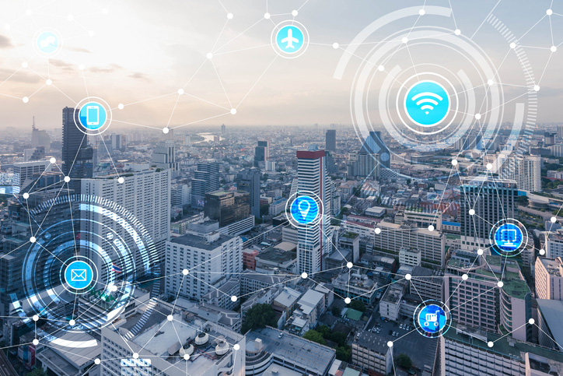
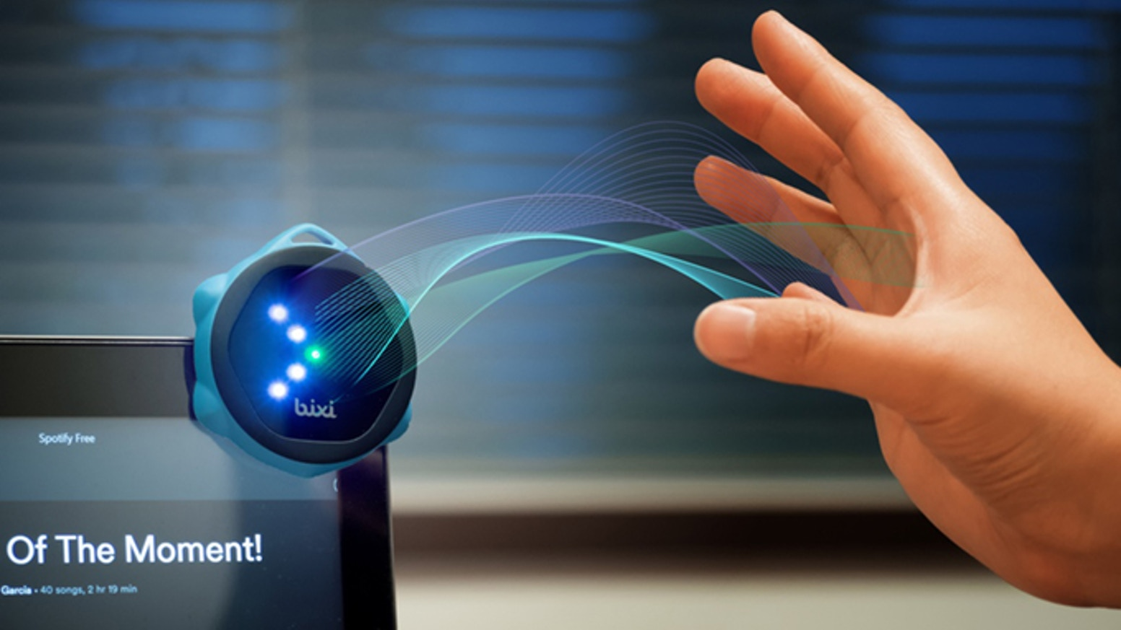
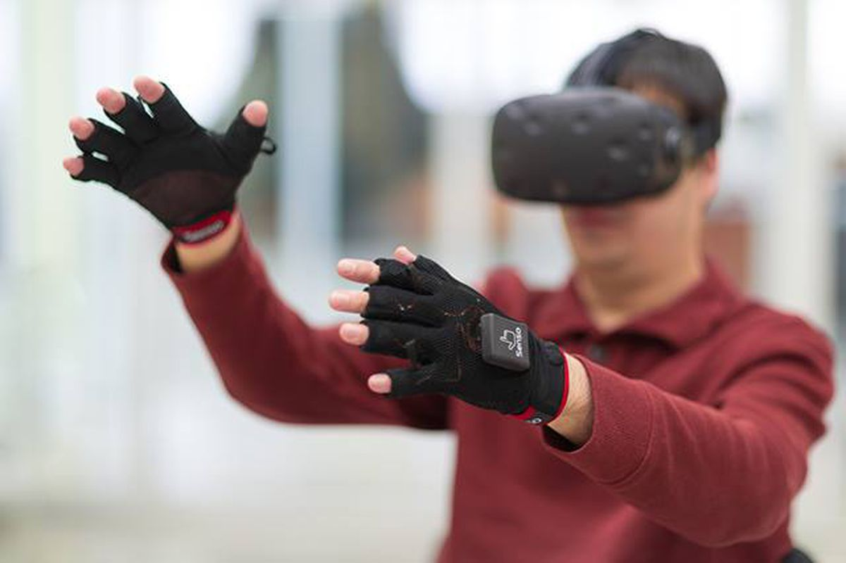
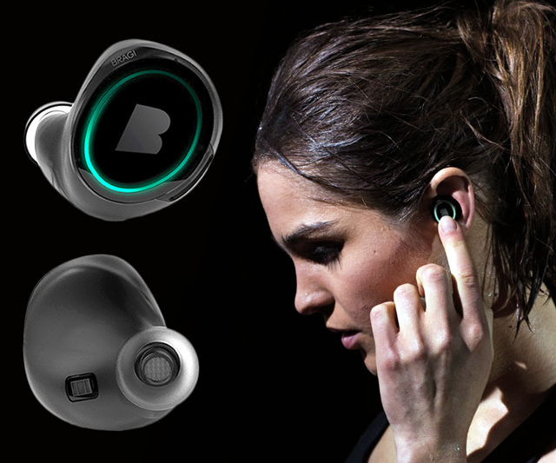
Wireless and Mobile Systems
for the IoT
CMSC 715 : Fall 2024
Lecture: Midterm review
Nirupam Roy
Tu-Th 12:30-1:45pm
IRB 2207

Slide 2
Exam logistics
November 13th, Thursday, 2:00 PM, Room: 2207 (i.e., the regular classroom)
The exam questions will be spread over the topics taught so far (up to lecture 4.1).
Fundamental concepts/theories are important.
No programming.
An open (book, notes, phone, computer) exam, but closed-internet/-AI.
Not open to discussions with humans. ☺

Slide 3
Question format (tentative)
1. Multiple choice questions (10x2 = 20 points)
Sensor basics, Sampling theory, Aliasing, FFT spectrum, Echolocation,
Wave propagation, Space-time equation of wave, beamforming or spatial filtering, ULA,
Inference, Security/privacy
2. Short answer type (25 points)
Bayesian inference, Markov Model, HMM
Beam-steering
FMCW radar
Environmental effects on signal (phase, attenuation) and physical sensing.
3. Problem solving (25 points)
Sampling, DFT/FFT, aliasing
Superposition of signal, Wavelength, Space-time equation
Automotive radar

Slide 4
Sample questions: MCQ
1. What is the primary purpose of an anti-aliasing filter in a signal processing system?
A) To amplify high-frequency components of the signal.
B) To remove low-frequency noise from the signal.
C) To prevent high-frequency components from causing aliasing during sampling.
D) To convert a continuous signal into a discrete signal.
2. Which of the following is a key characteristic of a Markov model?
A) The future state depends on both the current state and previous states.
B) The system’s behavior can be fully predicted from its initial state.
C) The system’s future state depends only on the current state, not on the history of
previous states.
D) The system transitions between states based on deterministic rules.
3. You can not use acoustic signals to communicate between the Earth and the Mars because
A) Acoustic signals can not carry data bits B) Acoustic signals require a medium to propagate C) Both of the above
D) None of the above

Slide 5
Sample questions: MCQ
4. A frog is jumping at a constant rate of 20 times per second. You are trying to capture the scene
with a video camera. Which of the following video frame rates can correctly capture the frog’s
jumping frequency.
15 frames per second
25 frames per second
35 frames per second
45 frames per second

Slide 6
Sample questions: Short answer type
1. Dropping a smartphone may damage it. You are planning to develop an airbag system for
smartphones that will inflate in the event of a fall to protect the phone.
The key challenge of this system is to detect the fall before the smartphone hits the ground.
Explain how you can detect the fall of the smartphone using its sensors.
2. What is the core idea of the RF-IDRAW paper: RF-IDraw: Virtual Touch Screen in the Air Using RF Signals
https://deepakv.web.illinois.edu/assets/papers/RF-IDraw_SIGCOMM_2014.pdf
3. Explain why we have a quadratic term of time variable (t) in the FMCW chirp equation?

Slide 7
Sample questions: Problem Solving Type
1. A sensor network is deployed in a forest to detect the presence of a certain animal species. Each sensor provides a noisy binary output indicating the presence (1) or absence (0) of the animal. Due to environmental noise and sensor limitations, the probability that a sensor correctly detects the animal when it is present is 0.8, and the probability that it correctly detects the absence of the animal is 0.9.
Assume that the prior probability of the animal being present in the forest area being monitored is 0.3. A sensor in the network detects the presence of the animal (output = 1).
Notes:
Using Bayesian inference, calculate the posterior probability that the animal is actually present in the area given this detection.
Use the following terms:
- Prior \( P(\text{Animal Present}) = 0.3 \)
- Likelihood of detection given presence \( P(\text{Detection} | \text{Animal Present}) = 0.8 \)
- Likelihood of detection given absence \( P(\text{Detection} | \text{Animal Absent}) = 0.1 \) (since it is \(1 - 0.9\))
Apply Bayes' theorem:
\[
P(\text{Animal Present} | \text{Detection}) = \frac{P(\text{Detection} | \text{Animal Present}) \times P(\text{Animal Present})}{P(\text{Detection})}
\]
where \( P(\text{Detection}) \) can be found using the law of total probability:
\[
P(\text{Detection}) = P(\text{Detection} | \text{Animal Present}) \times P(\text{Animal Present}) + P(\text{Detection} | \text{Animal Absent}) \times P(\text{Animal Absent}).
\]
Calculate \( P(\text{Animal Present} | \text{Detection}) \).

Slide 8
Sample questions: Problem Solving Type
<x1, y1>
<x4, y4>
<x2, y2>
<x3, y3>

Slide 9
Recap of some topics

Slide 10
The concept of the Fourier series
Amplitude
Time (sec)
0.00
0.25
0.50
0.75
1.00
1.25
Amplitude
Time (sec)
0.00
0.25
0.50
0.75
1.00
1.25

Slide 11
The Curious Case of “Negative frequency”
Magnitude
|z_{m}|
-4
-3
-2
-1
m = 0
1
2
3
4
Frequency
Real signal’s magnitude spectrum is symmetric.
Why?

Slide 12
The Curious Case of “Negative frequency”
Magnitude
|z_{m}|
-4
-3
-2
-1
m = 0
1
2
3
4
Frequency
Complex signal’s magnitude spectrum may or may not be symmetric.
Why?

Slide 13
Anti-aliasing filter
Anti-aliasing
filter
Amplitude
10k
20k
30k
40k
50k
60k
70k
80k
90k
100k
Frequency spectrum
Sensor
ADC
Anti-aliasing
Filter
Notes:
removes the unwanted frequencies above 24 kHz …
And ultimately, this filtered signal is sampled by an ADC to generate digital sound samples

Slide 14
Echolocation
Time = t1
Absorption
+
Reflection
d
echo
t2
Sound travelled (2d) distance
C.(t2-t1) = 2d

Slide 15
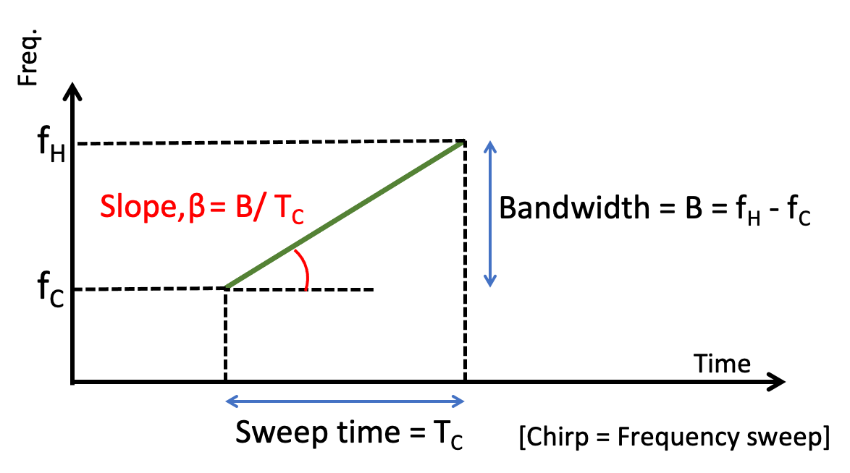
Chirp as the Tx signal (Frequency modulated signal)
Instantaneous frequency at time t:

Slide 16
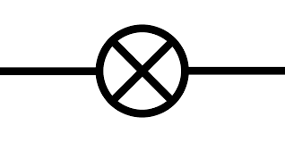
Beat frequency: Derivation
-
X
-

Slide 17
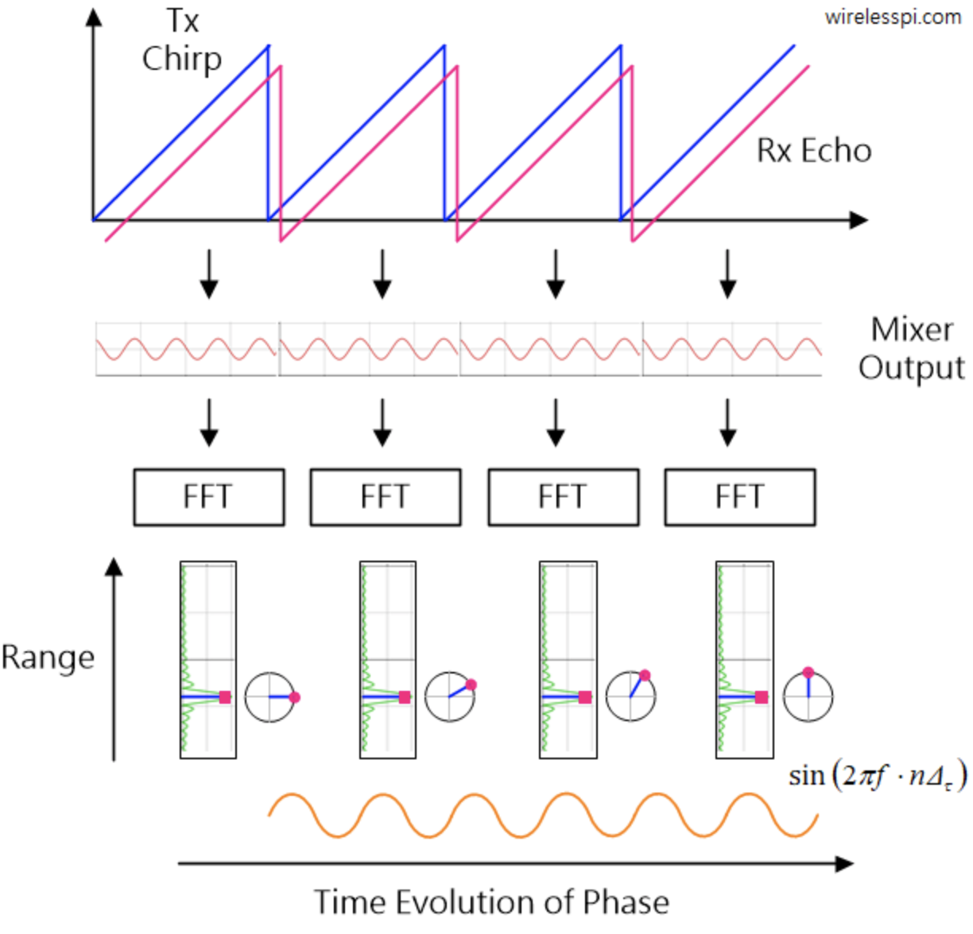

Slide 18
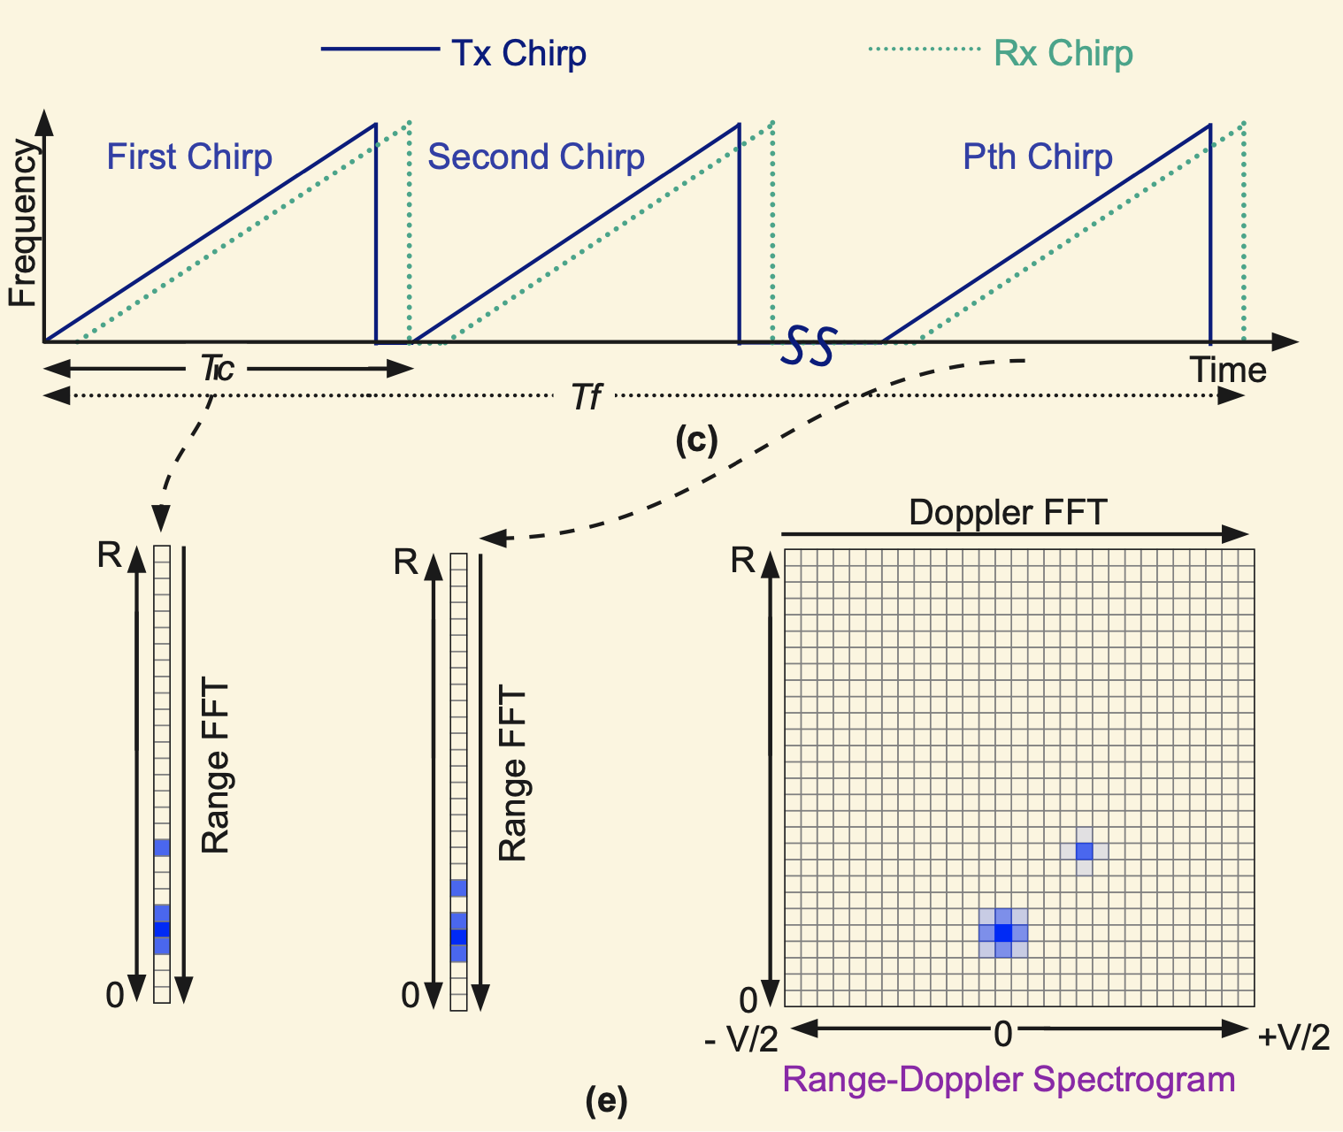
Range-Doppler plot: Detection of range and velocity

Slide 19
Time and space
d = X.sin($Θ$)
X meters
$$⁡j(2πft)$$
$$Θ$$
$$A . e$$

Slide 20
Spatial filtering
Alexa!

Slide 21
Superimposition of sinusoids
Signal amplified
(perfect constructive interference)
$$sin⁡(2πft)$$
$$d=λ/2$$
$$\sin\left(2πft+\frac{2πd}{λ}\right)$$
= $\sin\left(2πft+π\right)$
= $− sin\left(2πft\right)$
Signal nullified
Signal nullified

Slide 22
$3d cos$($φ$)
$2d sin$($φ$)
Beamforming in 2D space
$d sin$($φ$)
$$E1$$
$$E2$$
$$E3$$
$$E4$$
…
N elements
$$d$$
$$d$$
$$d$$
Path difference with n^{th} element:
$\left(n−1\right)d sin$($φ$)
Phase difference with n^{th} element:
$\left(n−1\right)d sin$($φ$) 2Π/λ
Signal at 1st sensor:
$e^{j\left(2πft\right)}{ }$
Combined signal:

Slide 24
Hidden Markov Model
Sunny
Sunny
Rainy
Sunny
Rainy
Rainy
t1 t2 t3 t4 t5 t6 (time)
P (sunny after rainy)
P (sunny after sunny)
P (rainy after rainy)
Sunny
day
Rainy
day
Temp.
P (rainy after sunny)
Temp.
Humidity
Humidity
Wind
Wind

Slide 25
Hidden Markov Model: Definition
S₁
S₁
S₂
M₁
Transition
Emission
1st order Markov assumption:
Transition probability depends on the current state only.
Output independence assumption:
Output/Emission probability depends on the current state only.

Slide 26
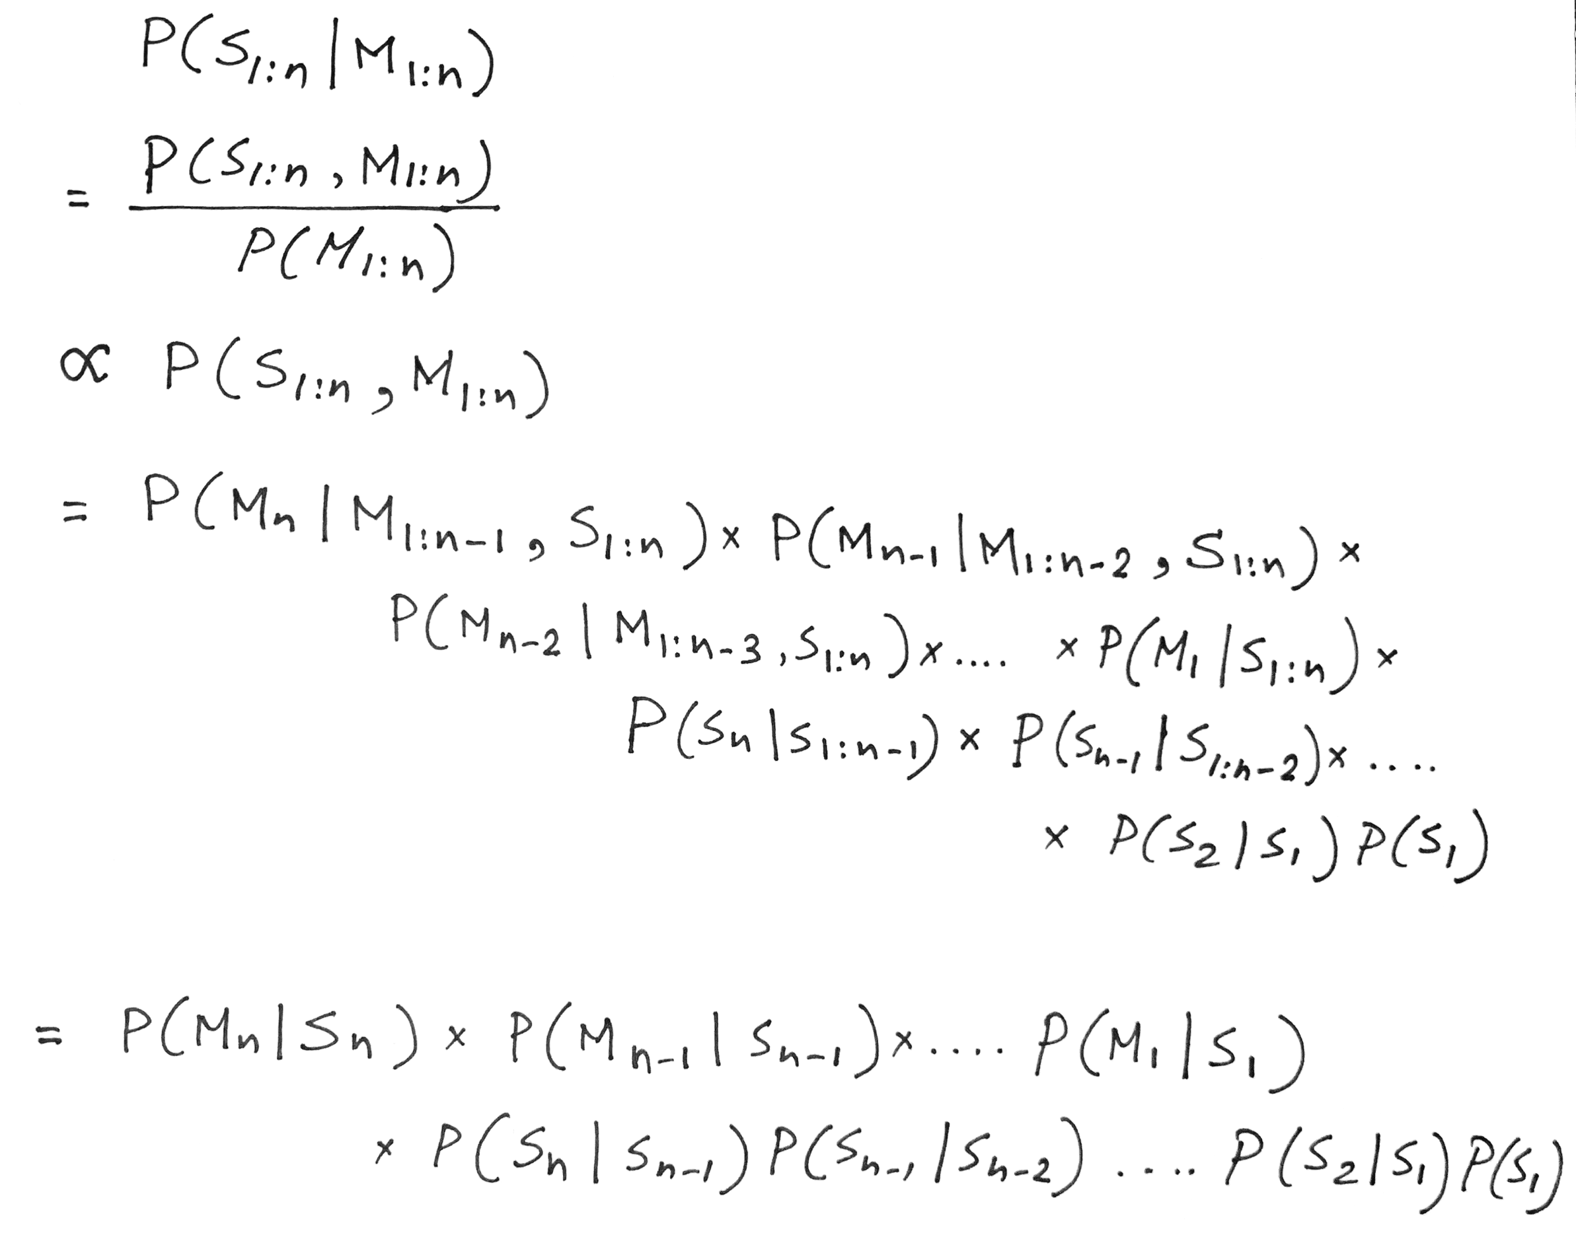
Hidden Markov Model: Definition
Observation depends on the current state only
Future state depends on the current state only

Slide 27
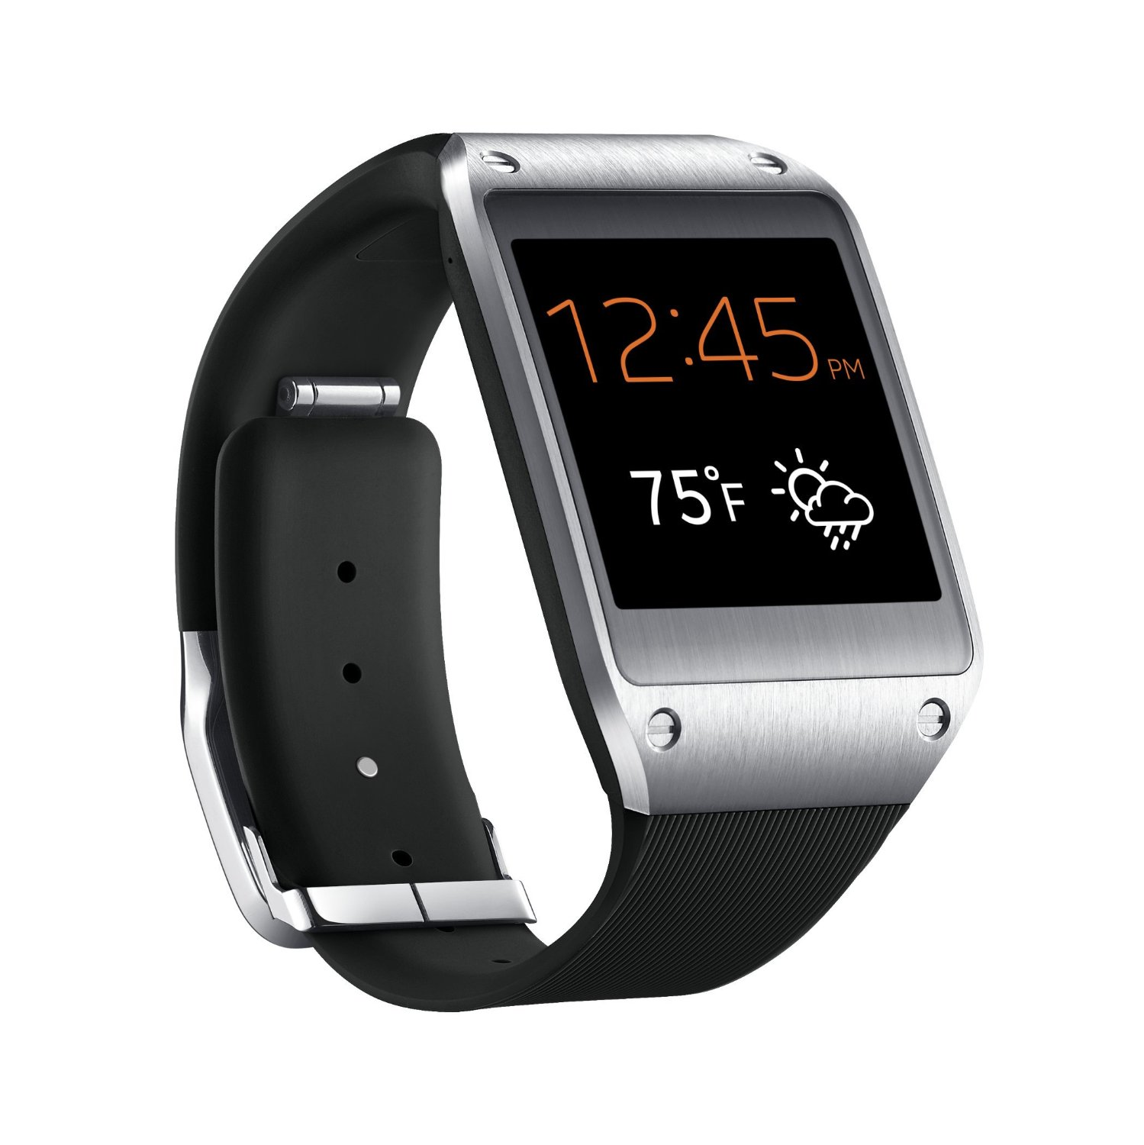
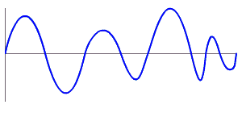
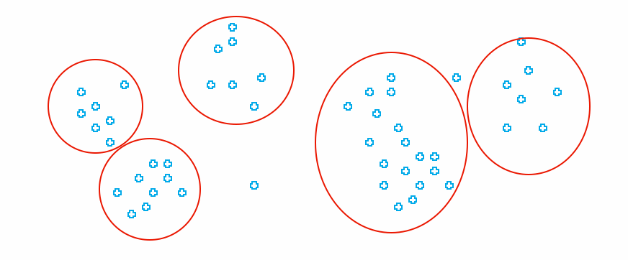
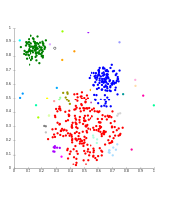
MoLe Architecture
Attacker Training Data
Rank of Word_{i}
Attacker Point Cloud
a b c d
Keystroke
Detector
Point
Cloud
Fitting
Bayesian
Inference
P(O|W_{i})
Time
Location
Word W_{i}
Unlabeled Point Cloud
Observation ( O )
User Data
Dictionary

Slide 28
RF-IDraw: Virtual Touch Screen in the Air
Deepak Vasisht
Jue Wang, Dina Katabi

Slide 29
Ambiguity-Resolution Tradeoff
High resolution
Low resolution
Ambiguity in position
No ambiguity

Slide 30
Owlet: Enabling Spatial Information in Ubiquitous Acoustic Devices
http://icosmos.cs.umd.edu/project-owlet.html
Notes:
Hi everyone, I am Nakul Garg, and (Yang says) and I am Yang Bai. Today we are going to present our paper called “Owlet: Enabling Spatial Information in Ubiquitous Acoustic Devices”. This is a joint work with our advisor Nirupam Roy. We are from the University of Maryland, College Park.

Slide 31
System Design
Direction-specific impulse response
$$H_{stencil}$$
environment impulse response
$$H_{env}$$
$$X$$
$$Y_{in}=XH_{env}H_{stencil}$$
$${H′}_{env}$$
$$Y_{out}=X{H′}_{env}$$
reference mic (outside the stencil)
Notes:
We have introduced a reference microphone placed outside the stencil.
When the same sound is received by the reference microphone, it will only be affected an environmental impulse response and Yout is equal to product of X and H environment prime.

Slide 32
System Design
One-time learning
$$Y_{in}=XH_{env}H_{stencil}$$
$$\frac{H_{env}}{{H′}_{env}}$$
$$\frac{Y_{in}}{Y_{out}}=\frac{XH_{env}H_{stencil}}{X{H′}_{env}}=\frac{H_{env}}{{H′}_{env}}H_{stencil}$$
Dividing
$$Y_{out}=X{H′}_{env}$$
Depends on external environment
Notes:
But, the ratio of these impulse responses depend on the external environment.

Slide 33
System Design
Microphone inside stencil
Synthetic dataset
Freq. spectrum
$$H_{stencil}\frac{H_{env}}{{H′}_{env}}$$
Predicted Angle
Reference microphone
Phase spectrum
Notes:
We take advantage of the bounded distribution of this ratio and simulate multiple environments to create a synthetic dataset.
Then we train a neural network on the frequency and phase spectrums of this signal. Once trained, it can work in any arbitrary environment and estimate the angle in real time.

Slide 34
Outline
Your phone has fingerprints! [7]
Your phone can spy on you! [6]
Even vacuum cleaners can spy on you! [3]
Hijacking a Smart Speaker! [4, 5]
Fighting DeepFake/ShallowFake live [1]
Side channel defense [2]

Slide 35
[1] “Is this my president speaking?” Tamper-proofing Speech in Live Recordings (TalkLock) http://icosmos.cs.umd.edu/images/2_publication/papers/TalkLock_MobiSys23_icosmos.pdf
[2] ThermWare: Toward Side-channel Defense for Tiny IoT Devices
http://icosmos.cs.umd.edu/images/2_publication/papers/ThermWare_HotMobile23_icosmos.pdf
[3] Spying with Your Robot Vacuum Cleaner: Eavesdropping via Lidar Sensors (This work is cited by National Security Commission on Artificial Intelligence)
http://icosmos.cs.umd.edu/images/2_publication/papers/LidarPhone_SenSys20_nirupam.pdf
[4] Inaudible Voice Commands: The Long-Range Attack and Defense
http://icosmos.cs.umd.edu/images/2_publication/papers/LipRead_NSDI18_nirupam.pdf
[5] BackDoor: Making Microphones Hear Inaudible Sounds
http://icosmos.cs.umd.edu/images/2_publication/papers/BackDoor_MobiSys17_nirupam.pdf
[6] Listening through a Vibration Motor
http://icosmos.cs.umd.edu/images/2_publication/papers/VibraPhone_MobiSys16_nirupam.pdf
[7] AccelPrint: Imperfections of Accelerometers Make Smartphones Trackable
http://icosmos.cs.umd.edu/images/2_publication/papers/AccelPrint_NDSS14_nirupam.pdf

