Slide 1
Robust Cross-lingual Hypernymy Detection using Dependency Context
Shyam Upadhyay* Yogarshi Vyas*
Dan Roth Marine Carpuat

Slide 2
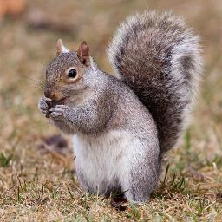
(Mono-lingual) Hypernymy Detection
squirrel
(i.e., is a kind of?)
Hypernym?
rodent
✔

Slide 3

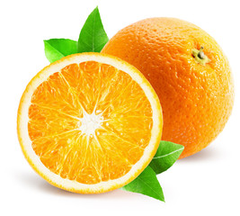
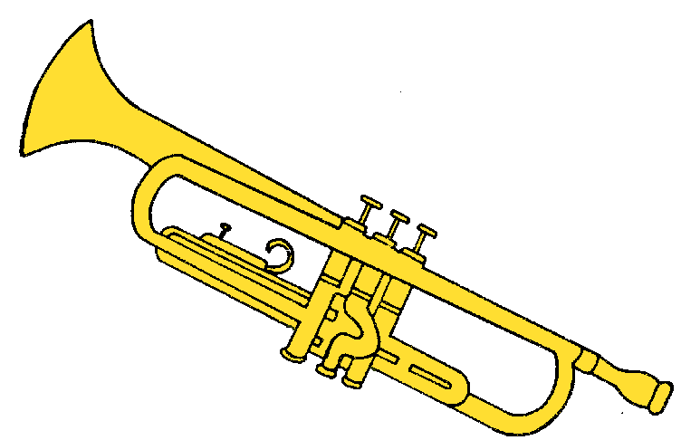
Cross-lingual Hypernymy Detection
Potential Applications
  Multi-lingual Taxonomy Construction (Fu et al., 2014)
  Cross-lingual Textual Entailment (Negri et al., 2012, 2013)
  Event Coreference across multi-lingual news sources (Vossen et al. 2015)
  Evaluating Machine Translation output (Pado et al. 2009)
rodent
bird
fruit
instrument
✔
écureuil
(French)
✔
ворона
(Russian)
✔
البرتقالي
喇叭
(Chinese)
(Arabic)

Slide 4
Why is this Challenging?
Translation does not capture language specific usage patterns.
Multilingual lexical resources (e.g., Babelnet) are useful, but incomplete.
supervisor
chronicler
chroniqueur
journalist
cook
chef
leader
Can we directly detect cross-lingual hypernymy using a distributional approach?

Slide 5
Overview of Our Approach
FR Corpus
pomme
Dependency Contexts
Hypernymy Scorer
Dependency Contexts
Yes!
EN Corpus
fruit
We also demonstrate robustness of this framework in various low-resource settings.

Slide 6
Dependency-Based Context Representations
Context Type | Example (for target word: traveler)
Window | tired, roamed
Dep-Full (Pado and Lapata 2007, Levy and Goldberg 2014) | roamed#nsubj⁻¹, tired#amod
Dep-Joint (Chersoni et al. 2016) | roamed#desert, roamed#seeking
Gives state of the art results in monolingual hypernymy detection.
(Roller and Erk 2016, Shwartz et al. 2017)
Dependency contexts abstract away language specific word order.

Slide 7
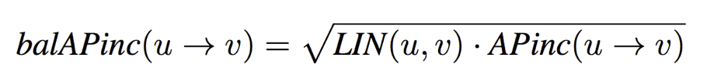
How to detect hypernymy using context features?
Symmetric measures like cosine similarity cannot detect asymmetric relations.
Distributional Inclusion Hypothesis (DIH) (Geffet and Dagan, 2005)
  “Reptile” can replace “snake” in its contexts, but not the other way round.
Scoring word pairs for DIH,
v is a hypernym of u, if context features of u appear within the features of v.
“reptile”
(Kotlerman et al. 2009)
“snake”
symmetric
similarity score
asymmetric
“inclusiveness” score

Slide 8
How to compare context features across languages?
v is a hypernym of u, if context features of u appear within the features of v.

Slide 9
Bi-lingual Representations = Continuous Approx. of Translation Dictionaries
Klementiev et al. (COLING 2012)
Faruqui and Dyer (EACL 2014)
Sogaard et al. (ACL 2015)
and many others …
Vectors in English
English | French
children | enfants
law | loi
money | argent
world | ??
?? | paix
?? | marche
law
loi
enfants
children
monde
world
market
marche
Vectors in French
argent
money
peace
paix

Slide 10
Generate bilingual representations ,
that can be used with the distributional inclusion hypothesis,
using monolingual dependency context representations ,
and a bilingual dictionary

Slide 11
Bilingual Sparse Coding
(Vyas and Carpuat 2016)
INPUT: Monolingual Dense Vector for i^{th} word
Mono. Obj. for Sparse Coding
OUTPUT: Bilingual Sparse Vector for i^{th} word
Lasso Reg.
matrix encoding all possible translations
Cross-ling. Obj. to respect translation matrix
Minimize distance of words which are possible translations of each other

Slide 12
Putting it all Together …
Parsed Corpus
FR Corpus
pomme (apple in French)
co-occurrence
matrix
SVD
Dep. Parser
Dep.-Based Context Extraction
Bilingual Sparse Coding
Bilingual Dictionary
BalAPinc
Scorer
co-occurrence
matrix
Dep. Parser
Dep.-Based Context Extraction
SVD
0.8
fruit
EN Corpus
Parsed Corpus

Slide 13
Experiments

Slide 14
Evaluation Setup
Crowd-sourcing evaluation datasets
  Candidate edges drawn from monolingual hypernymy datasets, Babelnet, …
Two evaluation sets
  Hypernymy vs Hyponymy (i.e., reverse relation, e.g. (reptile,snake) vs. (snake,reptile))
  Hypernymy vs Cohyponymy (i.e., words sharing the same hypernym, e.g. (lizard,snake))
Evaluation Metric: Accuracy
Lang. | # pos (= # neg)
French-English | 763
Russian-English | 706
Arabic-English | 691
Chinese-English | 806

Slide 15
Main Results – Hyper vs Hypo

Slide 16
Main Results – Hyper vs Cohypo
Distinguishing hypernyms from cohyponyms is easier than distinguishing them from hyponyms.

Slide 17
Evaluating Robustness in Low-Resource Settings

Slide 18
Low-Resource Setting - Absence of Treebank
Our approach requires a dependency parser in the target language.
Dependency treebanks are not available for most of the languages in the world.
Can we use a (delex) dependency parser trained on related languages?
English
Spanish
Zeman and Resnik, 2008;
McDonald et al., 2011
French
Italian
Portuguese

Slide 19
Robustness to Absence of Treebank (Hyper vs Hypo)

Slide 20
Robustness to Absence of Treebank (Hyper vs Cohypo)
  Frequent contexts - amod, nmod, nsubj, dobj together make >70% of all matrices.
  Delexicalized parsers are relatively robust on these frequent contexts.

Slide 21
Other Low-Resource Settings
reduce size of monolingual corpus
Fairly robust to these settings as well!
reduce quality of the bilingual dictionary

Slide 22
Our Contributions
pomme
We can identify hypernymy relations across languages using dependency based cross-lingual representations.
Framework is robust to various low-resource settings.
New datasets for cross-lingual hypernymy detection in 4 languages.
  Evaluation datasets and vectors available at github.com/yogarshi/bisparse-dep
Entailment Scorer
fruit
0.8
Thanks!

Slide 23
Reason for Robustness
Frequent contexts in the dependency context co-occurrence matrix
  amod, nmod, nsubj, dobj together make >70% of all matrices.
Delexicalized parsers are relatively robust on these frequent contexts.
  Most other contexts suffer 15-20 F1 drops.
This makes our framework applicable to many more languages!
Lang. | F1 on nmod edge | F1 on nmod edge (DELEX )
Russian | 76.7 | 68.6
French | 76.8 | 69.6
Arabic | 76.1 | 71.2
Chinese | 75.4 | 69.7
Notes:
backup

