Slide 1

Acting, Planning, and Learning Using
Hierarchical Operational Models
Invited talk: NSWC, IHD
December 3, 2020
Sunandita Patra​
Post-Doctoral Researcher University of Maryland, College Park
Collaborators: Dana Nau, Malik Ghallab, Paolo Traverso, James Mason, Amit Kumar | ​

Slide 2

AI
Basic Idea: Build an agent than can do all tasks a human can;
may be superhuman
Reasoning, problem solving
Knowledge representation
AI Planning and Acting
Machine Learning
Natural Language Processing
Perception
Motion and Manipulation
Social Intelligence
General Intelligence
…

Slide 3
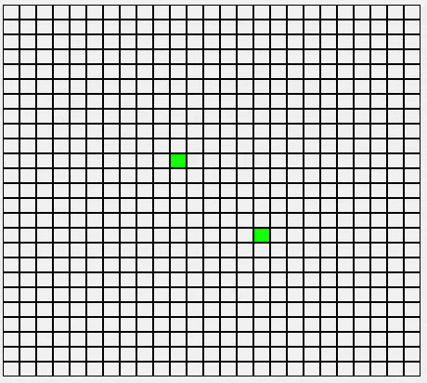
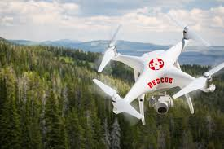
Planning and Acting
Planning​ :
You have a goal or a task to accomplish;
Problem: Need to come up with a sequence of
actions/steps to achieve the goal or accomplish the task
Prediction + search​
Acting​ :
Performing tasks and actions in the real world​

Slide 4

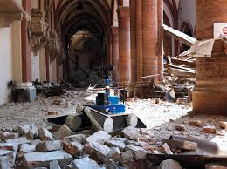
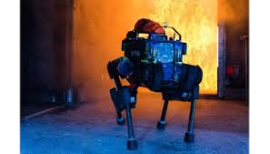
Why integrate Acting and Planning?
Notes:
As an example, consider automated search and rescue operations with dynamic events, concurrent tasks, sensing, planning, learning
On one hand, the actor can’t start acting without a plan, on the other hand, you can’t take a plan and execute it all the way through because a lot of things could go wrong. So, the actor needs to continually plan while it is acting. This is just one example, there are many such examples where the integration is important.

Slide 5


Our Architecture of the Actor
Actor
Planner
Learning Component
Tasks
Task and Action Models
Acting Engine
State
Actions
Events
Execution Platform
Actuation
Sensing
Notes:
Title OK?

Slide 6
AI Planning
Planning
  Prediction + search
  Search over predicted states, possible organization of tasks and actions
  Descriptive action models
    Efficiently predict next state(s)
    Search large state spaces quickly
Descriptive Models
What the actions do?
Planner
Learning component
Acting engine

Slide 7
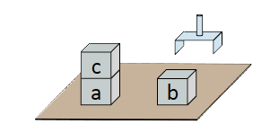
Descriptive Models
Say ``what” actions do
  With a set of preconditions and effects
Example: Simple blocks-world domain
  Range(x) = {a, b, c}
Action: Putdown(x)
Pre: holding = x
Eff: loc(x) ← table, holding ← nil
Action: Pickup(x)
Pre: loc(x) = table, top(x) = nil,
holding = nil
Eff: loc(x) ← hand, holding ← x
Descriptive Models
Notes:
Descriptive actions say what actions do. One common way to do this in the AI planning literature is with a set of preconditions and effects.

Slide 8


Acting
Acting
  Performing tasks and actions in the real world
  Knowing ``what” not enough
  Execution platform needs to know ``how”
    May involve closed loop online decision making
pickup(b)
How?
Planner
Learning component
Operational Models
How to perform the task?
Acting Engine
Rigid 3D objects

Slide 9
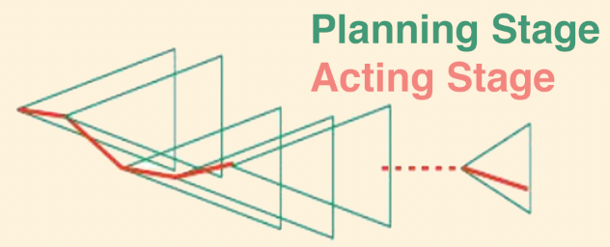
Integration of Actor and Planner
General approach
Descriptive Models
What the actions do?
Planner
Plans
Queries
Operational Models
How to perform the task?
Acting engine
Notes:
Planning happens online
Actor has nondeterministic actions,

Slide 10
Integration of Actor and Planner
Issues with this style of integration:
Consistency between
two different models
  Plan verification
  Plan management
Descriptive Models
What the actions do?
Planner
Consistent?
Operational Models
How to perform the task?
Acting engine
Notes:
If descriptive models are not predicting what operational models actually do, then plan verification becomes impossible.
It is more difficult to maintain consistency when there are dynamic events happening

Slide 11
Our Solution
One single representation for both actor and planner
  Must be operational
  Descriptive models too abstract
New planning
algorithms to reason
with operational models
Descriptive Models
What the actions do?
Planner
Operational Models
How to perform the task?
Acting engine

Slide 12
Parts of the Talk
Planning algorithm using Hierarchical Operational Models
Integration of actor and planner with Learning
Learn to choose operational models for tasks
Learn a heuristic function
Plan-with-UPOM
Learn to choose operational model parameters
Properties of the algorithm
Real-world prototype
Attack recovery in Software-defined networks using Plan-with-UPOM
Implementation and Experiments
Five simulated domains
Improved efficiency and success-ratio
Auto-generated problems

Slide 13
The Actor
Actor
Planner
Learning component
Tasks
Hierarchical
OperationalModels
Acting engine
State
Actions
Events
Execution Platform
Actuation
Sensing
Notes:
Title?

Slide 14
Operational Models
Tell us how to perform the task
Task: An activity for the actor to perform
For each task, one or more refinement methods
  Possible ways to accomplish the task
Commands: Actions sent to the execution platform
  Can have nondeterministic outcomes
method-name1(arg₁, …, arg_{k})
task: task-identifier
pre: test
body: computer program
to generate
commands and tasks

Slide 15
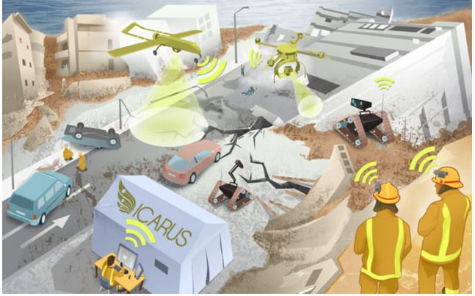
Example of Operational Models
Event: Some natural disaster
has happened
Search and Rescue with robots
Task: rescue(p)
rescue-method1(p, r)
task: rescue(p)
pre: status(r) = Free
and loc(p) = Unknown
body: for l in LOCATIONS:
move(r, l)
sense(l)
if loc(p) = l:
help(r, p)
return
output(“cannot find” p)
rescue-method2(p,l)
task: rescue(p)
pre: loc(p) = l and
l ≠ Unknown
body: r ← free robot
nearest to p
if r != NONE:
  move(r, l)
  help(r, p)
  else fail
Notes:
Not a realistic example, just a toy and simplified
M1 is where you don’t know where the person is and have to look around and find,
M2 is the other case where you know where the person is.

Slide 16
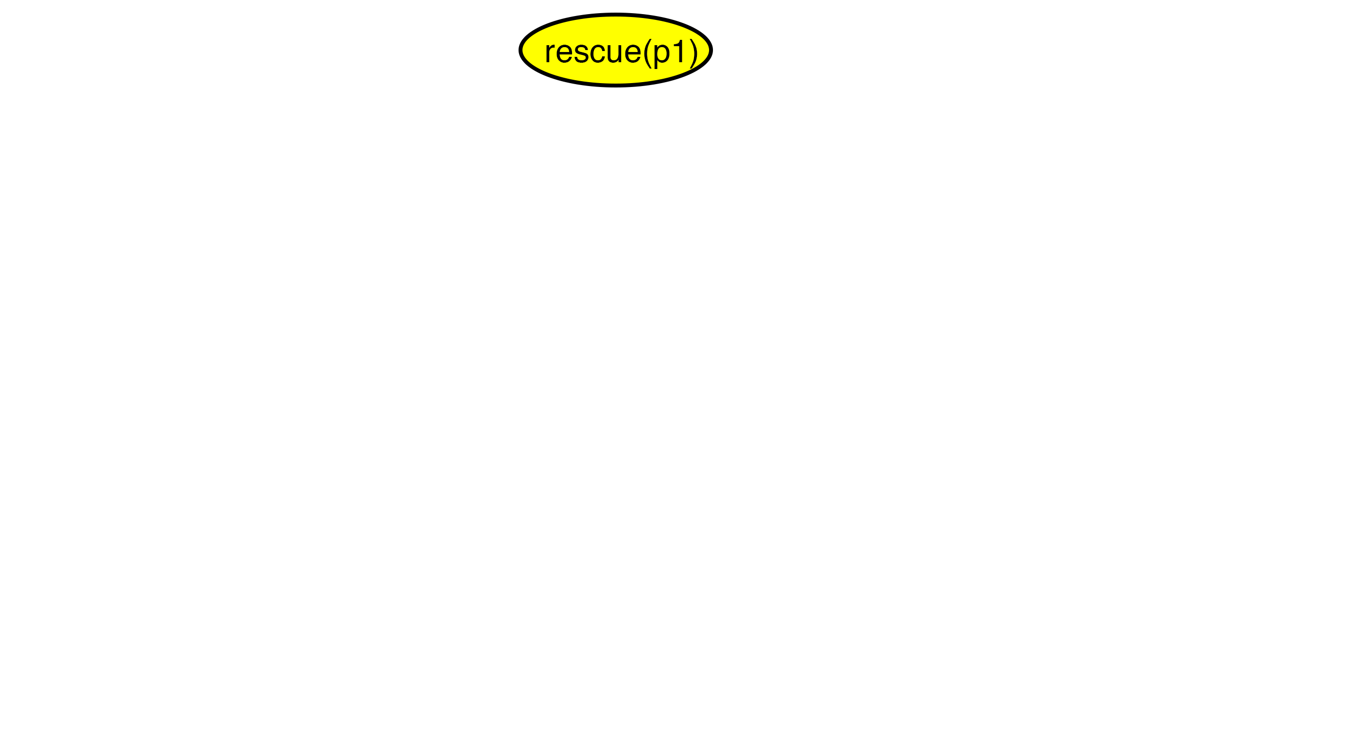
A Refinement Tree for rescue(p1)
Body of rescue-method1(p, r)
for l in LOCATIONS:
  move(r, l)
sense(l)
if loc(p) = l:
  help(r, p)
  return
output(“can’t find” p)

Slide 17
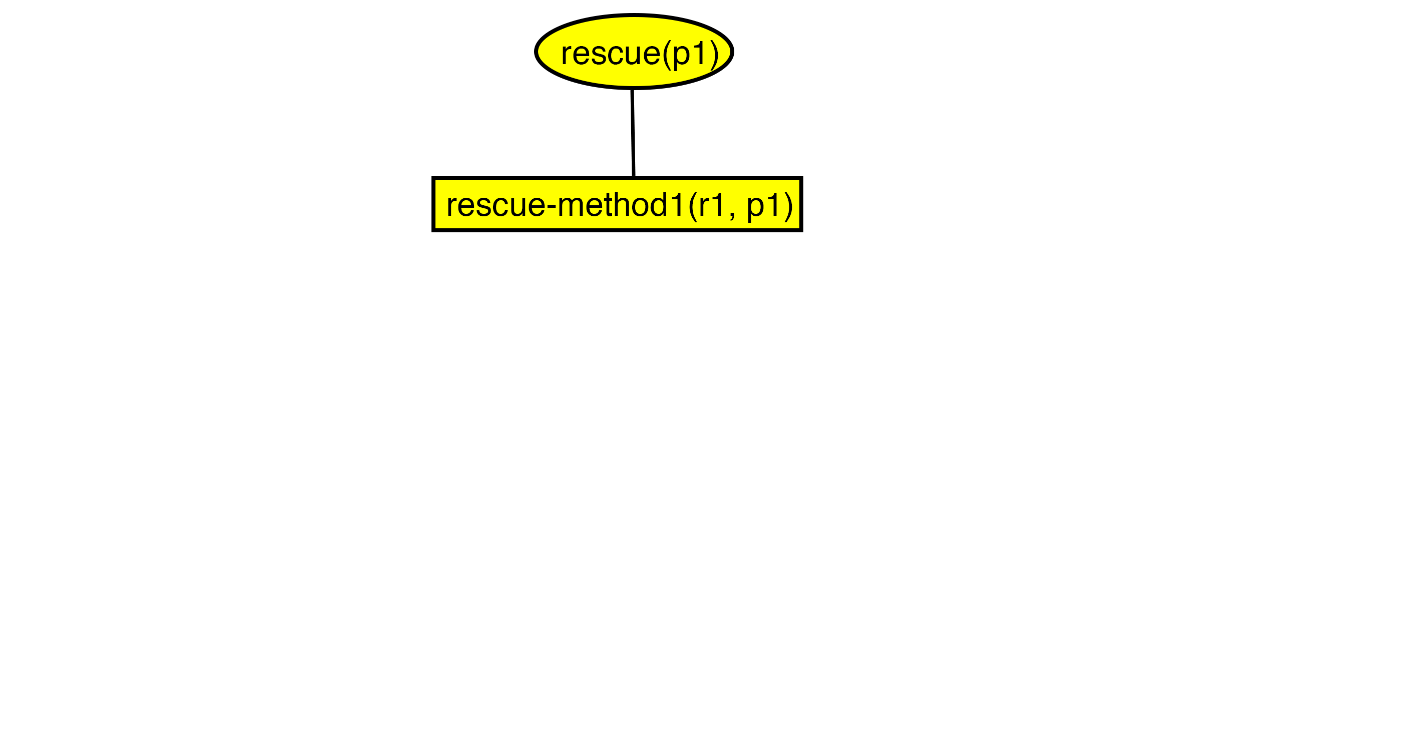
A Refinement Tree for rescue(p1)
Body of rescue-method1(p, r)
for l in LOCATIONS:
  move(r, l)
sense(l)
if loc(p) = l:
  help(r, p)
  return
output(“can’t find” p)

Slide 18
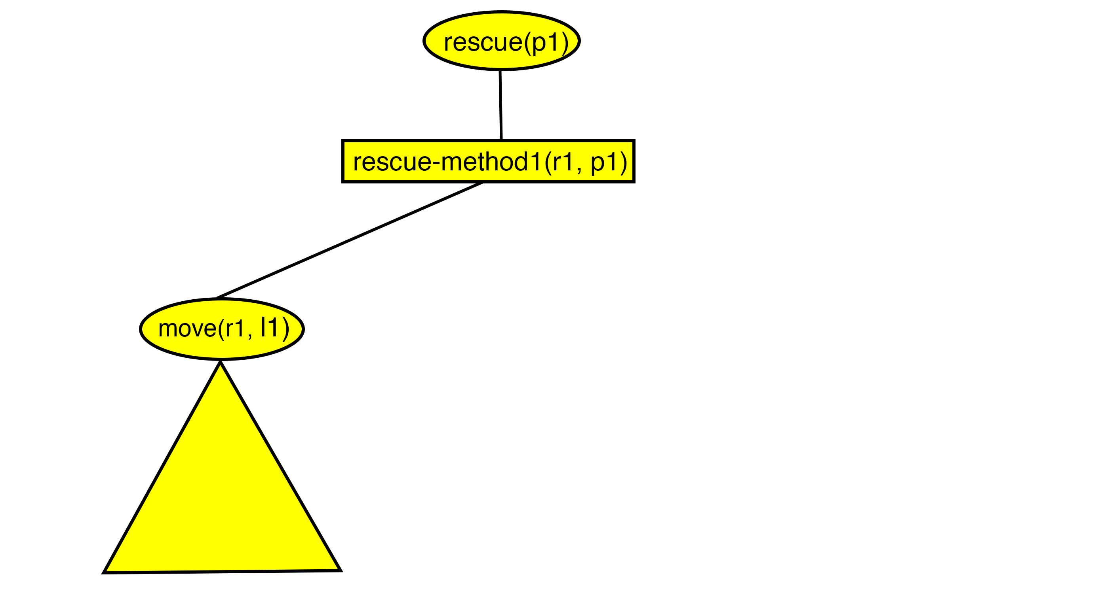
A Refinement Tree for rescue(p1)
Body of rescue-method1(p, r)
for l in LOCATIONS:
  move(r, l)
sense(l)
if loc(p) = l:
  help(r, p)
  return
output(“can’t find” p)
1
2
3

Slide 19
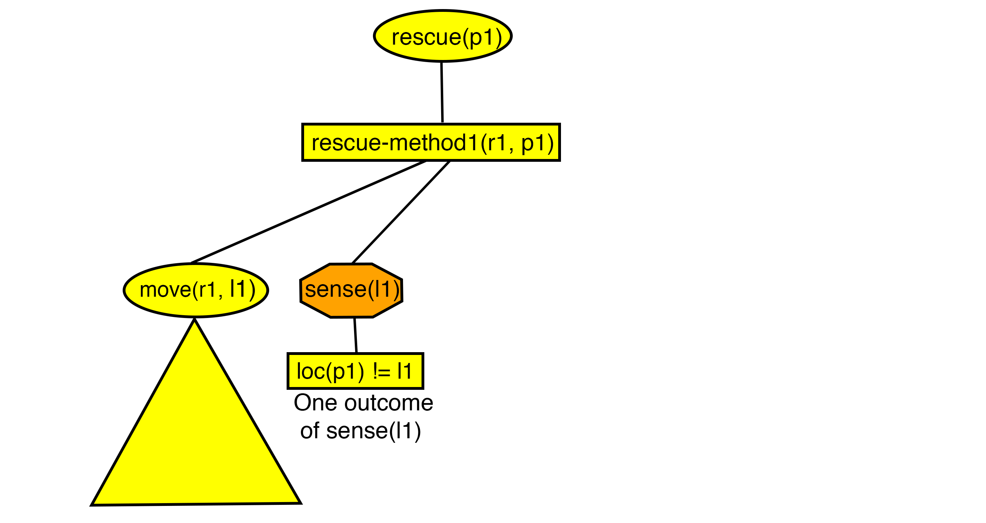
A Refinement Tree for rescue(p1)
Body of rescue-method1(p, r)
for l in LOCATIONS:
  move(r, l)
sense(l)
if loc(p) = l:
  help(r, p)
  return
output(“can’t find” p)
1
2
3
4
5
Notes:
The robot is looking around using whatever sensors it has to see what there is in the location.
If it finds P1, it will determine that p1 is in the location

Slide 20
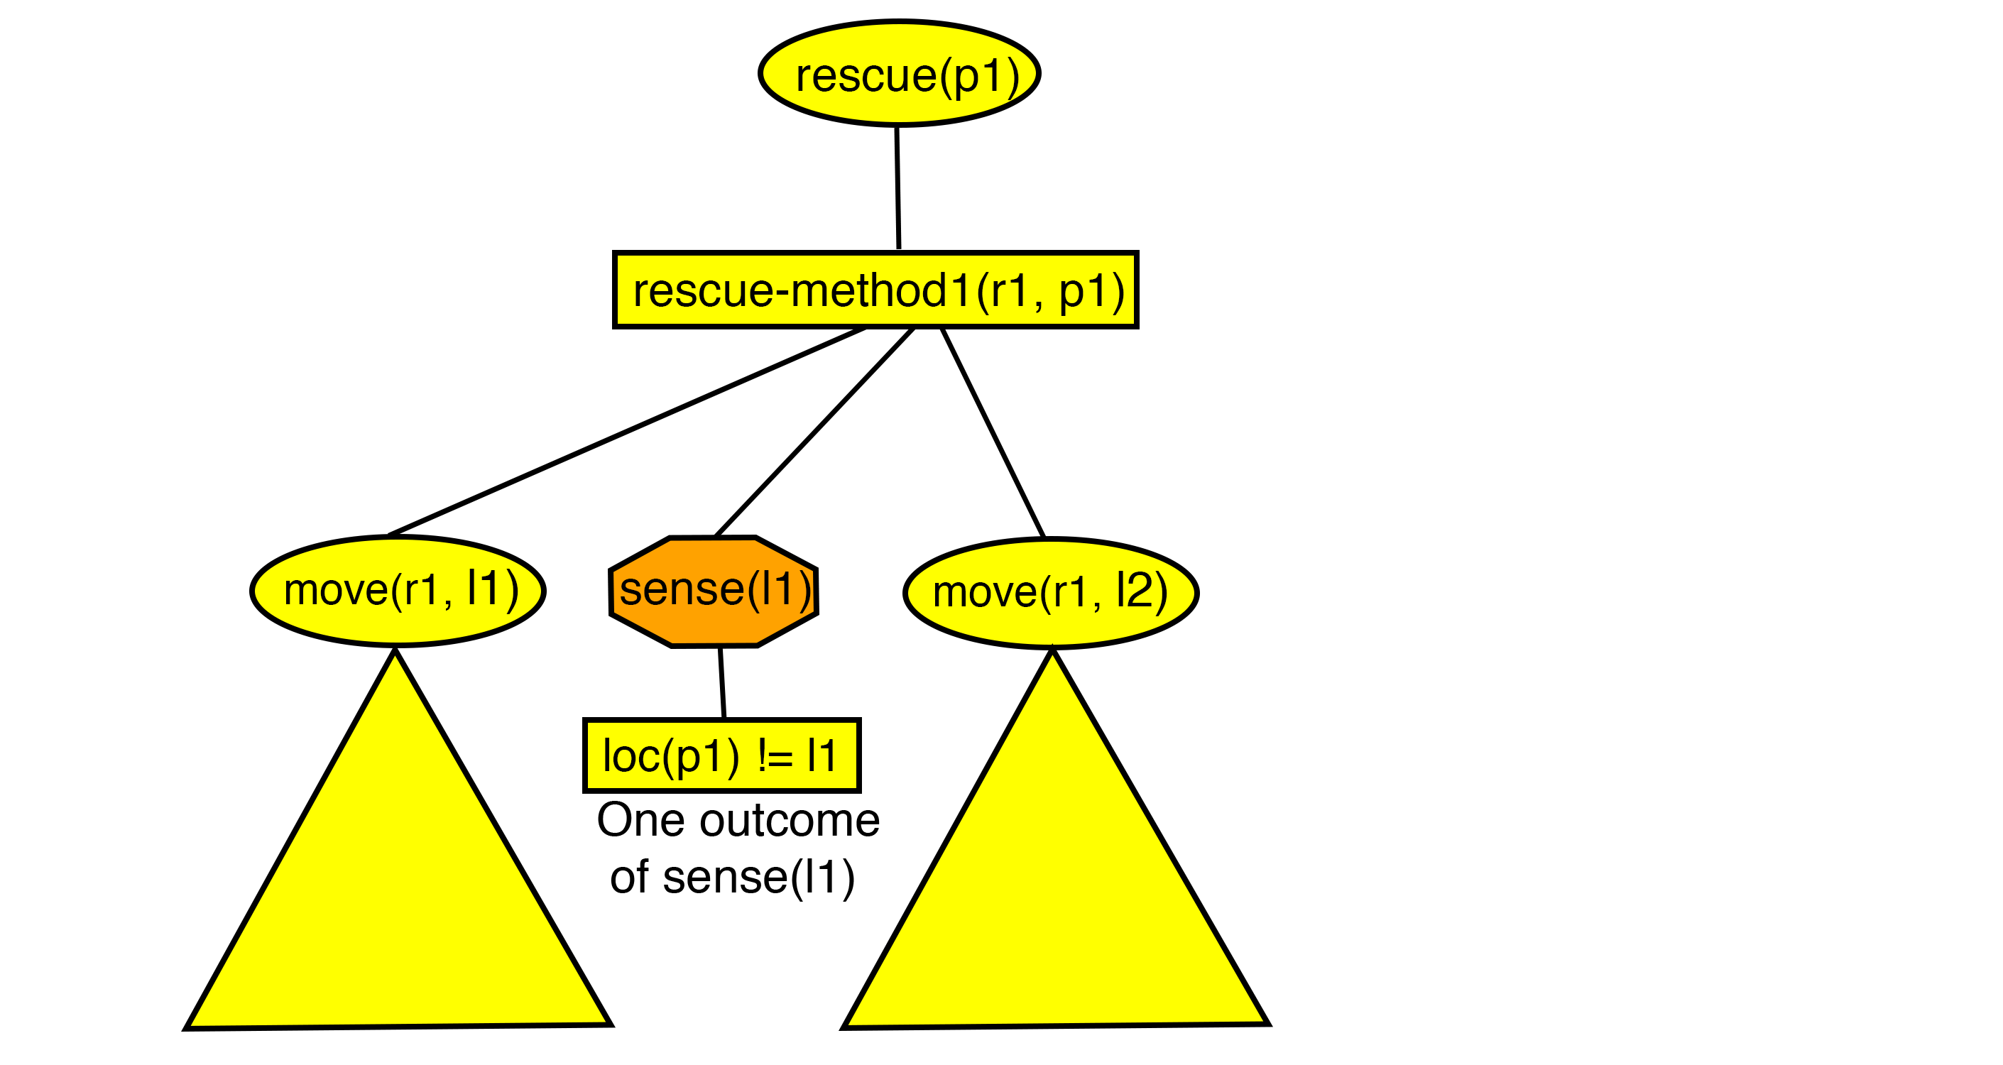
A Refinement Tree for rescue(p1)
Body of rescue-method1(p, r)
for l in LOCATIONS:
  move(r, l)
sense(l)
if loc(p) = l:
  help(r, p)
  return
output(“can’t find” p)
1
2
3
4
6
5

Slide 21
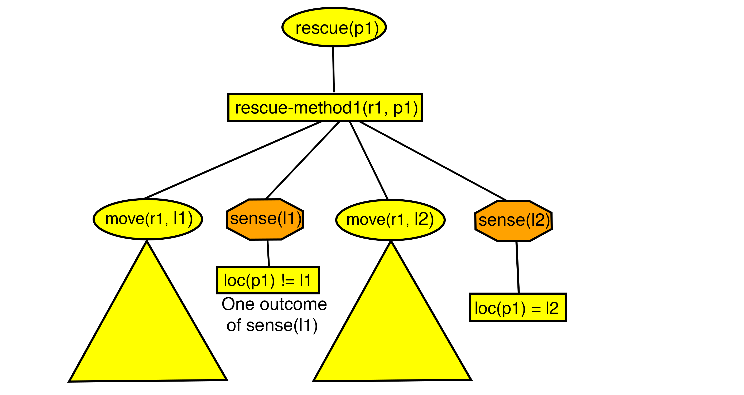
A Refinement Tree for rescue(p1)
Body of rescue-method1(p, r)
for l in LOCATIONS:
  move(r, l)
sense(l)
if loc(p) = l:
  help(r, p)
  return
output(“can’t find” p)
1
2
3
4
6
7
5
8

Slide 22
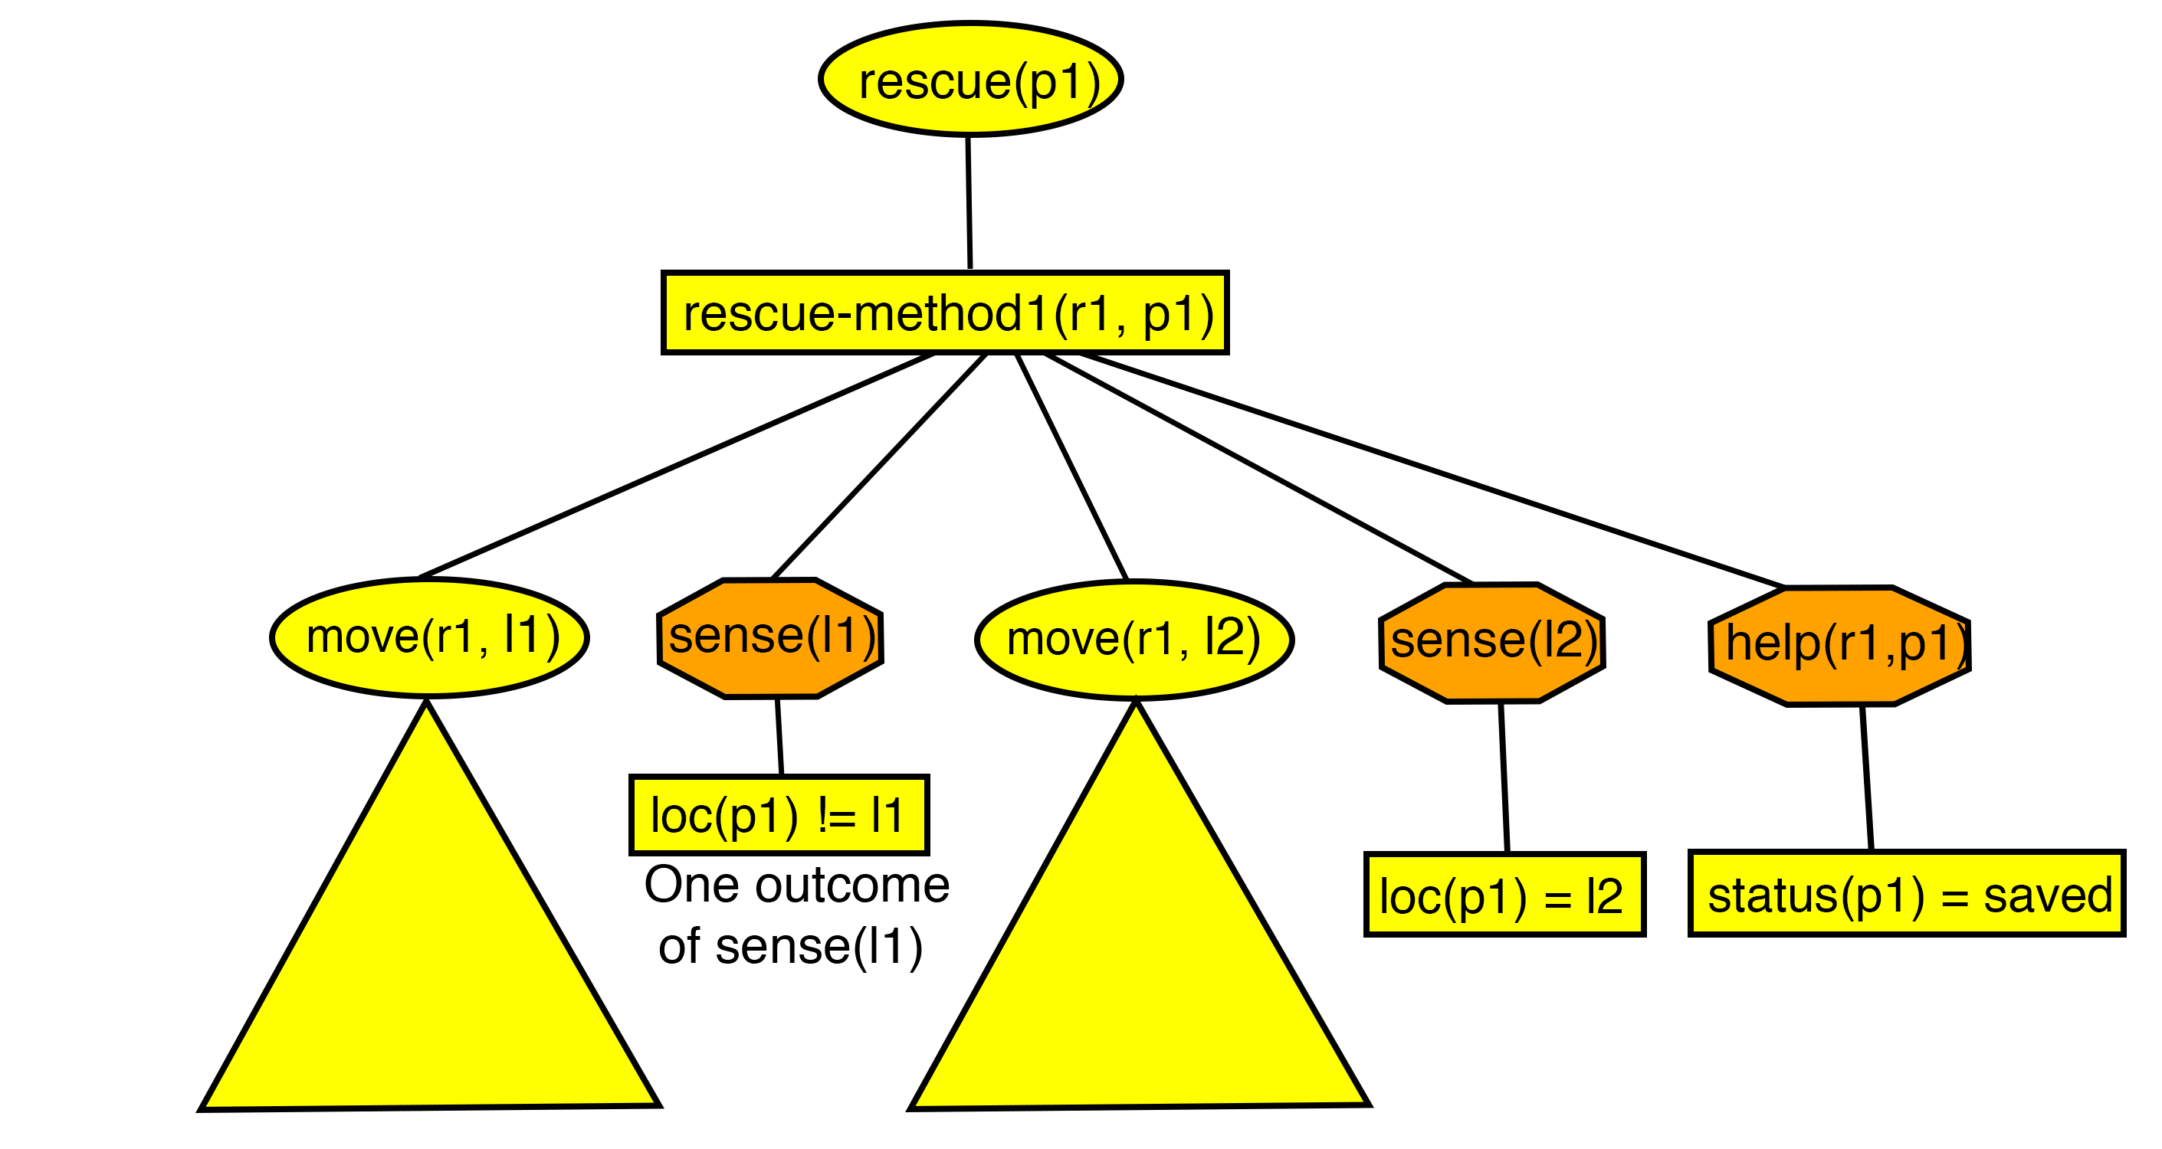
A Refinement Tree for rescue(p1)
Body of rescue-method1(p, r)
for l in LOCATIONS:
  move(r, l)
sense(l)
if loc(p) = l:
  help(r, p)
  return
output(“can’t find” p)
1
2
3
4
6
7
9
5
10
8

Slide 23
A Refinement Tree for rescue(p1)
Body of rescue-method1(p, r)
for l in LOCATIONS:
  move(r, l)
sense(l)
if loc(p) = l:
  help(r, p)
  return
output(“can’t find” p)
1
2
3
4
6
7
9
5
10
8

Slide 24
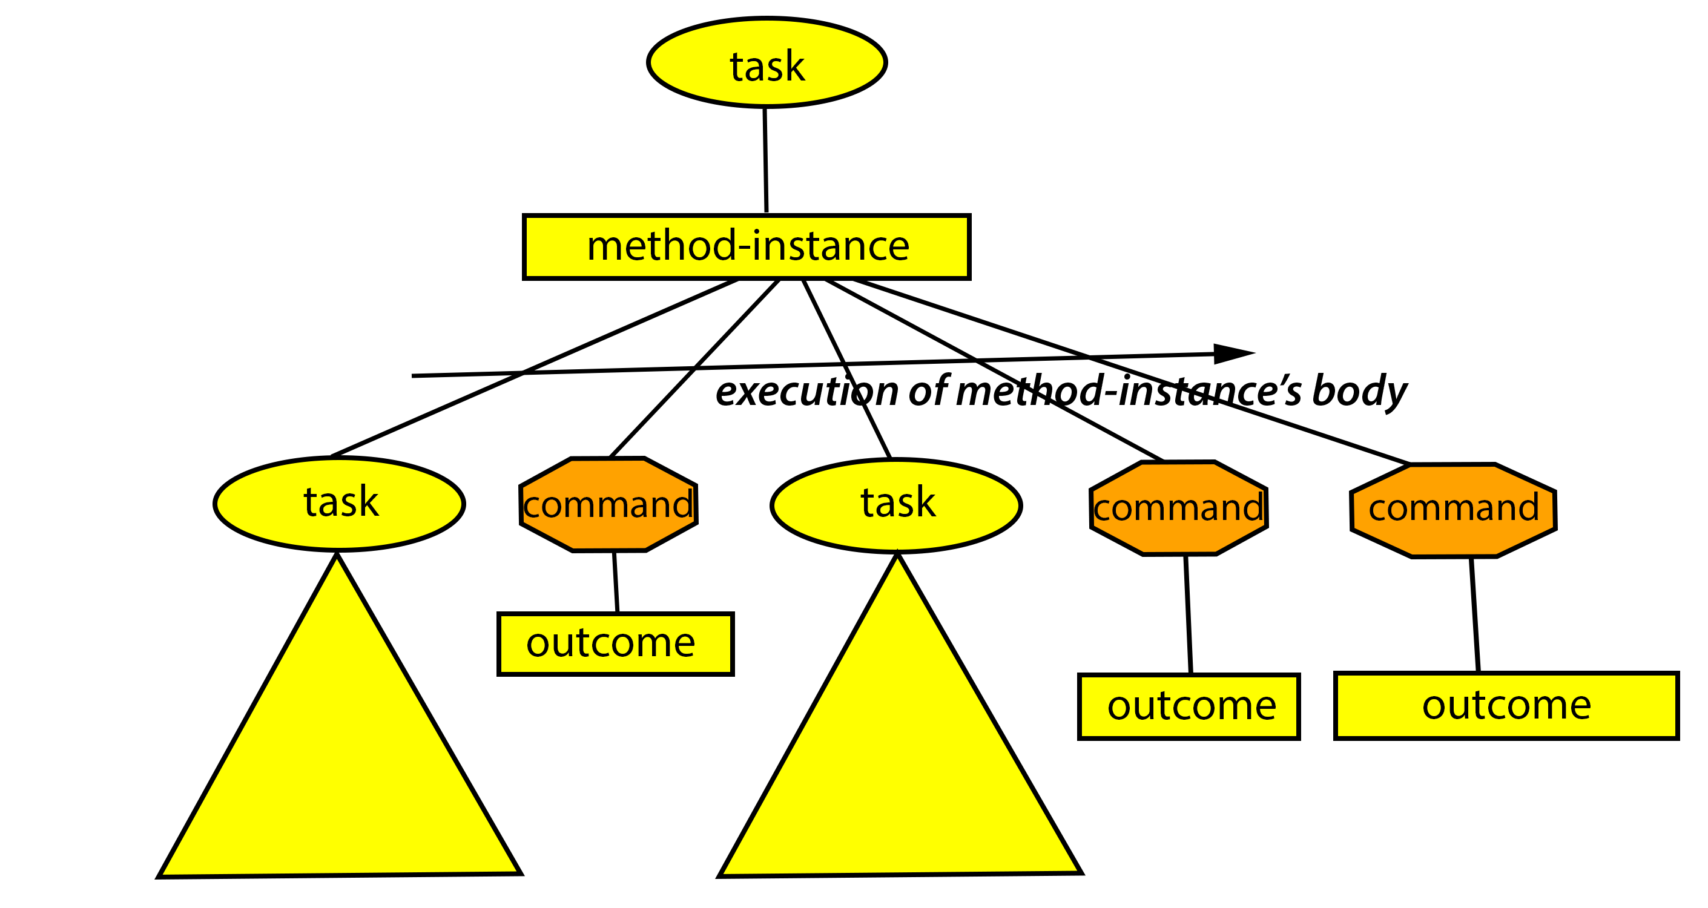
A Refinement Tree for task

Slide 25
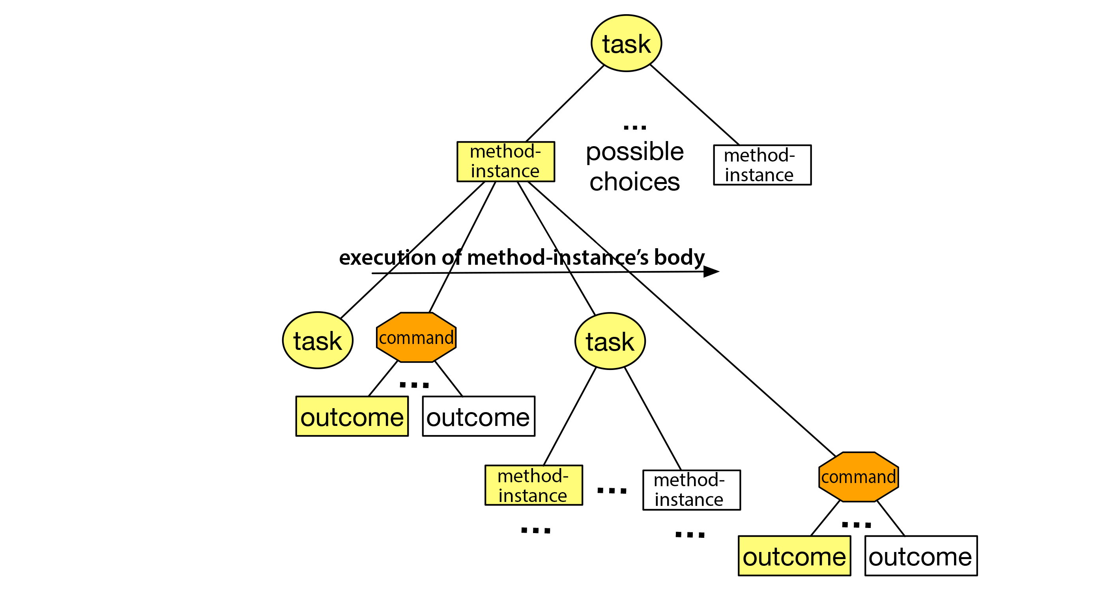
Several possible refinement trees

Slide 26
The Actor
The Actor
Actor
Planner
Learning component
✓
Tasks
Hierarchical
OperationalModels
Acting engine
Tasks and sub-tasks
Commands
Refinement methods
Refinement Tree
State
Actions
Events
Execution Platform
Actuation
Sensing

Slide 27
Acting Algorithm: RAE
RAE = Refinement Acting Engine
loop:
  for every new task
    Candidates ← {applicable methods}
    choose m ∈ Candidates
    create a refinement stack
      like a program execution stack
      initially with just task and m
    add the stack to Agenda
  for each stack in Agenda
    Progress(stack)
    - this may generate more tasks that
    need refinement
m
How to make an
informed choice?
Nondeterministic actions
Dynamic, partially
observable environment
Arbitrary choice may
make the situation worse
(task, m)
Notes:
Tough choice
Nondeterministic actions
Dynamic, partially observable environment
May lead to failure or make the situation worse

Slide 28
Planning Algorithm
Plan-with-UPOM
Planner
Learning component
✓
Hierarchical
OperationalModels
✓
Acting engine (RAE)

Slide 29
Planner: Plan-with-UPOM(task)
Job of the planner:
Which method instance to choose for task? m1 or m2?
  Both are applicable
To predict their outcomes,
Plan-with-UPOM executes the
methods in a
simulated environment
Optimize some utility function
  Expected cost
  Probability of success
m1
m2
Execution of m2’s body
Execution of m1’s body

Slide 30
Problem: Exponentially Large Search Tree
All tasks have several applicable refinement methods
Commands have nondeterministic outcomes
Exponential
complexity
Solution:
Do Monte Carlo
rollouts
  Doesn’t look at the
  whole search space
  No backtracking
Notes:
In an awful lot of AI planning algorithms, the way to choose is doing a heuristic search.
Tasks-several methods
Commands-outcomes, every subtask needs to be refined
Exploring everything has exponential complexity

Slide 31
Planner: Plan-with-UPOM(task)
Online Monte Carlo rollouts
n_{ro} rollouts
After rollouts are done,
estimate the expected utility
of each method instance
Choose the
method instance
with highest
expected utility
Each rollout
handled by
procedure UPOM
m1
m2
Execution of m2’s body

Slide 32

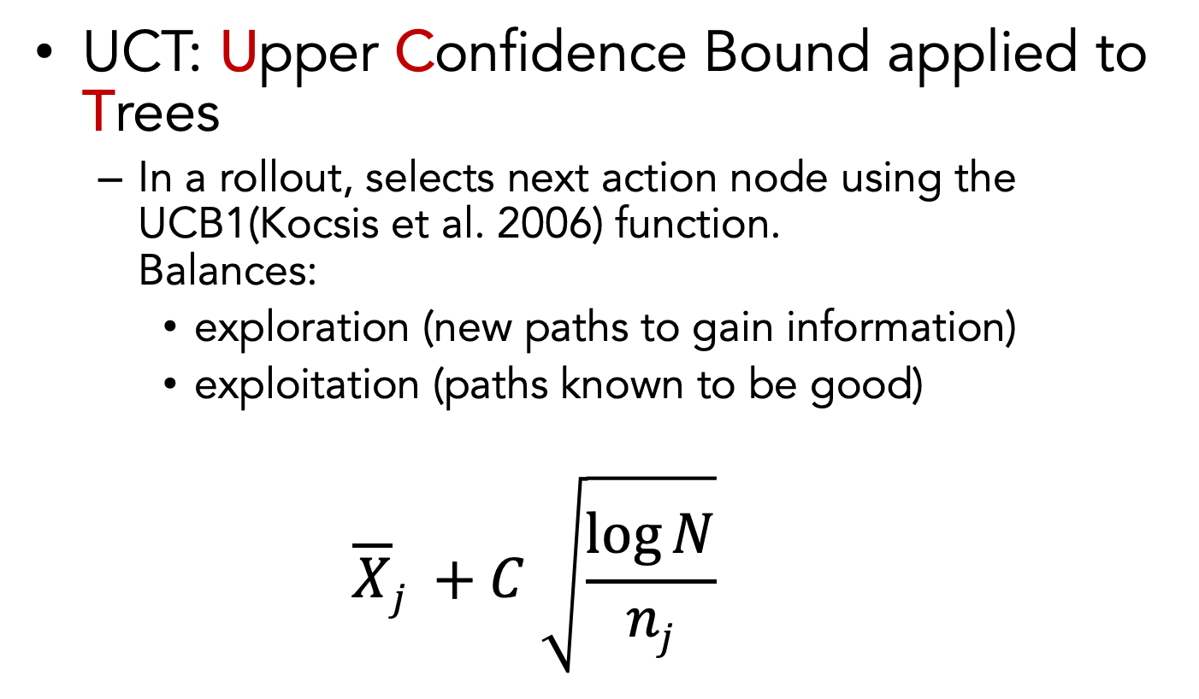
Background: UCT Search
UCT: Upper Confidence Bound applied to Trees
  In a rollout, selects next action node using the UCB1(Kocsis et al. 2006) function.
  Balances:
    exploration (new paths to gain information)
    exploitation (paths known to be good)
    $$\overline{X}j +C \sqrt{\frac{\log{N}}{nj}}$$
$\overline{X}j$ : Average reward computed for action j
N : Total number of actions tried
$nj$: Number of times action j was tried
C: Constant
Exploitation
Exploration

Slide 33
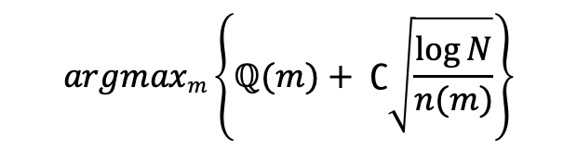
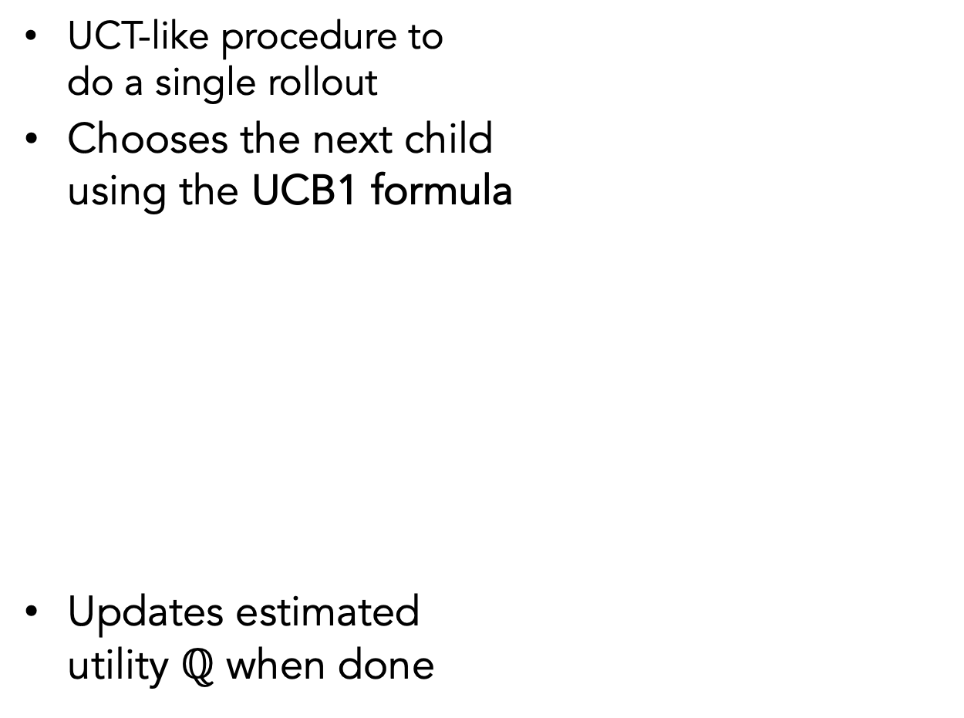
UPOM(task)
UCT-like procedure to
do a single rollout
Chooses the next child
using the UCB1 formula
Updates estimated
utility $ℚ$ when done
Number of times task is visited
$$argmaxm\left\{ℚ(m)+ ∁\sqrt{\frac{\log{N}}{n(m)}}\right\}$$
Estimated Utility of m
m1
m2
Number of times m is chosen
Execution of m2’s body

Slide 34
Limited depth rollouts
Planning happening online;
Don’t want long rollouts
UPOM’s rollouts have
length d
Remaining utility estimated using a heuristic function
m1

Slide 35
Properties of Plan-with-UPOM
Time and space complexities linear in n_{ro} (number of rollouts) and d (rollout length)
In a static environment (no dynamic events),
  The refinement planning domain can be mapped to an MDP
UCT search converges for an MDP as the number of rollouts approaches infinite

Slide 36
Parts of the Talk
Planning algorithms using Hierarchical Operational Models
Plan-with-UPOM
Integration of actor and planner with Learning
Learn to choose refinement methods
Learn a heuristic function
Learn to choose methods
Properties of the algorithm
Real-world prototype
Attack recovery in Software-defined networks using Plan-with-UPOM
Implementation and Experiments
Five simulated domains
Improved efficiency and success-ratio
Auto-generated problems

Slide 37
Integration with Learning
Learn𝛑: To choose refinement method for a task when there is not enough time to plan
LearnH: To estimate heuristic for UPOM
Gather training
data from acting
and planning
traces of RAE and
Plan-with-UPOM
Train classifiers
(multi-layered
perceptrons)
Plan-with-UPOM
Context,
task, m
Learning component
Estimated Heuristic value
m
Context, task
Acting engine (RAE)
Context: stack, state

Slide 38
Learn to choose method (Learn 𝛑)
Step 1: Data generation
((state s,
task 𝞽),
method m)
.
.
Step 2:
([w_{s},w_{𝞽}],w_{m} )
.
.
.
tasks
RAE + UPOM
Step 3:
nn_{𝛑}
One-Hot
encoding
Train
actions
Multi-layered perceptron to classify by m
Execution Platform
Step 4: Integration with RAE
(s,𝞽)
[w_{s} ,w_{𝞽}]
Task 𝞽
RAE
One-Hot encoder
i
Decode
m
nn_{𝛑}
actions
Execution Platform

Slide 39
Training data for Learn 𝛑
Can come from acting traces
  Which method was most ``efficient” for RAE?
Can come from planning traces
  Which method did Plan-with-UPOM suggest?
Learn 𝛑-1
Learn 𝛑-2

Slide 40
Learn a heuristic estimate (LearnH)
Step 1: Data generation
tasks
((state s,
task 𝞽),
method m,
utility u)
.
.
([w_{s},w_{𝞽},w_{m}], w_{u})
.
.
.
Step 2:
UPOM
Step 3:
nn_{H}
One-Hot
encoding
Train
Multi-layered perceptron
Step 4: Integration with RAE
𝞽
i
Decode
[w_{s},w_{𝞽},w_{m}]
(s,𝞽,m)
task
RAE
UPOM
One-Hot encoder
nn_{H}
m
actions
u
Execution Platform

Slide 41
LearnH
Tries to learn Heuristic values, i.e., real numbers
Tried regression – didn’t work
Solution: classify by intervals
Learn to choose ``which interval”
interval₁
interval₃
interval₄
interval₅
interval₂
interval₆
Range of Heuristic values

Slide 42
Parts of the Talk
Planning algorithms using Hierarchical Operational Models
Plan-with-UPOM
Integration of actor and planner with Learning
Learn to choose refinement methods
Learn a heuristic function
Learn to choose methods
Properties of the algorithm
Real-world prototype
Attack recovery in Software-defined networks using Plan-with-UPOM
Implementation and Experiments
Five simulated domains
Improved efficiency and success-ratio
Auto-generated problems

Slide 43
Experimental Domains
Domain characteristics we want to examine
  Dynamic Events
  Concurrent tasks
  Dead ends
  Multiple agents under central control
  Actors have sensors to acquire information about the world
We designed simulated domains to cover these characteristics
Open source code available: https://bitbucket.org/sunandita/rae/src/master

Slide 44

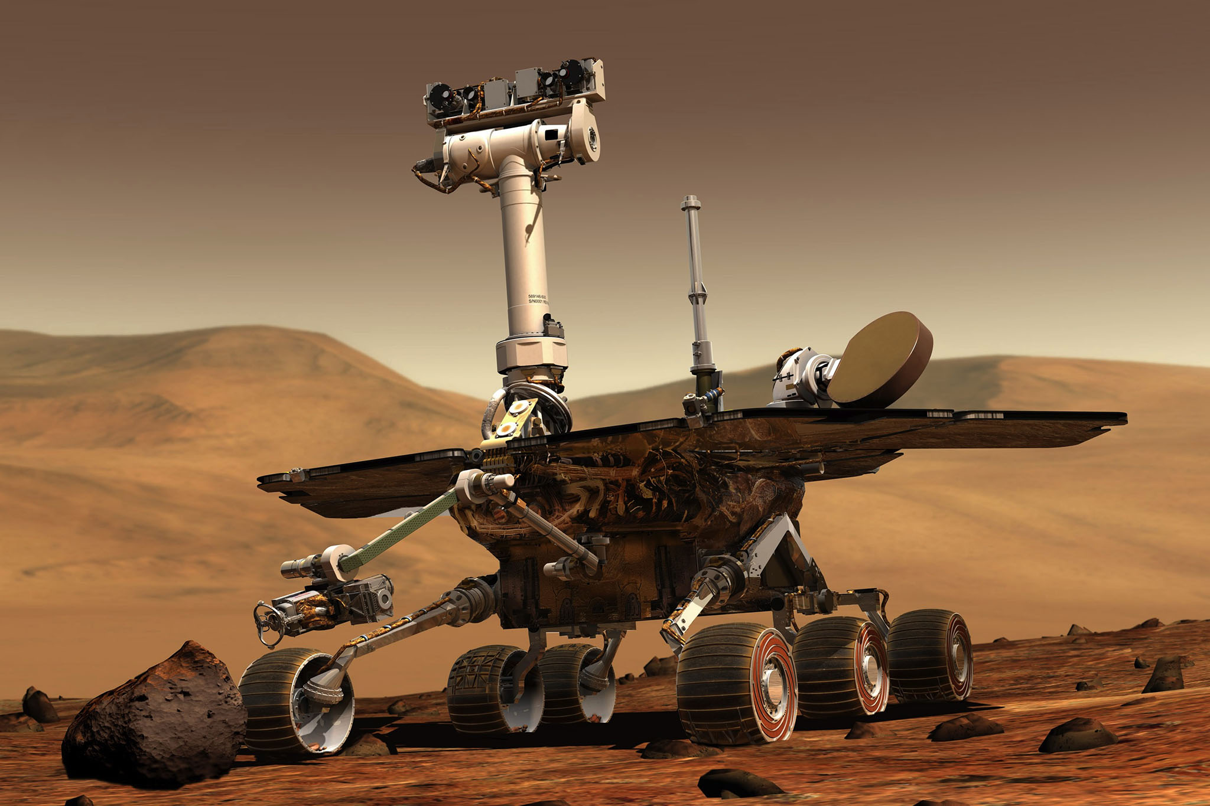

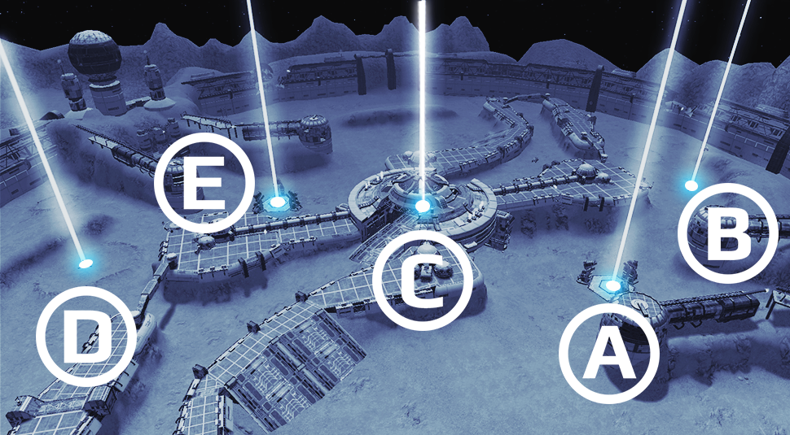
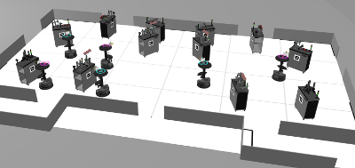
Experimental Domains
2. Deliver packages by navigating doorways
3. Explore a new environment
1. Search and Rescue
4. Sense and collect objects
5. Order fulfillment

Slide 45
Evaluation Metrics
Planner
Learning Component
Efficiency
  Reciprocal of the cost
  Measures how desirable the plan is
Success Ratio
  # successful jobs / # incoming jobs
  Robustness: ability to withstand failures due to dynamic events
jobs
Acting Engine

Slide 46
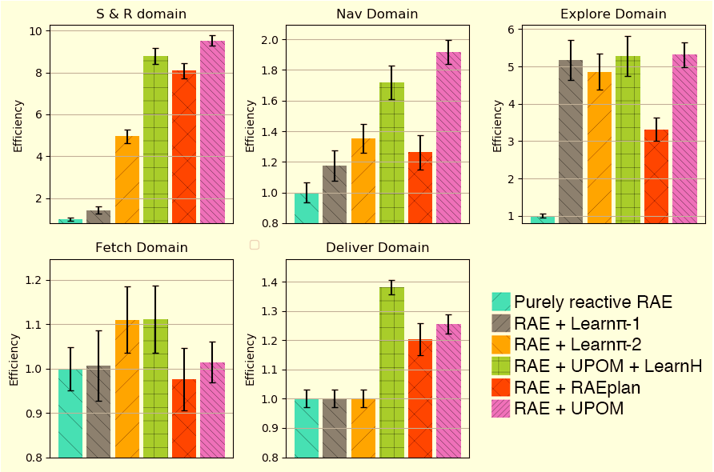
Efficiency (1/cost)
1
2
3
X: Different strategies
Y: Efficiency wrt purely reactive RAE
4
5
Error bars: 95% confidence
Notes:
RAE has multiple tasks in the Agenda, tasks interfere with each other, UPOM does consider this, UPOM plans for one task at a time

Slide 47
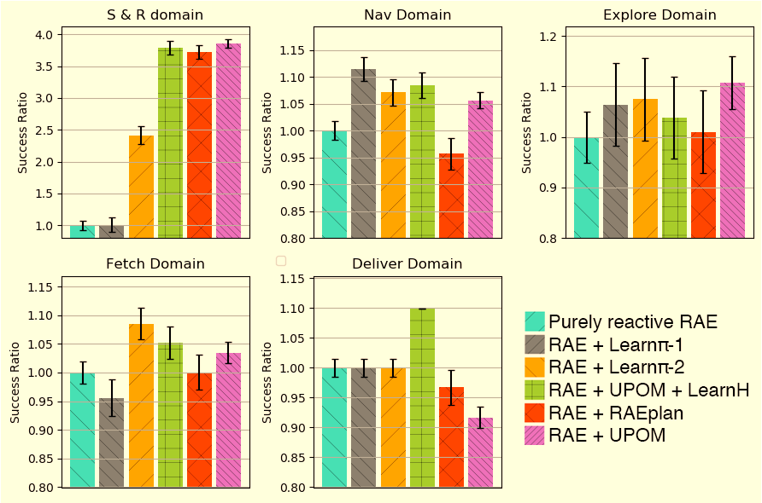
Success Ratio
(Tasks completed successfully) / (total number of tasks)
1
2
3
X: Different strategies
Y: Success-ratio wrt purely reactive RAE
(ratio of ratio)
4
5
Error bars: 95% confidence
Notes:
Should I add the same plot for retry-ratio?

Slide 48
Parts of the Talk
Planning algorithms using Hierarchical Operational Models
Plan-with-UPOM
Integration of actor and planner with Learning
Learn to choose refinement methods
Learn a heuristic function
Learn to choose methods
Properties of the algorithm
Real-world prototype
Attack recovery in Software-defined networks using Plan-with-UPOM
Implementation and Experiments
Five simulated domains
Improved efficiency and success-ratio
Auto-generated problems

Slide 49
Real-world prototype of RAE and UPOM
Software-defined networks
  Have decoupled control
  and data layers
  Prone to high-volume,
  fast-paced online attacks
  Need automated attack recovery
Our Solution (developed jointly with NRL):
  Use RAE + Plan-with-UPOM
  Expert writes recovery procedures
  as refinement methods
Billions of Data Points
Millions of Alerts
High-volume, fast-paced
Cyber Events
. . .
Cyber Warriors
Complex
Systems to Defend

Slide 50
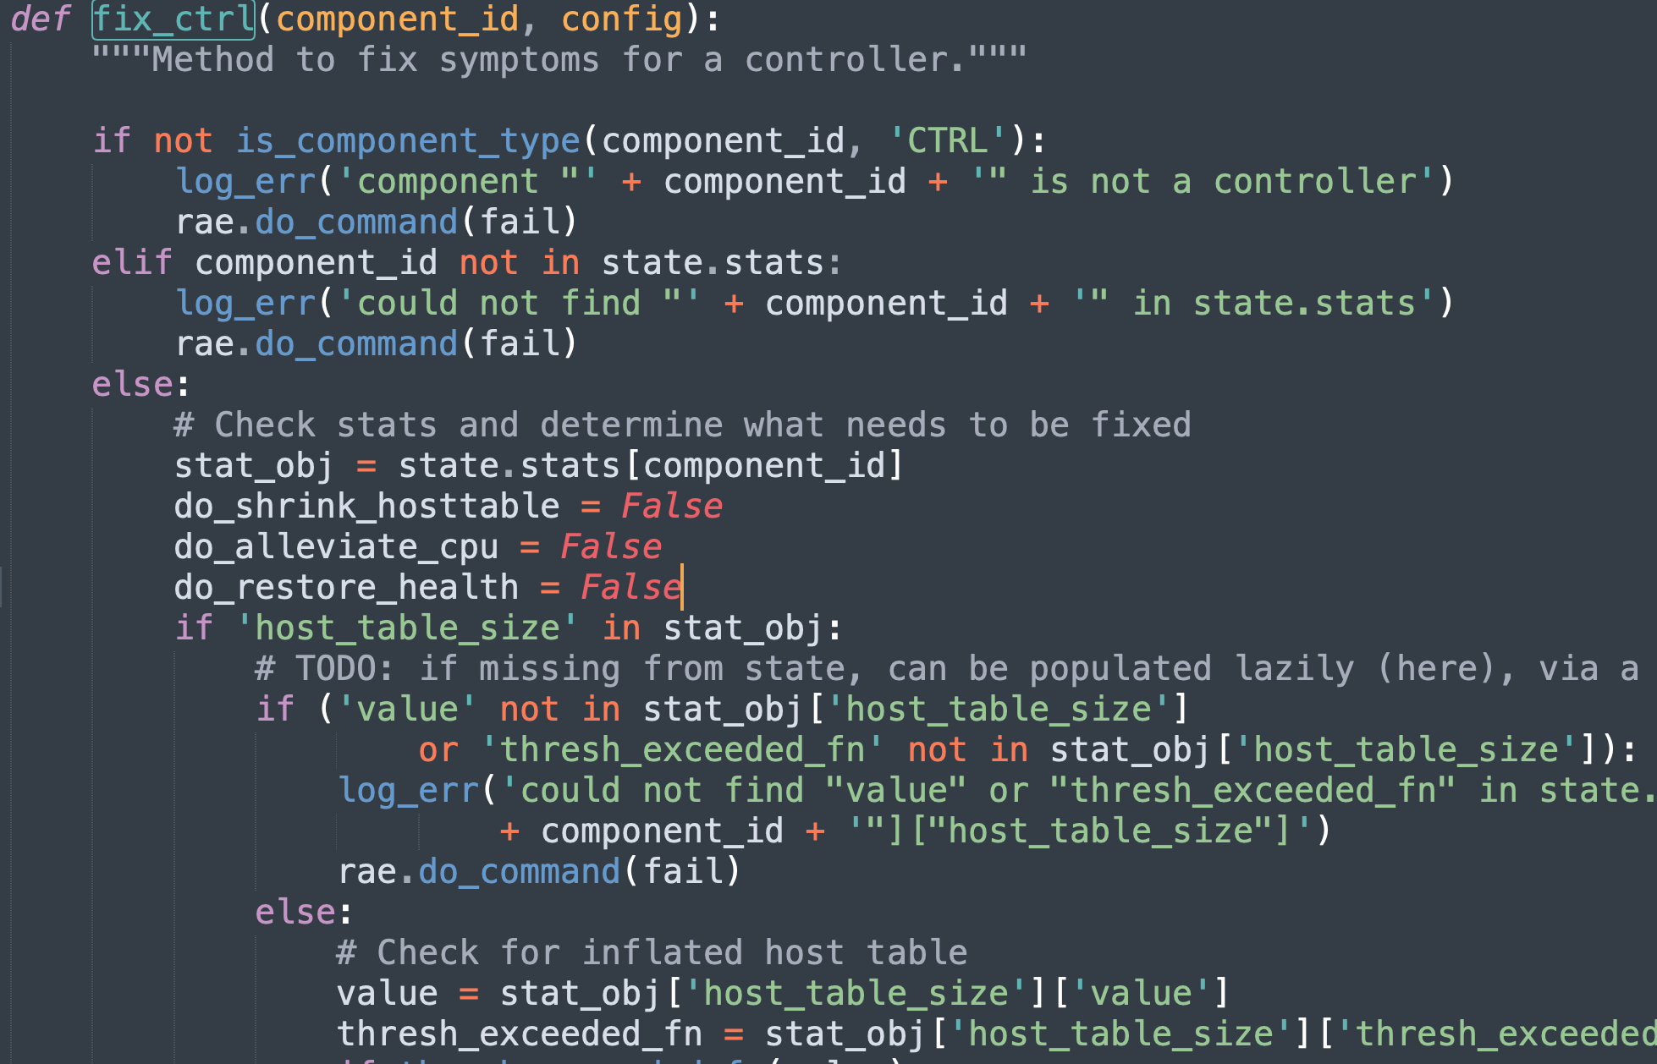
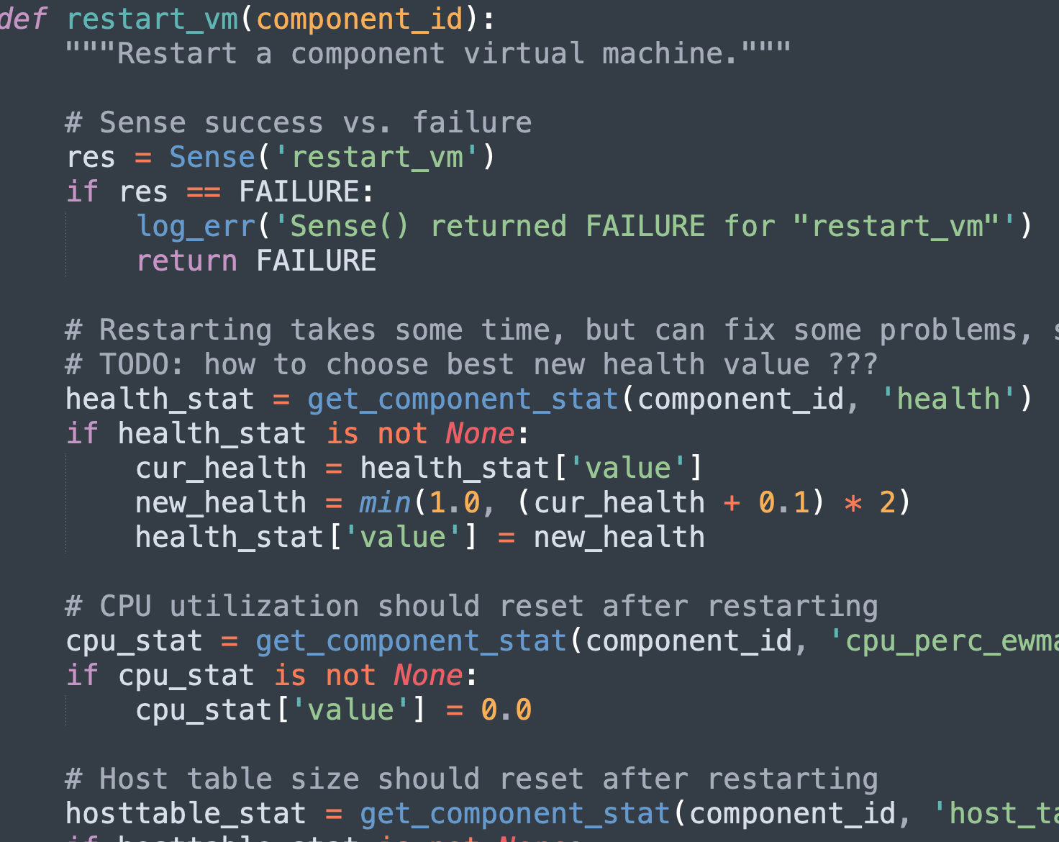
Operational Models for SDN
Events: attacks on controllers and switches
Incoming Tasks for RAE: fix_controller, fix_switch
Experts write refinement methods

Slide 51
Attack recovery using RAE and UPOM
Actor
Plan-with-UPOM
Written by domain expert
Plans
tasks
Three online communication channels
Acting Engine (RAE)
Hierarchical Operational Models for SDN
State
Actions
Task Queue
Command Execution Queue
Attacks
Command
Status
Queue
Security Manager
Action outcomes
SDN
Actuation
Sensing
Notes:
Task queue, command execution queue, command status queue

Slide 52
Experiments
SDN domain modelled with 11 tasks, 28 refinement methods, 13 commands
50 autogenerated problems each containing one or more random attacks
Utility optimized is Resilience: Linear combination of efficiency and success-ratio
= 1 + 1/(sum of costs of commands); for a successful plan
= 0; for a failed plan
Improved efficiency, success-ratio and resilience

Slide 53
Summary
Experiments on five simulated domains with
improved efficiency, success ratio
Plan-with-UPOM
Planner
Learning Component
Actor
Learn to choose methods,
estimate heuristics
Tasks
Hierarchical Operational Models
Task and Action Models
Acting Engine (RAE)
State
Actions
Events
Security Manager
Execution Platform
SDN
Sensing
Actuation
Notes:
Online planning in an actor
Key idea
Instead of using descriptive action models, planners use the actor’s operational models for planning
Avoids consistency problems between descriptive and operational models
Planner and actor integrated with learning
Experiments with simulated domains with new performance evaluation metrics
Real-world prototype of our algorithms

Slide 54
Thank you

Slide 55
References
[10] Sunandita Patra, James Mason, Amit Kumar, Malik Ghallab, Dana Nau, Paolo Traverso. Integrating Acting, Planning, and Learning in Hierarchical Operational Models. Accepted at IJCAI 2020 Monte Carlo Search Workshop. ​
[9] Sunandita Patra, James Mason, Amit Kumar, Malik Ghallab, Dana Nau, Paolo Traverso. Integrating Acting, Planning, and Learning in Hierarchical Operational Models. Accepted for publication at ICAPS 2020. Best Student Paper Honorable Mention Award. [link]
[8] Sunandita Patra, Malik Ghallab, Dana Nau, Paolo Traverso. Interleaving Acting and Planning Using Operational Models. ICAPS 2019 Workshop on Integrated Planning, Acting and Execution (IntEx). [link]
[7] Sunandita Patra, Malik Ghallab, Dana Nau, Paolo Traverso. Acting and Planning Using Operational Models. AAAI 2019. [link]
[6] Sunandita Patra, Malik Ghallab, Dana Nau and Paolo Traverso. APE: An Acting and Planning Engine. Conference on Advances in Cognitive Systems, 2018. [link]
[5] Sunandita Patra, Malik Ghallab, Dana Nau and Paolo Traverso. Using Operational Models to Integrate Acting and Planning, ICAPS 2018 Workshop on Integrated Planning, Acting and Execution (IntEx). [link]
[4] Sunandita Patra, Malik Ghallab, Dana Nau and Paolo Traverso. Planning and Acting with Hierarchical Input/Output Automata. Conference of Advances in Cognitive Systems, 2018. [link]
[3] Sunandita Patra, Malik Ghallab, Dana Nau and Paolo Traverso. APE: An Acting and Planning Engine. Journal of Advances in Cognitive Systems, 2018. [link]
[2] Sunandita Patra, Paolo Traverso, Malik Ghallab and Dana Nau. Planning and Acting with Hierarchical Input/Output Automata, ICAPS 2017 Workshop on Generalized Planning (GenPlan). [link]
[1] Sunandita Patra, Satya Gautam Vadlamudi, and Partha Pratim Chakrabarti. Anytime contract search. SGAI International Conference on Innovative Techniques and Applications of Artificial Intelligence 2013. [link]

