Slide 1
Algorithms
Lecture 37

Slide 2
Minimum cut

Slide 3
Minimum cut
Recall that a cut in a graph is a partition of its vertices into two non-empty subsets A, B
The size of a cut is the number of edges from vertices in A to vertices in B
  I.e., the number of edges crossing the cut
Min-cut problem: Given a graph G, find a minimum cut

Slide 4
Minimum cut
Previously we showed algorithms finding a minimum s-t cut
Possible to find the (global) min-cut by finding the minimum s-t cut for some s and all (O(|V|) executions of a network-flow algorithm)
  …but randomized algorithms are simpler; can be more efficient
  The algorithm we show can be further optimized

Slide 5
Bounding the size of the min-cut
Probabilistic method
To bound some quantity over all possible choices (e.g., choices of A, B), compute the quantity’s expectation for a random choice
  If expected value is s, then there must exist some choice where the quantity is at most s and some choice where the quantity is at least s
This sounds harder, but if the random choices are made cleverly it can be (much) easier!

Slide 6
Bounding the size of the min-cut
Given a (connected) graph G with |E| edges, can we upper bound the size of the min-cut in G?
(Roughly:) we will compute the expected size of
a random cut in G
If the expectation is s, then:
  There must be a cut in G of size at least s
  There must be a cut in G of size at most s
    ⇒ The min-cut of G has size at most s

Slide 7
Bounding the size of a cut
Fix a connected graph G
Consider putting each vertex uniformly and independently in either A or B
  (Note that if A or B is empty this is not a cut)
  What is the expected number of edges S between A
  and B?
Let I_{e} be an indicator random variable that is 1 if edge e goes from A to B, and 0 otherwise
Exp[S] = Exp[Σ_{e} I_{e}] = Σ_{e} Exp[I_{e}] = Σ_{e} ½ = |E|/2
  In particular, there must be a cut of size ≥|E|/2

Slide 8
Bounding the size of the min-cut
How about an upper bound on the size of
a cut (which upper-bounds the min-cut)?
We cannot immediately conclude that there is a cut of size ≤|E|/2, because (A, B) might not be a valid cut
  If A or B is empty then S = 0, but that is not a valid minimum cut
Exp[S] = Σ_{s} s ⋅ Pr[S=s] ≥ s_{min} ⋅ Pr[S > 0]
= s_{min} ⋅ (1 – 2^{-|V|+1})
  So s_{min} ≤ |E|/(2 ⋅ (1 – 2^{-|V|+1})) ≈ |E|/2
  This is tight (consider G with 3 vertices and 2 edges)

Slide 9
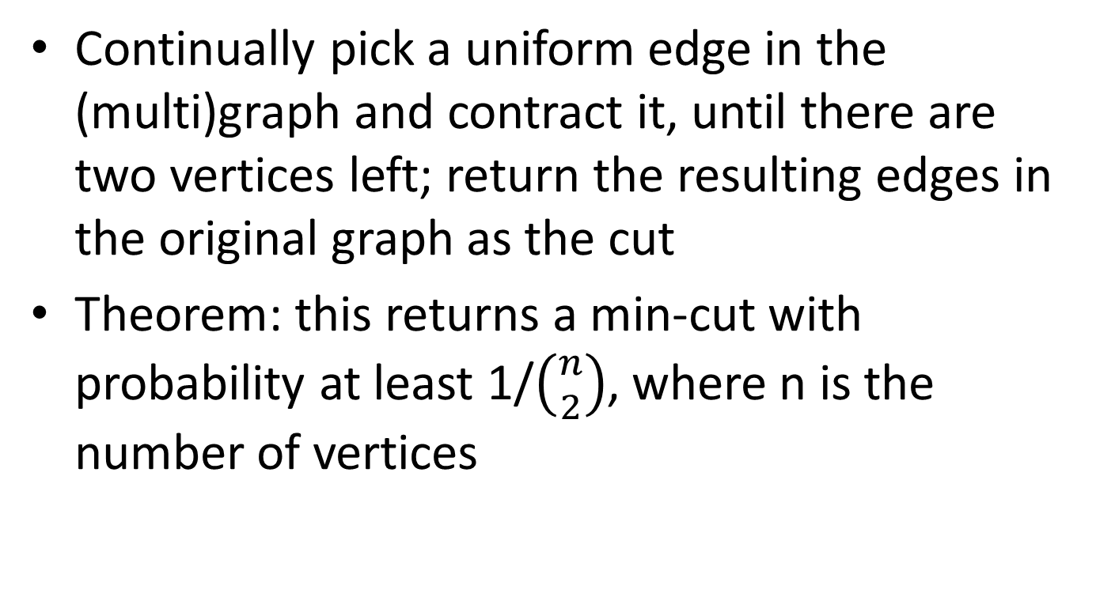
Finding a min-cut
Continually pick a uniform edge in the (multi)graph and contract it, until there are two vertices left; return the resulting edges in the original graph as the cut
Theorem: this returns a min-cut with probability at least 1/$\left({n \atop 2}\right)$, where n is the number of vertices

Slide 10
Finding a min-cut
Fix some min-cut C of size k; we show that C is returned with at least the claimed probability
C will be returned unless some edge in C is contracted
  What is the probability that no edge in C is ever contracted?
Let Bad_{i} be the event that an edge of C is contracted in step i
  Let Good_{i} be the complement of Bad_{i}

Slide 11
Finding a min-cut
Consider the first step
G has at least k n/2 edges
  Each vertex has degree at least k, or else C would not be a min-cut
Pr[Bad₁] = k/|E| ≤ k/(kn/2) = 2/n
Pr[Good₁] ≥ 1 – 2/n

Slide 12
Finding a min-cut
Consider the second step, assuming Good₁ occurred
As before, each vertex has degree at least k; now there are n-1 vertices
Pr[Bad₂ | Good₁] ≤ k/(k(n-1)/2) = 2/(n-1)
  Pr[Good₂ | Good₁] ≥ 1 – 2/(n-1)
Pr[Good₂ ∧ Good₁] = Pr[Good₁] ⋅ Pr[Good₂ | Good₁]
≥ (1 – 2/n) ⋅ (1 – 2/(n-1))

Slide 13
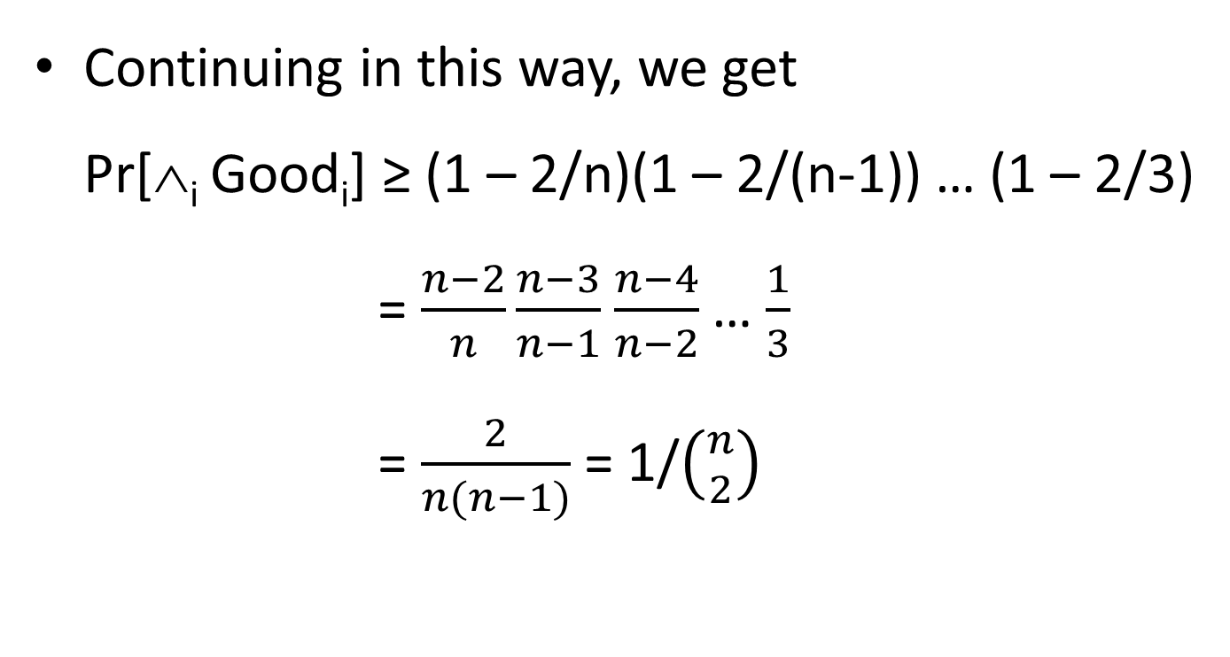
Finding a min-cut
Continuing in this way, we get
Pr[∧_{i} Good_{i}] ≥ (1 – 2/n)(1 – 2/(n-1)) … (1 – 2/3)
= $\frac{n−2}{n}\frac{n−3}{n−1}$ $\frac{n−4}{n−2}$… $\frac{1}{3}$
= $\frac{2}{n(n−1)}$ = 1/$\left({n \atop 2}\right)$

