Slide 1
Algorithms
Lecture 29

Slide 2
NP-completeness
We can show that L ∈ NP is NP-complete by showing that some NP-complete problem L’ is reducible to L
I.e., there is a poly-time algorithm f such that x ∈ L’ ⇔ f(x) ∈ L
Note: we have the freedom to choose any L’ that we already know is NP-complete!

Slide 3
Hamiltonian cycle
Given a directed graph G, a Hamiltonian cycle is a cycle that visits each vertex exactly once
HAM = {G | G has a Hamiltonian cycle}
Note HAM ∈ NP
We show HAM is NP-complete by reduction from 3-SAT

Slide 4
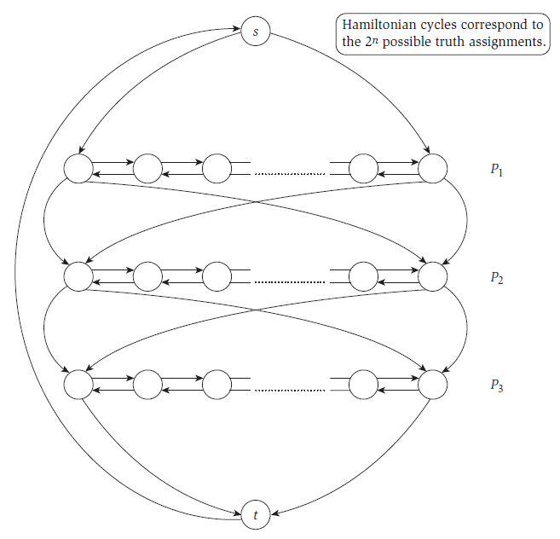
P_{i} corresponds to the variable x_{i}
Image taken from Kleinberg & Tardos, “Algorithm Design,” Addison Wesley, 2006

Slide 5
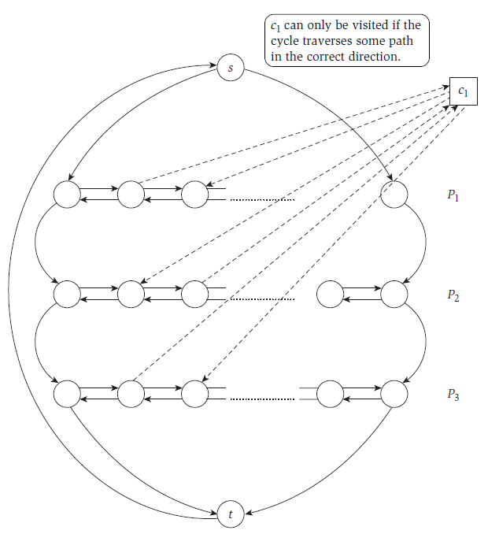
c₁ = x₁ ∨ ¬x₂ ∨ x₃
Image taken from Kleinberg & Tardos, “Algorithm Design,” Addison Wesley, 2006

Slide 6
HAM is NP-complete
Claim: there is a Hamiltonian cycle in this graph iff the original formula ϕ is satisfiable
Proof:
ϕ is satisfiable ⇒ construct Hamiltonian cycle
Hamiltonian cycle ⇒ if cycle enters a clause-vertex from some vertex, it must exit to the next vertex in the same row ⇒ use this to define values for the variables that will satisfy ϕ

Slide 7
Traveling salesperson problem (TSP)
Given a set of vertices with pairwise directed edges between all pairs of vertices, and a weight for each edge, a tour is a cycle that visits each vertex exactly once and returns to the starting point
TSP = {(G, k) | G has a tour of weight ≤ k}
Note TSP ∈ NP

Slide 8
TSP is NP-complete
Reduction from Hamiltonian cycle
Given directed graph G, define G’ as follows:
(v, w) has weight 1 iff there is an edge in G from v to w; otherwise, weight 2
Output (G’, n)
G’ has a tour of weight n ⇔ there is a Hamiltonian cycle in G

Slide 9
coNP

Slide 10
Review: NP
Recall the definition of NP:
$L$ ∈ NP if there exists an efficient verification algorithm V such that
If x ∈ $L$ there is a witness/proof w such that V(x, w) = 1
If x ∉ $L$ then for all proofs w we have V(x, w) = 0
I.e., possible to efficiently prove/verify that x ∈ $L$

Slide 11
coNP
coNP is “the opposite” of NP
$L$ ∈ coNP if there exists an efficient verification algorithm V such that
If x ∉ $L$ there is a witness/proof w such that V(x, w) = 1
If x ∈ $L$ then for all proofs w we have V(x, w) = 0
I.e., possible to efficiently prove/verify that x ∉ $L$
$L$ ∈ coNP ⇔ $\overline{L}$ ∈ NP

Slide 12
Example: independent set
An independent set in a graph G is a set of vertices where no two vertices have an edge between them
Let ind(G) = the size of the largest ind. set in G
Ind-Set = {(G, k) | ind(G) ≥ k}
Why is this in NP? What is a witness that (G, k) ∈ Ind-Set?
How would you prove that (G, k) ∉ Ind-Set?

Slide 13
Example: co-independent set
co-Ind-Set = {(G, k) | ind(G) < k}
Why is this in coNP? What is a witness that (G, k) ∉ co-Ind-Set?
How would you prove that (G, k)∈co-Ind-Set?

Slide 14
Example: vertex cover
A vertex cover in a graph G is a set of vertices such that every edge is incident with at least one vertex in the set
Let vc(G) = the size of the smallest vertex cover in G
VC = {(G, k) | vc(G) ≤ k}
Why is this in NP? What is a witness that (G, k) ∈ VC?
How would you prove that (G, k) ∉ VC?

Slide 15
Example: co-vertex cover
co-VC = {(G, k) | vc(G) > k}
Why is this in coNP? What is a witness that (G, k) ∉ co-VC?
How would you prove that (G, k)∈co-VC?

Slide 16
Example: SAT and unSAT
SAT = {φ : φ is satisfiable}
unSAT = {φ : φ is not satisfiable}
SAT ∈ NP
Prove φ ∈ SAT by giving a satisfying assignment
How is it possible to show that φ is not satisfiable?
unSAT ∈ coNP
Prove φ ∉ unSAT by showing φ ∈ SAT, i.e., by showing a satisfying assignment

Slide 17
Example: max-flow
Given a flow graph G, let flow(G) denote the value of the maximum flow in G
Max-flow ={(G, k) | flow(G) ≥ k}
Why is this in NP? What is a witness that (G, k) ∈ Max-flow?
Why is this in coNP?(!) What is a witness that (G, k) ∉ Max-flow?
(Note: since Max-flow ∈ P, we already knew it was in NP ∩ coNP…)

Slide 18
P, NP, and coNP
Note: P ⊆ coNP, so P ⊆ NP ∩ coNP
Open question: is P = NP ∩ coNP?
Open question: is NP = coNP?
I.e., for every problem where we can efficiently prove existence of a solution, can we also efficiently prove non-existence of a solution?
Seems unlikely
Not only intuitively (in general), but also for concrete problems like independent set
Note: NP ≠ coNP ⇒ P ≠ NP

