Slide 1

Computer Networks
CMSC 417 : Spring 2023
Topic: Midterm-2 Review
Nirupam Roy
Tu-Th 2:00-3:15pm
CSI 2117

Slide 2
Midterm exam -2.
April 13th in-class exam.
Midterm-2 syllabus: Lecture 8 to 18
Exam format: Similar to exam-1

Slide 3
CIDR: Classless address

Slide 4
IP addressing: CIDR
CIDR: Classless InterDomain Routing
  Network portion of address of arbitrary length
  address format: a.b.c.d/x, where x is # bits in subnet portion of address
subnet
part
host
part
11001000 00010111 00010000 00000000
200.23.16.0/23
200.23.16.0–200.23.17.255
This X bit network part is often called Prefix or Network-prefix

Slide 5
IP addressing: CIDR
CIDR: Classless InterDomain Routing
  subnet portion of address of arbitrary length
  address format: a.b.c.d/x, where x is # bits in subnet portion of address
forwarding table
4.0.0.0/8
4.83.128.0/17
201.10.0.0/21
201.10.6.0/23
126.255.103.0/24

Slide 6
CIDR: Super-netting/
Route aggregation

Slide 7

Lessons learned from subnetting
Forwarding tab.
Forwarding tab.
223.1.1.0/24
223.1.0.0/16
223.1.2.0/24
223.1.1.0
223.1.3.0/24
ISP
223.1.0.0/16
223.1.2.0
223.1.3.0

Slide 8
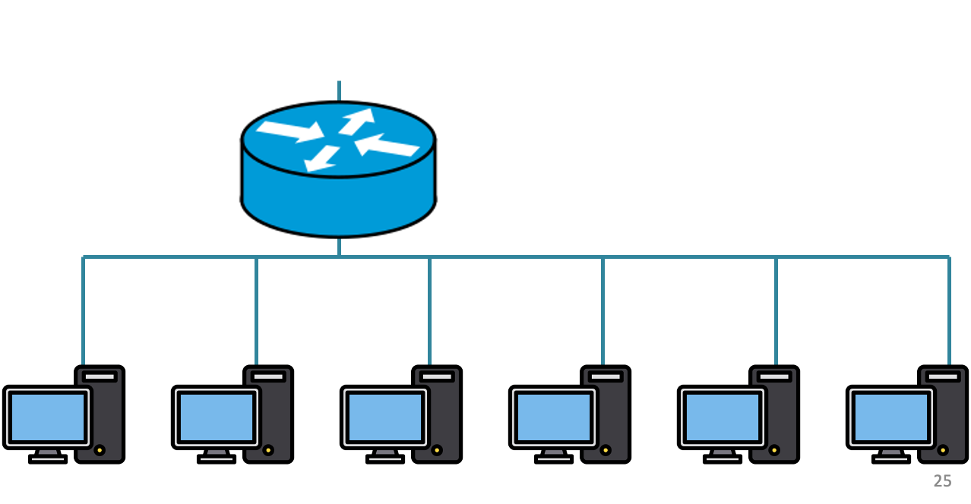
200.20.2.0/24
200.20.3.0/24
200.20.1.0/24

Slide 9
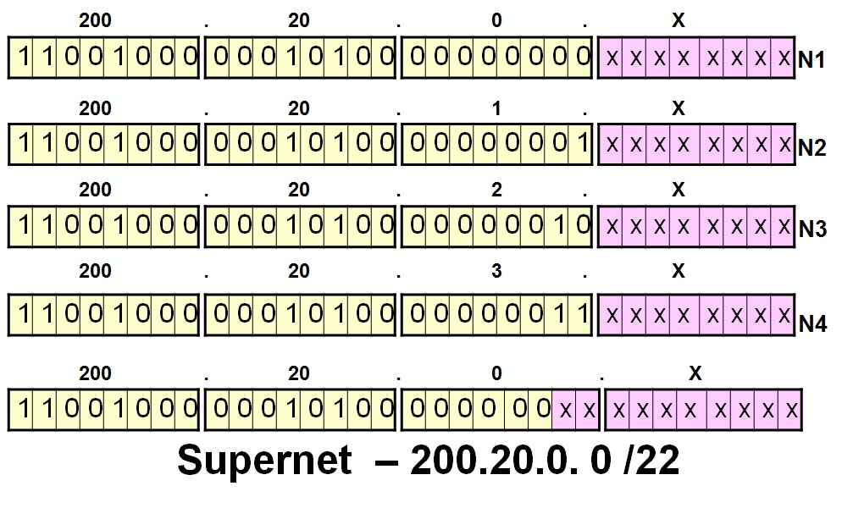
200.20.2.0/24
200.20.3.0/24
200.20.1.0/24

Slide 10
Route aggregation
200.20.2.0/24
200.20.3.0/24
200.20.1.0/24

Slide 11
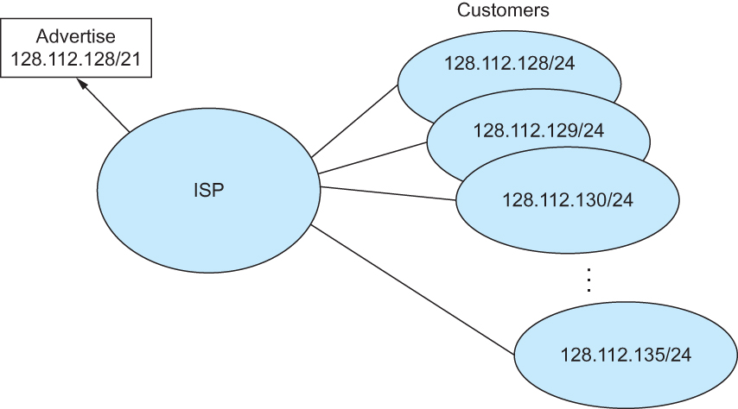
Route aggregation with CIDR

Slide 12
CIDR Makes Packet Forwarding Harder
Forwarding tab.
201.10.0.0/21
201.10.6.0/23
201.10.0.0/21
Provider 1
Provider 2
Multi-homing
201.10.0.0/22
201.10.4.0/24
201.10.5.0/24
201.10.6.0/23

Slide 13
CIDR Makes Packet Forwarding Harder
Forwarding table may have many matches
  E.g., entries for 201.10.0.0/21 and 201.10.6.0/23
  The IP address 201.10.6.17 would match both!
201.10.0.0/21
Provider 1
Provider 2
201.10.0.0/22
201.10.4.0/24
201.10.5.0/24
201.10.6.0/23

Slide 14
Longest Prefix Match Forwarding
Destination-based forwarding
  Packet has a destination address
  Router identifies longest-matching prefix
  Cute algorithmic problem: very fast lookups
forwarding table
4.0.0.0/8
4.83.128.0/17
201.10.0.0/21
201.10.6.0/23
126.255.103.0/24
destination
201.10.6.17
outgoing link

Slide 16
Getting an IP address:
DHCP Protocol

Slide 17



DHCP client-server scenario
DHCP
server
223.1.1.0/24
223.1.1.1
223.1.2.1
223.1.1.2
arriving DHCP
client needs
address in this
network
223.1.1.4
223.1.2.9
223.1.3.27
223.1.2.2
223.1.1.3
223.1.2.0/24
223.1.3.1
223.1.3.2
223.1.3.0/24

Slide 18
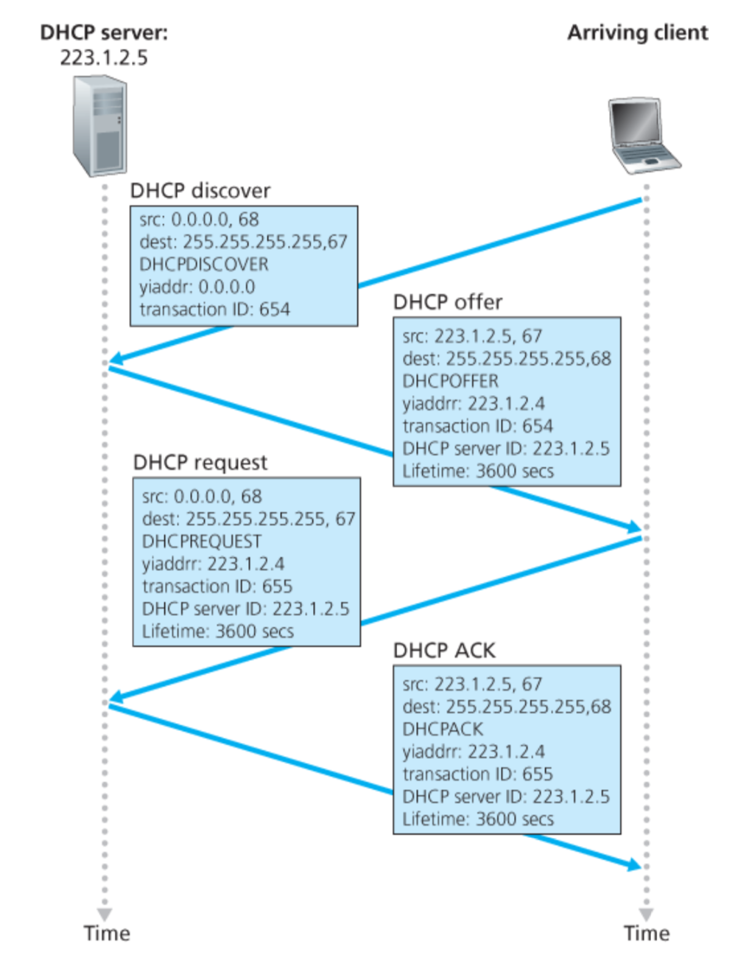
Broadcast: is there a DHCP server out there?

Slide 19
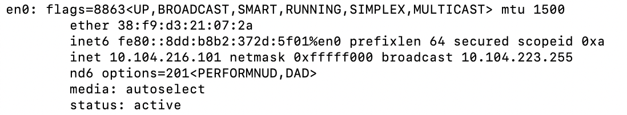
inet 10.104.216.101 ➔ 00001010.01101000.11011000.01100101
netmask ff:ff:f0:00 ➔ 11111111.11111111.11110000.00000000
broadcast 10.104.223.255 ➔
00001010.01101000.11011111.11111111

Slide 20
Broadcast: is there a DHCP server out there?
Broadcast: I’m a DHCP server! Here’s an IP address you can use
Broadcast: OK. I’ll take that IP address!
Broadcast: OK. You’ve got that IP address!

Slide 21
DHCP: more than IP addresses
DHCP can return more than just allocated IP address on subnet:
  address of first-hop router for client
  name and IP address of DNS sever
  network mask (indicating network versus host portion of address)

Slide 22
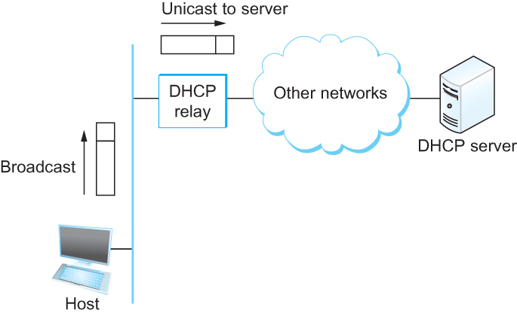
DHCP relay
Newly booted or attached host sends DHCPDISCOVER message to a special IP address (255.255.255.255)
DHCP relay agent unicasts the message to DHCP server and waits for the response

Slide 23
Lecture 9

Slide 24
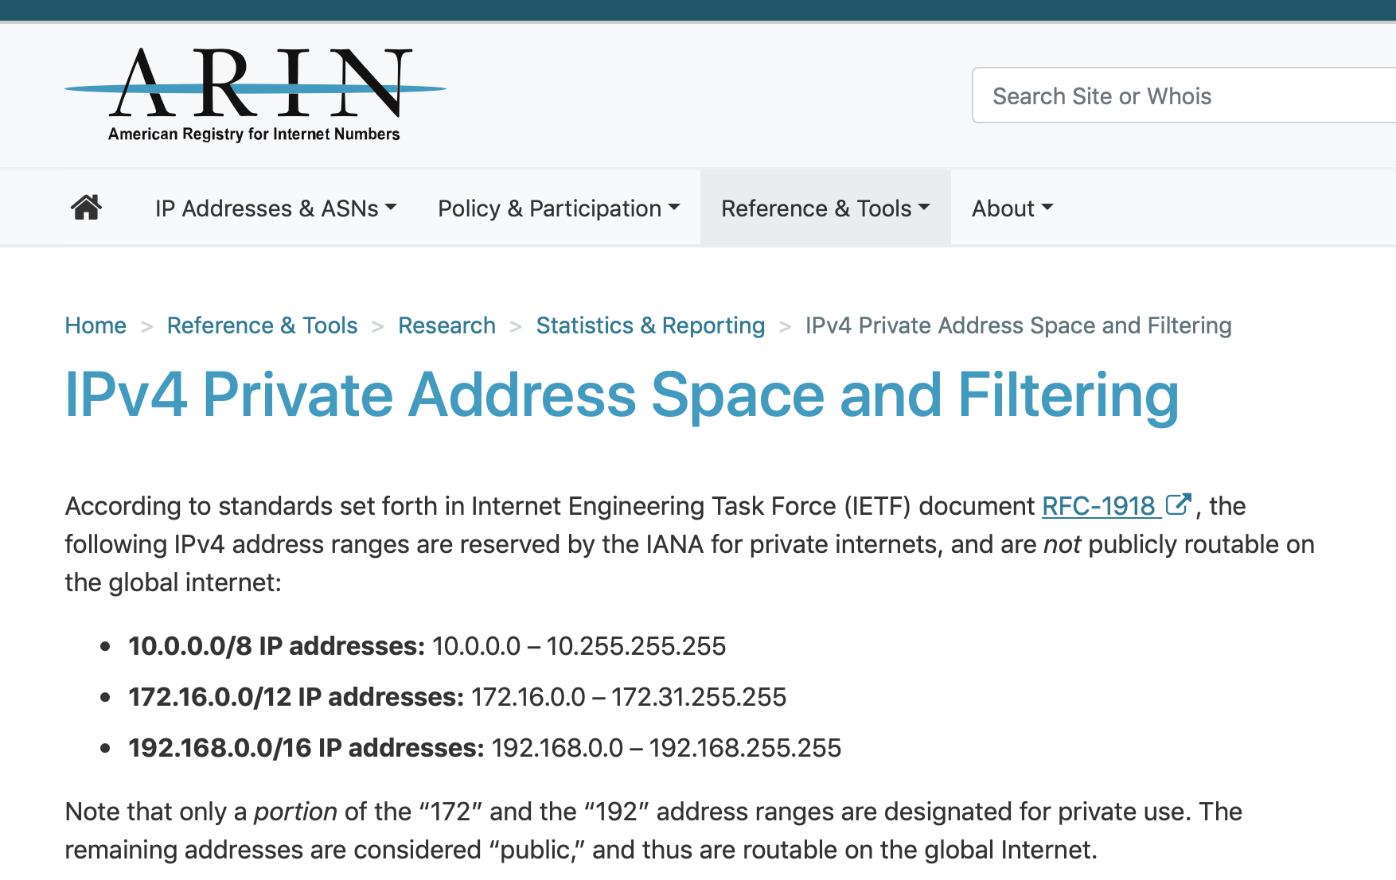

Slide 25
NAT: network address translation
rest of
Internet
local network
(e.g., home network)
10.0.0/24
10.0.0.1
10.0.0.4
10.0.0.2
138.76.29.7
10.0.0.3
all datagrams leaving local
network have same single source NAT IP address: 138.76.29.7,different source port numbers
datagrams with source or
destination in this network
have 10.0.0/24 address for
source, destination (as usual)

Slide 26
NAT: network address translation
NAT translation table
WAN side addr LAN side addr
2: NAT router
changes datagram
source addr from
10.0.0.1, 3345 to
138.76.29.7, 5001,
updates table
1: host 10.0.0.1
sends datagram to
128.119.40.186, 80
138.76.29.7, 5001 10.0.0.1, 3345
…… ……
S: 10.0.0.1, 3345
D: 128.119.40.186, 80
10.0.0.1
1
2
S: 138.76.29.7, 5001
D: 128.119.40.186, 80
10.0.0.4
10.0.0.2
138.76.29.7
S: 128.119.40.186, 80
D: 10.0.0.1, 3345
4
S: 128.119.40.186, 80
D: 138.76.29.7, 5001
3
10.0.0.3
4: NAT router
changes datagram
dest addr from
138.76.29.7, 5001 to 10.0.0.1, 3345
3: reply arrives
dest. address:
138.76.29.7, 5001

Slide 28
Network address vs
LAN address

Slide 29

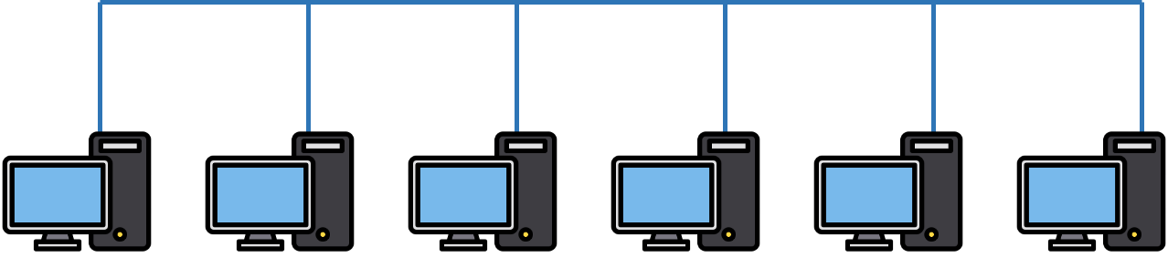

Two perspectives of addresses:
(1)Network-to-network & (2)machine-to-machine
Destination
Router
Source

Slide 30
Flat address for addressing machines at the link-layer
(MAC address)
network
link
physical
application
transport
network
link
physical
Router
Source

Slide 31
Address Resolution Protocol (ARP)

Slide 32
MAC addresses and ARP
32-bit IP address:
  network-layer address for interface
  used for layer 3 (network layer) forwarding
MAC (or LAN or physical or Ethernet) address:
  function: used “locally” to get frame from one interface to another physically-connected interface (same network, in IP-addressing sense)
  48 bit MAC address (for most LANs) burned in NIC ROM, also sometimes software settable
  e.g.: 1A-2F-BB-76-09-AD

Slide 33
MAC addresses and ARP
each adapter on LAN has unique LAN addr. or MAC addr.
1A-2F-BB-76-09-AD
LAN
(wired or
wireless)
adapter
71-65-F7-2B-08-53
58-23-D7-FA-20-B0
0C-C4-11-6F-E3-98
hexadecimal (base 16) notation
(each “numeral” represents 4 bits)

Slide 34


ARP: address resolution protocol
Question: how to determine
interface’s MAC address, knowing its IP address?
ARP table: each IP node (host, router) on LAN has table
  IP/MAC address mappings for some LAN nodes:
< IP address; MAC address; TTL>
  TTL (Time To Live): time after which address mapping will be forgotten (typically 20 min)
137.196.7.78
1A-2F-BB-76-09-AD
137.196.7.23
137.196.7.14
LAN
71-65-F7-2B-08-53
58-23-D7-FA-20-B0
0C-C4-11-6F-E3-98
137.196.7.88

Slide 35
ARP protocol: same LAN
A wants to send datagram to B
  B’s MAC address not in A’s ARP table.
A broadcasts ARP query packet, containing B's IP address
  destination MAC address = FF-FF-FF-FF-FF-FF
  all nodes on LAN receive ARP query
B receives ARP packet, replies to A with its (B's) MAC address
  frame sent to A’s MAC address (unicast)
A caches (saves) IP-to-MAC address pair in its ARP table until information becomes old (times out)
  soft state: information that times out (goes away) unless refreshed
ARP is “plug-and-play”:
  nodes create their ARP tables without intervention from net administrator

Slide 36
Lecture 10

Slide 37
Internet Control Message Protocol (ICMP)
Defines a collection of error messages that are sent back to the source host whenever a router or host is unable to process an IP datagram successfully
  Destination host unreachable due to link /node failure
  Reassembly process failed
  TTL had reached 0 (so datagrams don't cycle forever)
  IP header checksum failed
ICMP-Redirect
  From router to a source host
  With a better route information

Slide 38
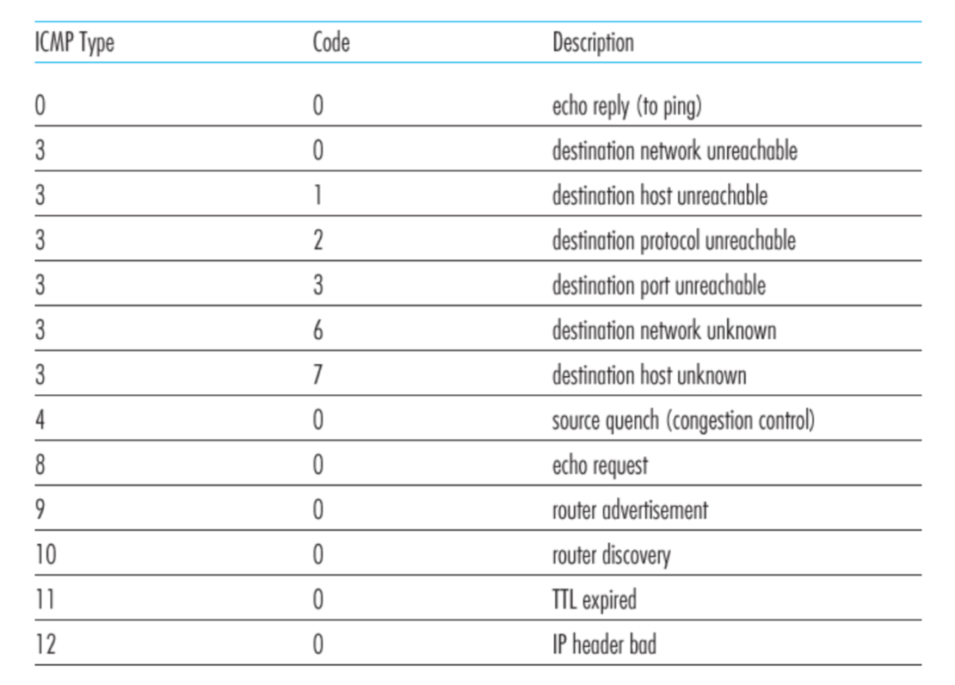
ICMP message types

Slide 39
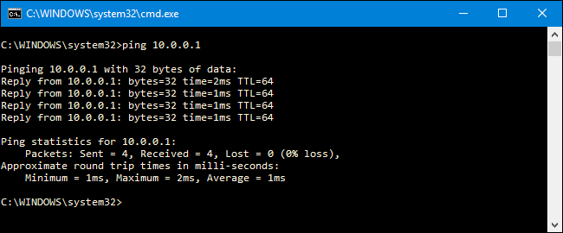
Ping example

Slide 40
Traceroute : An unintuitive application using ICMP

Slide 41
Traceroute : An unintuitive application

Slide 43


Untrusted/Shared network
Gateway A
Gateway B
Virtual Tunnel
IP Header
Data
Trusted network (Site A)
Trusted network (Site B)

Slide 44
New IP Header Source: Gateway-A Dest: Gateway-A
Encapsulation
Decapsulation
New IP Header Source: Gateway-A Dest: Gateway-A
IP Header
Data
IP Header
Data
Untrusted/Shared network
Gateway A
Gateway B
Virtual Tunnel
IP Header
Data
Trusted network (Site A)
Trusted network (Site B)

Slide 45
Why do we need virtual networks or tunnels?
1. Security
2. Special capabilities between routers (e.g., multicast)
3. Supporting heterogeneity
Disadvantages:
1. Increases packet length
a) Wastage of bandwidth
b) More processing
c) Fragmentation
2. Increases management cost

Slide 47
IPv6
1) Address and packet format
2) Unicast, Multicast, Anycast addressing
3) IPV4 and IPV6 coexistence

Slide 48
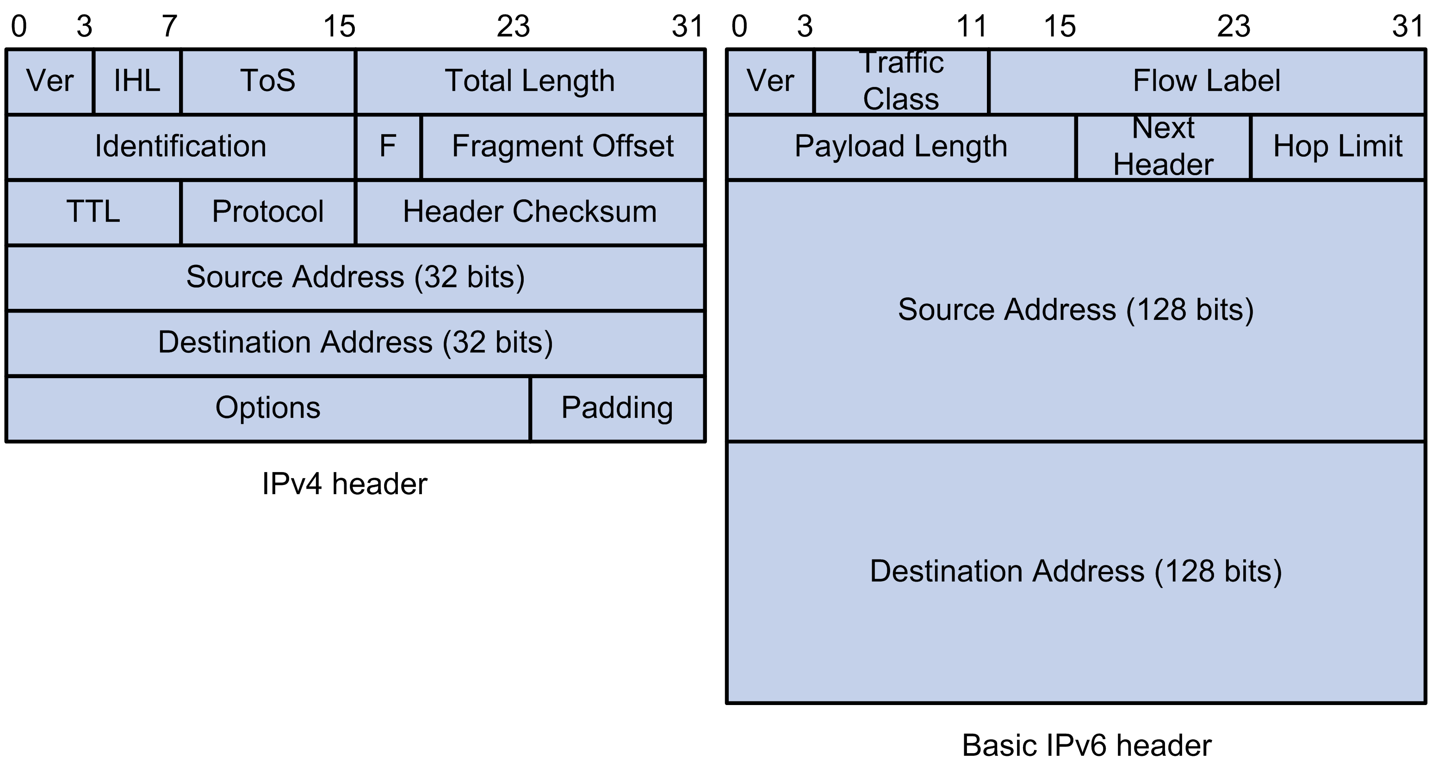
IPv6: Address and packet format
Pic courtesy: https://techhub.hpe.com

Slide 49
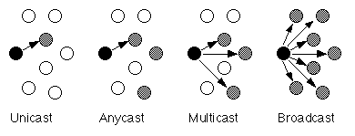
IPv6: Unicast, Multicast, Anycast addressing

Slide 50
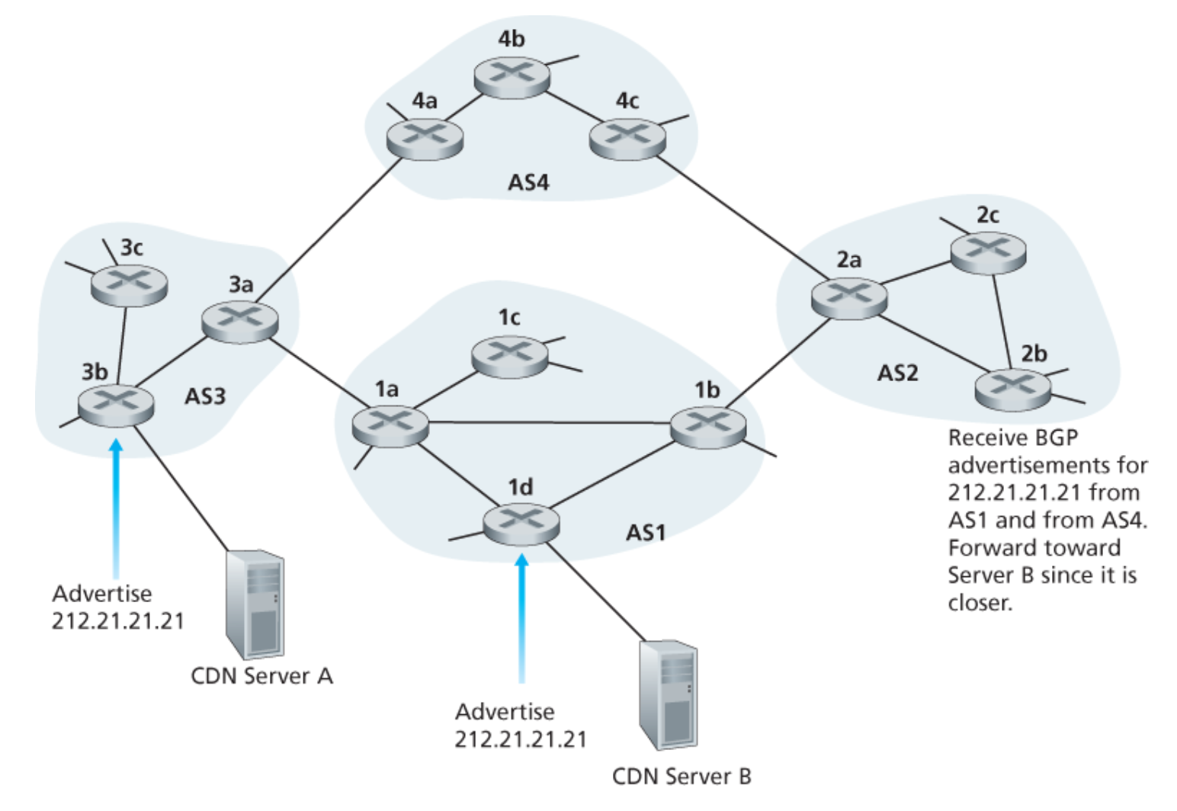
IPv6: Unicast, Multicast, Anycast addressing
IP: Anycast example

Slide 51
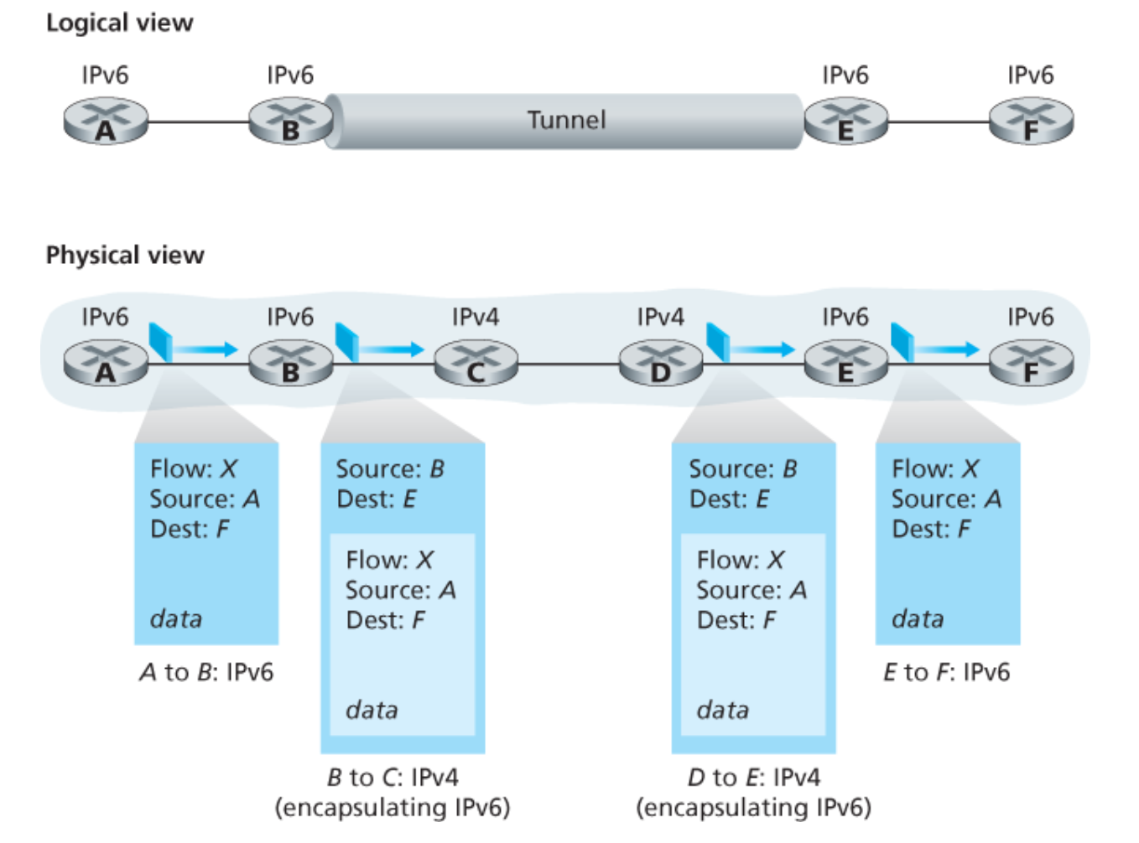
IPv4 and IPv6 Co-existence

Slide 52
Lecture 11

Slide 53
Transport Protocols
Logical communication between processes
  Sender divides a message into segments
  Receiver reassembles segments into message
Transport services
  (De)multiplexing packets
  Detecting corrupted data
  Optionally: reliable delivery, flow control, …

Slide 54
Two Basic Transport Features
Demultiplexing: port numbers
Error detection: checksums
Server host 128.2.194.242
Service request for
128.2.194.242:80
(i.e., the Web server)
Client host
Web server
(port 80)
Client
OS
Echo server
(port 7)
IP
payload
detect corruption

Slide 55
Connection-less mux/demux:
- User Datagram Protocol (UDP)
Connection-oriented mux/demux:
- Transmission Control Protocol (TCP)

Slide 56
Connectionless demultiplexing
When host receives UDP segment:
  checks destination port number in segment
  directs UDP segment to socket with that port number
IP datagrams with different source IP addresses and/or source port numbers directed to same socket
Create sockets with port numbers:
DatagramSocket mySocket1 = new DatagramSocket(99111);
DatagramSocket mySocket2 = new DatagramSocket(99222);
UDP socket identified by two-tuple:
(dest IP address, dest port number)

Slide 57
Connection-oriented demux
TCP socket identified by 4-tuple:
  source IP address
  source port number
  dest IP address
  dest port number
recv host uses all four values to direct segment to appropriate socket
Server host may support many simultaneous TCP sockets:
  each socket identified by its own 4-tuple
Web servers have different sockets for each connecting client
  non-persistent HTTP will have different socket for each request

Slide 59
End-to-end Protocols
(UDP, TCP)

Slide 60
End-to-end Protocols
Common properties that a transport protocol can be expected to provide
  Guarantees message delivery
  Delivers messages in the same order they were sent
  Delivers at most one copy of each message
  Supports arbitrarily large messages
  Supports synchronization between the sender and the receiver
  Allows the receiver to apply flow control to the sender
  Supports multiple application processes (Mux/DeMux)

Slide 61
UDP: User Datagram Protocol [RFC 768]
Bare minimum Internet transport protocol
“best effort” service, UDP segments may be:
  lost
  delivered out of order to app
connectionless:
  no handshaking between UDP sender, receiver
  each UDP segment handled independently of others

Slide 62
UDP checksum
Goal: detect “errors” (e.g., flipped bits) in transmitted segment
Sender:
treat segment contents as sequence of 16-bit integers
checksum: addition (1’s complement sum) of segment contents
sender puts checksum value into UDP checksum field
Receiver:
compute checksum of received segment
check if computed checksum equals checksum field value:
  NO - error detected
  YES - no error detected.
Is UDP service == IP service ??

Slide 63
Advantages of UDP
Fine-grain control
  UDP sends as soon as the application writes
No connection set-up delay
  UDP sends without establishing a connection
No connection state
  No buffers, parameters, sequence #s, etc.
Small header overhead
  UDP header is only eight-bytes long

Slide 64
Lec 12

Slide 65
Transmission Control Protocol (TCP)

Slide 66
TCP “Stream of Bytes” Service
Host A
Byte 0
Byte 1
Byte 2
Byte 3
Byte 80
Host B
Byte 0
Byte 1
Byte 2
Byte 3
Byte 80

Slide 67
…Emulated Using TCP “Segments”
Host A
Byte 0
Byte 1
Byte 2
Byte 3
Byte 80
Segment sent when:
Segment full (Max Segment Size),
Not full, but times out, or
“Pushed” by application.
TCP Data
TCP Data
Host B
Byte 0
Byte 1
Byte 2
Byte 3
Byte 80

Slide 68
Sequence Number
Host A
ISN (initial sequence number)
Byte 81
Sequence number =
ISN+ # of the 1st byte the segment
TCP Data
TCP Data
Host B

Slide 69
Initial Sequence Number (ISN)
Sequence number for the very first byte
  E.g., Why not a de facto ISN of 0?
Practical issue: reuse of port numbers
  Port numbers must (eventually) get used again
  … and an old packet may still be in flight
  … and associated with the new connection
So, TCP must change the ISN over time
  Set from a 32-bit clock that ticks every 4 microsec
  … which wraps around once every 4.55 hours!

Slide 70
Starting and Ending a Connection:
TCP Handshakes
(Three-Way Handshake)

Slide 71
Establishing a TCP Connection
A
B
SYN
SYN ACK
Each host tells its ISN to the other host.
ACK
Data
Data
Three-way handshake to establish connection
  Host A sends a SYN (open) to the host B
  Host B returns a SYN acknowledgment (SYN ACK)
  Host A sends an ACK to acknowledge the SYN ACK

Slide 72
TCP Header

Slide 75
Step 1: A’s Initial SYN Packet
A’s port
B’s port
A’s Initial Sequence Number
Flags:
SYN
FIN
RST
PSH
URG
ACK
Acknowledgment
20
Flags
Advertised window
0
Checksum
Urgent pointer
Options (variable)
A tells B it wants to open a connection…

Slide 78
Step 2: B’s SYN-ACK Packet
B’s port
A’s port
B’s Initial Sequence Number
Flags:
SYN
FIN
RST
PSH
URG
ACK
A’s ISN plus 1
20
Flags
Advertised window
0
Checksum
Urgent pointer
Options (variable)
B tells A it accepts, and is ready to hear the next byte…
… upon receiving this packet, A can start sending data

Slide 81
Step 3: A’s ACK of the SYN-ACK
A’s port
B’s port
Sequence number
Flags:
SYN
FIN
RST
PSH
URG
ACK
B’s ISN plus 1
20
Flags
Advertised window
0
Checksum
Urgent pointer
Options (variable)
A tells B it is okay to start sending
… upon receiving this packet, B can start sending data

Slide 82
What if the SYN Packet Gets Lost?
Suppose the SYN packet gets lost
  Packet is lost inside the network, or
  Server rejects the packet (e.g., listen queue is full)
Eventually, no SYN-ACK arrives
  Sender sets a timer and wait for the SYN-ACK
  … and retransmits the SYN if needed
How should the TCP sender set the timer?
  Sender has no idea how far away the receiver is
  Some TCPs use a default of 3 or 6 seconds

Slide 83
Tearing Down the Connection
B
ACK
SYN
SYN ACK
Data
ACK
FIN
ACK
FIN
ACK
A
time
Closing (each end of) the connection
  Finish (FIN) to close and receive remaining bytes
  And other host sends a FIN ACK to acknowledge
  Reset (RST) to close and not receive remaining bytes

Slide 85
TCP Acknowledgments
Host A
ISN (initial sequence number)
Sequence number = ISN+1st byte
TCP Data
ACK sequence number = next expected byte
TCP Data
Host B

Slide 86
Automatic Repeat reQuest (ARQ)
ACK and timeouts
  Receiver sends ACK when
  it receives packet
  Sender waits for ACK
  and times out
Simplest ARQ protocol
  Stop and wait
  Send a packet, stop and wait until ACK arrives
Sender
Receiver
Packet
Timeout
ACK
Time

Slide 87
Automatic Repeat reQuest (ARQ)
We will discuss two variations
  1. Stop and Wait
  2. Sliding window

Slide 88
Lec 13

Slide 89
Stop and Wait

Slide 90
Sender
Receiver
Packet
Timeout
ACK
Time

Slide 91
Reasons for Retransmission
Packet
Packet
Packet
Timeout
Timeout
ACK
Timeout
ACK
Packet
Packet
Packet
ACK
Timeout
Timeout
Timeout
ACK
ACK
Packet lost
ACK lost
DUPLICATE
PACKET
Early timeout
DUPLICATE
PACKETS
Notes:
Application may get duplicates in the case of early timeouts

Slide 92
How Long Should Sender Wait?
Sender sets a timeout to wait for an ACK
  Too short:
  >> wasted retransmissions
  Too long:
  >> excessive delays when packet lost
TCP sets timeout as a function of the RTT
  Expect ACK to arrive after a “round-trip time”
  … plus a fudge factor to account for queuing
But, how does the sender know the RTT?
  Running average of delay to receive an ACK

Slide 93
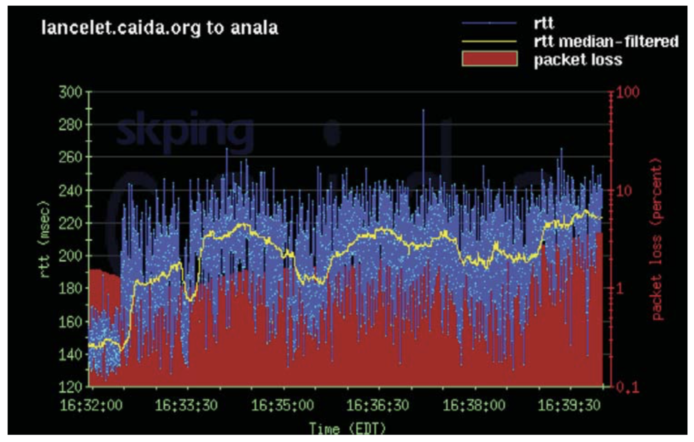
Example RTT Estimation

Slide 95
Reliable Delivery on a Lossy Channel With Bit Errors
TCP Flow control: Sliding Window Protocol

Slide 96
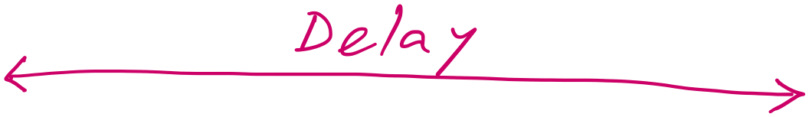
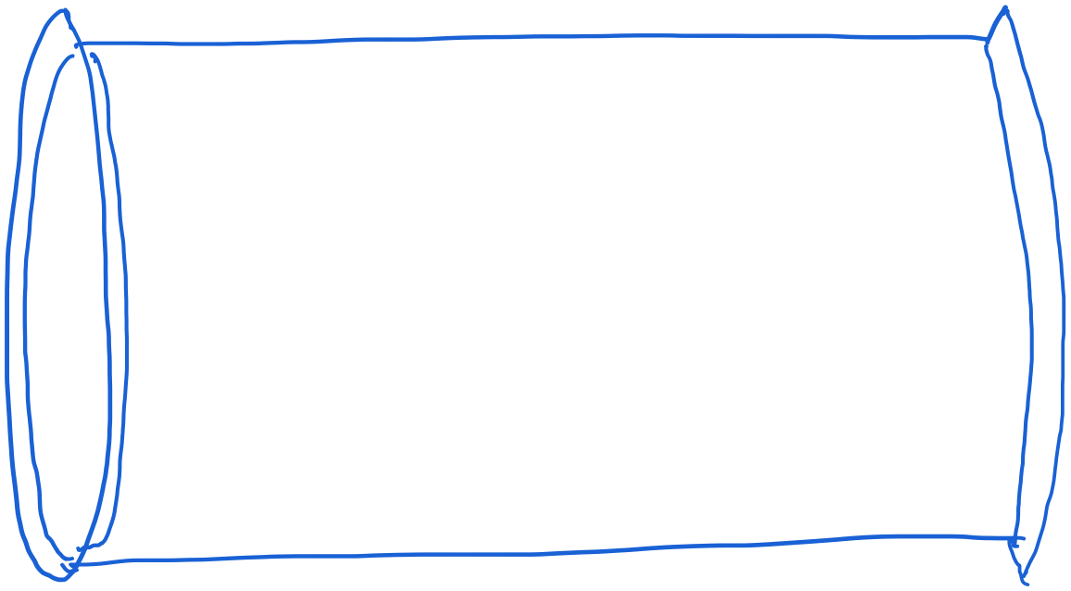
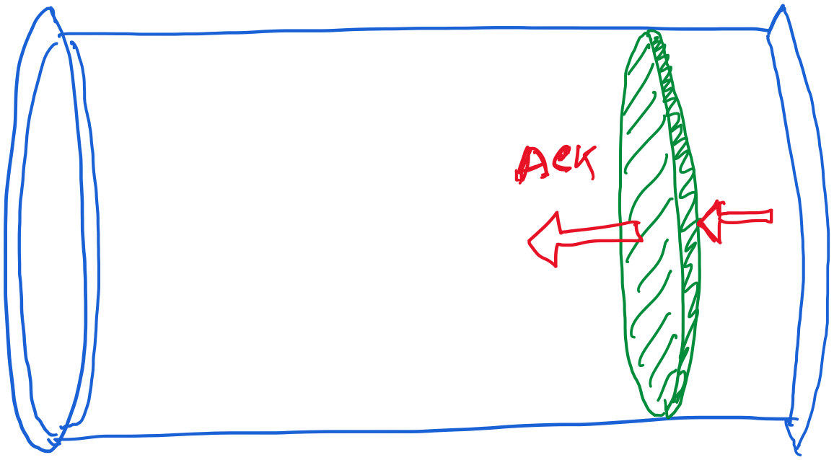
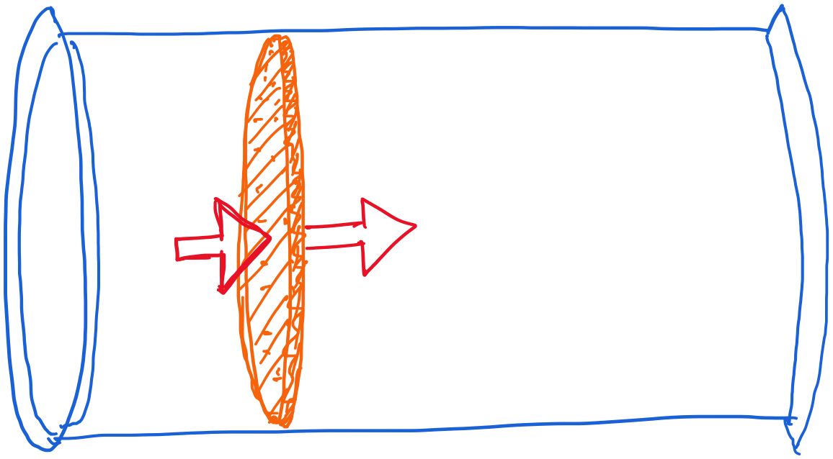
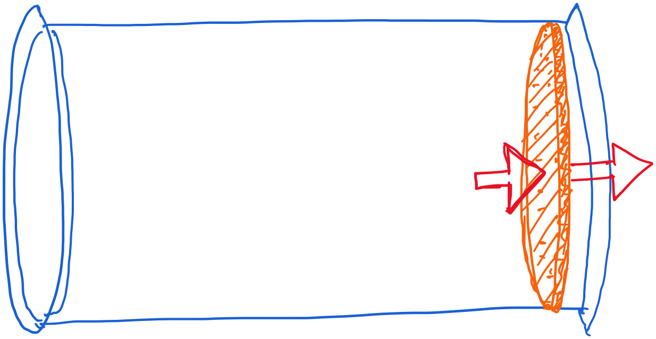
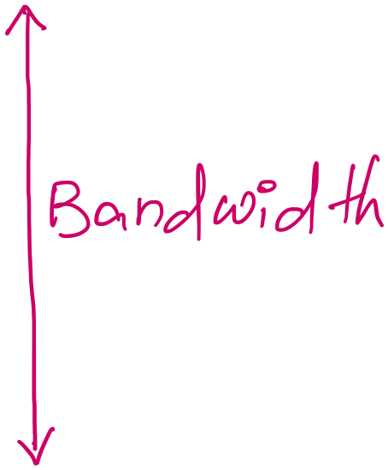
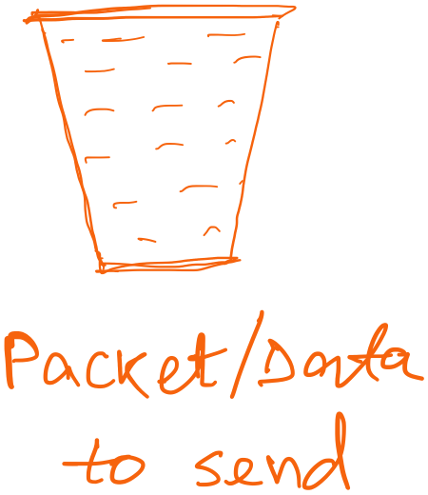
Revisiting “delay X bandwidth”

Slide 97
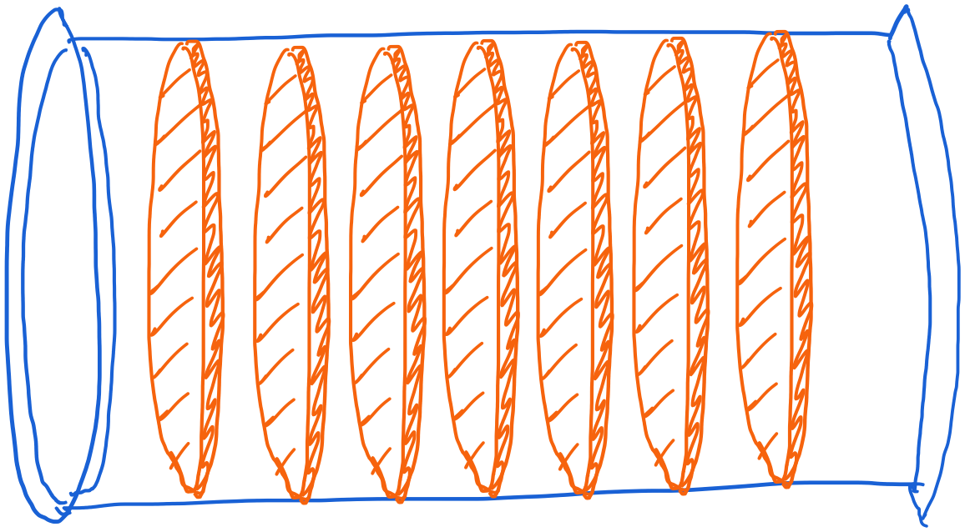
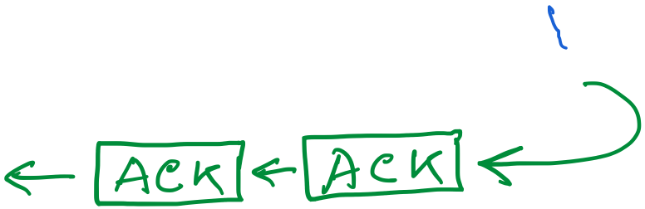
Revisiting “delay X bandwidth”

Slide 98
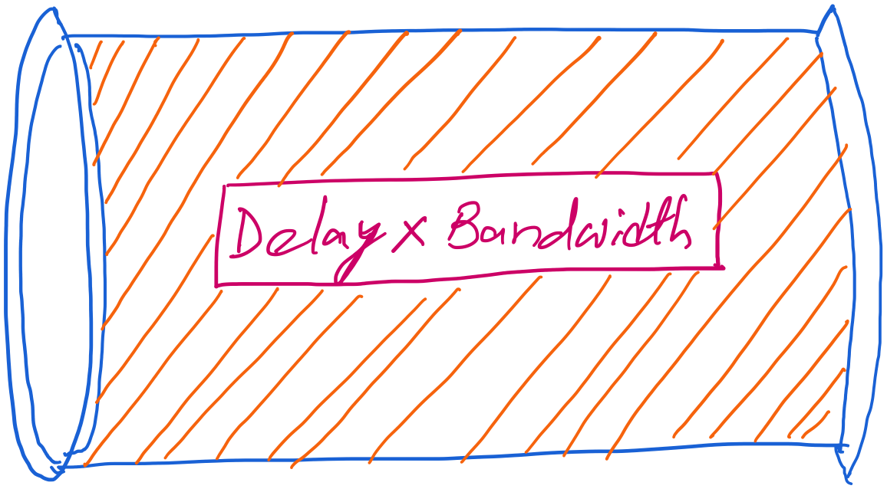
Revisiting “delay X bandwidth”
Consider two-way delay
or round-trip delay

Slide 99
stop-and-wait operation
sender
receiver
first packet bit transmitted, t = 0
last packet bit transmitted, t = L / R
first packet bit arrives
RTT
last packet bit arrives, send ACK
ACK arrives, send next
packet, t = RTT + L / R
Packet size = L bits
Network bandwidth = R bits-per-sec

Slide 100
stop-and-wait operation
sender
receiver
first packet bit transmitted, t = 0
last packet bit transmitted, t = L / R
1kB packet per 30.008 msec
first packet bit arrives
RTT
last packet bit arrives, send ACK
~33KB/sec throughput over a 1GBPS link!!
ACK arrives, send next
packet, t = RTT + L / R
Packet size = L bits
Network bandwidth = R bits-per-sec

Slide 101
stop-and-wait operation
sender
receiver
first packet bit transmitted, t = 0
last packet bit transmitted, t = L / R
1kB packet per 30.008 msec
first packet bit arrives
RTT
last packet bit arrives, send ACK
~33KB/sec throughput over a 1GBPS link!!
ACK arrives, send next
packet, t = RTT + L / R
Network protocol limits the full utilization of physical resources.
Transport-layer vs Link-layer capacity gap
Packet size = L bits
Network bandwidth = R bits-per-sec

Slide 102
Pipelining: increased utilization
sender
receiver
first packet bit transmitted, t = 0
last bit transmitted, t = L / R
first packet bit arrives
RTT
last packet bit arrives, send ACK
last bit of 2nd packet arrives, send ACK
last bit of 3rd packet arrives, send ACK
ACK arrives, send next
packet, t = RTT + L / R
Increase utilization
by a factor of 3!

Slide 103
Sliding Window Protocol

Slide 104

Sliding Window: A series of packets to be sent reliably
Window = # pkt in flight
Pkt:1
Pkt:2
Pkt:3
Pkt:4
Pkt:5
Pkt:6
Pkt:7
Pkt:8
Sent
Sent
Packet 1 is delivered. Slide the window.

Slide 105
Sliding Window: A series of packets to be sent reliably
Window = # pkt in flight
Pkt:1
Pkt:2
Pkt:3
Pkt:4
Pkt:5
Pkt:6
Pkt:7
Pkt:8
Sent
Sent
Sent
Packet 1 is delivered. Slide the window.

Slide 106
Sliding Window: A series of packets to be sent reliably
Should we advance the window in the following scenario?
Window = # pkt in flight
Pkt:1
Pkt:2
Pkt:3
Pkt:4
Pkt:5
Pkt:6
Pkt:7
Pkt:8
Sent
Sent
Sent
ACK
Note that the window size is not changed!

Slide 107
Sliding Window Protocol
(dealing packet loss)

Slide 108
Sliding Window: A series of packets to be sent reliably
Window = # pkt in flight
Pkt:1
Pkt:2
Pkt:3
Pkt:4
Pkt:5
Pkt:6
Pkt:7
Pkt:8
Sent
Sent
Sent
Re-tx
Re-tx
Re-tx
(1) ARQ strategy 1: Retransmit all un-ACKed packets

Slide 109
Sliding Window: A series of packets to be sent reliably
Window = # pkt in flight
Pkt:1
Pkt:2
Pkt:3
Pkt:4
Pkt:5
Pkt:6
Pkt:7
Pkt:8
Sent
Sent
Sent
Re-tx
(2) ARQ strategy 2: Retransmit only the lost packet
(2) Selective retransmit (Sender side)

Slide 111
TCP Cumulative ACK strategy (receiver side)
(A more specific example)
Seq. # | 234118
ACK flag | N/A
ACK # | N/A
Data Len | 100 bytes
Seq. # | 234218
ACK flag | N/A
ACK # | N/A
Data Len | 50 bytes
X
Seq. # | 234268
ACK flag | N/A
ACK # | N/A
Data Len | 120 bytes
Seq. # | 234388
ACK flag | N/A
ACK # | N/A
Data Len | 100 bytes

Slide 112
TCP Cumulative ACK strategy (receiver side)
(A more specific example)
Seq. # | 234118
ACK flag | N/A
ACK # | N/A
Data Len | 100 bytes
Seq. # | 234218
ACK flag | N/A
ACK # | N/A
Data Len | 50 bytes
X
Timeout
Seq. # | 234268
ACK flag | N/A
ACK # | N/A
Data Len | 120 bytes
Seq. # | 234388
ACK flag | N/A
ACK # | N/A
Data Len | 100 bytes

Slide 113
TCP Cumulative ACK strategy (receiver side)
(A more specific example)
ACKs
Seq. # | 234118
Data Len | 100 bytes
ACK flag | 1
ACK # | 234218
X
Seq. # | 234268
Data Len | 120 bytes
ACK flag | 1
ACK # | 234218
Seq. # | 234388
Data Len | 100 bytes
ACK flag | 1
ACK # | 234218
Seq. # | 234218
Data Len | 50 bytes
ACK flag | 1
ACK # | 234488

Slide 114
Flow Control:
TCP Sliding Window (Recap)
Motivation: Maximum utilization of the resources without overwhelming the receiver.

Slide 115
How to send the Advertised_Window size

Slide 116
Calculate Advertised_Window (Receiver side)
Receiving process
TCP
Last byte read
Next byte expected
Last byte received
AdvertisedWindow = MaxRcvBuffer – (bytes used)
AdvertisedWindow = MaxRcvBuffer –
((NextByteExpected-1) – LastByteRead)

Slide 117
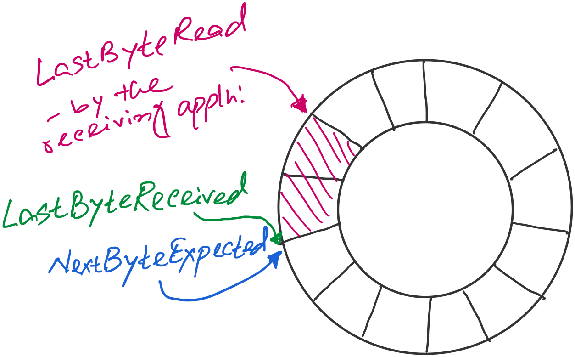
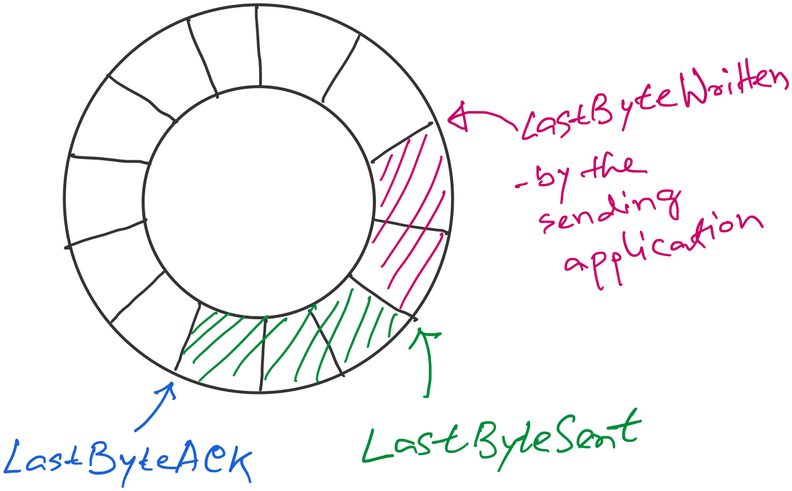
Sender buffer
Receiver buffer
What if the AdvertisedWindow is zero?
>> Periodically send 1byte packets to break the deadlock. (uses the persist timer)
AdvertisedWindow = MaxRcvBuffer –
((NextByteExpected-1) – LastByteRead)
EffectiveWindow (calculated at the sender side)
= AdvertisedWindow - (LastByteSent – LastByteACKed)

Slide 119
A few points of discussions on TCP flow control
Silly window syndrome
Nagle’s algorithm (self-clocking)
Karn-Partridge algorithm

Slide 120
Lec 15

Slide 121
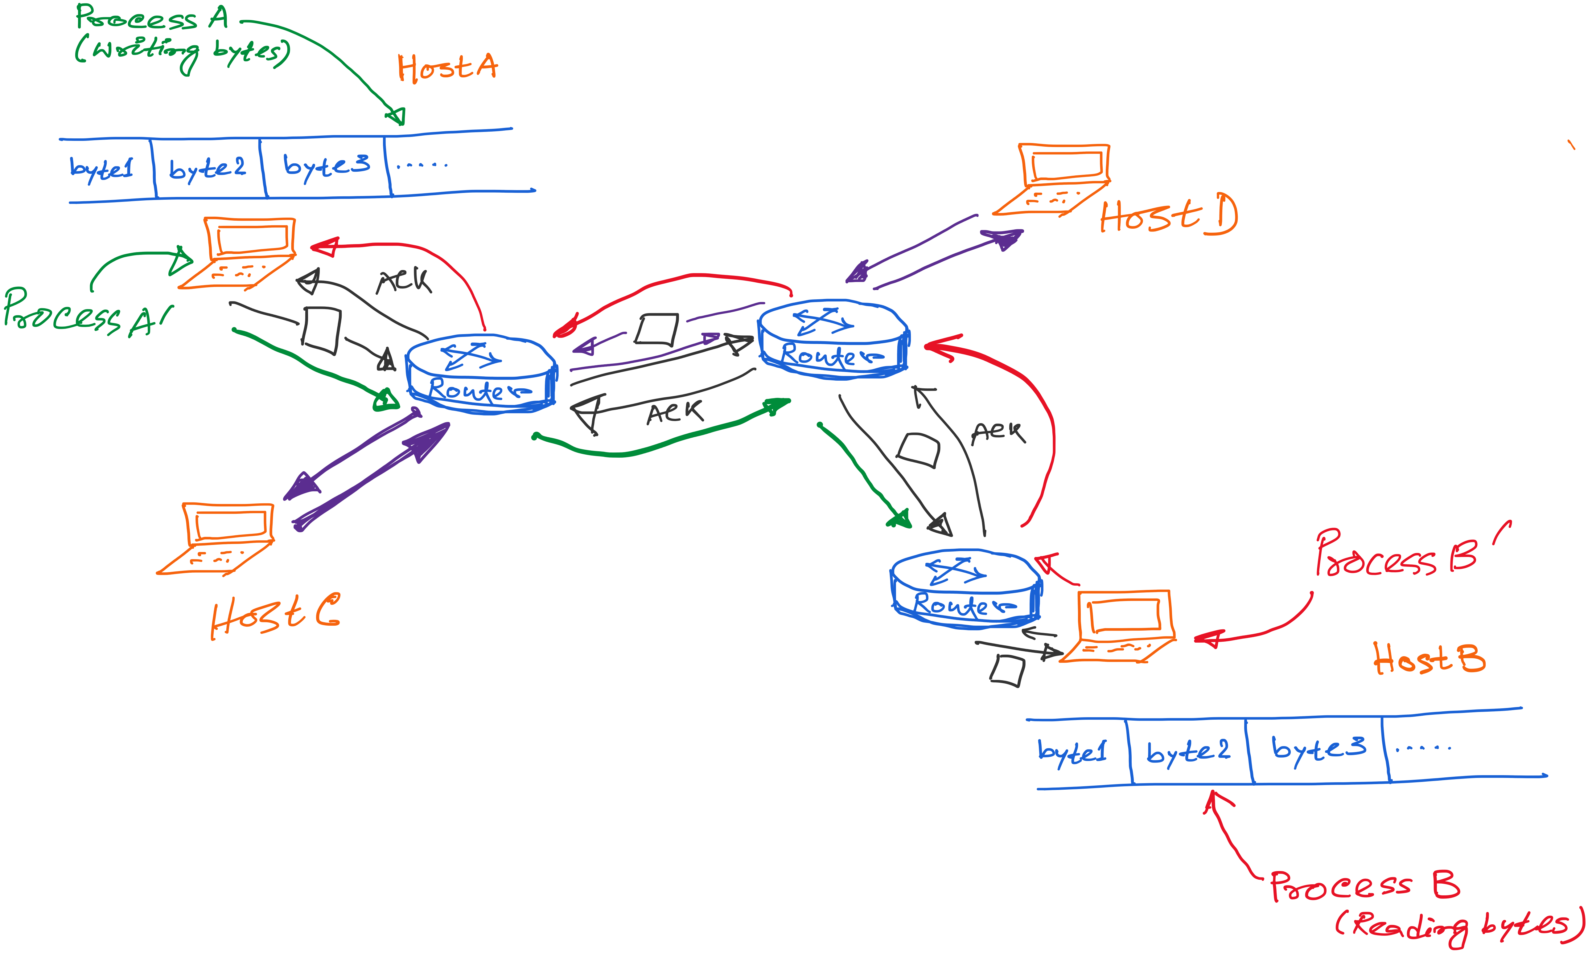
TCP: Abstraction of Reliable Bytes Stream

Slide 122
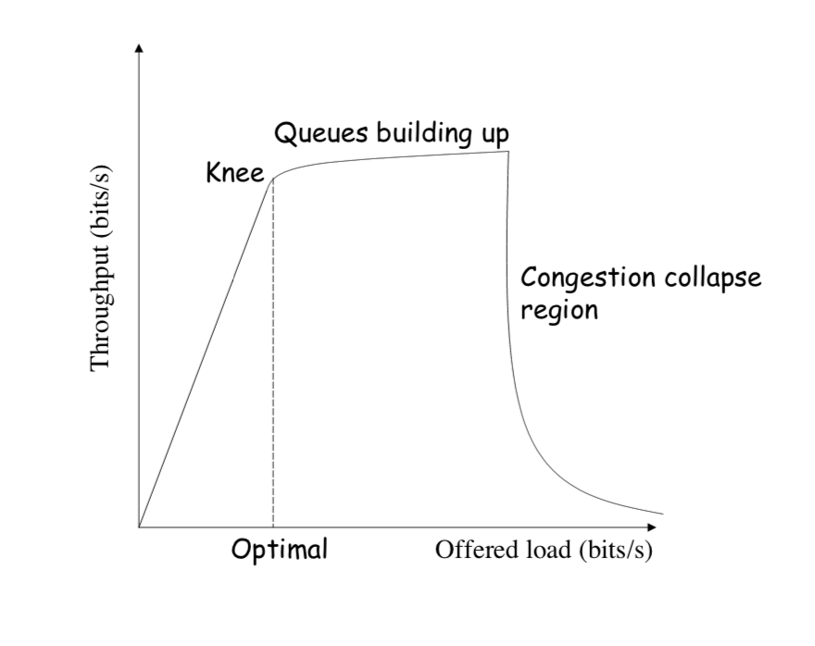
Congestion Collapse
Notes:
Picture: https://ocw.mit.edu/courses/electrical-engineering-and-computer-science/6-829-computer-networks-fall-2002/lecture-notes/L8e2ecc.pdf

Slide 123
How TCP detects packet losses
(1) Duplicate ACKs
  Packet# n is lost, but packets n+1, n+2, etc. are received and ACKs are sent.
(2) Timeout
  Packet# n is lost and detected via a timeout

Slide 124
TCP Congestion Control

Slide 125
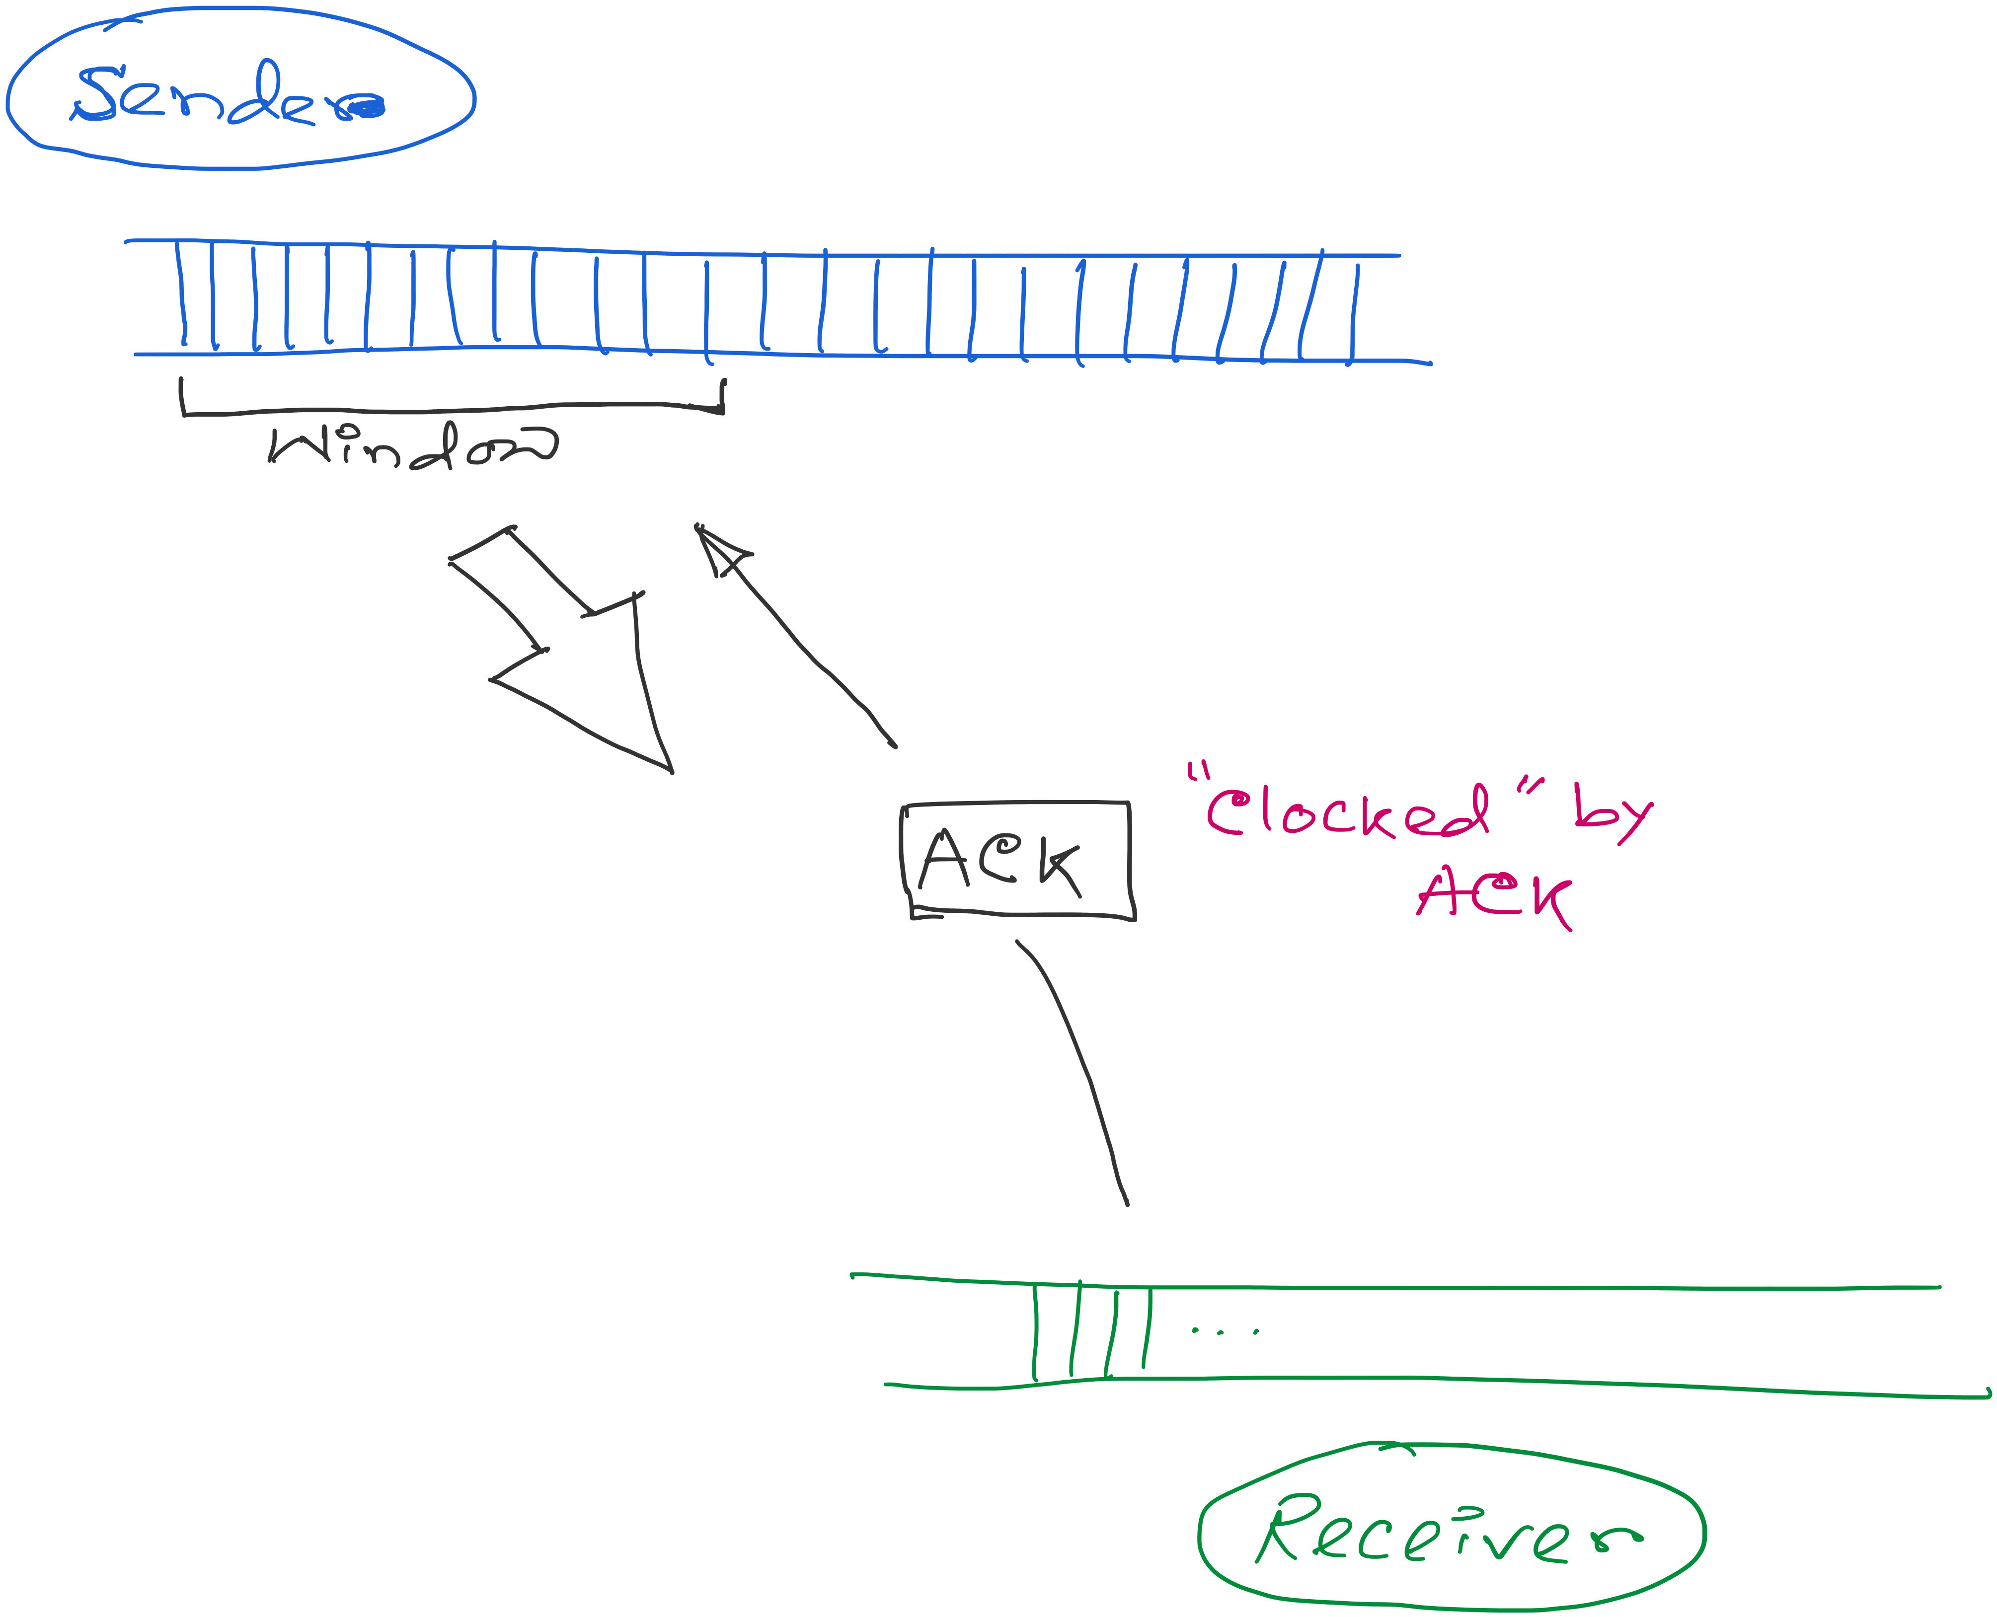
ACK works as the indicator and the window controls the flow.
Congestion_window: Calculated by the sender

Slide 126
Two Kinds of Loss in TCP
(1) Triple duplicate ACK (Fast retransmit)
  Packet n is lost, but packets n+1, n+2, etc. arrive
  Then, sender quickly resends packet n
  Do a multiplicative decrease and keep going
(2) Timeout (Repeat slow start – slow start restart)
  Packet n is lost and detected via a timeout
  Blasting entire CWND would cause another burst
  Better to start over with a low CWND

Slide 127
Repeating Slow Start After Timeout
(slow-start restart)
Window
timeout
Packet loss (3-dup ack, fast retransmit)
t
Slow start until reaching half of previous cwnd.
Slow-start restart: Go back to CWND of 1, but take advantage of knowing the previous value of CWND.

Slide 128
Lec 16

Slide 129
Implementation details
Update Time: Per RTT vs Per ACK
Double CWND per round-trip time
Implemented as CWND = CWND + 1 (per ACK)
1
2
4
8
Src
D
A
D
D
A
A
D
D
D
D
A
A
A
A
Dest

Slide 130
Implementation details
Update Time: Per RTT vs Per ACK
Linear increase of CWND per round-trip time
Implemented as CWND = CWND + 1/CWND (per ACK)
1
2
3
4
Src
D
A
D
D
A
A
D
D
D
D
A
A
A
A
Dest

Slide 131
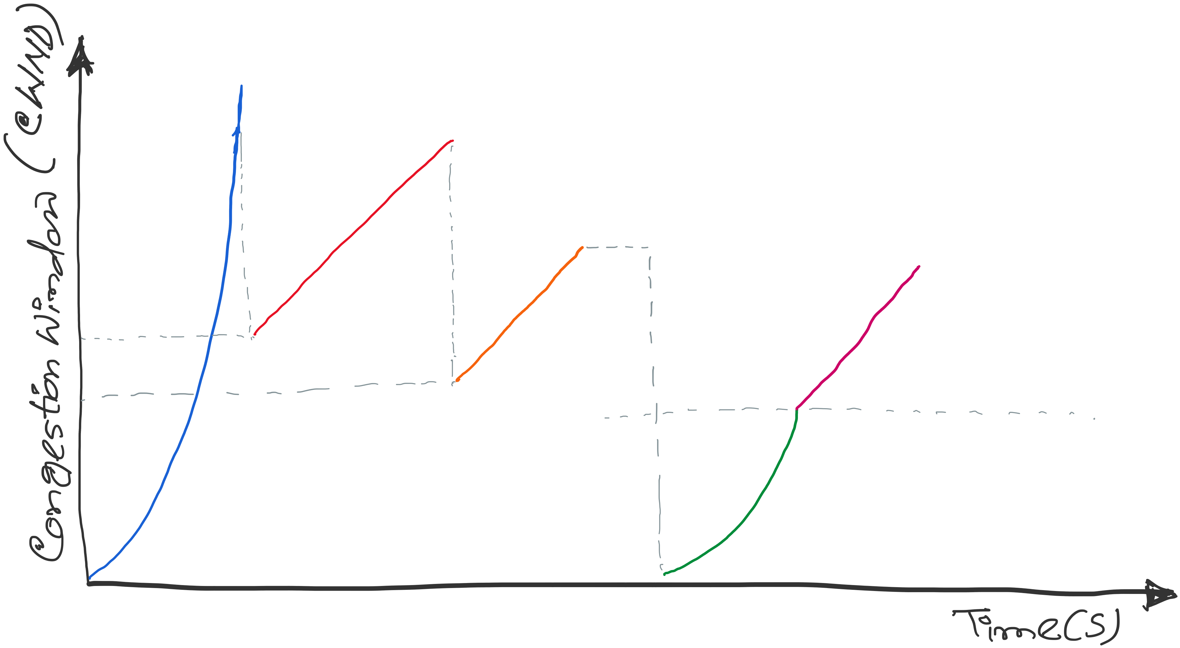
TCP congestion control: CWND graph
First packet loss (3-dup acks)
Congestion avoidance CWND = CWND + (1/CWND)
Packet loss
(3-dup acks)
CWND = CWND/2
Time out(no acks)
Congestion
avoidance
CWND =
CWND +
(1/CWND)
SSTHRES = CWND/2
CWND = CWND/2
Slow Start end
Slow start
Slow Start restart
CWND = 1
Notes:
[source: G.R.Wright and W.R.Stevens, TCP/IP Illustrated, Vol 2; J. Hoe, MSc Thesis, pp.22]
Tahoe (1988): slow start, congestion avoidance, fast retransmit
Reno (1990): fast recovery, TCP header prediction, SLIP header compression, routing table changes
4.4BSD (1993): multicasting, long fat pipe modifications

Slide 132
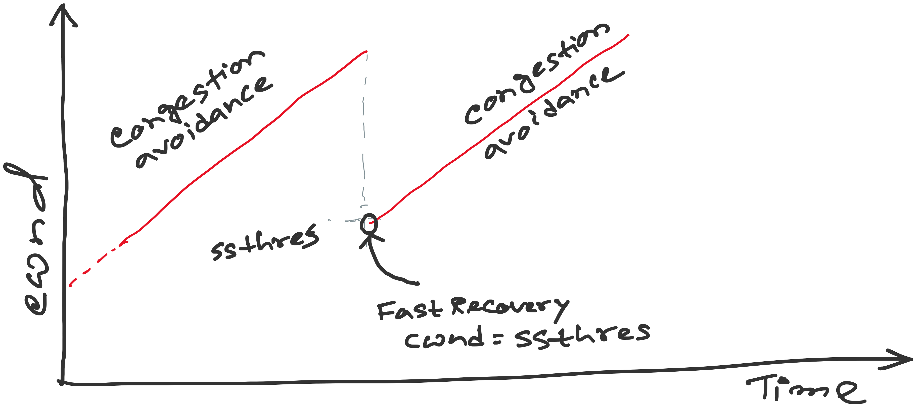
TCP Reno: details of Fast Recovery
Notes:
[source: G.R.Wright and W.R.Stevens, TCP/IP Illustrated, Vol 2; J. Hoe, MSc Thesis, pp.22]
Tahoe (1988): slow start, congestion avoidance, fast retransmit
Reno (1990): fast recovery, TCP header prediction, SLIP header compression, routing table changes
4.4BSD (1993): multicasting, long fat pipe modifications

Slide 133
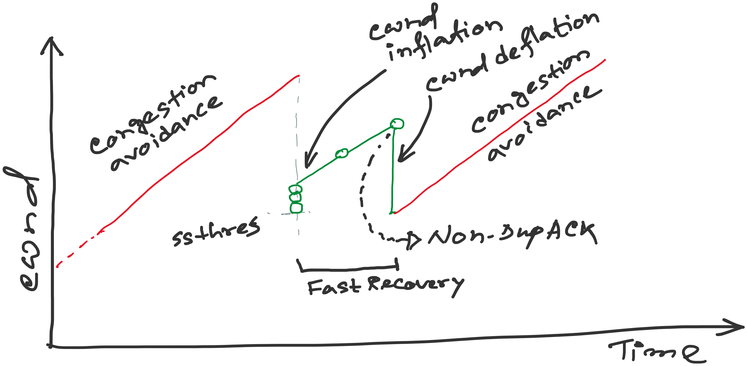
TCP Reno: details of Fast Recovery
Notes:
[source: G.R.Wright and W.R.Stevens, TCP/IP Illustrated, Vol 2; J. Hoe, MSc Thesis, pp.22]
Tahoe (1988): slow start, congestion avoidance, fast retransmit
Reno (1990): fast recovery, TCP header prediction, SLIP header compression, routing table changes
4.4BSD (1993): multicasting, long fat pipe modifications

Slide 134
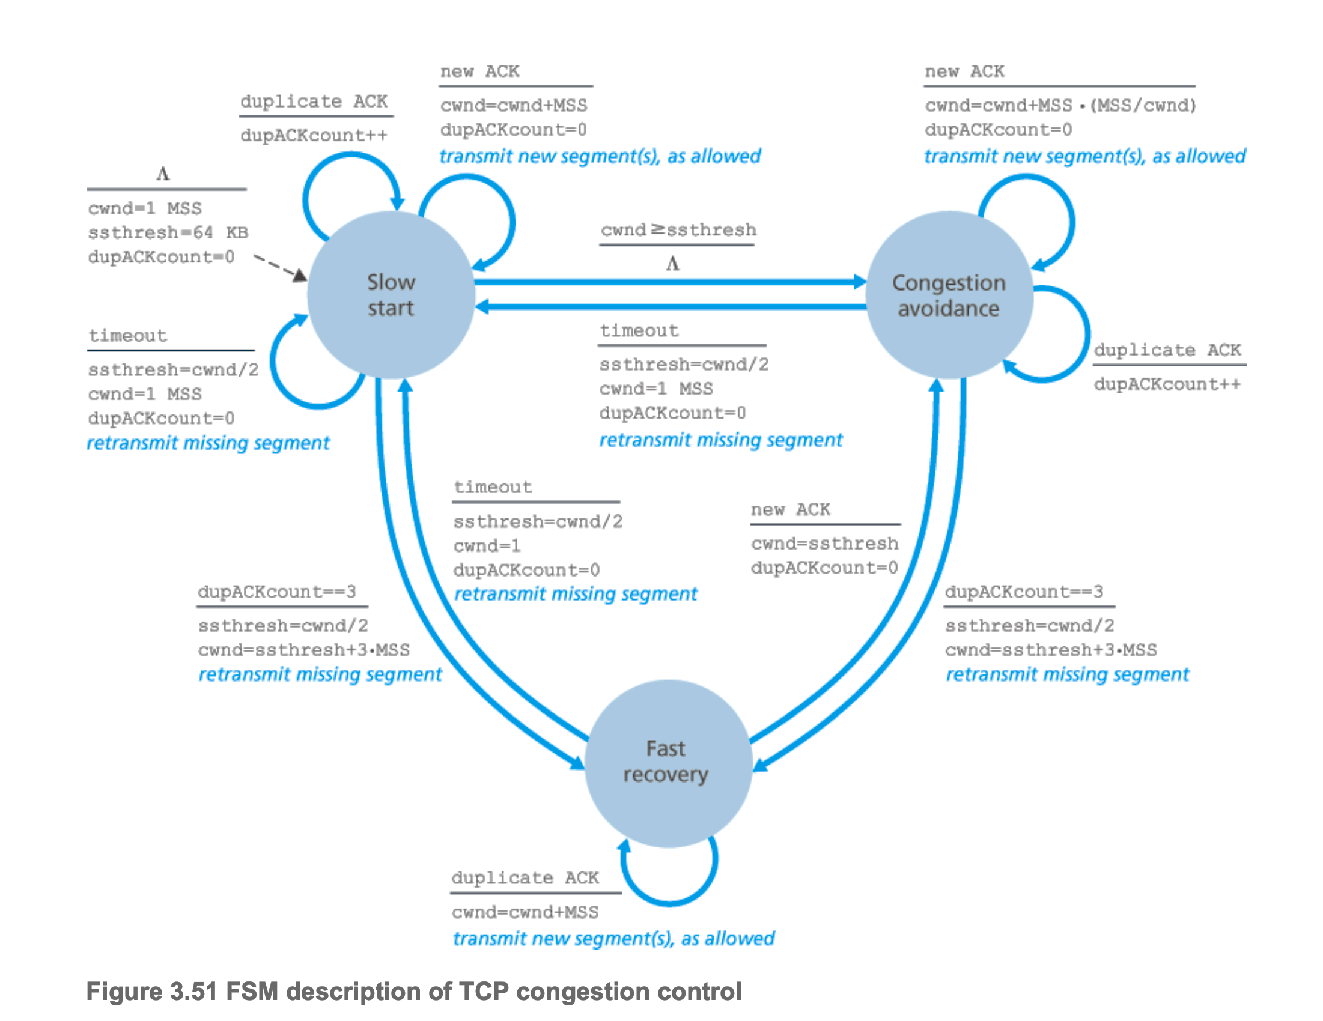
TCP Congestion Control

Slide 135
TCP versions
TCP is not perfectly homogenous (200+)
4.2 BSD first widely available release of TCP/IP (1983)
Windows 95
4.3 BSD (1986)
Windows NT
4.3 BSD Tahoe (1988)
SunOS 4.1.3,4.1.4
4.3 BSD Reno (1990)
Solaris 2.3,2.4
IRIX
Linux 1.0
Digital OSF
HP/UX
4.4 BSD (1993)
Vegas (1994)
NewReno (1999)
.....
Notes:
[source: G.R.Wright and W.R.Stevens, TCP/IP Illustrated, Vol 2; J. Hoe, MSc Thesis, pp.22]
Tahoe (1988): slow start, congestion avoidance, fast retransmit
Reno (1990): fast recovery, TCP header prediction, SLIP header compression, routing table changes
4.4BSD (1993): multicasting, long fat pipe modifications

Slide 136
2. Router-assisted Congestion Control
Copyright, 1996 © Dale Carnegie & Associates, In

Slide 137
Bursty Loss From Drop-Tail Queuing
TCP depends on packet loss
  Packet loss is indication of congestion
  TCP additive increase drives network into loss
Drop-tail leads to bursty loss
  Congested link: many packets encounter full queue
  Synchronization: many connections lose packets at once

Slide 138
Random Early Detection (RED)
Router notices that queue is getting full
  … and randomly drops packets to signal congestion
Packet drop probability
  Drop probability increases as queue length increases
  Else, set drop probability f(avg queue length)
Drop
Probability
0 1
Average Queue Length

Slide 139
Feedback: From Loss to Notification
Early dropping of packets
  Good: gives early feedback
  Bad: has to drop the packet to give the feedback
Explicit Congestion Notification (ECN)
  Router marks the packet with an ECN bit
  Sending host interprets as a sign of congestion
  Requires participation of hosts and the routers

Slide 140
Link Scheduling
FIFO
  One queue, trivial scheduler
Strict priority
  One queue per priority level, simple scheduler
Weighted fair scheduling
  One queue per class, and more complex scheduler

Slide 141
Lec 17

Slide 142
TCP Congestion Control

Slide 143
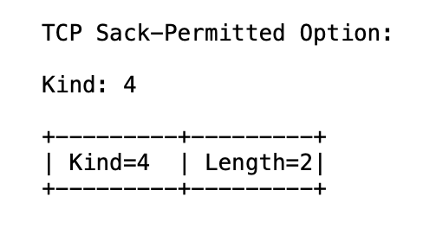
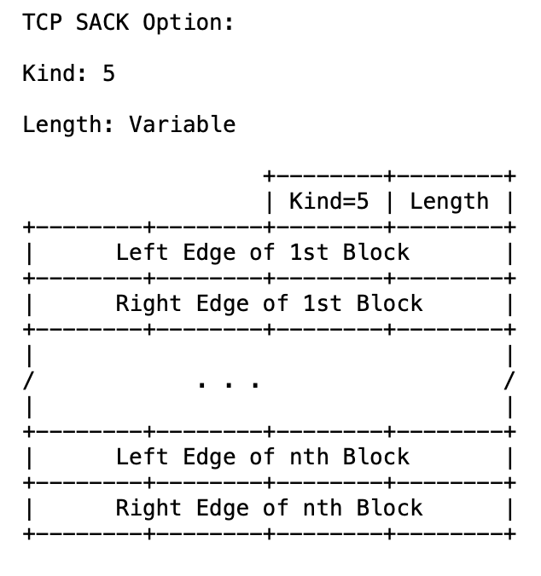
TCP Selective ACK (SACK): RFC 2018
https://www.rfc-editor.org/rfc/rfc2018

Slide 144
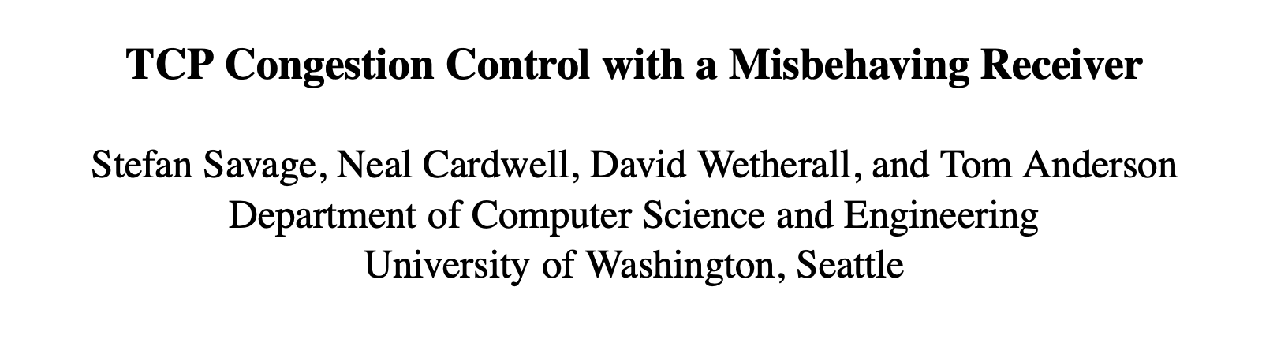
Slides courtesy: https://cseweb.ucsd.edu/classes/wi01/cse222/lectures/attack-18.pdf

