Slide 1
Information Dynamics
Ashok Agrawala

Slide 2
What is information???

Slide 3
Information
Shannon:
The word ‘information’ has been given different meanings by various writers in the general
field of information theory. It is likely that at least a number of these will prove sufficiently
useful in certain applications to deserve further study and permanent recognition.
It is hardly to be expected that a single concept of information would satisfactorily
account for the numerous possible applications of this general field,
1) technical problems concerning the quantification of information and dealt with by Shannon’s theory;
2) semantic problems relating to meaning and truth; and
3) what he called ‘influential’ problems concerning the impact and effectiveness of information on human behavior, which he thought had to play an equally important role.
Floridi, Luciano. Information: A Very Short Introduction (Very Short Introductions) (p. 2). OUP Oxford. Kindle Edition.

Slide 4
Definition of Information
General Definition of Information (GDI) – Data + meaning
Data Based Definition
GDI σ is an instance of information, understood as semantic content,
if and only if:
GDI.l) a consists of n data, for n ≥ 1;
GDI.2) the data are well formed;
GDI.3) the well-formed data are meaningful.
Data must comply with the meanings (semantics) of the chosen system, code or language.
Floridi, Luciano. Information: A Very Short Introduction (Very Short Introductions) (p. 2). OUP Oxford. Kindle Edition.

Slide 5
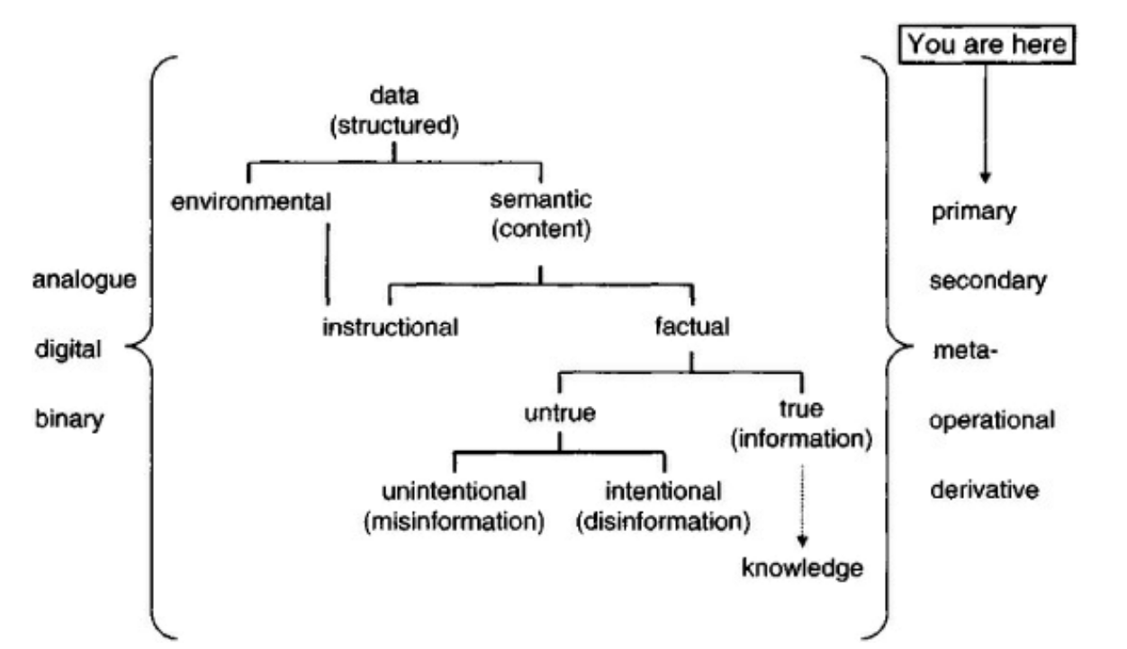
Types of data/information
Primary Data
Secondary Data
Meta Data
Operational Data
Derivative Data
Environmental Data/information
Information as Semantic Content
Instructional
Factual

Slide 6
Information Cycle

Slide 7
Shannon – Information theory
Mathematical theory of communication
The mathematical theory of communication deals with the carriers of information, symbols and signals, not with information itself. That is, information is the measure of your freedom of choice when you select a message. - Weaver
Entropy
You should call it entropy for two reasons: first, the function is already in use in thermodynamics under the same name; second, and more importantly, most people don’t know what entropy really is, and if you use the word entropy in an argument you will win every time. – von Neumann
Entropy is a measure of
The average amount of information per symbol produced by the informer, or
The corresponding average amount of data deficit (Shannon’s uncertainty) that the informee has before the inspection of the output of the informer, or
The corresponding informational potentiality of the same source, that is its informational entropy
Floridi, Luciano. Information: A Very Short Introduction (Very Short Introductions) (p. 45). OUP Oxford. Kindle Edition.

Slide 8
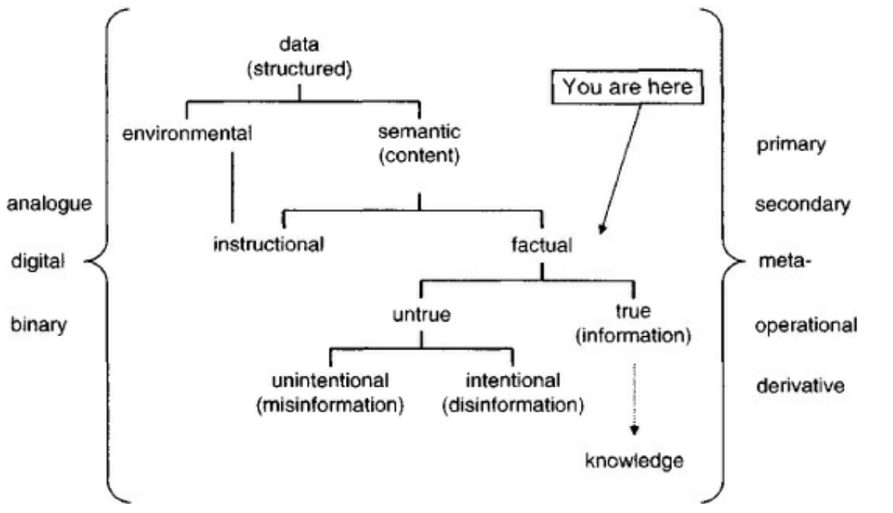
Semantic Information

Slide 9
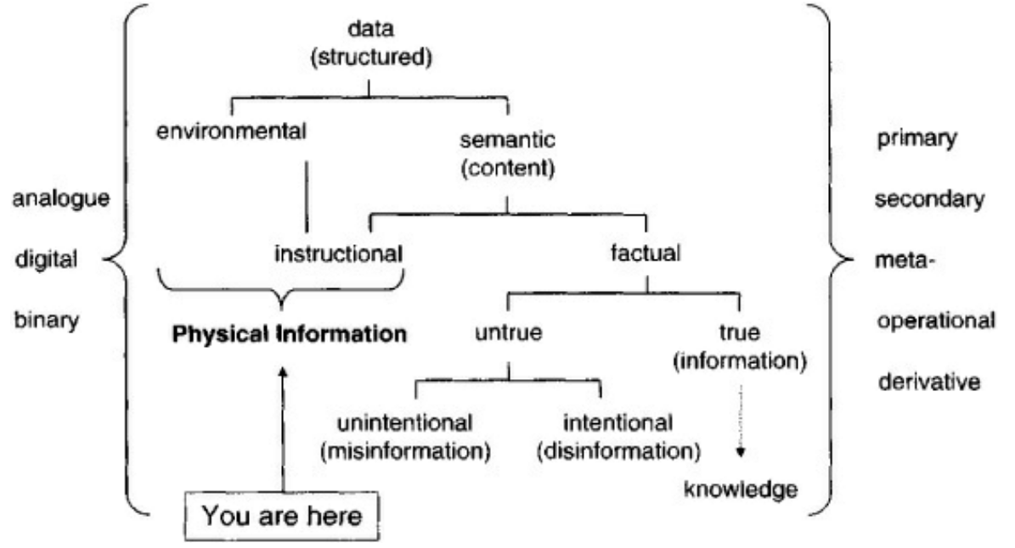
Physical Information

Slide 10
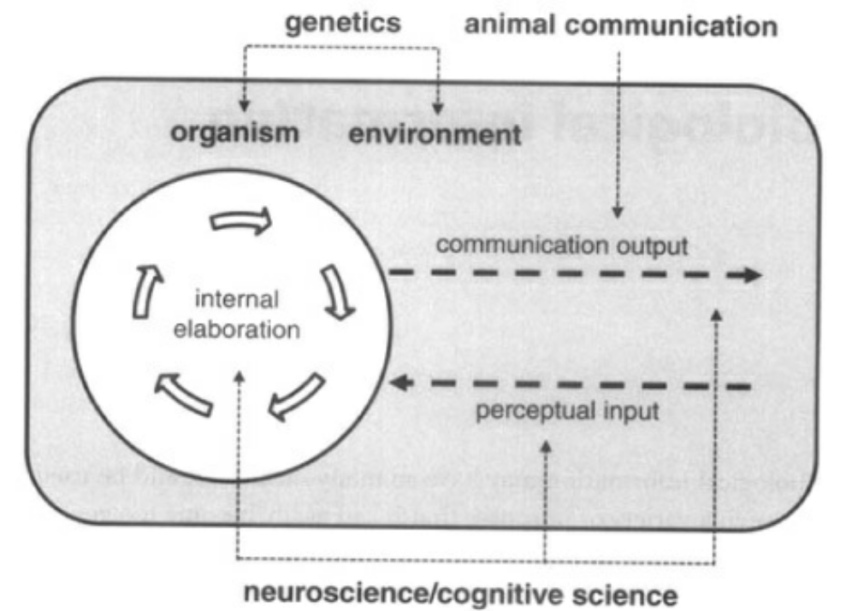
Biological Information
Biological
Genetic
DNA and genetic code
Neural Information

Slide 11
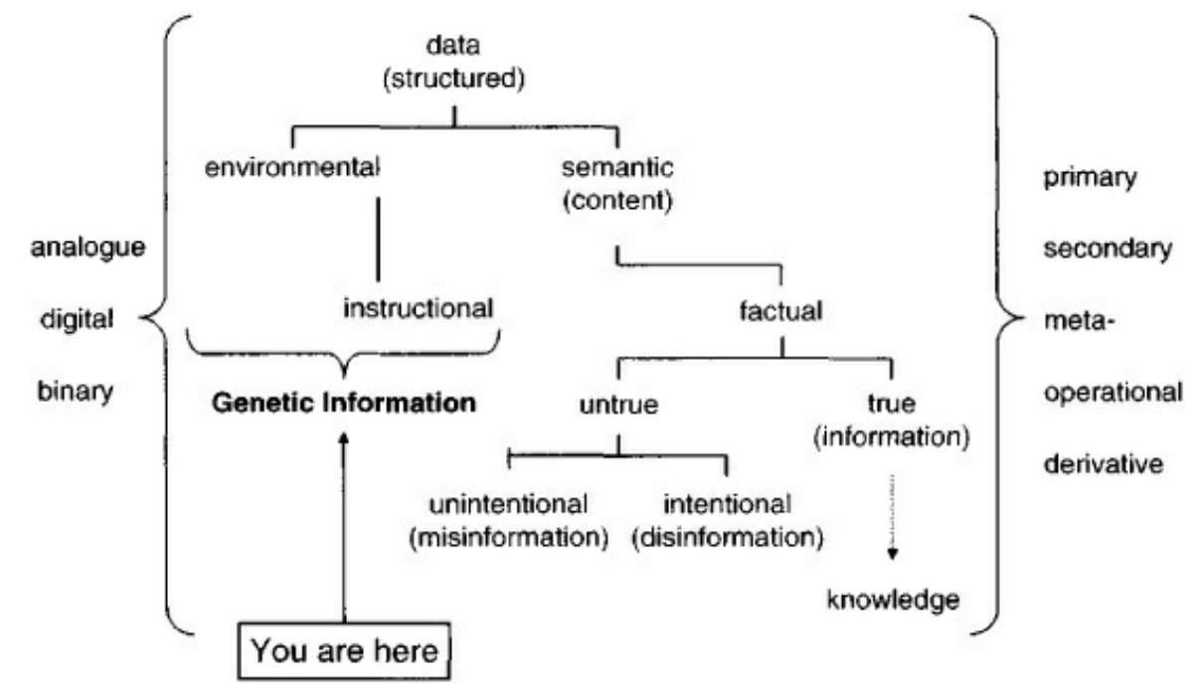
Genetic Information

Slide 12
Economic Information

Slide 13
Information
C = A + B
Newton’s First Laws of Motion
An object at rest stays at rest and an object in motion stays in motion with the same speed and in the same direction unless acted upon by an unbalanced force.

Slide 15
Information and Representations
Sentient entities deal with it
With meaning
In the physical world we only deal with representations
For
Communication
Storage
Manipulation
Use

Slide 16
Sentient Being
Large collection of information
Large collection if interrelationships among individual information items
Collection of all of it – Perceived Reality - knowledge
Acquiring
Through Senses
Deductions using prior information
Processing
Accessing
Exploring known relationships
Deducing new ones
Initiating actions
Actions
Decision – What action to take and when
Actuation – initiating the action
Execution – using physical parts of the body

Slide 17
Meaning
Derived in context
Context reflects ALL the interrelationships this information item has with all other information items
Deriving meaning is required to integrate any information with prior information/perceived reality/knowledge
If a relationship can not be established with a new information item then it may be kept as an isolated item

Slide 18
Context
All interrelationships
Any question you ask is exploring another relationship
Relationships are information items also
Standard graph theoretic models may not work
Models
Collection of interrelationships
Used in all decision making
Which may lead to actuation of actions

Slide 19
Models
Each sentient being has a very large number of such models
Some models may be static
Others may be refined
An expert is one who understand more interrelationships in a field – has better models

Slide 20
Perceived Reality
Collection of all information, models, and interrelationships
Model of
External world
Individuals
Self
Activities
….

Slide 21
Interaction among Sentient Beings
Primarily through exchange of information
Some interaction may be through physical means also

Slide 22
Exchange of information
Only through representations

Slide 23
Information Communication
Sentient Entity
Sentient Entity
Information
Information
Perceived
Reality
Perceived
Reality
Representation
Representation

Slide 24
Representations
All “Information” in physical world is the representations which are meaningful to sentient beings
Representations are created as arrangements of energy or matter
Ink spread on paper
Chalk on a board
Bits in a memory cell
Sound waves
Pictures
…
Many representations of any information item

Slide 25
Use of Representations
Storage
Keep the arrangement of matter or energy in a container
Very few interrelationships are retained
Movement
Transfer the representation directly or indirectly – so that at the receiving end a corresponding representation can be created
Manipulation
Transform them through physical operations
Addition, multiplication, …
Photoshop
…

Slide 26
Manipulation of Representations
Physical operations on representations which may be meaningful
2 + 3 = 5
010
Adder
101
011

Slide 27
Meaningful Manipulations
Sentient Entity
Information
Information
Operation
Perceived
Reality
Perceived
Reality
Representation
Representation
Operation

Slide 28
Information Manipulation in Computers
All representations in computers are in the form of bits
There is no meaning of bits or collection of bits that is available in or to the computer – only to the designer
Computer Operations
Arithmetic and Logic operations
Move bits individually or in groups
Control the movement of bits using some bit(s) as triggers
Complex manipulations are done as a sequence of simple ones
The sequence is defined by a program which is also represented as bits which are used to “guide” the movement of bits during the execution

Slide 29
Communications
Move representations from a sender to a receiver with no errors
May transform one or more times in the process
Compression
Encryption
…
Protocol
Each side has an implicit or explicit model of the other side
“When I send this, I expect to receive this”

Slide 30
Implications of Information Movement
Moving information from location x to location y takes time t_{xy}
At y we can only get information from x which is at least t_{xy} old

Slide 31
Information Uncertainty Principle-1
The perceived reality at any location CAN NOT be the same as the actual reality at any remote location of the global reality
Due to the transmission and processing delays
It is not sufficient to receive the information
It must be interpreted and processed to integrate it with the current perceived reality
Perceived reality at a location may be consistent with global/remote reality but can not be the same
We can never have a complete model of another entity:
model abstracts knowledge

Slide 32
Information Uncertainty Principle - 2
Due to finite precision of measurement and representations we can never have complete and precise knowledge of any quantifiable information
We deal with this uncertainty all the time !!!

Slide 33
Value of Information
Implicit understanding of the value
Is entity/agent specific
Use in selecting – deciding among options for processing and taking action
Value of information changes with time
Different for each agent
Depends on his perceived reality
Can not assign a fixed ordinal scale to the value

Slide 34
Value of Information
Value may be captured by uncertainty models
Example – queue length at a router
The knowledge of the queue length at time t may be precise
The knowledge at a later time given the value at t will have a variance which will increase with time
When we want to know the value of queue length from some other location, the information movement delay increases the variance

Slide 35
Ultimate User of all IT is some Sentient Being
What is HCI ?

