Slide 1
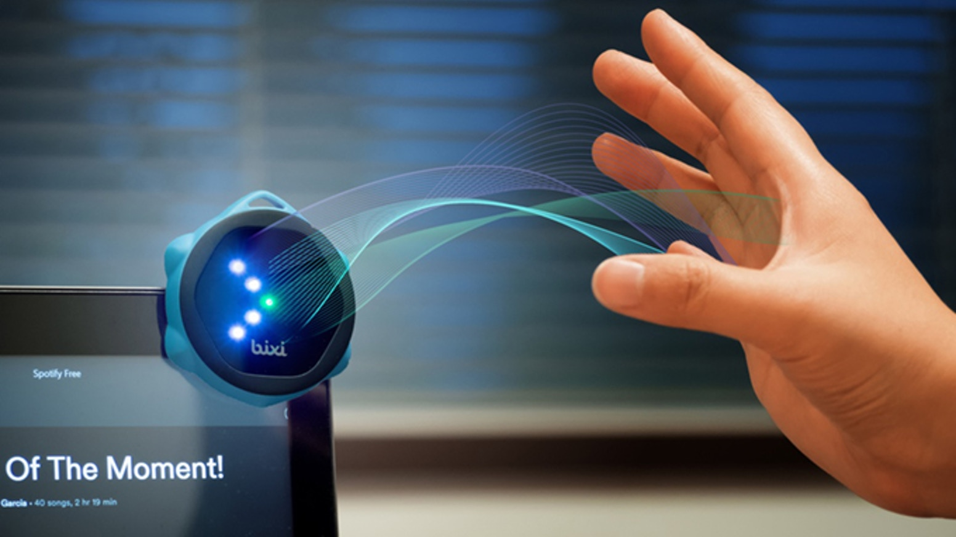
Wireless and Mobile Systems
for the IoT
CMSC 715 : Fall 2024
Lecture 2.2: Distance for Physical Perception
Nirupam Roy
Tu-Th 2:00 – 3:15pm
IRB 2207

Slide 2
Are “Time” and “Space(distance)” two fundamental parameters of our reality?

Slide 3
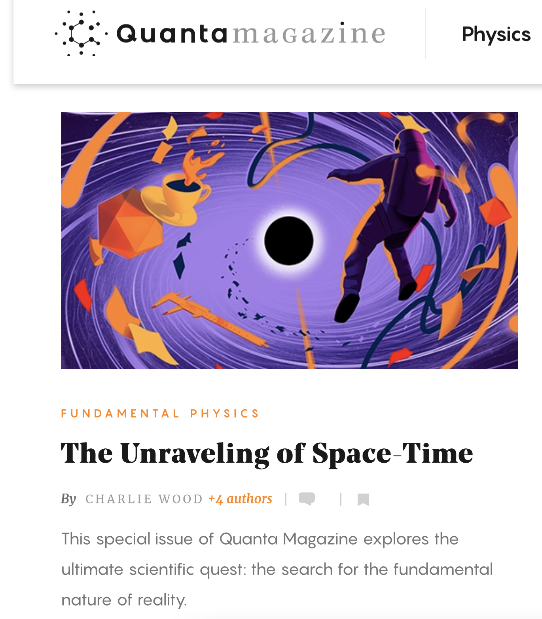
Notes:
[Ref] https://www.quantamagazine.org/?mc_cid=6329bae6d5&mc_eid=26d76e5936
Quanta magazine: Sept 30th, 2024

Slide 4
Equation of waves in time and space
$wavelength$ = λ
$$distance from the source (x)$$
$$space$$
$Ψ$(t, x)
$$=$$
$$A . sin⁡(2πft−θ(x))$$
$$A . sin⁡(2πft−\frac{2π}{\text{λ}}x)$$
$$=$$
$$⁡j(2πft−\frac{2π}{\text{λ}}x)$$
$$A . e$$
$$=$$

Slide 5
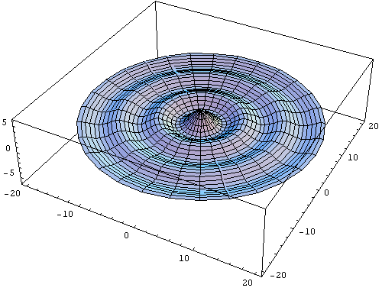

Slide 6
Equation of waves in time and space
$$time (t)$$
$$⁡j(2πft−\frac{2π}{\text{λ}}x)$$
$$e$$

Slide 7
Equation of waves in time and space
$$time (t)$$
$$⁡j(2πft−\frac{2π}{\text{λ}}x)$$
$$e$$
$$space (x)$$

Slide 8
Equation of waves in time and space
$$time (t)$$
$$⁡j(2πft−\frac{2π}{\text{λ}}x)$$
$$e$$
$$space (x)$$

Slide 11
Cycles per sec = frequency = f Hz
Distance per cycle = wavelength = λ meters
Distance per second = speed = C meters/sec

Slide 12
Time and space
Cycles per sec = frequency = f Hz
Distance per cycle = wavelength = λ meters
Distance per second = speed = C meters/sec
C = f . λ
Speed of sound in air: 343 m/s
Speed of sound in water: 1493 m/s
Speed of sound in iron: 5130 m/s
Speed of electromagnetic waves: 3*10⁸ m/s
(~ a million times faster than sound)

Slide 13
Equation of waves in time and space
$wavelength$ = λ
$$distance from the source (x)$$
$$space$$
$Ψ$(t, x)
$$=$$
$$A . sin⁡(2πft−θ(x))$$
$$A . sin⁡(2πft−\frac{2π}{\text{λ}}x)$$
$$=$$
$$⁡j(2πft−\frac{2π}{\text{λ}}x)$$
$$A . e$$
$$=$$

Slide 14
Time and space
$$A . sin⁡(2πft)$$

Slide 15
Time and space
$$⁡j(2πft)$$
$$A . e$$

Slide 16
Time and space
Distance = d meter
$$⁡j(2πft)$$
$$A . e$$

Slide 17
Time and space
$$⁡j(2πft−\frac{2π}{\text{λ}}d)$$
$$A . e$$
Distance = d meter
$$⁡j(2πft)$$
$$A . e$$

Slide 18
Time and space
$$⁡j(2πft−\frac{2π}{\text{λ}}d)$$
$$A . e$$
d meter
$$⁡j(2πft−\frac{2π}{\text{λ}}d)$$
$$A . e$$
Distance = d meter
$$⁡j(2πft)$$
$$A . e$$

Slide 19
Time and space
$$⁡j(2πft−\frac{2π}{\text{λ}}d)$$
$$A . e$$
d meter
$$⁡j(2πft−\frac{2π}{\text{λ}}d)$$
$$A . e$$
Distance = d meter
$$⁡j(2πft)$$
$$A . e$$

Slide 20
Time and space
$$⁡j(2πft)$$
$$A . e$$

Slide 21
Time and space
X meters
$$⁡j(2πft)$$
$$A . e$$

Slide 22
Time and space
X meters
$$⁡j(2πft)$$
$$Θ$$
$$A . e$$

Slide 23
Time and space
X.sin($Θ$)
X meters
$$⁡j(2πft)$$
$$Θ$$
$$A . e$$

Slide 24
Time and space
d = X.sin($Θ$)
X meters
$$⁡j(2πft)$$
$$Θ$$
$$A . e$$

Slide 25
Time and space
d = X.sin($Θ$)
X meters
$$⁡j(2πft)$$
$$Θ$$
$$A . e$$
Did you notice a small error?

Slide 26
Time and space
d = X.sin($Θ$)
X
X meters
$$⁡j(2πft)$$
$$Θ$$
$$A . e$$

Slide 27
Time and space
d = X.sin($Θ$)
X meters
$$⁡j(2πft)$$
$$Θ$$
$$A . e$$
Far-field approximation, Planar wave

Slide 28
Distance estimation (Ranging)
in
time-domain vs frequency-domain

Slide 29
Amplitude
Time (or Sample #)

Slide 30
Time delay
Amplitude
Time (or Sample #)

Slide 31
Time delay
Amplitude
Time (or Sample #)
Freq.
What difference will you see in frequency domain?

Slide 32
Time delay
Amplitude
Amplitude
Time (or Sample #)
Time (or Sample #)
Freq.
Freq.
What difference will you see in frequency domain?

Slide 33
Time delay
Amplitude
Amplitude
Time (or Sample #)
Time (or Sample #)
Freq.
Freq.
What difference will you see in frequency domain?

Slide 34
Can we send the signal continuously?
Time delay
Amplitude
Amplitude
Time (or Sample #)
Time (or Sample #)
Freq.
Freq.
What difference will you see in frequency domain?

Slide 35
Phase and time-of-arrival both can estimate distance.
What are the pros and cons?

Slide 36
Time delay
Amplitude
Amplitude
Time (or Sample #)
Time (or Sample #)
Freq.
Freq.
How are the phases related?

Slide 37
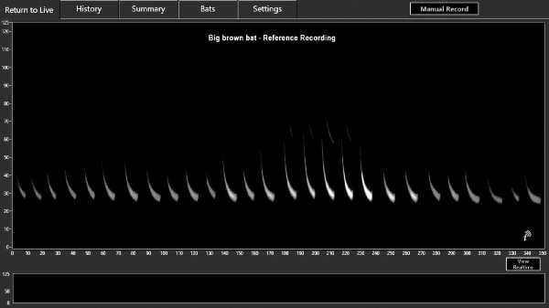

Slide 38
Chirp as the Tx signal (Frequency modulated signal)
Frequency
Time

Slide 39
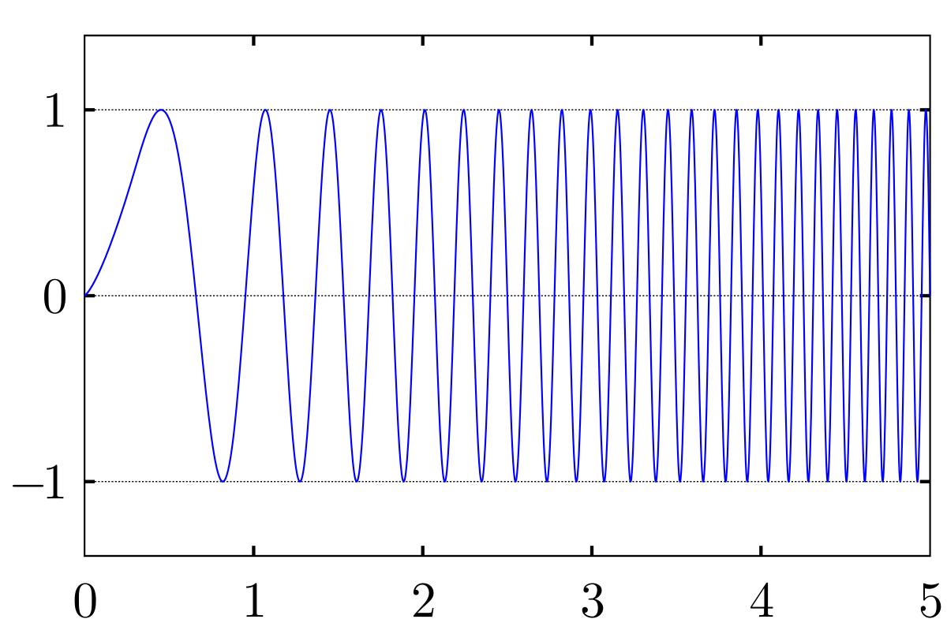
Chirp as the Tx signal (Frequency modulated signal)
Frequency
Time
Amplitude
Time

Slide 40
Chirp as the Tx signal (Frequency modulated signal)
Frequency
Time

Slide 41
Chirp as the Tx signal (Frequency modulated signal)
Freq.
Time

Slide 42
Signal Detection and Ranging: RADAR & SONAR

Slide 44
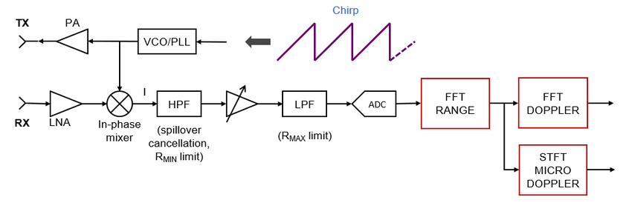

Slide 46
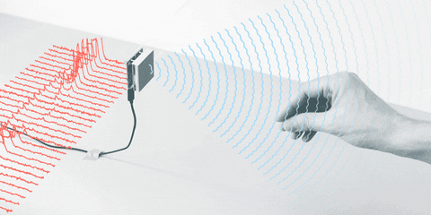

Slide 47
