Slide 1

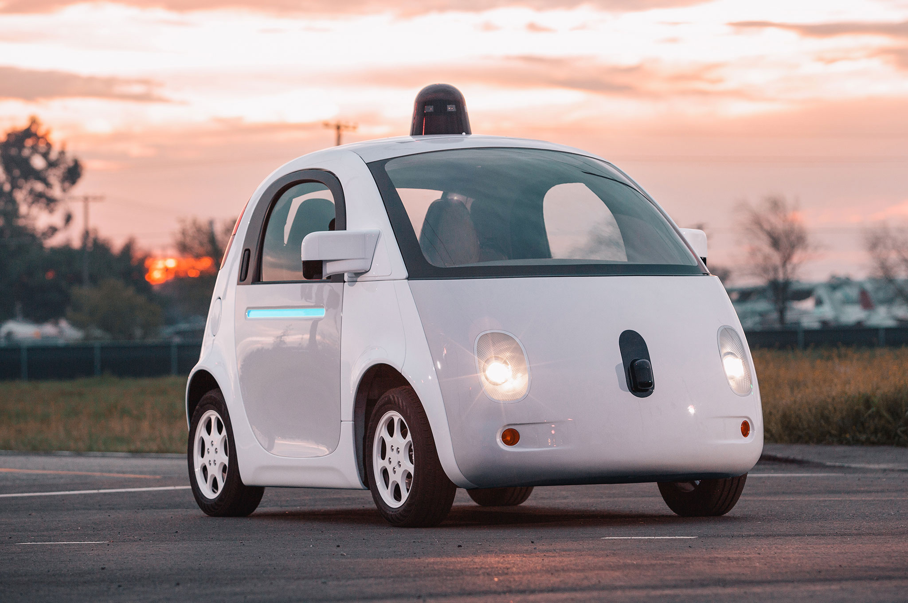



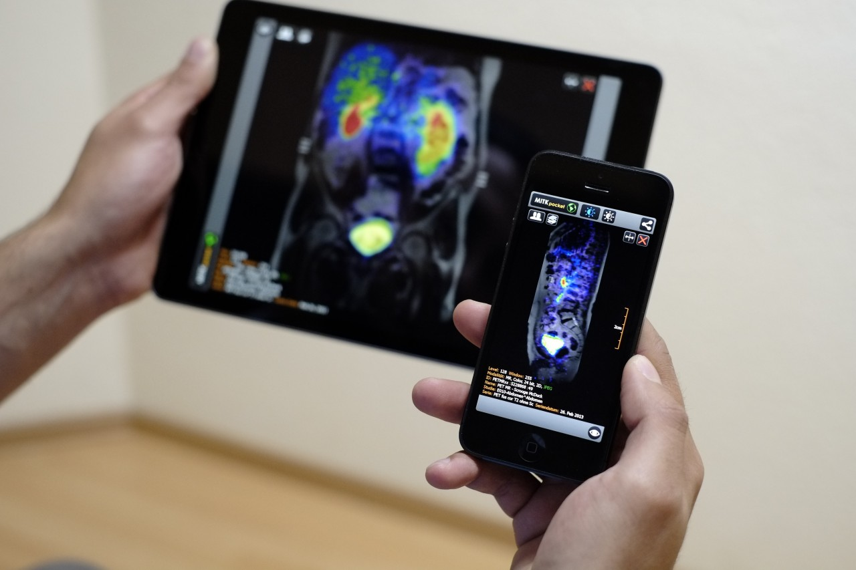
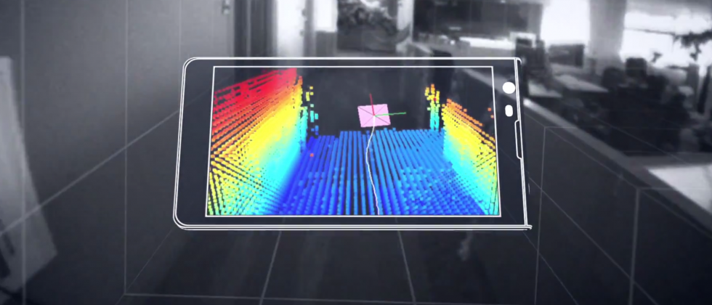
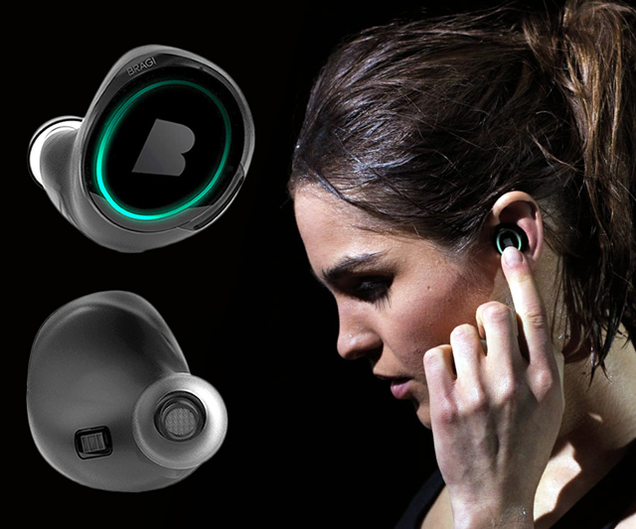
Wireless and Mobile Systems
for the IoT
CMSC 715 : Fall 2024
Lecture 1.4: Fourier analysis
Nirupam Roy
Tu-Th 2:00 – 3:15pm
IRB 2207

Slide 2
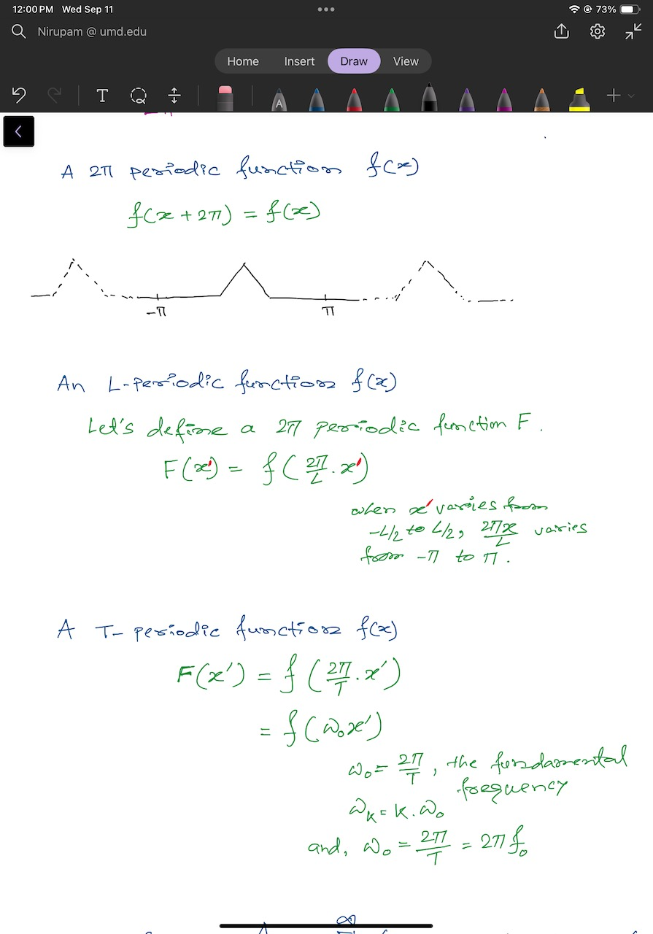

Slide 4
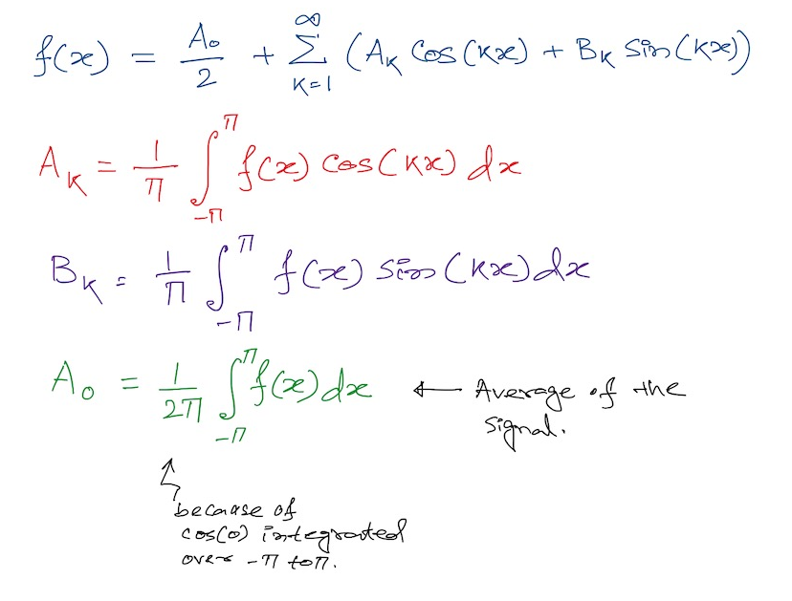
Fourier series
2

Slide 5
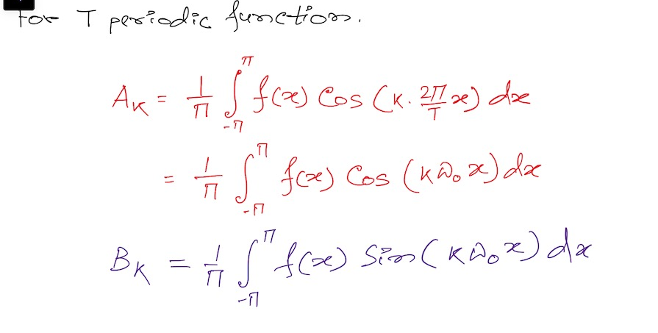
Fourier series

Slide 6
Mathematical abstractions

Slide 7
Mathematical abstractions
… we use them everyday to
understand our world

Slide 8
A few examples of Mathematical abstraction
What is a number?
What is a negative number?
What do they model?
Any other example?

Slide 9
Model for a signal (frequency, amplitude, and phase)

Slide 10


Model for a signal (frequency, amplitude, and phase)
$$A . sin⁡(θ)$$
$$A . cos⁡(θ)$$

Slide 11


Model for a signal (frequency, amplitude, and phase)
$$A . sin⁡(θ)$$
$$A . cos⁡(θ)$$
Why not use the sinusoid as the model ?

Slide 12
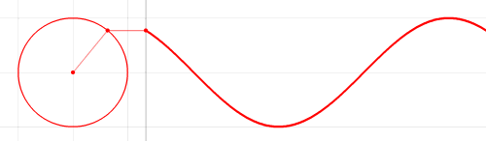

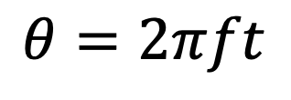



Model for a signal (frequency, amplitude, and phase)
1
$$sin⁡(θ)$$
𝚹
$$cos⁡(θ)$$
$$f cycles per second$$
$$θ=2πft$$
$$2π angles per cycle$$

Slide 13
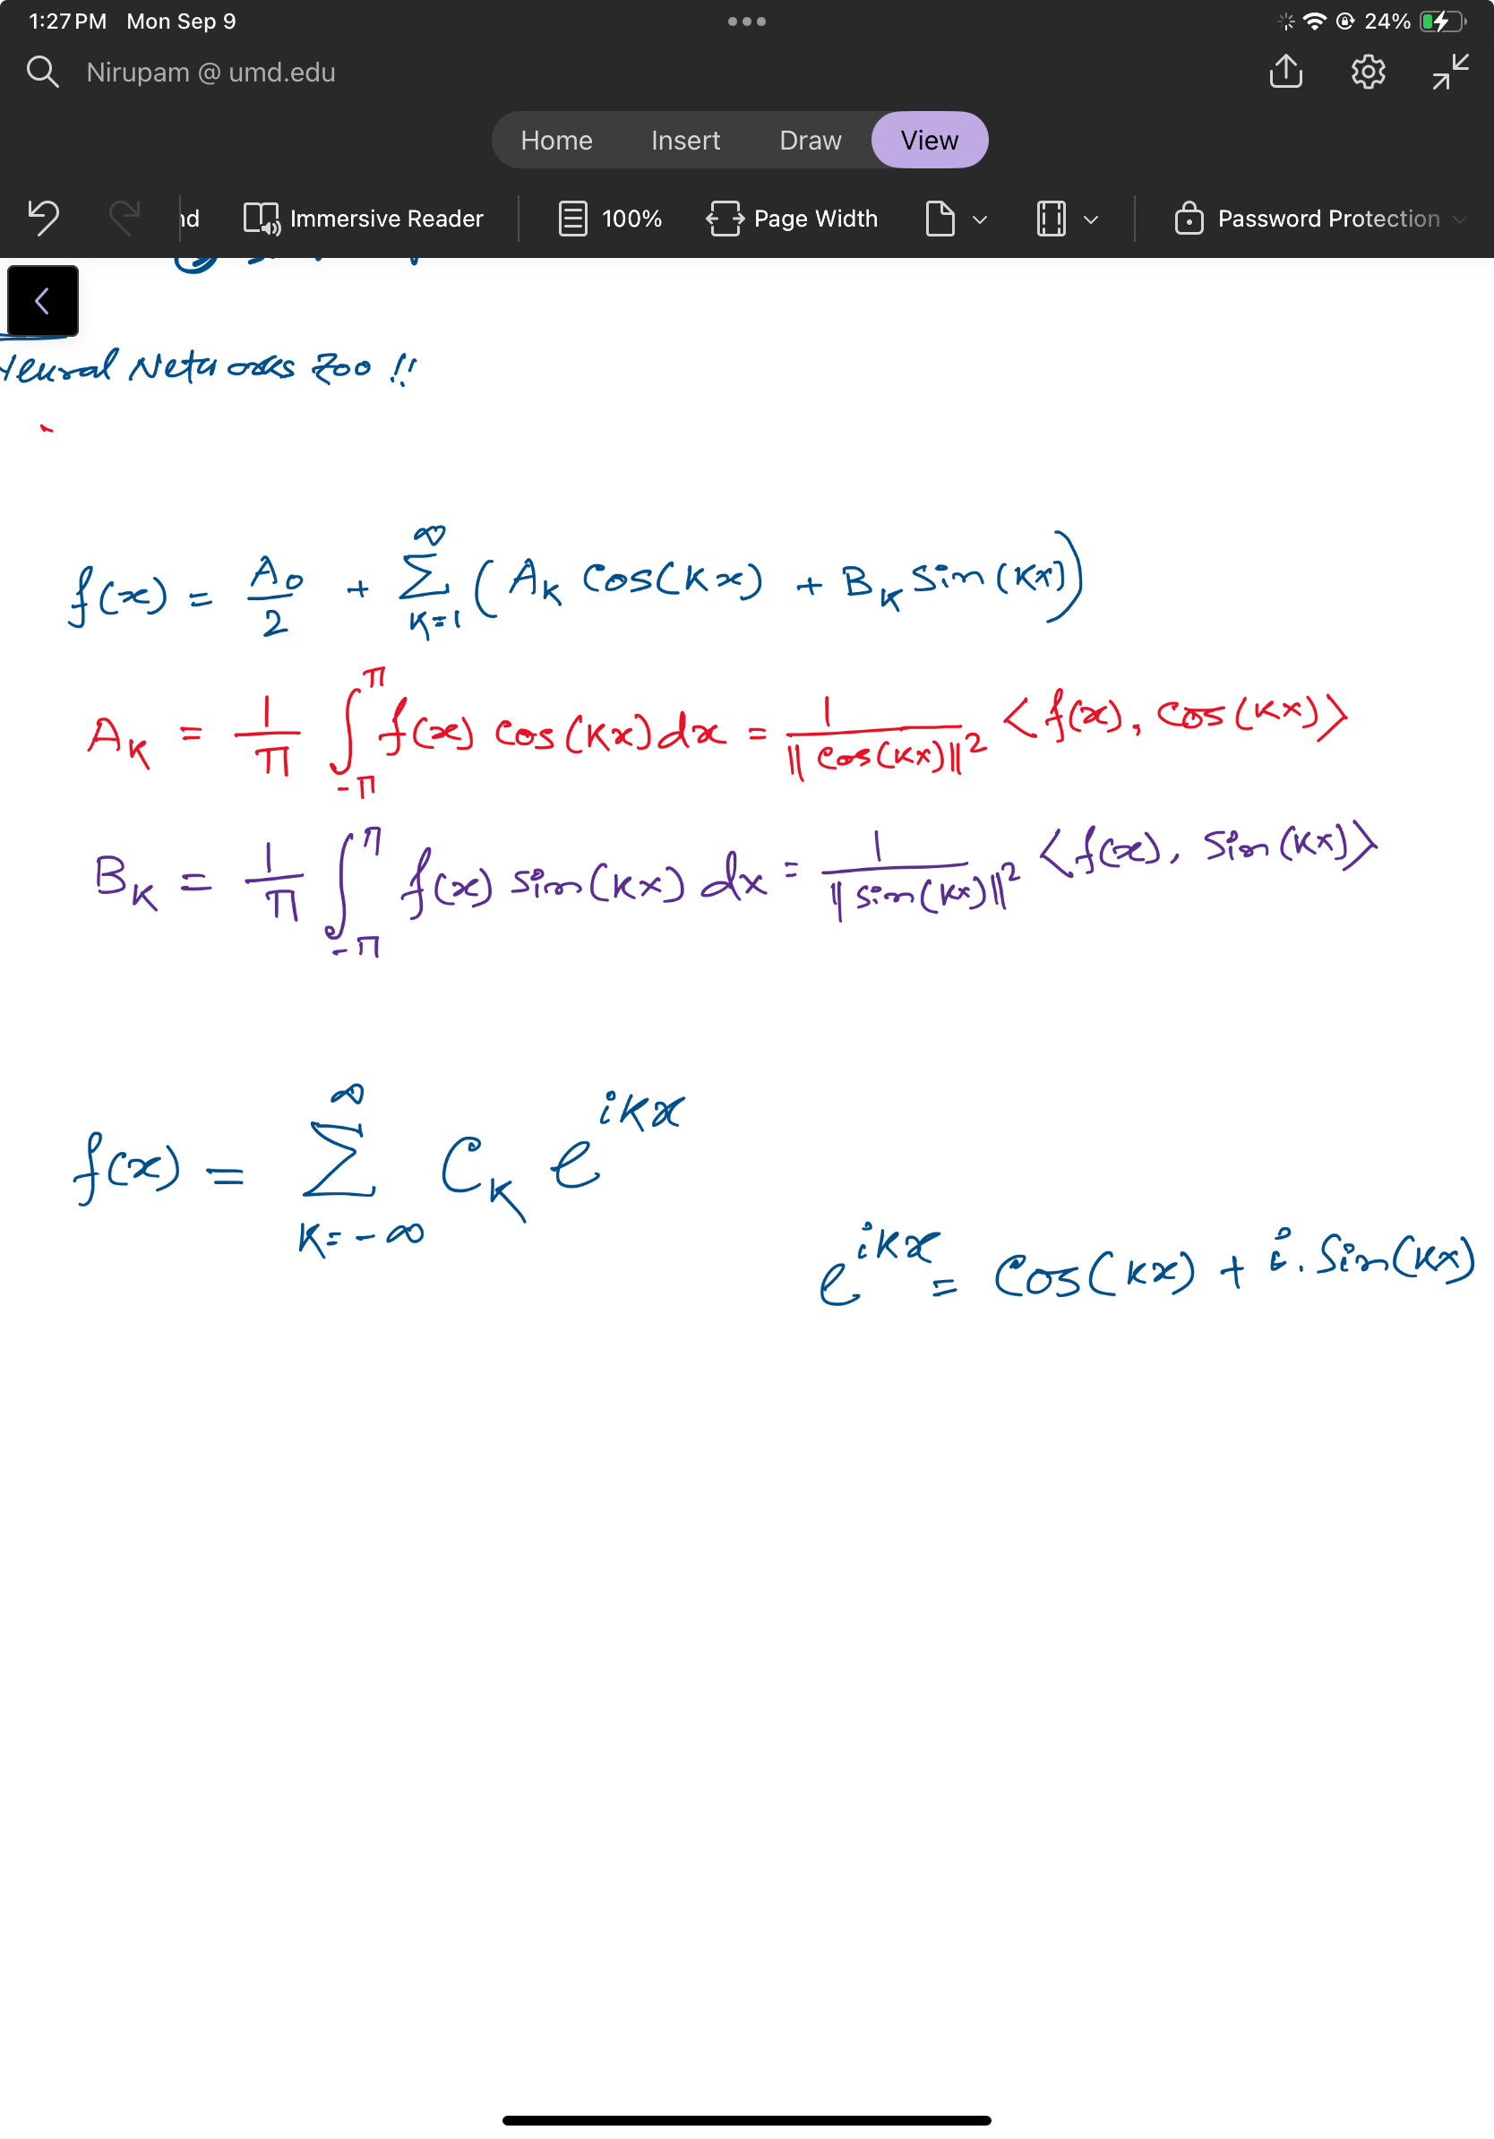
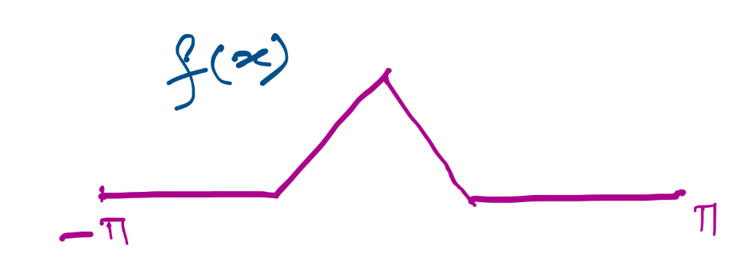

Slide 14
Projections on sinusoids

Slide 15
Projections on sinusoids
Notes:
Talk about cos() is an even function and sin() is odd. The even component of the function f() is captured by the cos() and odd is by sin().
Odd fn X Odd fn = Even fn.
Even X Odd = Odd
Eve X Eve = Even
Integration of an odd function between –a to a, is zero.

Slide 16
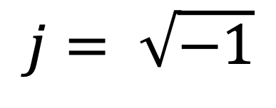
Complex numbers
Imaginary
$$j= \sqrt{−1}$$

Slide 17
Complex numbers and Natural exponential
j
j

Slide 18
Complex numbers and Natural exponential
…

Slide 19
Complex numbers and Natural exponential
…
…

Slide 20
Complex numbers and Natural exponential
…
…
…

Slide 21
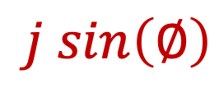

Complex numbers and Natural exponential
…
…
…
$$\cos\left(∅\right)$$
$$j sin\left(∅\right)$$
Euler’s formula

Slide 22

Complex numbers and Natural exponential
$$e^{j∅}=\cos{∅+j sin∅}$$

Slide 23
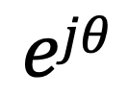
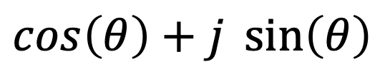

Model for a signal (frequency, amplitude, and phase)
$$\cos\left(θ\right)+j \sin\left(θ\right)$$
$$=$$
$$ejθ$$

Slide 24
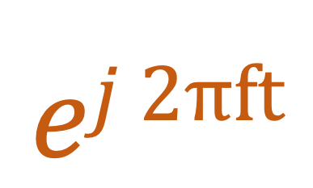

Model for a signal (frequency, amplitude, and phase)
$$ej 2πft$$
$$\cos\left(θ\right)+j \sin\left(θ\right)$$
$$=$$
$$ejθ$$
$$=$$

Slide 25
Model for a signal (frequency, amplitude, and phase)
$$ej 2πft$$
$$\cos\left(θ\right)+j \sin\left(θ\right)$$
$$=$$
$$ejθ$$
$$=$$

Slide 26
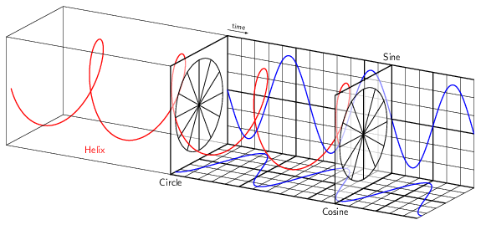
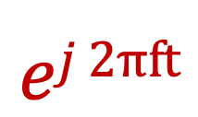
Model for a signal (frequency, amplitude, and phase)
$$ej 2πft$$

Slide 27
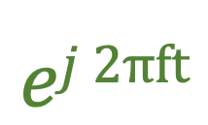
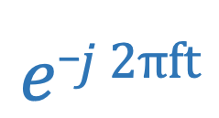
Model for a signal (frequency, amplitude, and phase)
$$ej 2πft$$
$$e_j 2πft$$

Slide 28
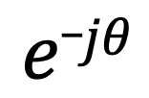

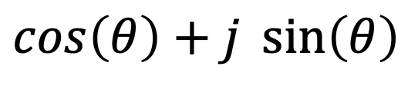
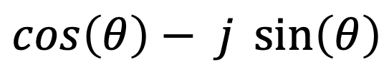
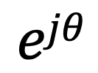
Model for a signal (frequency, amplitude, and phase)
$$ejθ$$
$$=$$
$$\cos\left(θ\right)+j \sin\left(θ\right)$$
$$e_jθ$$
$$=$$
$$\cos\left(θ\right)− j \sin\left(θ\right)$$

Slide 29




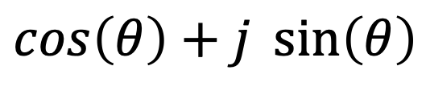

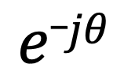
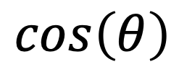

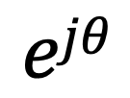
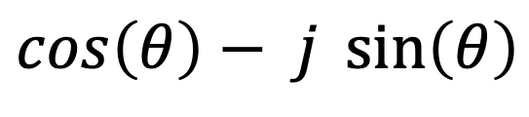
Presenting real signal with the complex model
$$ejθ$$
$$=$$
$$\cos\left(θ\right)+j \sin\left(θ\right)$$
$$e_jθ$$
$$=$$
$$\cos\left(θ\right)− j \sin\left(θ\right)$$
How about real sinusoids?
$$\cos\left(θ\right)$$
$$=$$
$$?$$
$$\sin\left(θ\right)$$
$$=$$
$$?$$

Slide 30

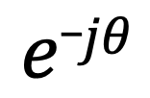
Presenting real signal with the complex model
$$ejθ$$
$$=$$
$$\cos\left(θ\right)+j \sin\left(θ\right)$$
$$e_jθ$$
$$=$$
$$\cos\left(θ\right)− j \sin\left(θ\right)$$
How about real sinusoids?
$$ejθ$$
$$+$$
$$e_jθ$$
$$\cos\left(θ\right)$$
$$=$$
2
$$\sin\left(θ\right)$$
$$=$$
$$?$$

Slide 31
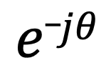
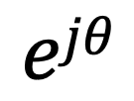

Presenting real signal with the complex model
$$ejθ$$
$$=$$
$$\cos\left(θ\right)+j \sin\left(θ\right)$$
$$e_jθ$$
$$=$$
$$\cos\left(θ\right)− j \sin\left(θ\right)$$
How about real sinusoids?
$$ejθ$$
$$+$$
$$e_jθ$$
$$\cos\left(θ\right)$$
$$=$$
2
$$ejθ$$
$$−$$
$$e_jθ$$
$$\sin\left(θ\right)$$
$$=$$
2j

Slide 32
Presenting real signal with the complex model

Slide 33


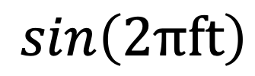
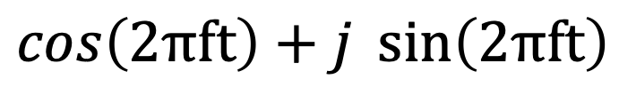




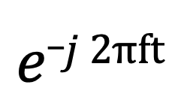
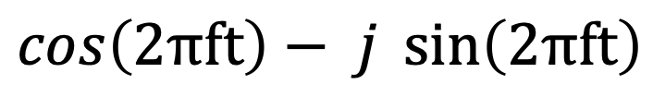
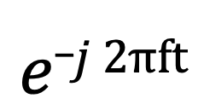
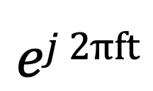
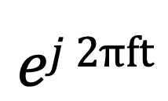
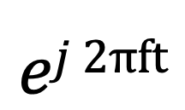
Presenting real signal with the complex model
$$ej 2πft$$
$$=$$
$$\cos\left(2πft\right)+j \sin\left(2πft\right)$$
$$e_j 2πft$$
$$=$$
$$\cos\left(2πft\right)− j \sin\left(2πft\right)$$
$$ej 2πft$$
$$+$$
$$e_j 2πft$$
$$\cos\left(2πft\right)$$
$$=$$
2
$$ej 2πft$$
$$−$$
$$e_j 2πft$$
$$\sin\left(2πft\right)$$
$$=$$
2j

Slide 36
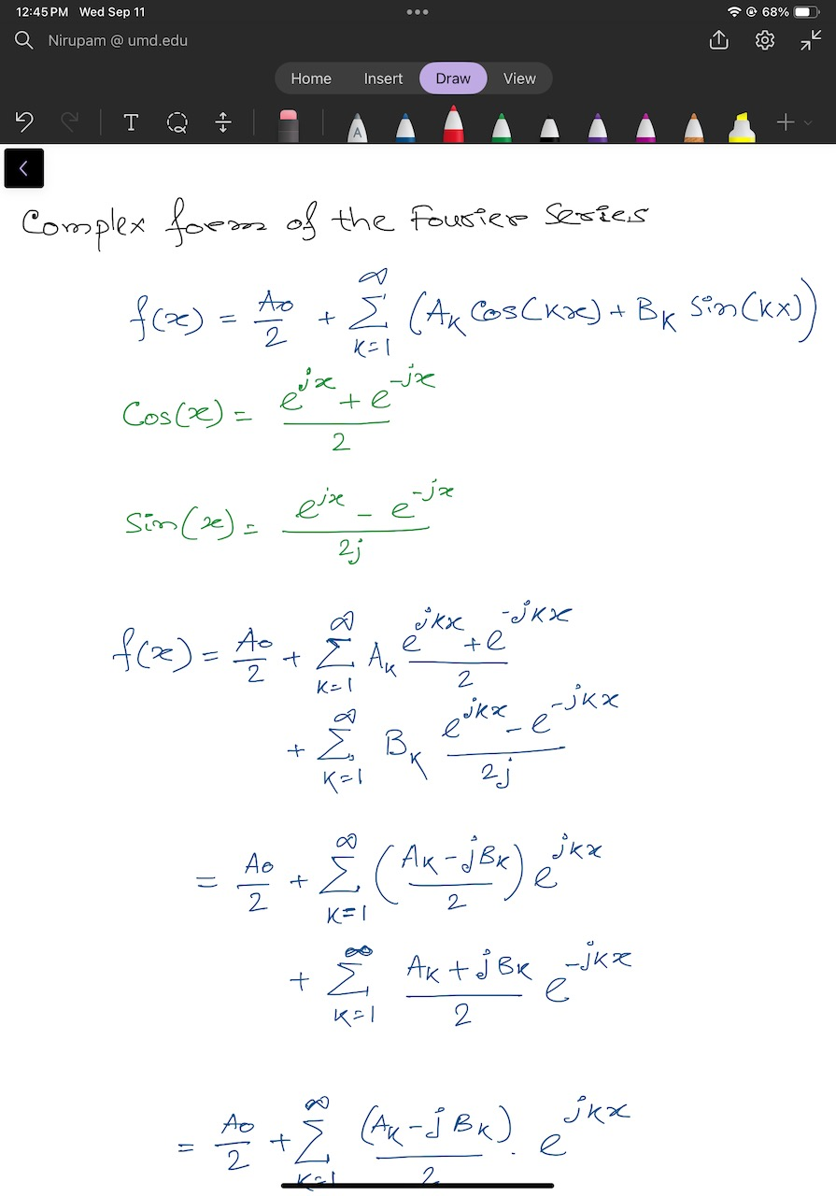

Slide 39
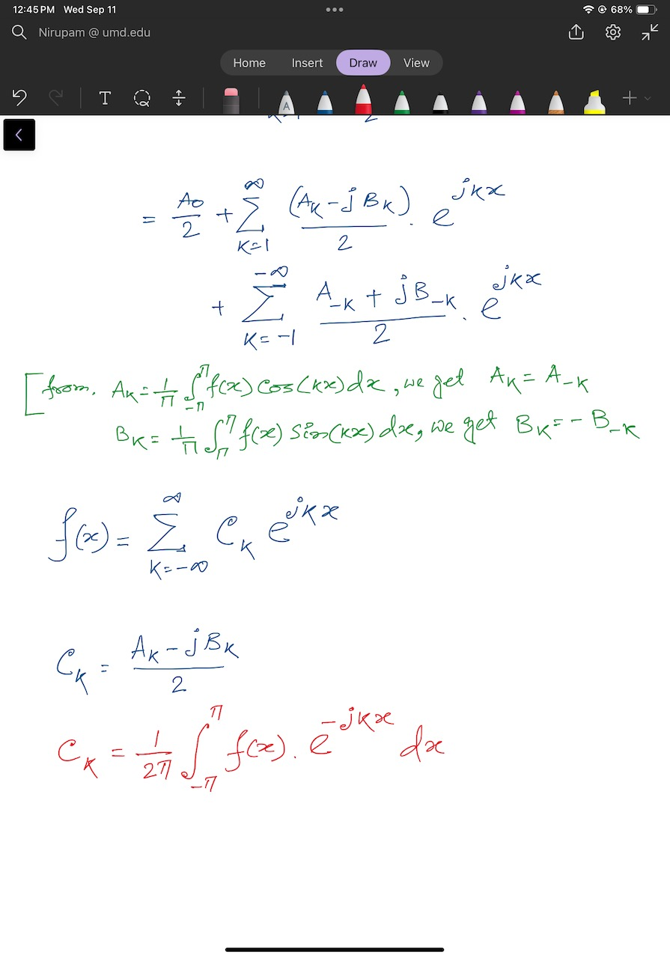

Slide 41
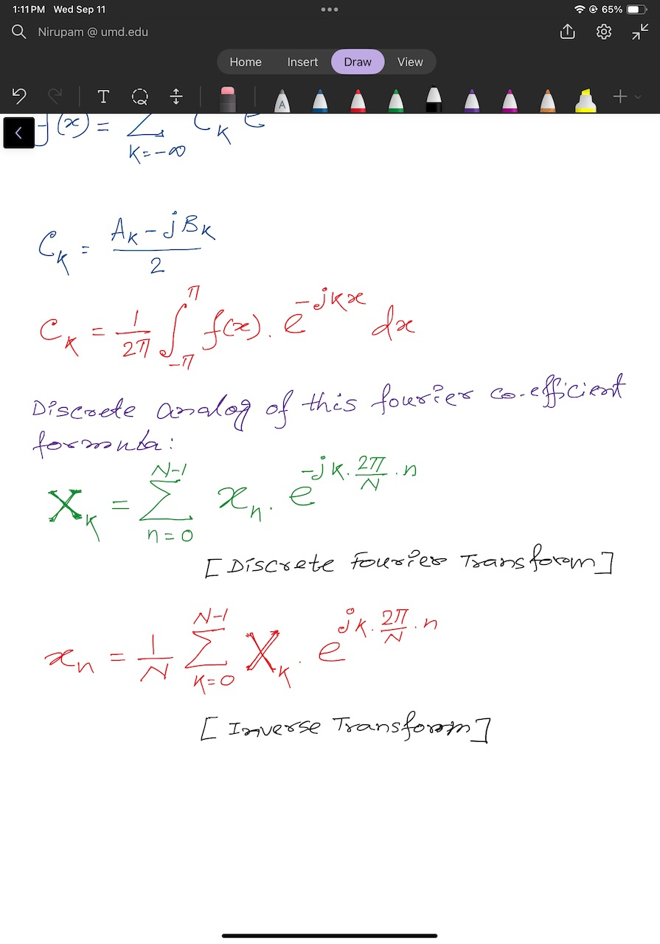
Discrete Fourier Transform formula
Discrete version:

Slide 42
Discrete Fourier Transform formula
Discrete version:

Slide 43
Time Domain and Frequency Domain
Fourier Transform
FFT
Amplitude
Amplitude
IFFT
0.00
0.25
0.50
0
2
4
6
8
Time
Frequency (Hz)
Time domain
Frequency domain
FFT = Fast Fourier Transform
IFFT = Inverse Fast Fourier Transform

Slide 44
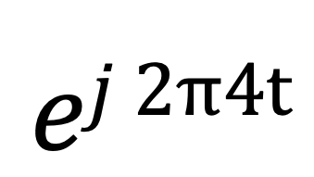
Time Domain and Frequency Domain
Fourier Transform
$$ej 2π4t$$
FFT
Amplitude
0
2
4
6
8
Frequency (Hz)
Time domain
Frequency domain
FFT = Fast Fourier Transform
IFFT = Inverse Fast Fourier Transform

Slide 45

Time Domain and Frequency Domain
Fourier Transform
FFT
?
$$\cos\left(2π4t\right)$$
Amplitude
0
2
4
6
8
Frequency (Hz)
Time domain
Frequency domain
FFT = Fast Fourier Transform
IFFT = Inverse Fast Fourier Transform

Slide 46




Time Domain and Frequency Domain
Fourier Transform
FFT
?
$$\cos\left(2π4t\right)$$
Amplitude
$$ej 2π4t$$
$$+$$
$$e_j 2π4t$$
$$=$$
2
0
2
4
6
8
Frequency (Hz)
Time domain
Frequency domain
FFT = Fast Fourier Transform
IFFT = Inverse Fast Fourier Transform

Slide 47
Time Domain and Frequency Domain
Fourier Transform
FFT
$$\cos\left(2π4t\right)$$
Amplitude
$$ej 2π4t$$
$$+$$
$$e_j 2π4t$$
$$=$$
2
-6
-4
-2
0
2
4
6
8
Frequency (Hz)
Time domain
Frequency domain
FFT = Fast Fourier Transform
IFFT = Inverse Fast Fourier Transform

Slide 48

Time Domain and Frequency Domain
Fourier Transform
FFT
$$\cos\left(2π4t\right)$$
Amplitude
$$ej 2π4t$$
$$+$$
$$e_j 2π4t$$
$$=$$
2
-6
-4
-2
0
2
4
6
8
Frequency (Hz)
Time domain
Frequency domain
FFT = Fast Fourier Transform
IFFT = Inverse Fast Fourier Transform

Slide 49
Matlab demo
function fft_test()
freq = 200;
sampleRate = 1000;
time_ticks = 0:1/sampleRate:1;
realSignal = sin(2*pi*freq*time_ticks);
plot_fft(realSignal, sampleRate);
complexSignal = exp(j*2*pi*freq*time_ticks);
plot_fft(complexSignal, sampleRate);
end

Slide 50
Calculating
Discrete Fourier Transform (DFT)

Slide 51
Discrete Fourier Transform
…
0
1
2
3
4
5
6
N-1
Sample number
X = [ ]
x[0], x[1], x[2], x[3], x[4], … x[N-1]

Slide 52
Discrete Fourier Transform
…
0
1
2
3
4
5
6
N-1
Sample number
X = [ ]
x[0], x[1], x[2], x[3], x[4], … x[N-1]

Slide 53





Discrete Fourier Transform
…
0
1
2
3
4
5
6
N-1
Sample number
$$e^{j2.\frac{2π}{N}}$$
$$e^{j1.\frac{2π}{N}}$$
$$\frac{2π}{N}$$
$$e^{j0.\frac{2π}{N}}$$
$$e^{j(N−1).\frac{2π}{N}}$$

Slide 54



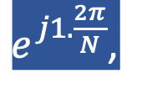
Discrete Fourier Transform
…
0
1
2
3
4
5
6
N-1
Sample number
= [ ]
Freq f₁
$$e^{j0.\frac{2π}{N}},$$
$e^{j1.\frac{2π}{N}}$,
$$e^{j2.\frac{2π}{N}},$$
…
$${,e}^{j(N−1).\frac{2π}{N}}$$
$$e^{j2.\frac{2π}{N}}$$
$$e^{j1.\frac{2π}{N}}$$
$$\frac{2π}{N}$$
$$e^{j0.\frac{2π}{N}}$$
$$e^{j(N−1).\frac{2π}{N}}$$

Slide 55

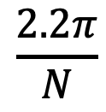


Discrete Fourier Transform
…
0
1
2
3
4
5
6
N-1
Sample number
$$e^{j1.\frac{2.2π}{N}}$$
$$\frac{2.2π}{N}$$
$$e^{j0.\frac{2.2π}{N}}$$
$$e^{j(N−1).\frac{2.2π}{N}}$$

Slide 56

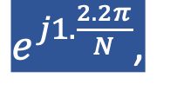


Discrete Fourier Transform
…
0
1
2
3
4
5
6
N-1
Sample number
= [ ]
Freq f₂
$$e^{j0.\frac{2.2π}{N}},$$
$e^{j1.\frac{2.2π}{N}}$,
$$e^{j2.\frac{2.2π}{N}},$$
…
$${,e}^{j(N−1).\frac{2.2π}{N}}$$
$$e^{j1.\frac{2.2π}{N}}$$
$$\frac{2.2π}{N}$$
$$e^{j0.\frac{2.2π}{N}}$$
$$e^{j(N−1).\frac{2.2π}{N}}$$

Slide 57
Discrete Fourier Transform
…
0
1
2
3
4
5
6
N-1
Sample number
What is the MINIMUM number of cycles
observable in this model?

Slide 58

Discrete Fourier Transform
…
0
1
2
3
4
5
6
N-1
Sample number
$$0$$

Slide 59



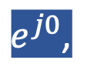
Discrete Fourier Transform
…
0
1
2
3
4
5
6
N-1
Sample number
= [ ]
Freq f₀
$$e^{j0},$$
$e^{j0}$,
$$e^{j0},$$
…
$${,e}^{j0}$$
$$0$$

Slide 60





Discrete Fourier Transform
…
0
1
2
3
4
5
6
N-1
Sample number
= [ ]
Freq f₀
$$e^{j0.\frac{2π}{N}},$$
$e^{j1.\frac{2π}{N}}$,
$$e^{j2.\frac{2π}{N}},$$
…
$${,e}^{j(N−1).\frac{2π}{N}}$$
$$e^{j2.\frac{2π}{N}}$$
$$e^{j1.\frac{2π}{N}}$$
$$\frac{2π}{N}$$
$$e^{j0.\frac{2π}{N}}$$
$$e^{j(N−1).\frac{2π}{N}}$$

Slide 61
Discrete Fourier Transform
…
0
1
2
3
4
5
6
N-1
Sample number
What is the MAXIMUM number of cycles
observable in this model?

Slide 62
Discrete Fourier Transform
…
0
1
2
3
4
5
6
N-1
Sample number
What happens when the ball rotates exactly N times?
$$0$$
We can uniquely observe up to (N-1) number of cycles.

Slide 63


Discrete Fourier Transform
Freq f₀
n=0
$$e^{j0}$$
n=1
$$e^{j0}$$
n=2
$$e^{j0}$$
…
…
n=N-1
$$e^{j0}$$

Slide 64
Discrete Fourier Transform
Number of cycles
…
…
Freq f₀
Freq f₁
Freq f_{m}
Freq f_{N-1}
n=0
$$e^{j0}$$
n=1
$$e^{j0}$$
Sample number
n=2
$$e^{j0}$$
…
…
n=N-1
$$e^{j0}$$

Slide 65












Discrete Fourier Transform
Number of cycles
…
…
Freq f₀
Freq f₁
Freq f_{m}
Freq f_{N-1}
n=0
$$e^{j0}$$
$$e^{j0.\frac{2π}{N}}$$
$$e^{j0.\frac{m.2π}{N}}$$
$$e^{j0.\frac{(N−1).2π}{N}}$$
n=1
$$e^{j0}$$
$$e^{j1.\frac{2π}{N}}$$
$$e^{j1.\frac{m.2π}{N}}$$
$$e^{j1.\frac{(N−1).2π}{N}}$$
Sample number
…
…
$$e^{j2.\frac{(N−1).2π}{N}}$$
$$e^{j2.\frac{2π}{N}}$$
$$e^{j2.\frac{m.2π}{N}}$$
n=2
$$e^{j0}$$
…
…
…
…
…
$$e^{j(N−1).\frac{2π}{N}}$$
$$e^{j(N−1).\frac{m.2π}{N}}$$
$$e^{j(N−1).\frac{(N−1).2π}{N}}$$
n=N-1
$$e^{j0}$$

Slide 66














Discrete Fourier Transform
$$e^{j0}$$
$$e^{j0.\frac{2π}{N}}$$
$$e^{j0.\frac{m.2π}{N}}$$
$$e^{j0.\frac{(N−1).2π}{N}}$$
$$e^{j0}$$
$$e^{j1.\frac{2π}{N}}$$
$$e^{j1.\frac{m.2π}{N}}$$
$$e^{j1.\frac{(N−1).2π}{N}}$$
+
$$e^{j2.\frac{2π}{N}}$$
+
$$e^{j2.\frac{m.2π}{N}}$$
+
$$e^{j2.\frac{(N−1).2π}{N}}$$
Z₀
$$e^{j0}$$
Z₁
…
Z_{m}
…
Z_{N-1}
…
…
…
…
$$e^{j(N−1).\frac{2π}{N}}$$
$$e^{j(N−1).\frac{m.2π}{N}}$$
$$e^{j(N−1).\frac{(N−1).2π}{N}}$$
$$e^{j0}$$

Slide 67














Discrete Fourier Transform
$$e^{j0}$$
$$e^{j0.\frac{2π}{N}}$$
$$e^{j0.\frac{m.2π}{N}}$$
$$e^{j0.\frac{(N−1).2π}{N}}$$
$$e^{j0}$$
$$e^{j1.\frac{2π}{N}}$$
$$e^{j1.\frac{m.2π}{N}}$$
$$e^{j1.\frac{(N−1).2π}{N}}$$
+
$$e^{j2.\frac{2π}{N}}$$
+
$$e^{j2.\frac{m.2π}{N}}$$
+
$$e^{j2.\frac{(N−1).2π}{N}}$$
Z₀
$$e^{j0}$$
Z₁
…
Z_{m}
…
Z_{N-1}
…
…
…
…
$$e^{j(N−1).\frac{2π}{N}}$$
$$e^{j(N−1).\frac{m.2π}{N}}$$
$$e^{j(N−1).\frac{(N−1).2π}{N}}$$
$$e^{j0}$$

Slide 68
Discrete Fourier Transform
$$e^{j0}$$
$$e^{j0.\frac{2π}{N}}$$
$$e^{j0.\frac{m.2π}{N}}$$
$$e^{j0.\frac{(N−1).2π}{N}}$$
$$e^{j0}$$
$$e^{j1.\frac{2π}{N}}$$
$$e^{j1.\frac{m.2π}{N}}$$
$$e^{j1.\frac{(N−1).2π}{N}}$$
+
$$e^{j2.\frac{2π}{N}}$$
+
$$e^{j2.\frac{m.2π}{N}}$$
+
$$e^{j2.\frac{(N−1).2π}{N}}$$
Z₀
$$e^{j0}$$
Z₁
…
Z_{m}
…
Z_{N-1}
…
…
…
…
$$e^{j(N−1).\frac{2π}{N}}$$
$$e^{j(N−1).\frac{m.2π}{N}}$$
$$e^{j(N−1).\frac{(N−1).2π}{N}}$$
$$e^{j0}$$
=
…
0
1
2
3
4
5
6
N-1
Sample number

Slide 69
Discrete Fourier Transform
Frequency domain coefficients
$$e^{j0}$$
$$e^{j0.\frac{2π}{N}}$$
$$e^{j0.\frac{m.2π}{N}}$$
$$e^{j0.\frac{(N−1).2π}{N}}$$
$$e^{j0}$$
$$e^{j1.\frac{2π}{N}}$$
$$e^{j1.\frac{m.2π}{N}}$$
$$e^{j1.\frac{(N−1).2π}{N}}$$
+
$$e^{j2.\frac{2π}{N}}$$
+
$$e^{j2.\frac{m.2π}{N}}$$
+
$$e^{j2.\frac{(N−1).2π}{N}}$$
Z₀
$$e^{j0}$$
Z₁
…
Z_{m}
…
Z_{N-1}
…
…
…
…
$$e^{j(N−1).\frac{2π}{N}}$$
$$e^{j(N−1).\frac{m.2π}{N}}$$
$$e^{j(N−1).\frac{(N−1).2π}{N}}$$
$$e^{j0}$$
x[0]
x[1]
=
X =
x[2]
Time domain samples
…
x[N-1]

Slide 70
Discrete Fourier Transform
_{F}
…
DFT matrix,
=
f₀
f₁
…
f_{m}
f_{N-1}

Slide 71
Discrete Fourier Transform
_{F}
…
DFT matrix,
=
f₀
f₁
…
f_{m}
f_{N-1}
_{Z}
Z₀
Fourier coefficients,
=
Z₁
…
Z_{m}
…
Z_{N-1}

Slide 72
Discrete Fourier Transform
_{F}
…
DFT matrix,
=
f₀
f₁
…
f_{m}
f_{N-1}
_{Z}
Z₀
x[0]
X =
Fourier coefficients,
=
Z₁
Time series,
…
x[1]
Z_{m}
x[2]
…
…
Z_{N-1}
x[N-1]

Slide 73
Discrete Fourier Transform
_{X}
_{F}
_{Z}
=
_{X}
_{Z}
_{F}⁻¹
=
_{H}
_{X}
_{Z}
_{F}
=

Slide 74
Discrete Fourier Transform
_{X}
_{F}
_{Z}
=
_{X}
_{Z}
_{F}⁻¹
=
_{H}
_{X}
_{Z}
_{F}
=
*
f₀
*
f₁
…
*
f_{m}
…
*
f_{N-1}

Slide 75
Discrete Fourier Transform
_{X}
_{F}
_{Z}
=
IDFT
_{X}
_{Z}
_{F}⁻¹
=
DFT
_{H}
_{X}
_{Z}
_{F}
=
*
f₀
x[0]
Z₀
*
Z₁
f₁
x[1]
…
=
…
*
x[2]
Z_{m}
f_{m}
…
…
…
Z_{N-1}
*
x[N-1]
f_{N-1}

Slide 76
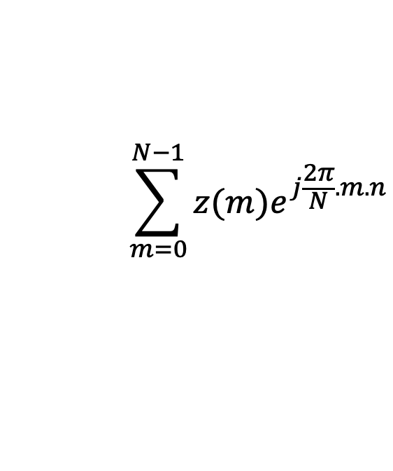
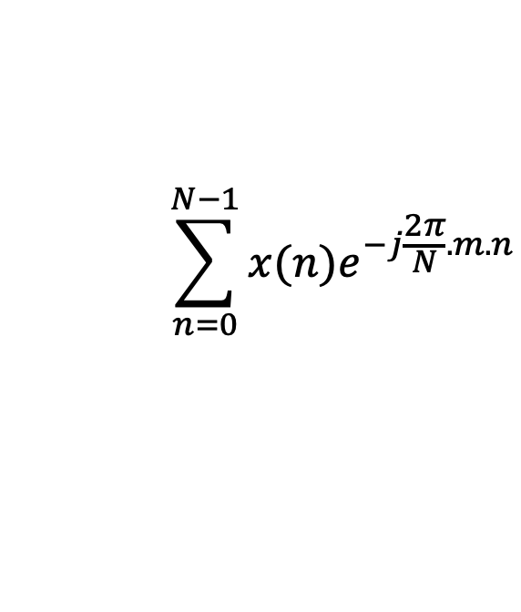
Discrete Fourier Transform
$$\sum_{n=0}^{N−1}{x(n)e^{−j\frac{2π}{N}.m.n}}$$
DFT:
z(m) =
$$\sum_{m=0}^{N−1}{z(m)e^{j\frac{2π}{N}.m.n}}$$
IDFT:
x(n) =

Slide 77
Preserving energy in time and frequency domain

Slide 78
Preserving energy in time and frequency domain
Is IDFT( DFT(x) ) = x ?

Slide 79

Preserving energy in time and frequency domain
Is IDFT( DFT(x) ) = x ?
*
_{X ?}
_{X}
_{F F}
=
*
_{N.X}
_{X}
_{F F}
=
_{F}
$$\frac{1}{\sqrt{N}}$$
…
DFT matrix,
=
f₀
f₁
…
f_{m}
f_{N-1}

Slide 80




Discrete Fourier Transform
$$\sum_{n=0}^{N−1}{x(n)e^{−j\frac{2π}{N}.m.n}}$$
z(m) =
$$\frac{1}{\sqrt{N}}$$
DFT:
$$\sum_{m=0}^{N−1}{z(m)e^{j\frac{2π}{N}.m.n}}$$
x(n) =
$$\frac{1}{\sqrt{N}}$$
IDFT:

Slide 81
Plotting
DFT spectrum

Slide 82
Plotting the DFT spectrum
Magnitude
|z_{m}|
m = 0
1
2
3
4
…
Frequency
N-2
N-1

Slide 83
Plotting the DFT spectrum
Magnitude
|z_{m}|
m = 0
1
2
3
4
…
Frequency
N-2
N-1
Phase
⦨ z_{m}
m = 0
1
2
3
4
…
Frequency
N-2
N-1

Slide 84






The Curious Case of “Negative frequency”
$$\frac{(N−1)2π}{N}=2π−\frac{2π}{N}$$
$$\frac{2π}{N}$$
$$\frac{2π}{N}$$
$$\frac{(N−1)2π}{N}=2π−\frac{2π}{N}$$
Positive rotation with $\frac{2π}{N}$ radian angle per step
Negative rotation with $\frac{2π}{N}$ radian angle per step

Slide 85
The Curious Case of “Negative frequency”
m = 0
1
2
3
4
…
Frequency
N-2
N-1
+
+
+
-
-
-

Slide 86
The Curious Case of “Negative frequency”
-4
-3
-2
-1
m = 0
1
2
3
4
Frequency

Slide 87
The Curious Case of “Negative frequency”
Magnitude
|z_{m}|
-4
-3
-2
-1
m = 0
1
2
3
4
Frequency
Real signal’s magnitude spectrum is symmetric.
Why?

Slide 88
The Curious Case of “Negative frequency”
Magnitude
|z_{m}|
-4
-3
-2
-1
m = 0
1
2
3
4
Frequency
Complex signal’s magnitude spectrum may or may not be symmetric.
Why?

Slide 89

Estimating the real-world frequencies
Sampling frequency = f_{s} (i.e., f_{s} samples per second)
Slowest frequency ($\frac{2π}{N}$ radians per step) = N samples per rotation
= (N/ f_{s}) seconds per rotation
Therefore, the slowest frequency = (f_{s} /N) Hz
Higher frequencies are integer multiple of (f_{s} /N) Hz
0, $\frac{\text{f}\text{s}}{N}\text{, }\frac{\text{2}\text{f}\text{s}}{N}$ , $\frac{\text{3}\text{f}\text{s}}{N}$ , $\frac{\text{4}\text{f}\text{s}}{N}$, … , , $\frac{\text{(}\text{N}\text{−1)}\text{f}\text{s}}{N}$

Slide 90

The resolution and the highest frequency
Magnitude/Phase of z_{m}
-4
-3
-2
-1
m = 0
1
2
3
4
Frequency
Resolution
= minimum observable frequency difference =
$\frac{\text{f}\text{s}}{N}$
What if the actual frequency falls in between two frequency bins?

Slide 91



Estimating the real-world frequencies
Sampling frequency = f_{s} (i.e., f_{s} samples per second)
Slowest frequency ($\frac{2π}{N}$ radians per step) = N samples per rotation
= (N/ f_{s}) seconds per rotation
Therefore, the slowest frequency = (f_{s} /N) Hz
Higher frequencies are integer multiple of (f_{s} /N) Hz
0, $\frac{\text{f}\text{s}}{N}\text{, }\frac{\text{2}\text{f}\text{s}}{N}$ , $\frac{\text{3}\text{f}\text{s}}{N}$ , $\frac{\text{4}\text{f}\text{s}}{N}$, … , , $\frac{\text{(}\text{N}\text{/2)}\text{f}\text{s}}{N}$
$$\frac{\text{f}\text{s}}{2}$$
- $\frac{\text{f}\text{s}}{N}\text{, }\text{−}\frac{\text{2}\text{f}\text{s}}{N}$ , - $\frac{\text{3}\text{f}\text{s}}{N}$ , - $\frac{\text{4}\text{f}\text{s}}{N}$, … , , - $\frac{\text{(}\text{N}\text{/2)}\text{f}\text{s}}{N}$

Slide 92
The resolution and the highest frequency
Magnitude/Phase of z_{m}
-4
-3
-2
-1
m = 0
1
2
3
4
Frequency
Resolution
= minimum observable frequency difference =
$\frac{\text{f}\text{s}}{N}$
What if the actual frequency falls in between two frequency bins?

Slide 93


The resolution and the highest frequency
Magnitude/Phase of z_{m}
-4
-3
-2
-1
m = 0
1
2
3
4
Frequency
$−\frac{\text{f}\text{s}}{2}$
$\frac{\text{f}\text{s}}{2}$
Highest frequency =

Slide 94




The resolution and the highest frequency
How can we increase the resolution?
$$\frac{\text{f}\text{s}}{N}$$
= $\frac{\text{sample} \text{rate}}{\# of FFT points}$
How can we increase the range of the spectrum?
$[−\frac{\text{f}\text{s}}{2}$
, $\frac{\text{f}\text{s}}{2} ]$

Slide 95
Time resolution v/s Frequency resolution

Slide 96



Time resolution v/s Frequency resolution
U
M
D
[
[
DFT
DFT
$$\frac{\text{f}\text{s}}{N}$$
= $\frac{\text{sample} \text{rate}}{\# of FFT points}$
How can we increase the frequency resolution?
How can we increase the time resolution?

Slide 97
Aliasing

Slide 98
Sampling theorem
Amplitude
Time (sec)
0.00
0.25
0.50
0.75
1.00
1.25
Amplitude
Time (sec)
0.00
0.25
0.50
0.75
1.00
1.25
Aliasing: Two signals become indistinguishable after sampling

Slide 99
Time domain samples
Amplitude
Time (sec)
0.00
0.25
0.50
0.75
1.00
1.25
FFT
Amplitude
-6
-4
-2
0
2
4
6
8
Frequency (Hz)
Frequency domain

Slide 100

Aliasing: Different frequencies, same name!!
Magnitude/Phase of z_{m}
-4
-3
-2
-1
m = 0
1
2
3
4
Frequency
Assume, Sample rate $\text{f}\text{s}$ = 8 Hz
For a COMPLEX signal, what value will we see if the actual frequency is:
a) 3 Hz
b) -2 Hz
c) 6 Hz
d) -5 Hz
e) 4 Hz and -4Hz

Slide 101
Magnitude/Phase of z_{m}
-4
-3
-2
-1
m = 0
1
2
3
4
Frequency
5
6
7
8

Slide 102
Magnitude/Phase of z_{m}
-4
-3
-2
-1
m = 0
1
2
3
4
Frequency
5
6
7
8

Slide 103
Magnitude/Phase of z_{m}
-4
-3
-2
-1
m = 0
1
2
3
4
Frequency
0
- F_{s}/4
F_{s}/4
F_{s}/2

Slide 104
Magnitude/Phase of z_{m}
-4
-3
-2
-1
m = 0
1
2
3
4
Frequency
0
-1
1
- 2
2
-3
3
4
-4

Slide 105
Aliasing: Different frequencies, same name!!
Magnitude/Phase of z_{m}
-4
-3
-2
-1
m = 0
1
2
3
4
Frequency
Assume, Sample rate $\text{f}\text{s}$ = 8 Hz
For a COMPLEX signal, what value will we see if the actual frequency is:
a) 3 Hz
b) -2 Hz
c) 6 Hz
d) -5 Hz
e) 4 Hz and -4Hz

Slide 106
Aliasing: Different frequencies, same name!!
Magnitude/Phase of z_{m}
-4
-3
-2
-1
m = 0
1
2
3
4
Frequency
Assume, Sample rate $\text{f}\text{s}$ = 8 Hz
For a REAL signal, what value will we see if the actual frequency is:
a) 3 Hz
b) -2 Hz
c) 6 Hz
d) -5 Hz
e) 4 Hz and -4Hz

Slide 107

Aliasing: Spectrogram of increasing frequency

Slide 108


Calculating the aliased frequency value for real signals
Sampling frequency = 10Hz
Nyquist frequency = 5Hz
Amplitude
0
2
4
6
8
Frequency (Hz)

Slide 109

Calculating the aliased frequency value for real signals
Sampling frequency = 10Hz
Nyquist frequency = 5Hz
Amplitude
Received
signal
Amplitude
0
2
4
6
8
0
2
4
6
8
Frequency (Hz)
Frequency (Hz)

Slide 110
Calculating the aliased frequency value for real signals
Sampling frequency = 10Hz
Nyquist frequency = 5Hz
Amplitude
Received
signal
Amplitude
0
2
4
6
8
0
2
4
6
8
Frequency (Hz)
Frequency (Hz)
f_{s} = Sampling frequency
f = Target frequency
f_{a} = Aliased(perceived) frequency
K = Non-negative integer
f_{a} = min(abs(K*f_{s} - f))

Slide 111
Aliasing: A real life scenario
Nyquist frequency
Amplitude
10k
20k
30k
40k
50k
60k
70k
80k
90k
100k
Frequency spectrum
Notes:
to amplify the signal power …
Now, this signal typically contains many more frequencies than the sampling system can handle …

Slide 112
Aliasing: A real life scenario
Nyquist frequency
Amplitude
10k
20k
30k
40k
50k
60k
70k
80k
90k
100k
Frequency spectrum
Notes:
to amplify the signal power …
Now, this signal typically contains many more frequencies than the sampling system can handle …

Slide 113
Aliasing: A real life scenario
Nyquist frequency
Amplitude
10k
20k
30k
40k
50k
60k
70k
80k
90k
100k
Frequency spectrum
We need a “Low-pass filter”
to remove unwanted high frequency signals
Notes:
to amplify the signal power …
Now, this signal typically contains many more frequencies than the sampling system can handle …

Slide 114
Anti-aliasing filter
Nyquist frequency
Amplitude
10k
20k
30k
40k
50k
60k
70k
80k
90k
100k
Frequency spectrum
Sensor
ADC
Anti-aliasing
Filter
Notes:
to amplify the signal power …
Now, this signal typically contains many more frequencies than the sampling system can handle …

Slide 115
Anti-aliasing filter
Nyquist frequency
Amplitude
10k
20k
30k
40k
50k
60k
70k
80k
90k
100k
Frequency spectrum
Sensor
ADC
Anti-aliasing
Filter
Notes:
Hence, a low pass filter…

Slide 116
Anti-aliasing filter
Anti-aliasing
filter
Amplitude
10k
20k
30k
40k
50k
60k
70k
80k
90k
100k
Frequency spectrum
Sensor
ADC
Anti-aliasing
Filter
Notes:
removes the unwanted frequencies above 24 kHz …
And ultimately, this filtered signal is sampled by an ADC to generate digital sound samples

