Slide 1

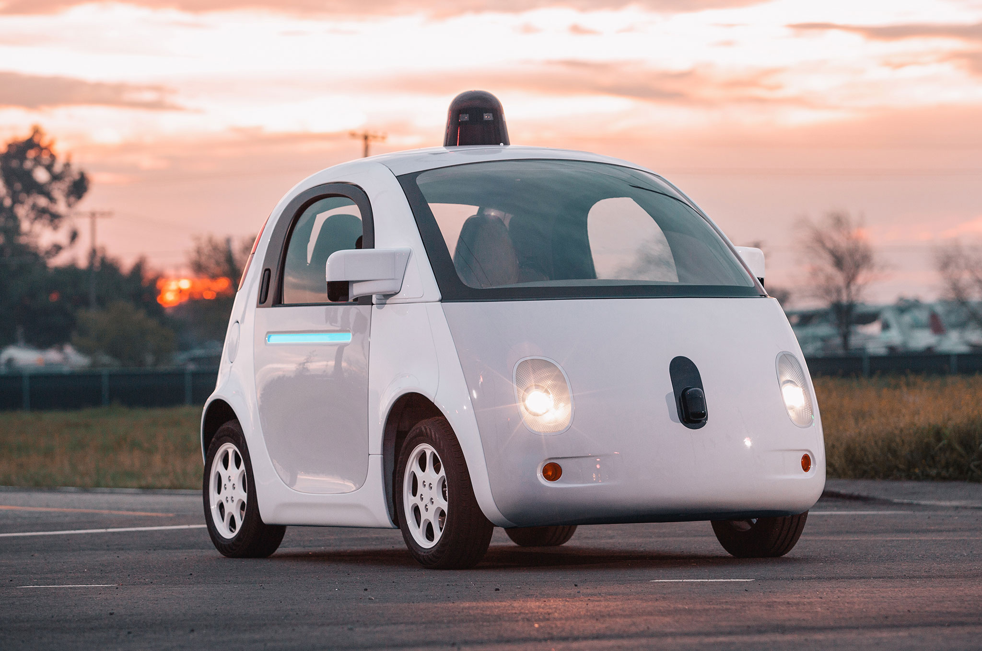
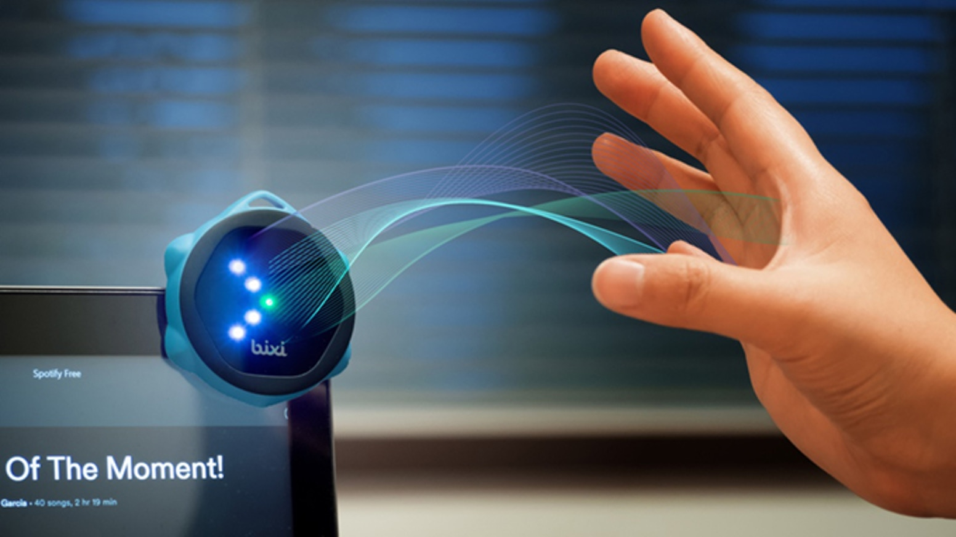
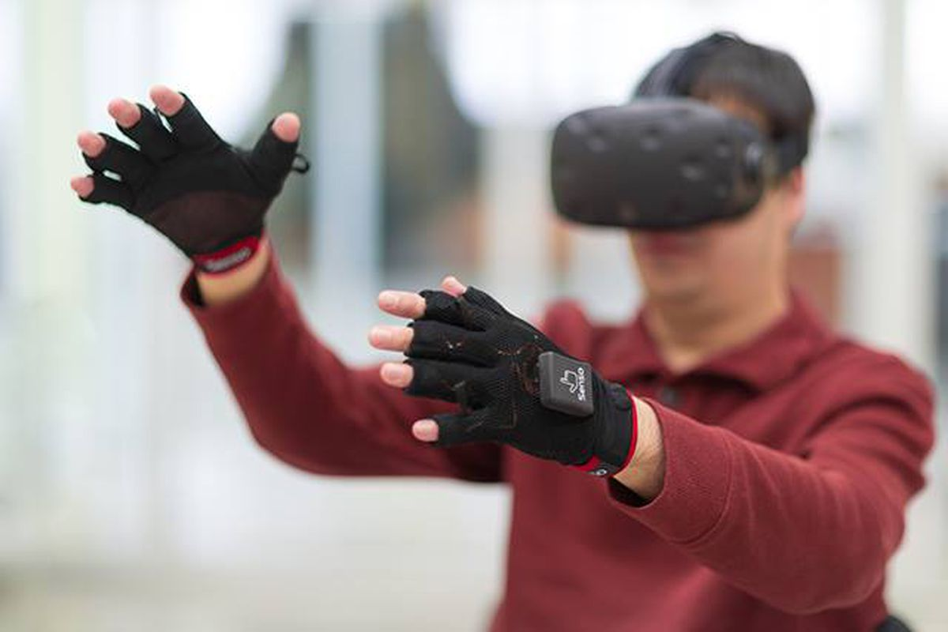

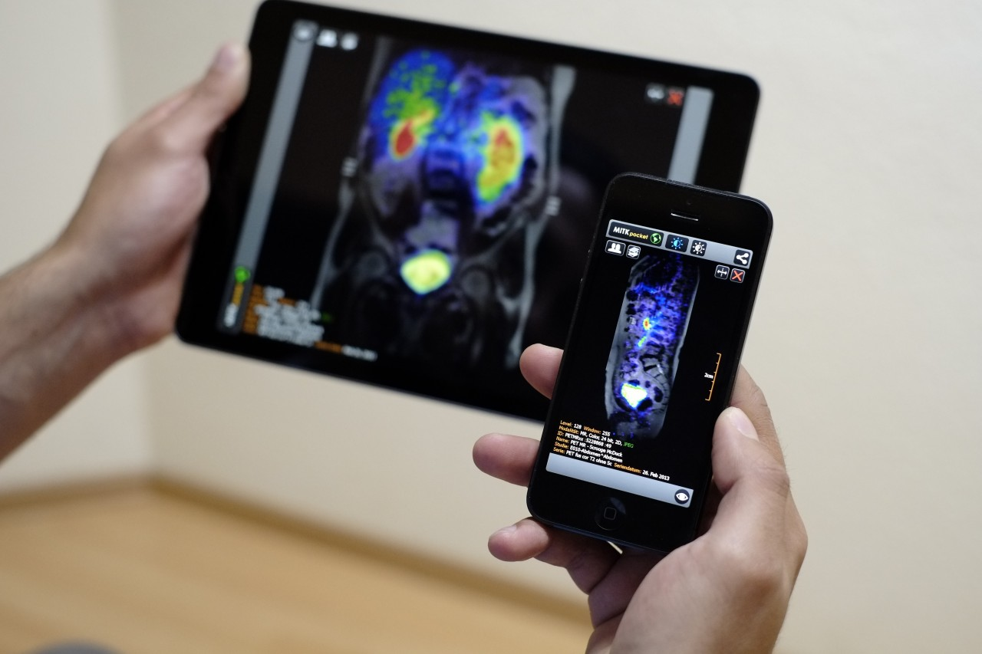
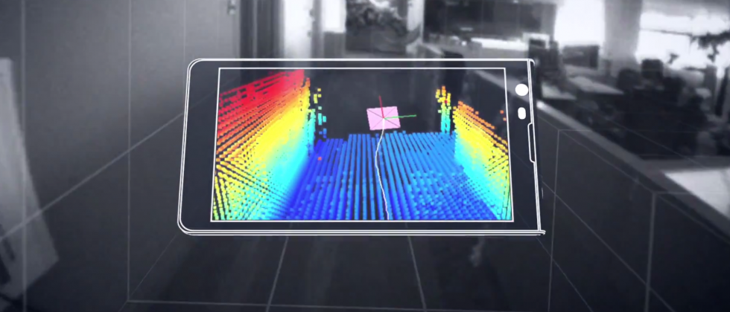
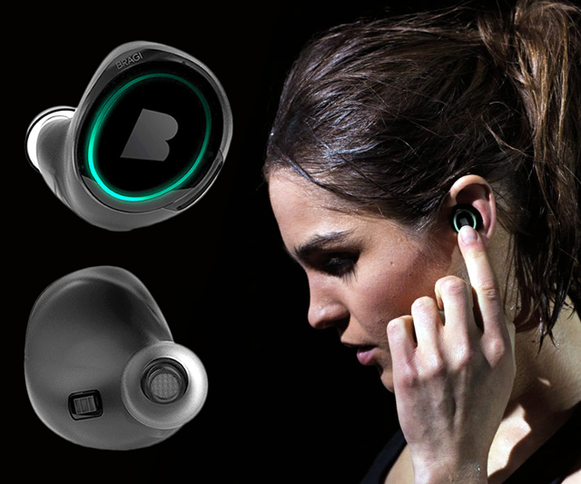
Wireless and Mobile Systems
for the IoT
CMSC 715 : Fall 2023
Lecture 2.5: Direction of arrival (Cont…)
Nirupam Roy
Tu-Th 12:30-1:45pm
IRB 2107

Slide 2
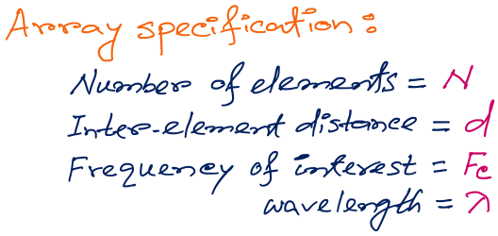
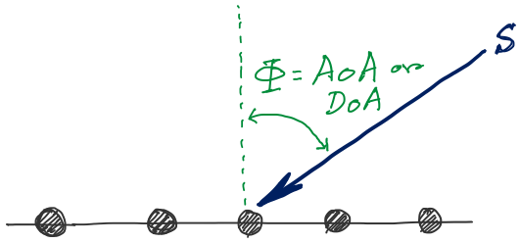
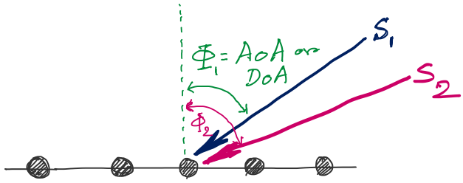
DoA Estimation
d
d
d
d
Notes:
http://www.waves.utoronto.ca/prof/svhum/ece422/notes/15-arrays2.pdf

Slide 3
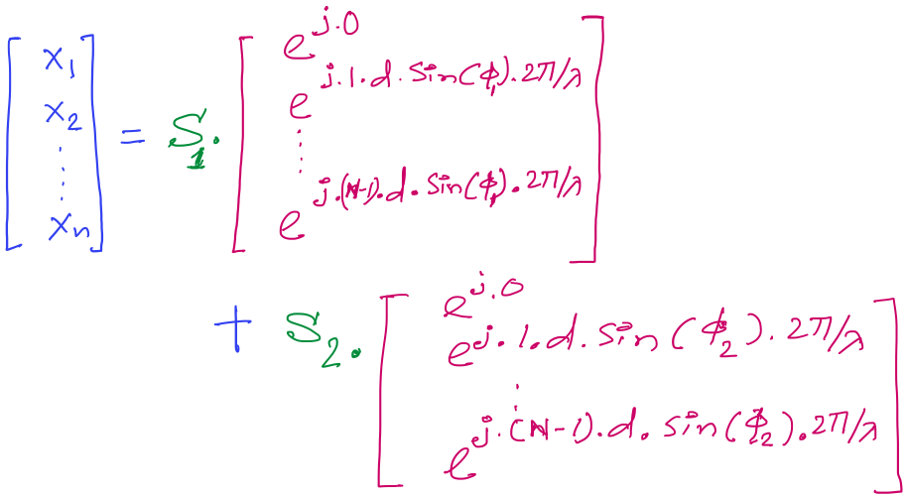
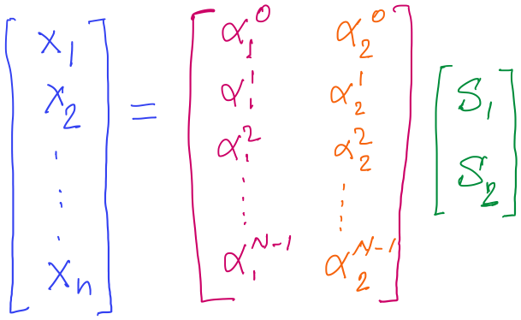
DoA Estimation

Slide 4
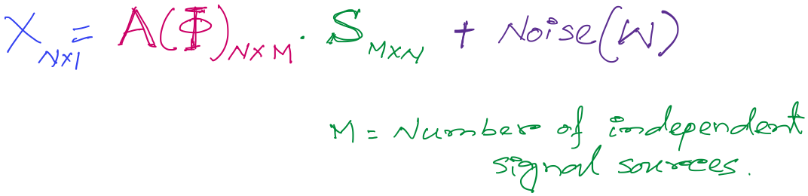
DoA Estimation
Mx1
Steering matrix

Slide 5
A different approach to DoA estimation

Slide 6
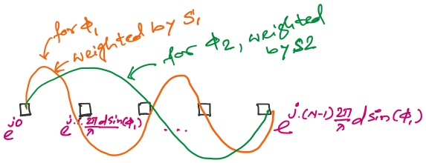
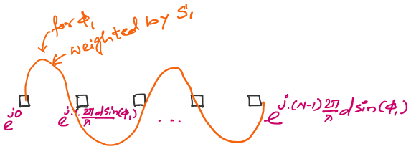
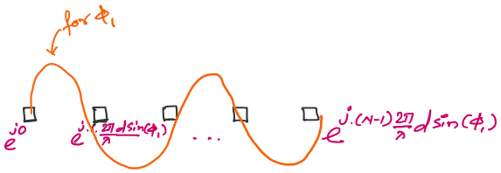

An observation on the spatial samples

Slide 7
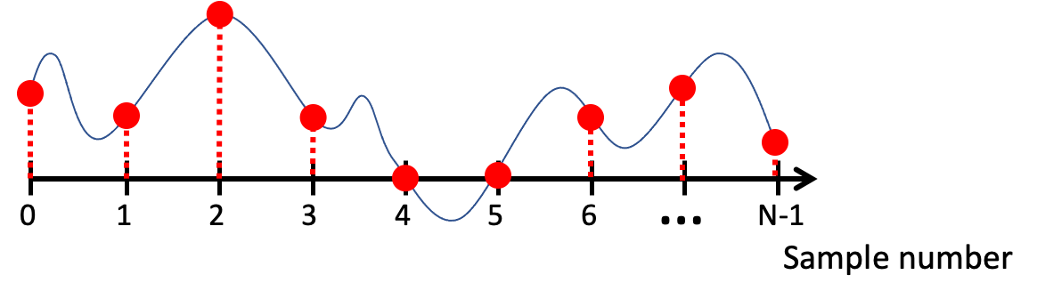
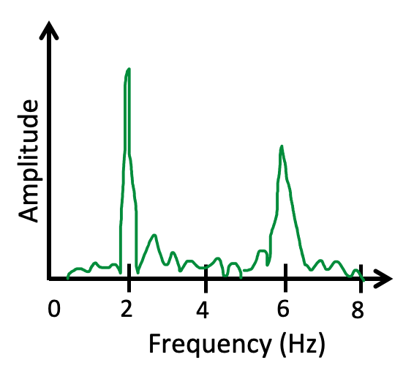
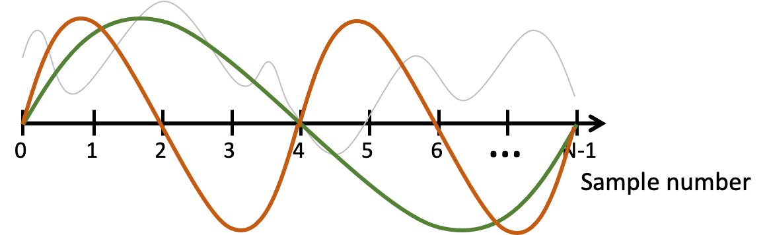
FFT
Arbitrary signals can be represented as a combination of sinusoids

Slide 8
FFT
Arbitrary signals can be represented as a combination of sinusoids
Agnostic of the type of signal or sampling details

Slide 9
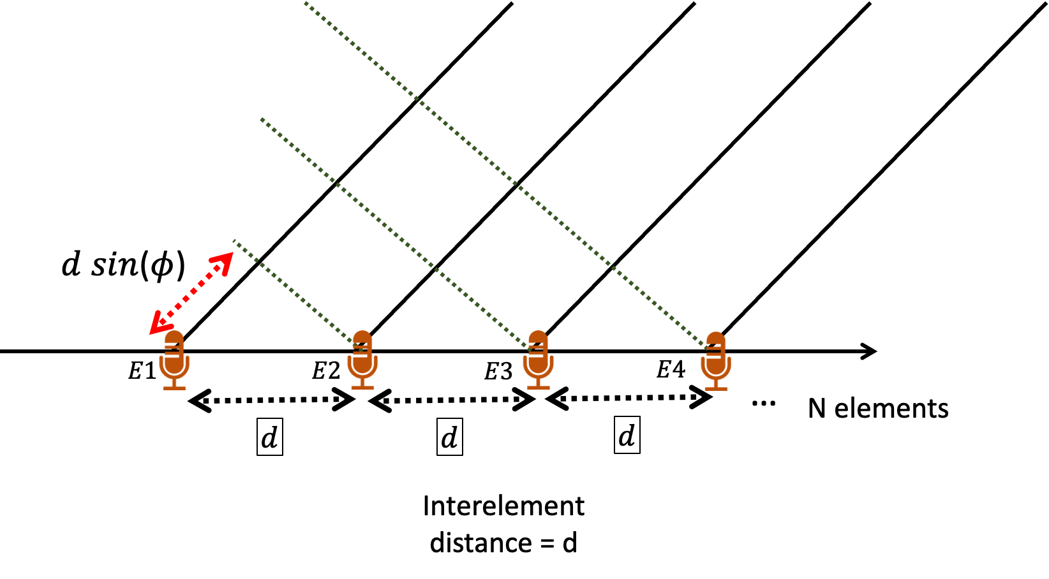
FFT
Arbitrary signals can be represented as a combination of sinusoids

Slide 10
FFT
Arbitrary signals can be represented as a combination of sinusoids

Slide 11
DoA Estimation : Classical FFT approach

Slide 12
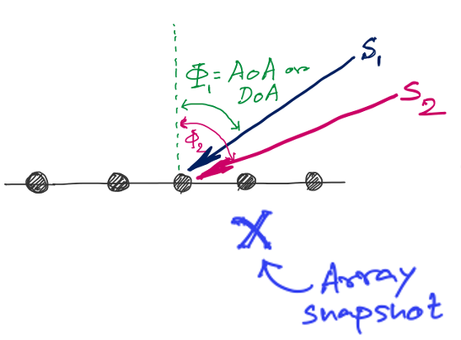
DoA Estimation : Classical FFT approach
FFT
Amplitude
0
4
8
12
16
Frequency (Hz) ??

Slide 13
Discrete Fourier Transform
…
0
1
2
3
4
5
6
N-1
Sample number
X = [ ]
x[0], x[1], x[2], x[3], x[4], … x[N-1]

Slide 14
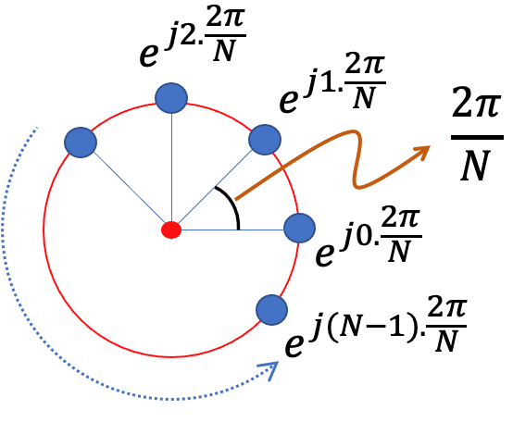
Discrete Fourier Transform
…
0
1
2
3
4
5
6
N-1
Sample number
Slowest frequency goes $\frac{2π}{N}$ radians per step.

Slide 15
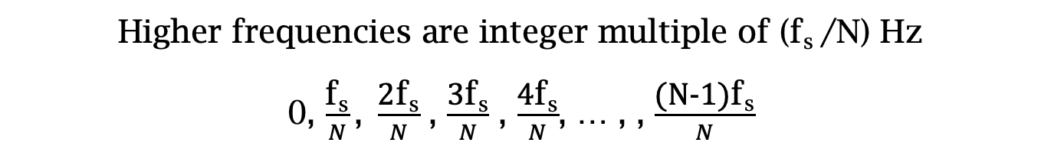
Estimating the real-world frequencies
Sampling frequency = f_{s} (i.e., f_{s} samples per second)
Slowest frequency ($\frac{2π}{N}$ radians per step) = N samples per rotation
= (N/ f_{s}) seconds per rotation
Therefore, the slowest frequency = (f_{s} /N) Hz
Higher frequencies are integer multiple of (f_{s} /N) Hz
0, $\frac{\text{f}\text{s}}{N}\text{, }\frac{\text{2}\text{f}\text{s}}{N}$ , $\frac{\text{3}\text{f}\text{s}}{N}$ , $\frac{\text{4}\text{f}\text{s}}{N}$, … , , $\frac{\text{(}\text{N}\text{−1)}\text{f}\text{s}}{N}$

Slide 16
Discrete Fourier Transform
…
0
1
2
3
4
5
6
N-1
Sample number
Slowest frequency goes $\frac{2π}{N}$ radians per step.

Slide 17
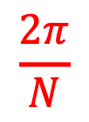
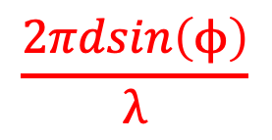

Discrete Fourier Transform
…
0
1
2
3
4
5
6
N-1
Sample number
$$\frac{2π}{N}$$
$$\frac{2πdsin\left(ϕ\right)}{λ}$$
$$=$$

Slide 18
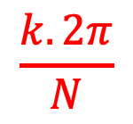
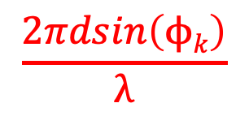

Discrete Fourier Transform
…
0
1
2
3
4
5
6
N-1
Sample number
$$\frac{k.2π}{N}$$
$$\frac{2πdsin\left(ϕk\right)}{λ}$$
$$=$$

Slide 19

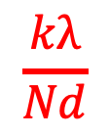
Discrete Fourier Transform
…
0
1
2
3
4
5
6
N-1
Sample number
$$\frac{kλ}{Nd}$$
$$ϕk$$
$$=$$
asin( )

Slide 20
DoA Estimation : Classical FFT approach
What is the minimum and maximum value of the inter-element distance (d)?
d
d
d
d

Slide 21
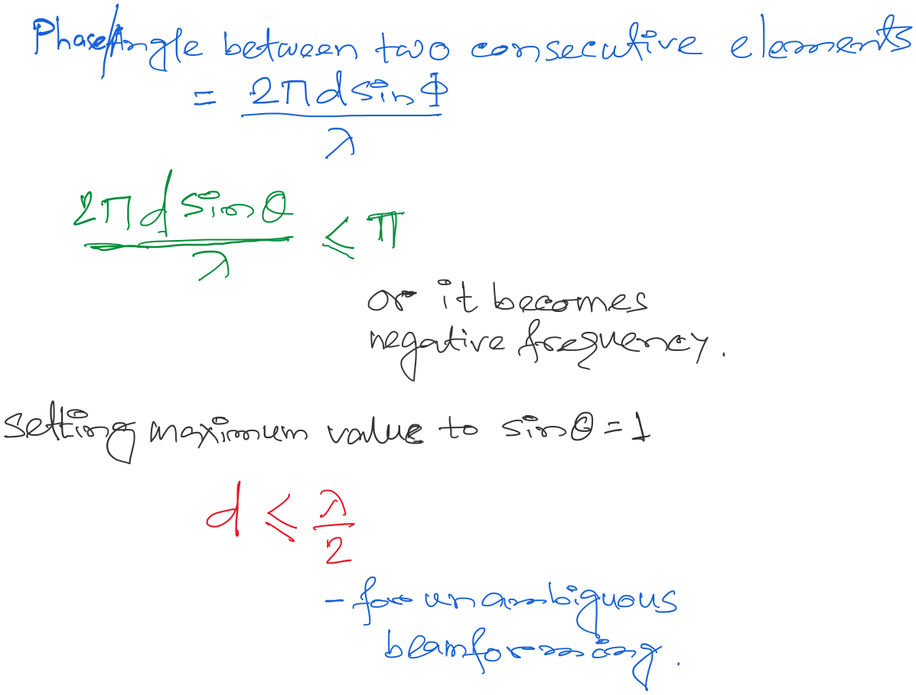
DoA Estimation : Classical FFT approach

Slide 22
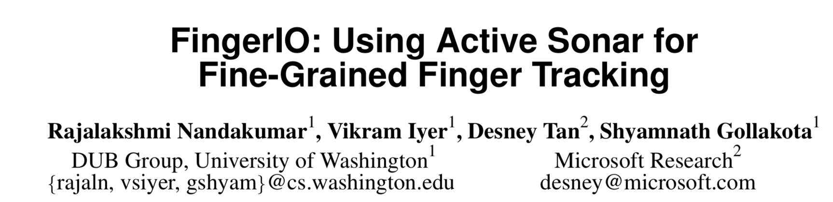

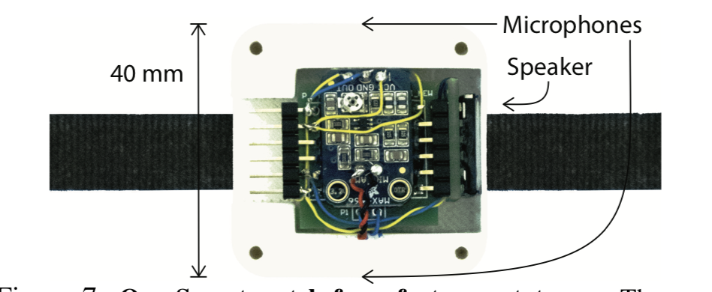
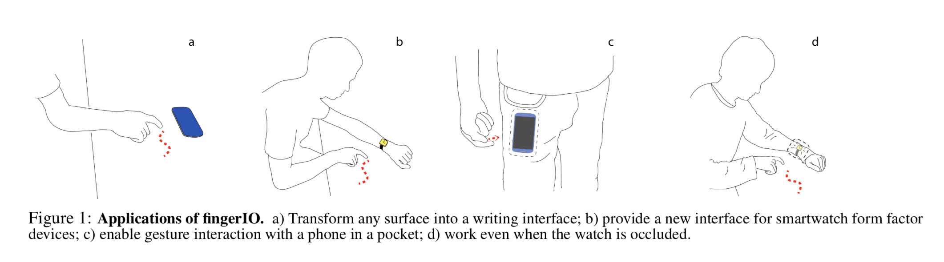

Slide 23
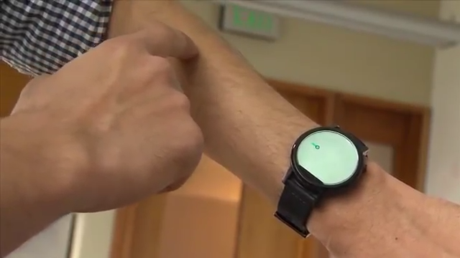

Slide 24
Announcements
Assignment-1 scores are out. Congratulations!
Papers for class presentations are released.
Prepare a list of choices and wait for the FCFS
slot selection on Friday 12noon.
3) Assignment-2 will be released today.

Slide 25
Extra slides
(not covered in lecture)

Slide 26
Hint for assignment-2: Signal detection
Amplitude
Time/Sample
Transmitter signal

Slide 27
Hint for assignment-2: Signal detection
Amplitude
Amplitude
Time/Sample
Time/Sample
Transmitter signal
Receiver signal

Slide 28
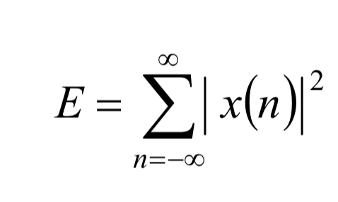
Hint for assignment-2: Signal detection
Amplitude
Amplitude
Time/Sample
Time/Sample
Transmitter signal
Receiver signal
Energy based signal detector
Energy of a discrete signal x(n),

Slide 29
Signal detection
Amplitude
Amplitude
Time/Sample
Time/Sample
Transmitter signal
Receiver signal

Slide 30
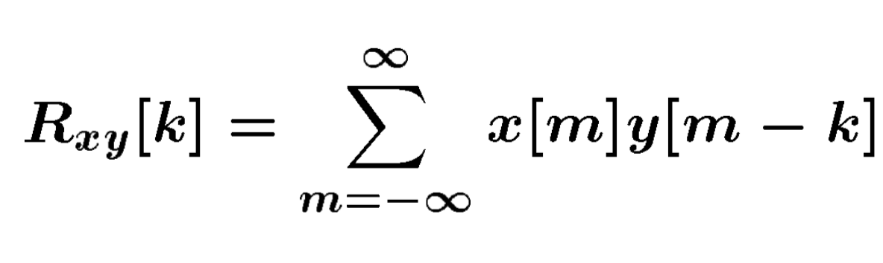
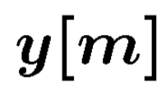
Signal detection
Received signal
Signal matching
Transmit signal template

Slide 31
Signal detection
Received signal
Signal matching
Transmit signal template
Correlation

Slide 32
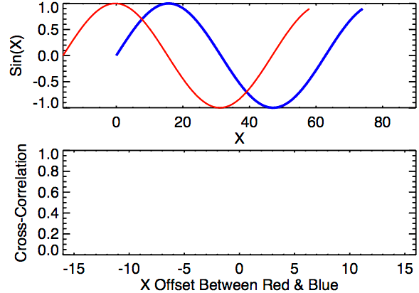
Signal detection
Correlation

Slide 33
Extra Slide for reference
(not presented in class)

Slide 34
Finding distance using waves

Slide 35
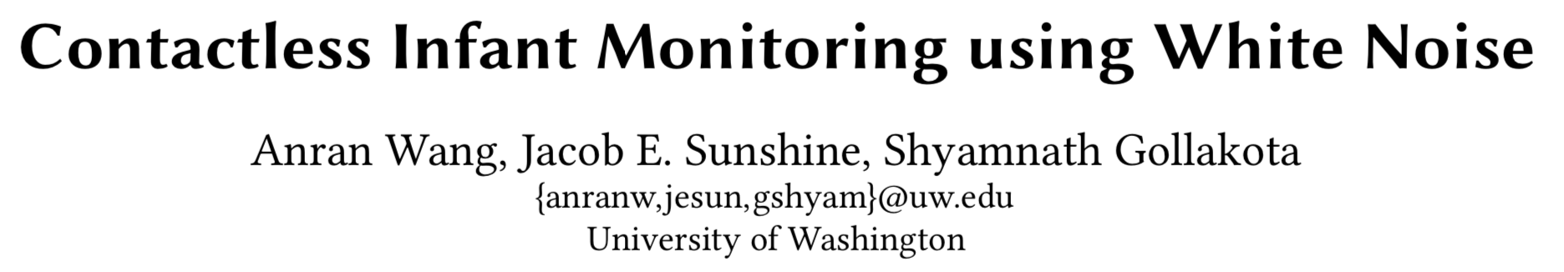
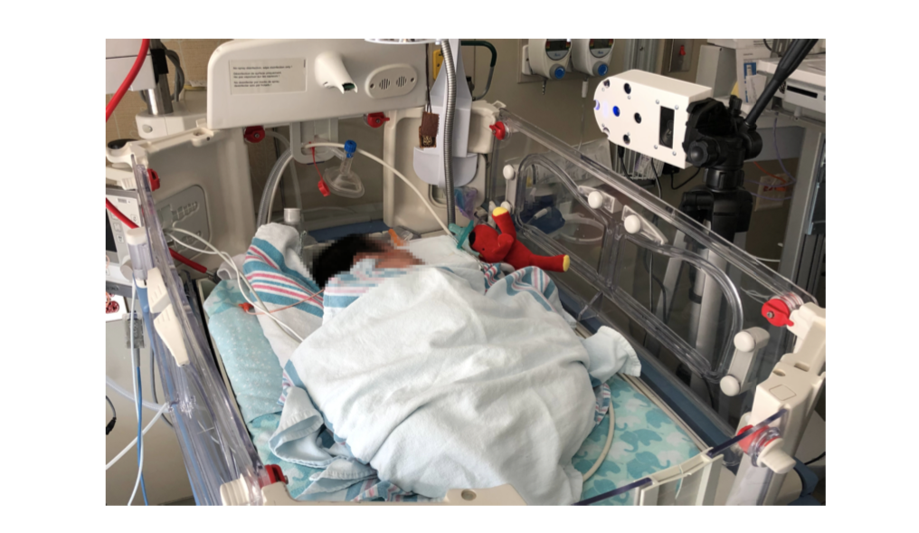

Slide 36
Finding distance using waves
(Ranging)

Slide 37
…
SONAR
(detection)
Depth/Image
Gesture

Slide 38
…
SONAR
(detection)
Depth/Image
Gesture
Finding distance using waves
(Ranging)

Slide 39
…
SONAR
(detection)
Depth/Image
Gesture
Finding distance using waves
(Ranging)
Speed
Amplitude
Frequency
Phase

Slide 40
1. Distance from the speed information
a. Techniques
b. Signal detection
2. Distance from the amplitude information
a. Absorption
b. Propagation loss
3. Distance from the frequency information
a. Doppler effect
b. A case study (Doppler + Triangulation)
4. Distance from the phase information
a. Overview
b. Impulse function, Impulse response, Convolution
c. A case study

Slide 41
1. Distance from the speed information
a. Techniques
b. Signal detection
2. Distance from the amplitude information
a. Absorption
b. Propagation loss
3. Distance from the frequency information
a. Doppler effect
b. A case study (Doppler + Triangulation)
4. Distance from the phase information
a. Overview
b. Impulse function, Impulse response, Convolution
c. A case study

Slide 42
Distance from the speed information
Dist. = (speed) X (time of travel)
Time of Arrival (ToA)
Signal source
observer

Slide 43
Distance from the speed information
Dist. = (speed) X (time of travel)
Time of Arrival (ToA)
Signal source
observer
Signal source
Time Difference of Arrival (TDoA)
observer 1
observer2

Slide 44
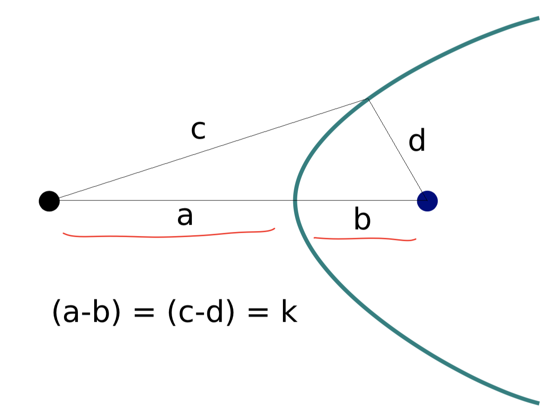
TDoA
a
b
Find the location of the wave source when (a-b) is known.

Slide 45
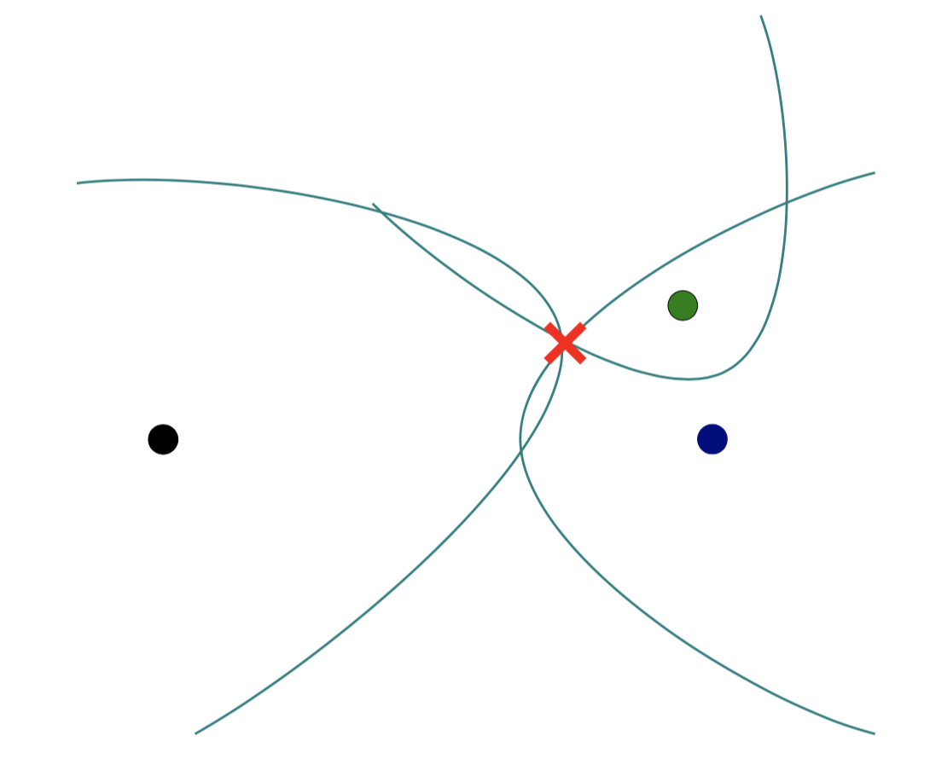
TDoA

Slide 46
Distance from the speed information
Dist. = (speed) X (time of travel)
Time of Arrival (ToA)
Signal source
observer
Signal source
Time Difference of Arrival (TDoA)
observer 1
observer2
Round-trip Time of Flight (RToF)
Signal source
+ observer
Reflector

Slide 47
Distance from the speed information
Dist. = (speed) X (time of travel)
Time of Arrival (ToA)
Signal source
observer
How to detect the signal at the receiver/observer?
Signal source
Time Difference of Arrival (TDoA)
observer 1
observer2
Round-trip Time of Flight (RToF)
Signal source
+ observer
Reflector

Slide 48
Signal detection
Amplitude
Time/Sample
Transmitter signal

Slide 49
Signal detection
Amplitude
Amplitude
Time/Sample
Time/Sample
Transmitter signal
Receiver signal

Slide 50
Signal detection
Amplitude
Amplitude
Time/Sample
Time/Sample
Transmitter signal
Receiver signal
Energy based signal detector
Energy of a discrete signal x(n),

Slide 51
Signal detection
Amplitude
Amplitude
Time/Sample
Time/Sample
Transmitter signal
Receiver signal

Slide 52
Signal detection
Received signal
Signal matching
Transmit signal template

Slide 53
Signal detection
Received signal
Signal matching
Transmit signal template
Correlation

Slide 54
Signal detection
Correlation

Slide 55
Distance from the speed information
Dist. = (speed) X (time of travel)
Time of Arrival (ToA)
Signal source
observer
Time Difference of Arrival (TDoA)
Signal source
observer 1
observer2
Round-trip Time of Flight (RToF)
Signal source
+ observer
Reflector
Notes:
Slide 23: 20 minutes

Slide 56
1. Distance from the speed information
a. Techniques
b. Signal detection
2. Distance from the amplitude information
a. Absorption
b. Propagation loss
3. Distance from the frequency information
a. Doppler effect
b. A case study (Doppler + Triangulation)
4. Distance from the phase information
a. Overview
b. Impulse function, Impulse response, Convolution
c. A case study

Slide 57

Distance from the amplitude information
Amplitude
Time (sec)
$$AS . sin⁡(2πft)$$

Slide 58

Distance from the amplitude information
Dist. = d
Amplitude
Time (sec)
Amplitude
Time (sec)
$$AS . sin⁡(2πft)$$
$$AO . sin⁡(2πft)$$

Slide 59
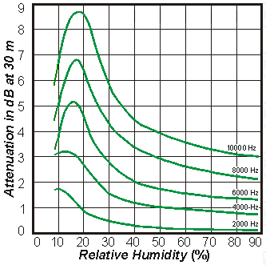
Distance from the amplitude information
Dist. = d
Amplitude
Time (sec)
Amplitude
Time (sec)
$$AS . sin⁡(2πft)$$
$$AO . sin⁡(2πft)$$
Attenuation due to atmospheric absorption and diffraction

Slide 60
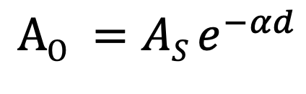
Distance from the amplitude information
Dist. = d
Amplitude
Time (sec)
Amplitude
Time (sec)
$$AS . sin⁡(2πft)$$
$$AO . sin⁡(2πft)$$
$$AO =AS e^{−αd}$$
α = attenuation coefficient
Depends on frequency and
environment ( temperature, humidity etc.)

Slide 61
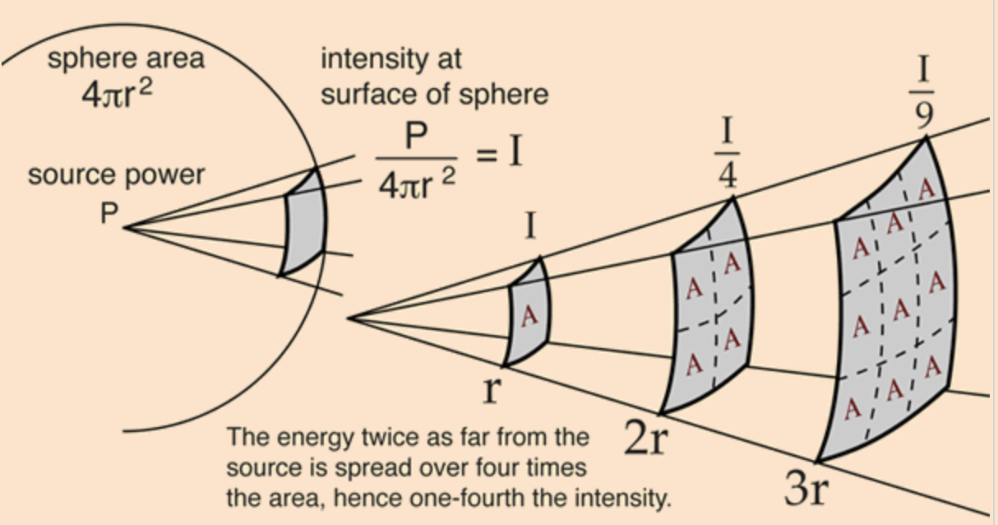
Distance from the amplitude information
Propagation loss

Slide 62
Distance from the amplitude information
Propagation loss
Notes:
Slide 30: 25 minutes

Slide 63
1. Distance from the speed information
a. Techniques
b. Signal detection
2. Distance from the amplitude information
a. Absorption
b. Propagation loss
3. Distance from the frequency information
a. Doppler effect
b. A case study (Doppler + Triangulation)
4. Distance from the phase information
a. Overview
b. Impulse function, Impulse response, Convolution
c. A case study

Slide 64
Distance from the frequency information
Motion of the sound source and/or the observer changes the frequency of the observed signal.
The change depends on the velocity of the source/observer.
This phenomena is known as Doppler effect or Doppler shift.

Slide 65
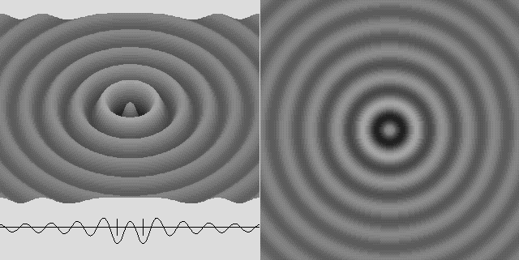
Doppler effect

Slide 66

Doppler effect

Slide 67
Doppler effect

Slide 68
Doppler effect
Simple wave model: Stationary source

Slide 69
Doppler effect
Simple wave model: Stationary source
Time = t1

Slide 70
Doppler effect
Simple wave model: Stationary source
Time = t2

Slide 71
Doppler effect
Simple wave model: Stationary source
Time = t2

Slide 72
Doppler effect
Simple wave model: Stationary source
Time = t3

Slide 73
Doppler effect
Simple wave model: Stationary source
Time = t3

Slide 74
Doppler effect
Simple wave model: Stationary source
Wavelength = λ meters
Time = t3

Slide 75
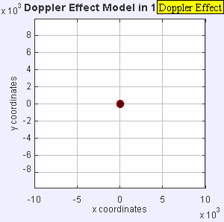
Doppler effect

Slide 76
Doppler effect
Simple wave model: Moving source

Slide 77
Doppler effect
Simple wave model: Moving source
Time = t1

Slide 78
Doppler effect
Simple wave model: Moving source
Time = t2

Slide 79
Doppler effect
Simple wave model: Moving source
Time = t2

Slide 80
Doppler effect
Simple wave model: Moving source
Time = t2

Slide 81
Doppler effect
Simple wave model: Moving source
Time = t3

Slide 82
Doppler effect
Simple wave model: Moving source
Time = t3

Slide 83
Doppler effect
Simple wave model: Moving source
Time = t3

Slide 84
Doppler effect
Simple wave model: Moving source
Actual wavelength = λ meters
Wavelength = λ₂ meters
Wavelength = λ₁ meters
Time = t3
Notes:
Slide 19: 2 minutes 30 seconds

Slide 85
Doppler effect
Simple wave model: Moving source
Actual wavelength = λ meters
Observer
Wavelength = λ₂ meters
Wavelength = λ₁ meters
Time = t3
Notes:
Slide 19: 2 minutes 30 seconds

Slide 86
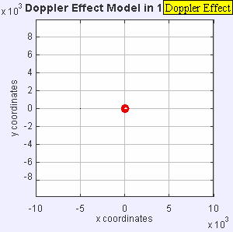
Doppler effect

Slide 87
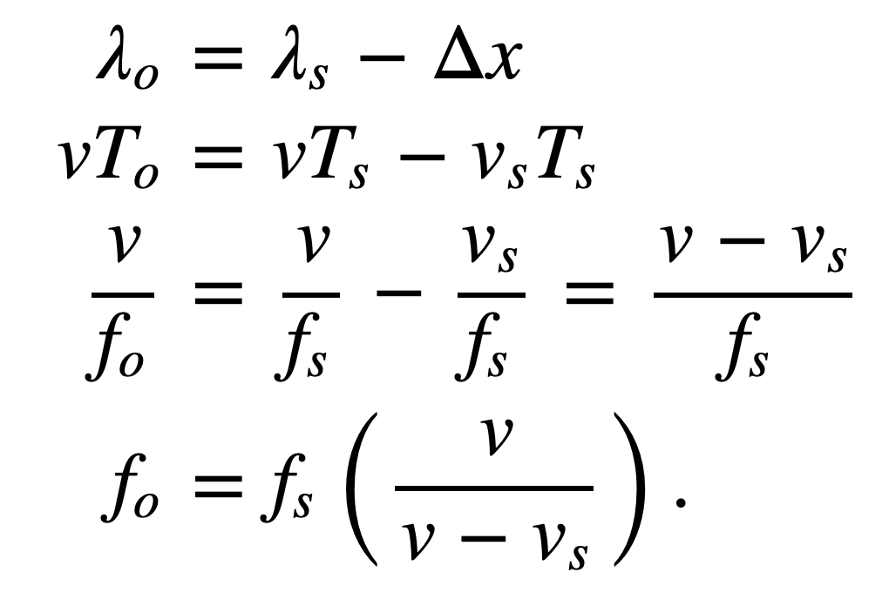
Doppler effect
Simple wave model: Moving source
Source moving towards the observer
v = Velocity of the signal (sound, light etc.)
v_{O} , T_{O} , f_{O} = Velocity of the observer and observed period and frequency
v_{S} , T_{S} , f_{S} = Velocity of the source and original period and frequency
Notes:
Slide 19: 2 minutes 30 seconds

Slide 88
Doppler effect
Simple wave model: Moving observer
Observer

Slide 89
Doppler effect
Simple wave model: Moving observer
t
t
Observer

Slide 90
Doppler effect
Simple wave model: Moving observer
t’ <t
t’ <t

Slide 91
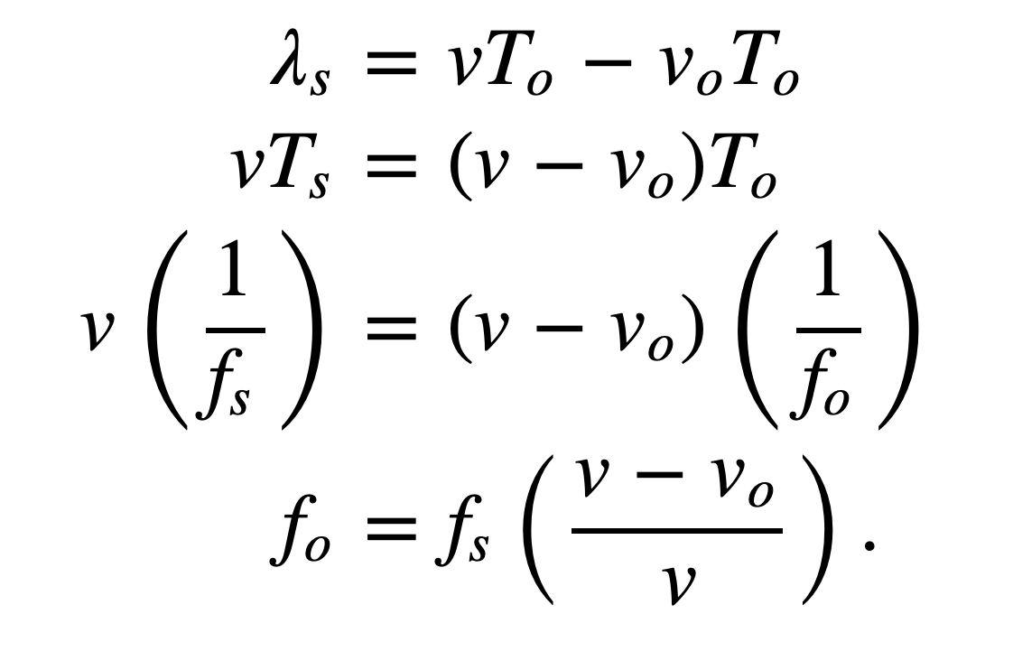
Doppler effect
Simple wave model: Moving observer
Observer moving towards the stationary source
+
+
+
+
v_{O} , T_{O} , f_{O} = Velocity of the observer and observed period and frequency
v_{S} , T_{S} , f_{S} = Velocity of the source and original period and frequency

Slide 92
Doppler effect
Simple wave model: Moving observer
Observer moving towards the stationary source
+
Doppler shift, Δf = f_{O}-f_{S} = f_{S} (v_{O}/v)
+
+
How will it change with signal’s velocity and frequency?
+
v_{O} , T_{O} , f_{O} = Velocity of the observer and observed period and frequency
v_{S} , T_{S} , f_{S} = Velocity of the source and original period and frequency

Slide 93
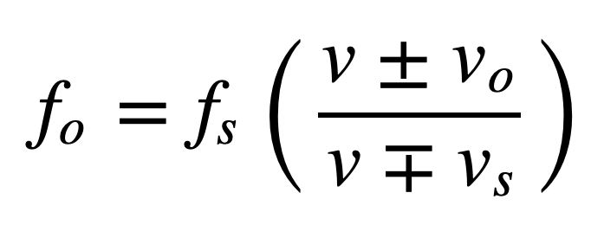
Doppler effect
Simple wave model: Moving observer
Both the source and the observer are moving
v_{O} , T_{O} , f_{O} = Velocity of the observer and observed period and frequency
v_{S} , T_{S} , f_{S} = Velocity of the source and original period and frequency
Notes:
Slide 58: 30 minutes

Slide 94
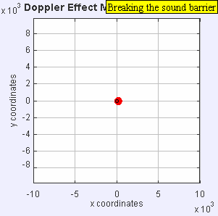

Doppler effect

Slide 95
Doppler effect

