Slide 1




Gradual typing Embedded securely in javascript
Aseem Rastogi
University of Maryland, College Park
Joint Work With:
Nikhil Swamy, Cédric Fournet, Karthikeyan Bhargavan, Juan Chen, Pierre-Yves Strub, Gavin Bierman

Slide 2
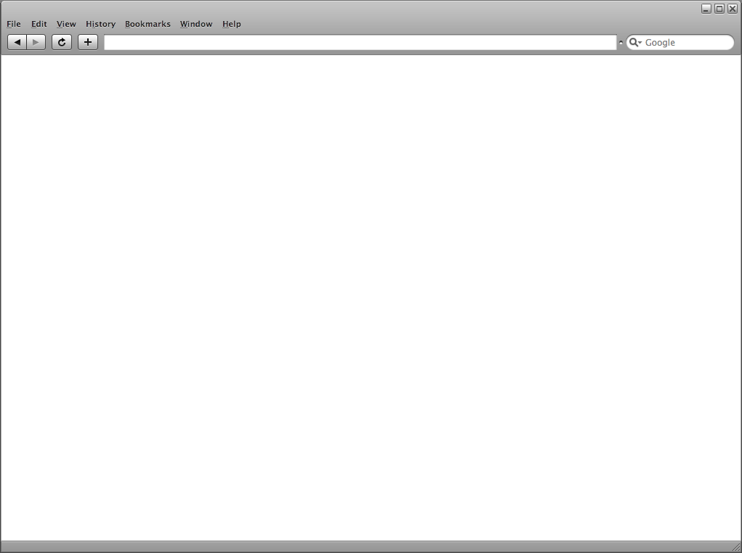
Architecture of JavaScript Applications
Untrusted
(e.g. ads)
Shared Global State
(e.g. Object.prototype, String.prototype, Array.prototype)
Libraries
(e.g. JQuery)
Application
All scripts execute in the same environment

Slide 3
At Least It’s Dynamically Type Safe
var x = 0; x(17); ~>* TypeError /* cannot apply a non-function */
Provides some useful security properties
var x = 0x1234567; x.f(); ~>* TypeError /* cannot forge an address */

Slide 4
Or Is It ?
Goal : Protect the send message function to restrict malicious URLs
function send(url, msg)
{
/* e.g. XMLHttpRequest */
…
}
Object.prototype[“evil.com”] = true;
send(“evil.com”, “gotcha”);
function protect(rawSend) {
var whitelist =
{ “www.microsoft.com/mail” : true,
“www.microsoft.com/owa” : true };
return function(url, msg) {
if(whitelist[url]) rawSend(msg);
}
}
Attacker Succeeds !
Also looks up in Object.prototype
window.send = protect(send);

Slide 5
Type Errors ≈ Security Vulnerabilities
Attacker can exploit missing property accesses
Can execute arbitrary JavaScript
Need a stronger notion of type safety !

Slide 6
Stronger Type Safety for JavaScript ?
DJS (Chugh et. al.), DJS(Maffeis et. al.), JSVerify(Swamy et. al.), JSVerify(Gardner et. al.), Adsafety(Guha et. al.), SES-light(Taly et. al.), Moller et. al., …
Handle only subsets of JavaScript
Cannot ignore the adversary
Lots of crazy stuff
  eval
  Proxies
  Stack walking
  Prototype poisoning
  Global namespace corruption
  …

Slide 7
Attempts to Handle Full JavaScript ?
TypeScript, Closure
Great in increasing programmer productivity
But Not Type Safe

Slide 8
We ask …
Can we provide stronger JS type safety
While accounting for the full ECMAScript5 language
  Unrestricted adversary
And still retaining idiomatic JS programming interface

Slide 9
TS★: Gradual Type System for All of JavaScript
Statically typed core
  number, bool, string
  T₁ T₂
  { f_{i} : T_{i} } (mutable, extensible)
  ADTs
U
Dynamically typed fragment
  any
  JSON
  Runtime type tests
D
S
Un typed adversary
  arbitrary JavaScript
  unmodified
  unverified
  unrestricted
Run time checks mediate interactions

Slide 10
Key Invariants of TS★
Static Safety:
Statically typed code is safe without any runtime checks
U
Dynamic Safety:
Runtime types are always refinements of static types
D
S
Memory Isolation:
No un-location referenced directly in static/any code
No static/any reference leaked to un-code

Slide 11
Key Idea: Gradual Security
function protect(rawSend) {
var whitelist =
{ “www.microsoft.com/mail” : true,
“www.microsoft.com/owa” : true };
return function(url, msg) {
if(whitelist[url]) rawSend(msg);
}
}
ad.js
lib.js
app.js
Identify security critical code

Slide 12
Key Idea: Gradual Security
function protect(rawSend)
ad.js
function protect(rawSend:(string,string)=>any)
{
var whitelist =
{ “www.microsoft.com/mail” : true,
“www.microsoft.com/owa” : true };
return function(url:string, msg:string) {
if(whitelist[url]) rawSend(msg);
}
}
lib.js
app.js
Identify security critical code
Port to TS★

Slide 13
Key Idea: Gradual Security
function protect(rawSend)
ad.js
function protect(rawSend:(string,string)=>any)
{
var whitelist =
{ “www.microsoft.com/mail” : true,
“www.microsoft.com/owa” : true };
return function(url:string, msg:string) {
if(whitelist[url]) rawSend(msg);
}
}
lib.js
app.js
Identify security critical code
TS★
Port to TS★
Compile
function protected() {
function protect(rawSend) { … }
return wrap<Un>(protect);
}
window.send = protected();

Slide 14
Key Idea: Gradual Security
function protect(rawSend)
ad.js
function protect(rawSend:(string,string)=>any)
{
var whitelist =
{ “www.microsoft.com/mail” : true,
“www.microsoft.com/owa” : true };
return function(url:string, msg:string) {
if(whitelist[url]) rawSend(msg);
}
}
lib.js
app.js
Identify security critical code
TS★
Port to TS★
Compile
function protected() {
function protect(rawSend) { … }
return wrap<Un>(protect);
}
window.send = protected();
Drop-in in the app

Slide 15
Gradual Security – Initial Experience
OWASP CSRFGuard and Facebook API
  Reported many attacks
  Both widely used and security critical libraries
  Ported critical fragments to TS★
  Easy to argue correctness in the presence of memory isolation
Secure, High Integrity, and Efficient HTML5 localStorage
(http://rise4fun.com/FStar/tutorial/tsStar)

Slide 16
TS★ Gradual Typing Overview
Based on runtime type information (RTTI)
Point
type Point = { x:number; y:number }
{ x = 2, y = 3 }
Compiled as is
U
Compiled with runtime checks to respect RTTI tags
D
S
Library provided wrappers ensure memory isolation

Slide 17
TS★ Tour with Example
function bar(q)
{
q.x = true;
}
type Point = { x:number; y:number }
function diag(p:Point) : Point
{
bar(p);
p.x = p.y;
return p;
}
var o = { x : true };
o.x = 2; o.y = 3;
diag(o);
TS★
JS

Slide 18
Compilation of Statically Typed Code
function bar(q)
{
q.x = true;
}
type Point = { x:number; y:number }
function diag(p:Point) : Point
{
bar(p);
p.x = p.y;
return p;
}
var o = { x : true };
o.x = 2; o.y = 3;
diag(o);
TS★
JS
function diag(p)
{
bar(p);
p.x = p.y;
return p;
}
(Statically typed code is safe as is)

Slide 19
RTTI Instrumentation
function bar(q)
{
q.x = true;
}
type Point = { x:number; y:number }
function diag(p:Point) : Point
{
bar(p);
p.x = p.y;
return p;
}
var o = { x : true };
o.x = 2; o.y = 3;
diag(o);
TS★
JS
function diag(p)
{
bar(p);
p.x = p.y;
return p;
}
diag.rtti = [[Point Point]]
(Statically typed code is safe as is)

Slide 20
RTTI Instrumentation
function bar(q)
{
q.x = true;
}
type Point = { x:number; y:number }
function diag(p:Point) : Point
{
bar(p);
p.x = p.y;
return p;
}
var o = { x : true };
o.x = 2; o.y = 3;
diag(o);
TS★
JS
function diag(p)
{
bar(p);
p.x = p.y;
return p;
}
(Compiled with runtime type checks)
diag.rtti = [[Point Point]]
(Statically typed code is safe as is)

Slide 21
Runtime Checks on RTTI (Dynamic Safety)
function bar(q)
{
q.x = true;
}
type Point = { x:number; y:number }
function diag(p:Point) : Point
{
bar(p);
p.x = p.y;
return p;
}
var o = { x : true };
o.x = 2; o.y = 3;
diag(o);
◄
TS★
JS
o:
any
{ x = true }

Slide 22
Runtime Checks on RTTI (Dynamic Safety)
function bar(q)
{
q.x = true;
}
type Point = { x:number; y:number }
function diag(p:Point) : Point
{
bar(p);
p.x = p.y;
return p;
}
var o = { x : true };
o.x = 2; o.y = 3;
diag(o);
◄
TS★
JS
Is o a record ? Does o.x = 2 respect o’s rtti ?
✔
o:
o:
any
any
{ x = true }
{ x = 2 }

Slide 23
Runtime Checks on RTTI (Dynamic Safety)
function bar(q)
{
q.x = true;
}
type Point = { x:number; y:number }
function diag(p:Point) : Point
{
bar(p);
p.x = p.y;
return p;
}
var o = { x : true };
o.x = 2; o.y = 3;
diag(o);
◄
TS★
JS
Is o a record ? Does o.y = 3 respect o’s rtti ?
✔
o:
o:
o:
any
any
any
{ x = true }
{ x = 2 }
{ x = 2, y = 3 }

Slide 24
Dynamically Typed to Statically Typed
function bar(q)
{
q.x = true;
}
type Point = { x:number; y:number }
function diag(p:Point) : Point
{
bar(p);
p.x = p.y;
return p;
}
var o = { x : true };
o.x = 2; o.y = 3;
diag(o);
◄
TS★
JS
o:
any
{ x = 2, y = 3 }

Slide 25
Attempt 1 : Use Higher Order Casts for Mutable Records
function bar(q)
{
q.x = true;
}
type Point = { x:number; y:number }
function diag(p:Point) : Point
{
bar(p);
p.x = p.y;
return p;
}
var o = { x : true };
o.x = 2; o.y = 3;
diag(o);
◄
TS★
var o’ =
{
get x() { if hasOwnProperty(o, “x”) … };
get y() { … };
set x(v) { … };
set y(v) { … };
}
diag(o’);
JS

Slide 26
Problems with Higher Order Casts
function bar(q)
{
q.x = true;
}
type Point = { x:number; y:number }
function diag(p:Point) : Point
{
bar(p);
p.x = p.y;
return p;
}
var o = { x : true };
o.x = 2; o.y = 3;
diag(o);
◄
TS★
var o’ =
{
get x() { … };
get y() { … };
set x(v) { … };
set y(v) { … };
}
diag(o’);
JS
Lazy failures in statically typed code
  Undesirable for security critical applications
  Performance penalty for casts reduction
Space inefficient
  Might recover with fancy coercion reductions
Breaks object identity
  o === o’ ?

Slide 27
Gradual Typing with RTTI
function bar(q)
{
q.x = true;
}
type Point = { x:number; y:number }
function diag(p:Point) : Point
{
bar(p);
p.x = p.y;
return p;
}
var o = { x : true };
o.x = 2; o.y = 3;
diag(o);
◄
TS★
JS
Does o look like a Point ? If so, tag it. (setTag)
✔
o:
o, p:
any
Point
{ x = 2, y = 3 }
{ x = 2, y = 3 }

Slide 28
Monotonic Evolution of RTTI
RTTI is always a sound approximation of a runtime value
v0:t0
v1:t1
v2:t2
…
vn:tn
t0
t1
t2
tn
v0
v1
v2
vn
t0 :> t1 :> t2 :> … :> tn
RTTI evolves monotonically w.r.t the subtyping relation

Slide 29
Seamless Transition from Statically Typed to Dynamically Typed
function bar(q)
{
q.x = true;
}
type Point = { x:number; y:number }
function diag(p:Point) : Point
{
bar(p);
p.x = p.y;
return p;
}
var o = { x : true };
o.x = 2; o.y = 3;
diag(o);
◄
TS★
JS
Seamless via subtyping – Point <: any.
o, p:
Point
{ x = 2, y = 3 }

Slide 30
RTTI Violations Cause Runtime Failures
function bar(q)
{
q.x = true;
}
type Point = { x:number; y:number }
function diag(p:Point) : Point
{
bar(p);
p.x = p.y;
return p;
}
◄
var o = { x : true };
o.x = 2; o.y = 3;
diag(o);
TS★
JS
Is q a record ? Does q.x = true respect q’s rtti ?
✗ Runtime
failure
o, p, q:
Point
{ x = 2, y = 3 }

Slide 31
Runtime Checks on RTTI (Dynamic Safety)
function bar(q)
{
q.color = “red”;
}
type Point = { x:number; y:number }
function diag(p:Point) : Point
{
bar(p);
p.x = p.y;
return p;
}
◄
var o = { x : true };
o.x = 2; o.y = 3;
diag(o);
TS★
JS
Is q a record ? Does q.color = “red” respect q’s rtti ?
✔
o, p, q:
o, p, q:
Point
Point
{ x = 2, y = 3 }
{ x = 2, y = 3, color = “red” }

Slide 32
Statically Typed Code Executes As Is
function bar(q)
{
q.color = “red”;
}
type Point = { x:number; y:number }
function diag(p:Point) : Point
{
bar(p);
p.x = p.y;
return p;
}
var o = { x : true };
o.x = 2; o.y = 3;
diag(o);
◄
TS★
JS
Executes as expected, without any checks.
o, p, q:
Point
{ x = 2, y = 3, color = “red” }

Slide 33
Key Invariants of TS★
Static Safety:
Statically typed code is safe without any runtime checks
U
Dynamic Safety:
Runtime types are always refinements of static types
D
S
Memory Isolation:
No un-location referenced directly in static/any code
No static/any reference leaked to un-code

Slide 34
Memory Isolation from Un
type Point = { x:number; y:number }
function diag(p:Point) : Point
{
baz(p);
p.x = p.y;
return p;
}
function baz(q)
{
…
}
TS★
JS
Unmodified, unverified, unrestricted.

Slide 35
Memory Isolation from Un
function baz(q)
{ delete q.x; }
type Point = { x:number; y:number }
function diag(p:Point) : Point
{
baz(p);
p.x = p.y;
return p;
}
function baz(q)
{ delete q.rtti; }
function baz(q)
{ q.rtti = “junk”; }
TS★
JS
Unmodified, unverified, unrestricted.
How to protect invariants ?

Slide 36
Memory Isolation from Un
type Point = { x:number; y:number }
baz : Un
function diag(p:Point) : Point
{
baz(p);
p.x = p.y;
return p;
}
function baz(q)
{
…
}
TS★
A second dynamic type Un
Abstract type: not related to any other type
Point <: any <\: Un
{ f : number; g : Un } <: { g : Un } <\: { }

Slide 37
Memory Isolation from Un
type Point = { x:number; y:number }
baz : Un
function diag(p:Point) : Point
{
baz(p);
p.x = p.y;
return p;
}
function baz(q)
{
…
}
TS★
Compile error: Cannot apply an Un typed term

Slide 38
Memory Isolation from Un
type Point = { x:number; y:number }
baz : Un
function diag(p:Point) : Point
{
wrap<Un, Point any>(baz)(p);
p.x = p.y;
return p;
}
function baz(q)
{
…
}
TS★
Library provided wrappers, ensure memory isolation

Slide 39
Wrappers Enforce Heap Shape Invariant
Static and any-typed
un fragment
DMZ
(stubs)
Non-Un values completely independent of untrusted global state (prototypes etc.) – thus send/protect example is secure in TS★
TS★ runtime system needs “first starter privileges” on the page

Slide 40
Facebook API Example
Retrieves user’s access token
Gives access token to the untrusted page if it’s authorized by user
Facebook API
Untrusted web page
Iframe
Wants to connect to Facebook on current user’s credentials

Slide 41
Facebook API Sample Code
function decode(s)
{
var res = { };
if(s === “”) return res;
var p = String.split(s,“&”);
for(var k in p) {
var kv = String.split(p[k],“=“);
res[kv[“0”]] = kv[“1”];
}
return res;
}
function checkOrigins(g, e)
{
for(var k in e) {
if(g === e[k]) return true;
}
return false;
}

Slide 42
Example Vulnerabilities in Facebook API
function decode(s)
{
var res = { };
if(s === “”) return res;
var p = String.split(s,“&”);
for(var k in p) {
var kv = String.split(p[k],“=“);
res[kv[“0”]] = kv[“1”];
}
return res;
}
Attacks similar to
protect/send
(Using Object.prototype)
function checkOrigins(g, e)
{
for(var k in e) {
if(g === e[k]) return true;
}
return false;
}

Slide 43
Porting Facebook API to TS★
function decode(s:string):any
{
var res = { };
if(s === “”) return res;
var p = String.split(s,“&”);
for(var k in p) {
var kv = String.split(p[k],“=“);
res[kv[“0”]] = kv[“1”];
}
return res;
}
function checkOrigins(g:string, e:array string):bool
{
for(var k in e) {
if(g === e[k]) return true;
}
return false;
}

Slide 44
Also in the paper …
More details on the wrappers
Formal translation from TS★ to JavaScript
Formalization of TS★ in JSVerify†
Type soundness theorem and proof sketch
A standards based mechanism for first starter privileges
More examples
See our paper !
†Swamy et. al. PLDI’ 13

Slide 45
TS★:The First JavaScript Type System To
Provide strong type safety in a modular way
While accounting for ALL of JavaScript
http://research.microsoft.com/en-us/um/people/nswamy/Playground/TSSecure/index.html

